Slide 1

Compiler Design
Preet Kanwal
Department of Computer Science & Engineering
Teaching Assistant : Sree Pranavi G

Slide 2

Compiler Design
Unit 3: Syntax Directed Translation
Preet Kanwal
Department of Computer Science & Engineering

Slide 3
Compiler Design Lecture Overview
In this lecture, you will learn about -
Syntax Directed Translation
Design of Translation Schemes
Types of Translation Schemes
Problematic SDT
Postfix schemes

Slide 4
Compiler Design Recap
The Principle of Syntax Directed Translation states that the meaning of an input sentence is related to its syntactic structure, i.e., to its Parse-Tree.
Translations for programming language constructs guided by context-free grammars.
There are 2 kinds of attributes - Synthesized and Inherited.
An SDD with only synthesized attributes is an S-attributed definition.
Every S-attributed SDD is also L-attributed.

Slide 5
Compiler Design
Recap - Syntax Directed Translation
We associate Attributes to the grammar symbols representing the language constructs.
Values for attributes are computed by Semantic Rules associated with grammar productions.
There are two notations for attaching semantic rules:
Syntax Directed Definitions : High-level specification hiding many implementation details.
Translation Schemes : More implementation oriented, indicate the order in which semantic rules are to be evaluated.

Slide 6
Compiler Design
Syntax Directed Translation Schemes
Translation Schemes are more implementation oriented than syntax directed definitions since they indicate the order in which semantic rules and attributes are to be evaluated.
A Translation Scheme is a context-free grammar in which,
Attributes are associated with grammar symbols.
Semantic Actions are enclosed between braces {} and are inserted within the right-hand side of productions.
Yacc uses Translation Schemes.

Slide 7
Compiler Design
Design of Translation Schemes
When designing a Translation Scheme we must be sure that an attribute value is available when a semantic action is executed.
When the semantic action involves only synthesized attributes, the action can be put at the end of the production.
If we have an L-Attributed SDD we must enforce the following restrictions:
An inherited attribute for a symbol in the right-hand side of a production must be computed in an action before the symbol
A synthesized attribute for the non terminal on the left-hand side can only be computed when all the attributes it references have been computed - The action is usually put at the end of the production.

Slide 8
Compiler Design Problematic SDT
Implementation
Ignoring the actions, parse the input and produce a parse tree as a result.
Then, examine each interior node N, say one for production A -> α. Add additional children to N for the actions in α, so the children of N from left to right have exactly the symbols and the actions of α.
Perform a preorder traversal of the tree, and as soon as a node labelled by an action is visited, perform that action.

Slide 9
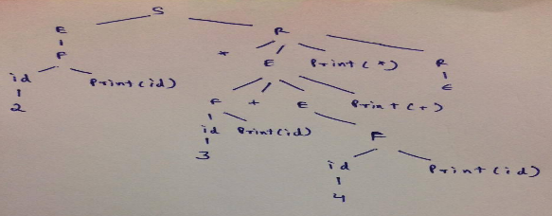
Compiler Design SDT – Gate example
What does the following SDT scheme print for 2 * 3 + 4
Consider the following translation scheme. S → ER R → *E{print(“*”);}R | ε E → F + E {print(“+”);} | F F → (S) | id {print(id.value);}
(A) 2 * 3 + 4 (B) 2 * +3 4 (C) 2 3 * 4 + (D) 2 3 4+*
Explanation : We are given L-Attributed Syntax Directed Translation as semantic actions like printf statements are inserted anywhere on the RHS of production (R → *E{print(“*”);}R). After constructing the parse tree as shown below from the given grammar, we will follow depth first order left to right evaluation in order to generate the final output.
https://www.geeksforgeeks.org/gate-gate-cs-2006-question-59/

Slide 10
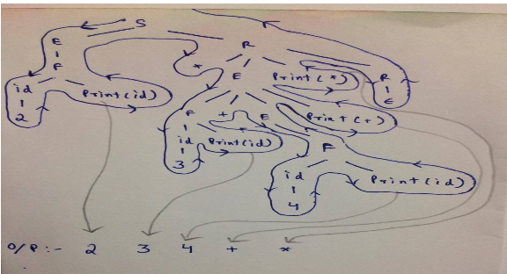
Explanation : We are given L-Attributed Syntax Directed Translation as semantic actions like printf statements are inserted anywhere on the RHS of production (R → *E{print(“*”);}R). After constructing the parse tree as shown below from the given grammar, we will follow depth first order left to right evaluation in order to generate the final output.

Slide 11
Compiler Design Problematic SDT
Infix to prefix example
L -> En
E -> {printf(“+”);} E + T E -> T
T -> {printf(“*”);} T * F T -> F
F -> (E)
F -> digit {printf(“digit.lexval”);}

Slide 12
Compiler Design Problematic SDT
Infix to prefix example (contd.)
L
E
n
{printf(“+”);}
E
+
T
T {printf(“*”);} T * F
F
F digit
{printf(“digit.lexval”);}
digit
{printf(“digit.lexval”);}
digit
{printf(“digit.lexval”);}

Slide 13
Compiler Design Problematic SDT
What does the following SDT scheme print for 5 + 4 - 2
E -> TR
R→+T {print(“+”);} R1
R→−T {print(“-”);} R1 R→ ε
T -> F
F -> digit {print(digit.lexval);}

Slide 14
Compiler Design Postfix SDT for S attribute SDD
S attributed to SDT.
Evaluation of S-attributed SDD
S-attributed SDDs will have only synthesized attributes and can be evaluated by a bottom up parser.
Since the attributes in the semantic actions are only synthesized, the actions can be placed at the end of the production.

Slide 15
Compiler Design Postfix SDT
Rules for evaluation
Consider the following production,
A -> BCD
before reducing BCD to A, the attributes of B, C and D must be computed before attribute of A which appears on the stack.
Corresponding semantic action associated with the production must be executed.

Slide 16
Compiler Design Postfix SDT
Rules for evaluation
The parser stack is extended to have parallel value stack.
If the Action appears at the end of production in a SDT, such SDTs are called Postfix SDTs.
Parser / Value Stack
A | A.a
B | B.b
. . . | . . .
Parser Stack
Value Stack

Slide 17
THANK YOU
Preet Kanwal
Department of Computer Science & Engineering
preetkanwal@pes.edu

