Slide 1

Compiler Design
Preet Kanwal
Department of Computer Science & Engineering
Teaching Assistant : Sree Pranavi G

Slide 2

Compiler Design
Unit 3: SDD to SDT
Preet Kanwal
Department of Computer Science & Engineering

Slide 3
Compiler Design Lecture Overview
In this lecture, you will learn about -
L-attributed SDD to SDT
SDT Implementation
S-attributed SDD to SDT (Postfix SDT)

Slide 4
Compiler Design
Conversion of L-attributed SDD to SDT
Translation by traversing a parse tree
Build parse tree and annotate.
Build the parse tree, add actions and execute the actions in pre-order.

Slide 5
Compiler Design
Conversion of L-attributed SDD to SDT
Translation during parsing
Use a RDP with a function for each non-terminal.
Generate code on the fly, using a RDP.
Implement an SDT in conjunction with an LL parser.
Implement an SDT in conjunction with an LR parser.

Slide 6
Compiler Design
Conversion of L-attributed SDD to SDT
Place the computation of inherited attributes for a non-terminal before that non-terminal appears in the right hand side of the production.
Place the computation of synthesized attributes at the end of production.

Slide 7
Compiler Design
Evaluation of L-attributed SDD
L-attributed SDDs can have both synthesized attributes and inherited attributes.
Rule to be followed for evaluation
Place the semantic rule corresponding to the inherited attributes of the non-terminal before the non-terminal appears on the right hand side of the production.
Place the semantic rule corresponding to the synthesized attributes of the non-terminal at the end of the production.

Slide 8
Compiler Design
Conversion of L-attributed SDD
Example
Production | Semantic Rule
T -> FT’ | T' .inh = F.syn; T.syn = T'.syn
T' ->*FT1′ | T1′.inh = T’.inh * F.syn; T’.syn = T′1.syn
T’ -> Ꞓ | T′.syn = T′.inh
F -> digit | F.syn = digit.lexval

Slide 9
Compiler Design
Conversion of L-attributed SDD
Example (contd.)
SDT
T -> F { T’.inh = F.syn;} T′ {T.syn = T’.syn}
T’ -> *F {T’1.inh = T’.inh * F.syn;} T’1 {T’.syn = T’1.syn}
T1 -> Ꞓ { T’.syn = T’.inh;}
F -> digit { F.syn = digit.lexval; }

Slide 10
Compiler Design
L-attributed SDD to SDT - Type Declarations
Production | Semantic Rule | Translation Scheme
D → T L | { L.in = T.type;} | D → T { L.in := T.type } L
T → int | { T.type = integer; } | T → int { T.type := ‘integer’ }
T → real | { T.type = float; } | T → real { T.type := ‘real’ }
L → L , id 1 | { L₁.in= L.in; addType(id.entry, L.in); } | L → { L1.in := L.in } L1, id { addtype(id.entry, L.in) }
L → id | { addType(id.entry, L.in); } | L → id { addtype(id.entry, L.in) }

Slide 11
Compiler Design
L-attributed SDD to SDT - Intermediate Code Generation
Convert the L-attributed SDD to generate intermediate code for If statement to SDT -
Production | Semantic Rule
S → if(C) S1 | L1 = new label(); C.true = L1; C.false = S.next; S1.next = S.next; S.code = C.code || label(L1) || S1.code

Slide 12
Compiler Design
L-attributed SDD to SDT
Translation Scheme -
S → if ( L1 = new label ();
C.true = L1 C.false = S.next
C ) S1.next = S.next S1
S.code = C.code ||
L1 || S1.code

Slide 13
Compiler Design
L-attributed SDD to SDT
Convert the L-attributed SDD to generate intermediate code for while statement to SDT :
Production | Semantic Rule
S → while (C) S1 | L1 = new label(); L2 = new label(); C.true = L2 C.false = S.next S1.next = L1 S.code = label(L1) || C.code || label(L2) || S1.code || gen(‘goto’L1)

Slide 14
Compiler Design
L-attributed SDD to SDT
Translation Scheme -
S → while ( L1 = new label ();
L2 = new label (); C.true = L2; C.false = S.next;
C ) S1.next = L1; S1
S.code = L1
|| C.code || L2
|| S1.code

Slide 15
Compiler Design SDT Implementation
Ignoring the actions, parse the input and produce a parse tree as a result.
Examine each interior node N.
Add additional children to N for the actions.
Perform a preorder traversal of the tree, and as soon as a node labelled by an action is visited, perform that action.

Slide 16
Compiler Design SDT Implementation
Consider the following translation scheme. S → ER
R → *E { print("*"); } R | ε
E → F + E { print("+"); } | F
F → ( S ) | id { print(id.value); }
Here id is a token that represents an integer and id.value represents the corresponding integer value.
For an input 2 * 3 + 4, this translation scheme prints
.

Slide 17
Compiler Design
SDT Implementation - Infix to Postfix
Convert the SDD for infix expression to postfix to SDT.
Production | Semantic Rule
E → E1 + T | { print(‘+’);}
E → T
T → T1 * F | { print(‘*’);}
T → F
F → num | {printf(“%d”, num.lexval);}
F → id | {printf(“%d”, id.lexval);}

Slide 18
Compiler Design
SDT Implementation - Infix to Prefix
Convert the SDD for infix expression to prefix to SDT.
Production | Semantic Rule
E → E1 + T | E → {printf(“+”);} E1+ T
E → T | E → T
T → T1 * F | T → {printf(“*”);} T1* F
T → F | T → F
F → num | F → num {printf(“%d”, num.lexval);}
F → id | F → id {printf(“%d”, id.lexval);}

Slide 19
Compiler Design
Evaluation of S-Attributed Definitions -Revision
Synthesized Attributes can be evaluated by a bottom-up parser as the input is being analyzed avoiding the construction of a dependency graph.
The parser keeps the values of the synthesized attributes in its stack.
Whenever a reduction A → α is made, the attribute for A is computed from the attributes of α which appear on the stack.
Thus, a translator for an S-Attributed Definition can be simply implemented by extending the stack of an LR-Parser.

Slide 20
Compiler Design Extending a Parser Stack
Extra fields are added to the stack to hold the values of synthesized attributes.
In the simple case of just one attribute per grammar symbol the stack has two fields - state and val.
The current top of the stack is indicated by the pointer top.

Slide 21
Compiler Design Parser Stack
Synthesized attributes are computed just before each reduction :
Before the reduction A → XY Z is made, the attribute for A is computed :
A.a := f (s[top-2].val, s[top − 1].val, s[top ].val).
state | val
X Y Z(top) … | X.x Y.x Z.x …

Slide 22
Compiler Design
Postfix SDT scheme for simple desk calculator
E → E1 + T
{stack[top-2].val = stack[top-2].val + stack[top].val; top = top - 2; }
E → T
T → T1 * F
{stack[top-2].val = stack[top-2].val * stack[top].val; top = top - 2; }
T → F
F → ( E )
{stack[top-2].val = stack[top-1].val; top = top - 2; }
F → digit

Slide 23
Compiler Design
Implementing L-attributed SDD during LR Parsing
SDT's With Actions Inside Productions
• Consider a production: B→ X {a} Y
– The action a is done after we have recognized X (if X is a terminal) or all the terminals derived from X (if X is a nonterminal)
• Insert marker nonterminals to remove the embedded action and to change the SDT to a postfix SDT
– Rewrite the product with marker nonterminal M into
B → X M Y
M → ε {a}
• Problems with inserting marker nonterminals
– May introduce conflicts in the parse table
– How to propagate inherited attributes?

Slide 24
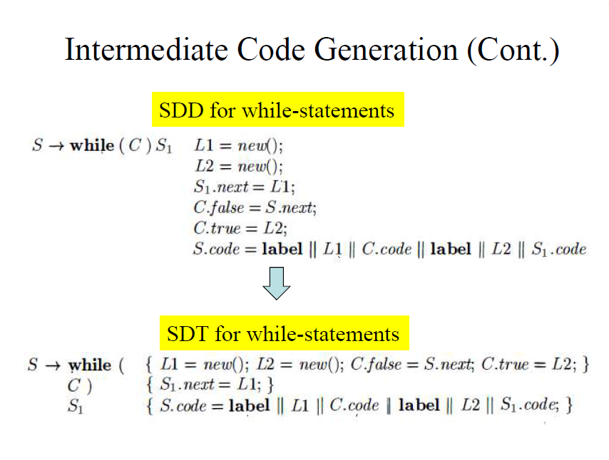
Compiler Design Implementing L-attributed SDD during LR Parsing Lets take an example of while stmt

Slide 25
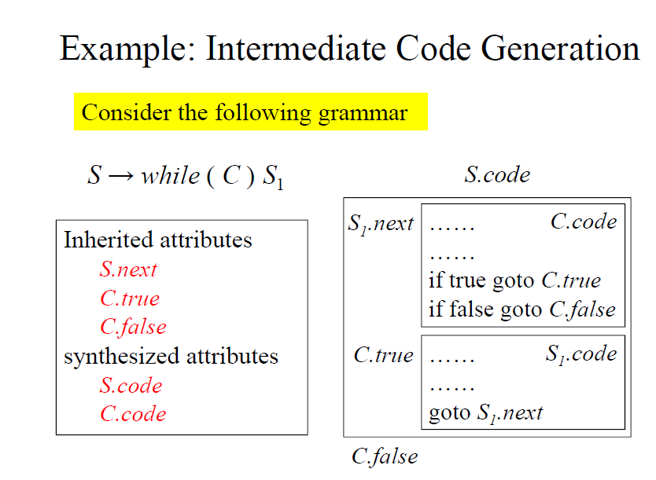
Compiler Design Implementing L-attributed SDD during LR Parsing Lets take an example of while stmt

Slide 26
Compiler Design
Implementing L-attributed SDD during LR Parsing
S → while ( M C ) N S1
Example
S → while (
L1 = new label (); L2 = new label (); C.true = L2;
C.false = S.next;
C ) S1.next = L1;
S1 S.code = L1 || C.code || L2 ||
S1.code

Slide 27
Compiler Design
Implementing L-attributed SDD during LR Parsing
Example continued…
S → while ( M C ) N S1
S.code = L1 || C.code || L2 ||
S1.code

Slide 28
Compiler Design
Implementing L-attributed SDD during LR Parsing
Example continued…
M → epsilon
L1 = new label(); L2 = new label(); C.true = L2; C.false = S.next;
N → epsilon
S1.next = L1;

Slide 29
Compiler Design
Implementing L-attributed SDD during LR Parsing
Parser Stack Structure
A | Synthesized attributes of A
Inherited attributes of A
Stack record
Record of Marker A
Note : We perform general style of bottom-up parsing - shift-reduce parsing. A - non terminal

Slide 30
Compiler Design
Implementing L-attributed SDD during LR Parsing
S → while ( M C ) N S1
Example continued…
Stack | Input Buffer Action
$ | while (cond)Stmt $ Shift while (dummy string)
$ while while $ | (cond)Stmt $ Shift ( S → while ( M C ) N S1
$ while ( | cond)Stmt $ Reduce using M → L1 = new label(); ^{epsilon} L2 = new label(); _{and execute the} C.true = L2; C.false = S.next; _{action}
(
while
$

Slide 31
Compiler Design
Implementing L-attributed SDD during LR Parsing
Example continued…
Stack | Input Buffer | Action
$ while ( M | cond)Stmt $ | Shift C
$ while ( M C | )Stmt $ | Shift )
L2
M | L1 | L2 | C.true | C.false
(
while
$
C |  |  | C.code
M | L1 | L2 |  | C.true | C.false
(
while
$
L2

Slide 32
Compiler Design
Implementing L-attributed SDD during LR Parsing
Example continued…
Stack | Input Buffer Action
$ while ( M C ) | Stmt $ Reduce using N → epsilon S1.next = L1; S → while ( M C ) N S1
)
C |  |  | C.code
M | L1 | L2 |  | C.true | C.false
(
while
$
L2

Slide 33
Compiler Design
Implementing L-attributed SDD during LR Parsing
Example continued…
Stack | Input Buffer | Action
$ while ( M C ) N | Stmt $ | Shift S1
N |  |  | S1.next = s[top-3].L1
)
C |  |  |  | C.code
M | L1 | L2 |  |  | C.true | C.false
(
while
$
L2

Slide 34
Compiler Design
Implementing L-attributed SDD during LR Parsing
Example continued…
Stack
Input Buffer
Action
$ while ( M C ) N S
$
Reduce using
S → while(MC)NS
pos
top | S1 |  |  | S1.code
top-1 | N |  |  | S1.next = s[top-3].L1
top-2 | )
top-3 | C |  |  |  | C.code
top-4 | M | L1 | L2 |  |  | C.true | C.false
top-5 | (
top-6 | while
 | $
and execute the action
s[top-6].code = s[top-4].L1 || s[top-3].code || s[top-4].L2 || s[top].code;
L2
top = top-6;
S.code = L1 || C.code || L2 || S1.code

Slide 35
Compiler Design
Implementing L-attributed SDD during LR Parsing
Example continued…
Stack | Input Buffer | Action
$ S | $ | Accept
S | S.code
$

Slide 36
Compiler Design
Implementing L-attributed SDD during LR Parsing
Example
S → if ( L1 = new label ();
C.true = L1 C.false = S.next;
C ) S1.next = S.next;
S1 S.code = C.code || L1 || S1.code

Slide 37
Compiler Design
Implementing L-attributed SDD during LR Parsing
Example
S → if ( M C ) N S1
S.code = C.code || L1 || S1.code
M → epsilon
L1 = new label(); C.true = L1;
C.false = S.next;
N → epsilon
S1.next = S.next;

Slide 38
THANK YOU
Preet Kanwal
Department of Computer Science & Engineering
preetkanwal@pes.edu

