Slide 1

Compiler Design
Preet Kanwal
Department of Computer Science & Engineering
Teaching Assistant : Kavya P K

Slide 2

Compiler Design
Unit 4: Static Single-Assignment(SSA)
Preet Kanwal
Department of Computer Science & Engineering

Slide 3
Compiler Design Lecture Overview
In this lecture, you will learn about -
Static Single-Assignment (SSA) Form
ɸ-function
ɸ-function Examples

Slide 4
Compiler Design
Static Single Assignment (SSA) Form
Each variable is assigned exactly once but may be used multiple times.
Existing variables in the original IR are split into versions:
New version of variable is typically indicated by the original name with a subscript, so that every definition gets its own version.
SSA is an intermediate form widely used by modern optimizing compilers.

Slide 5
Compiler Design
Example 1
Convert the following code segment to SSA form:
x = y - z
s = x + s
x = s + p
s = z * q
s = x * s
Solution:
x = y - z
s₂ = x + s
x₂ = s₂ + p
s₃ = z * q
s₄ = x₂ * s₃
Here x,y,z,s,p,q are original variables and x₂, s₂, s₃, s₄ are versions of x and s.

Slide 6
Compiler Design
Example 2
Convert the following code segment to SSA form:
a = s – b
q = a * e
a = q + d
q = b - c
q = a * q
Solution:
a = s - b
q = a * e
a₂ = q + d
q₂ = b - c
q₃ = a₂ * q₂
Here a,b,c,d,e,q,s are original variables and a₂, q₂, q₃ are versions of a and q.

Slide 7
Compiler Design
ɸ-function
Control flow can’t be predicted in advance, so we can’t always know which definition of a variable reached a particular use.
To handle this uncertainty, we create ɸ functions.
Notation represents natural “meet points” where values are combined.
No. of arguments to ɸ(a1, a2 ....) is the number of incoming flow edges.
Return value of the function corresponds to the control-flow path taken to get to the statement.

Slide 8
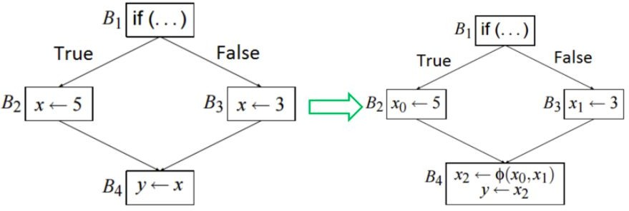
Compiler Design
ɸ-function - Example 1

Slide 9
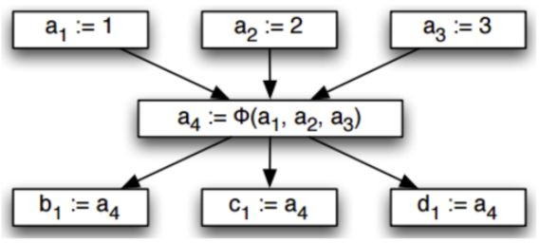
Compiler Design
ɸ-function - Example 2
case (...) of 0: a := 1;
1: a := 2;
2: a := 3;
end
case (...) of 0: b := a;
1: c := a;
2: d := a;
end

Slide 10
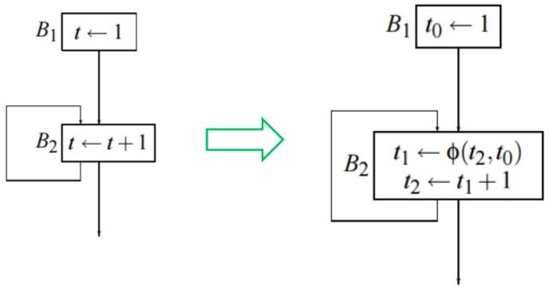
Compiler Design
ɸ-function - Example 3

Slide 11
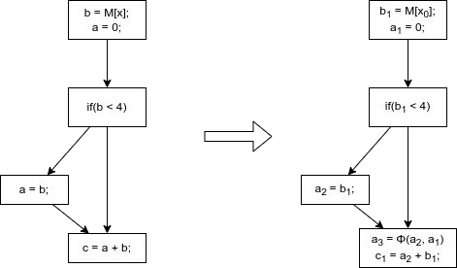
Compiler Design
ɸ-function - Example 4

Slide 12
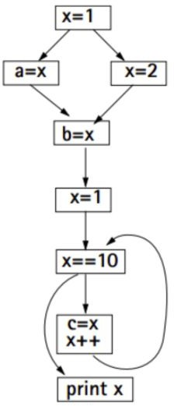
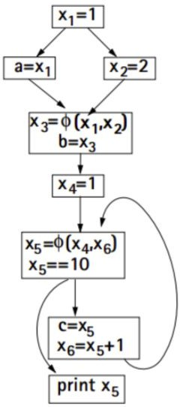
Compiler Design
ɸ-function - Example 5

Slide 13
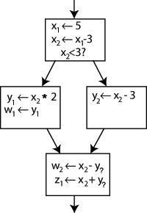
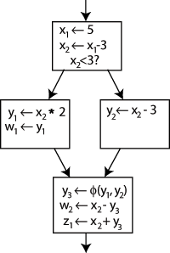
Compiler Design
ɸ-function - Example 6

Slide 14
Compiler Design Note -
Most modern production compilers use SSA form (eg. gcc, suif, llvm, hotspot etc.)
Popular compiler optimizations (eg. constant propagation) become easier to write (and in some cases, algorithmically faster) when applied to programs in SSA form.
Conversion to SSA form introduces a lot of assignments - compilers that do this need to have good register allocators that can eliminate most of them again (not a concern these days).

Slide 15
THANK YOU
Preet Kanwal
Department of Computer Science & Engineering
preetkanwal@pes.edu

