Slide 1

Object Oriented Analysis and Design
Prof. Swati Shah
Department of Computer Science and Engineering

Slide 2

Object Oriented Analysis and Design
Advanced State Modeling
Prof. Swati Shah
Department of Computer Science and Engineering

Slide 3
Advanced State Models
Conventional state diagrams are sufficient for describing simple systems but need additional power to handle large problems.
You can more richly model complex systems by using nest- ed state diagrams, nested states, signal generalization, and concurrency.

Slide 4
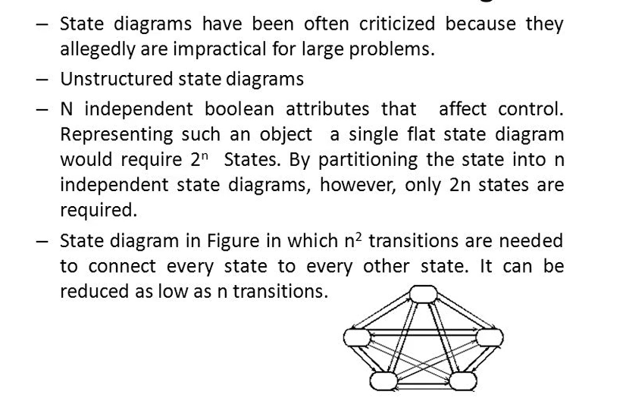
Problems with Flat State Models

Slide 5
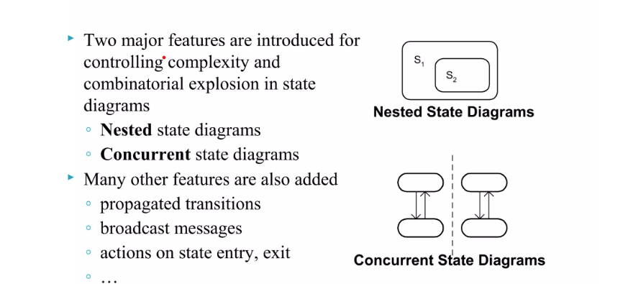
Features of Advanced state Diagram

Slide 6
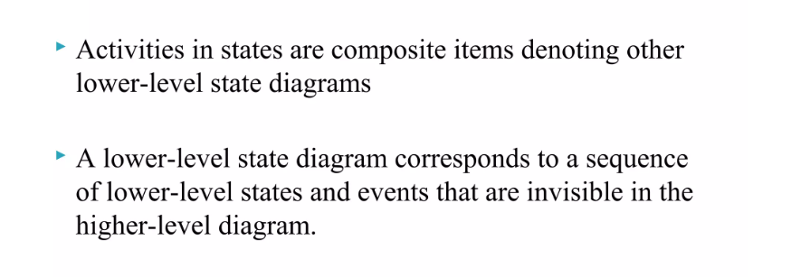
Nested State Diagram

Slide 7
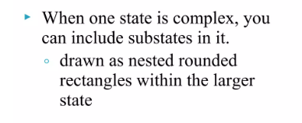
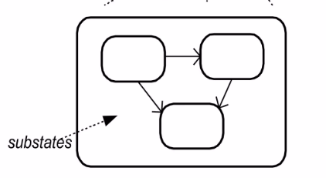
Super or Substate

Slide 8
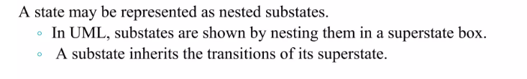
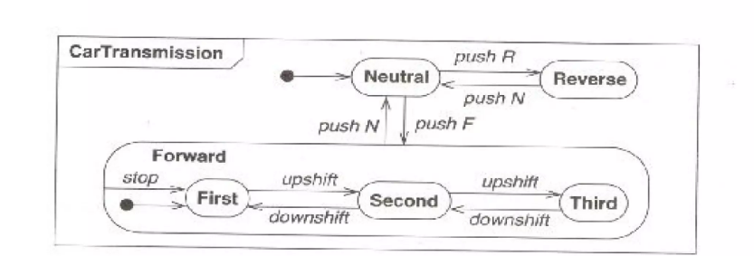
Nested state example

Slide 9
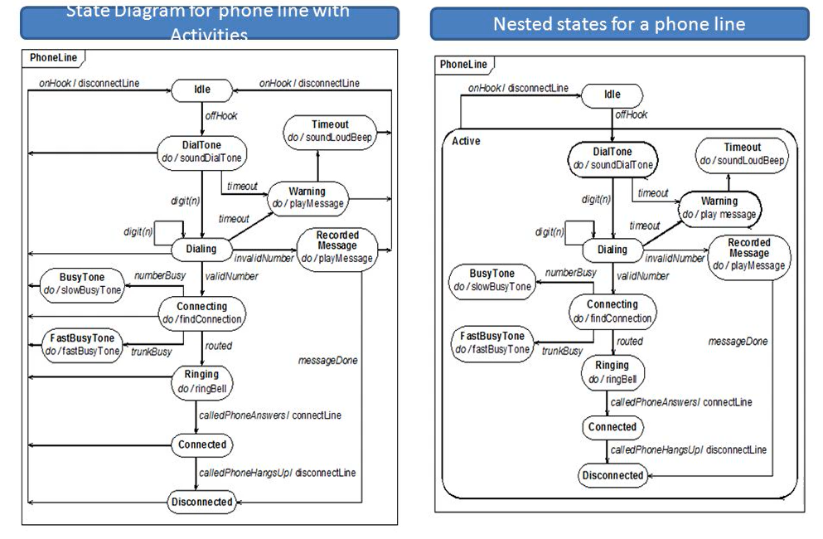
Simple state v/s Nested state

Slide 10
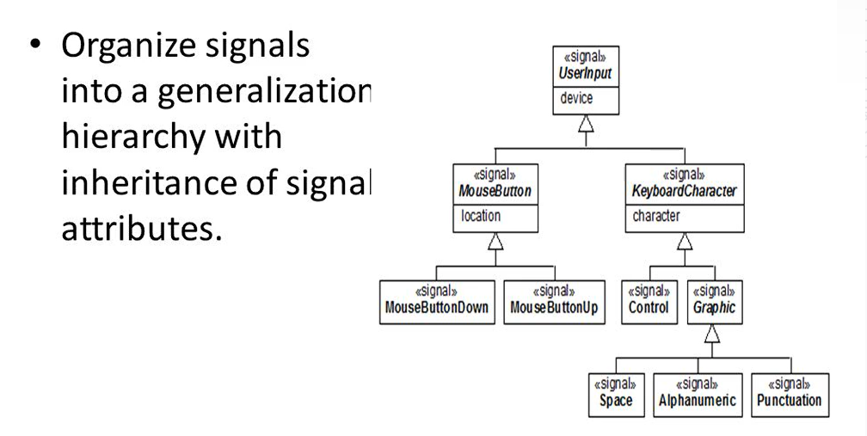
Signal Concurrency

Slide 11
Concurrency
State Models also Supports concurrency among objects. It supports two types of concurrency-
1. Aggregation Concurrency
2. Concurrency within an object

Slide 12
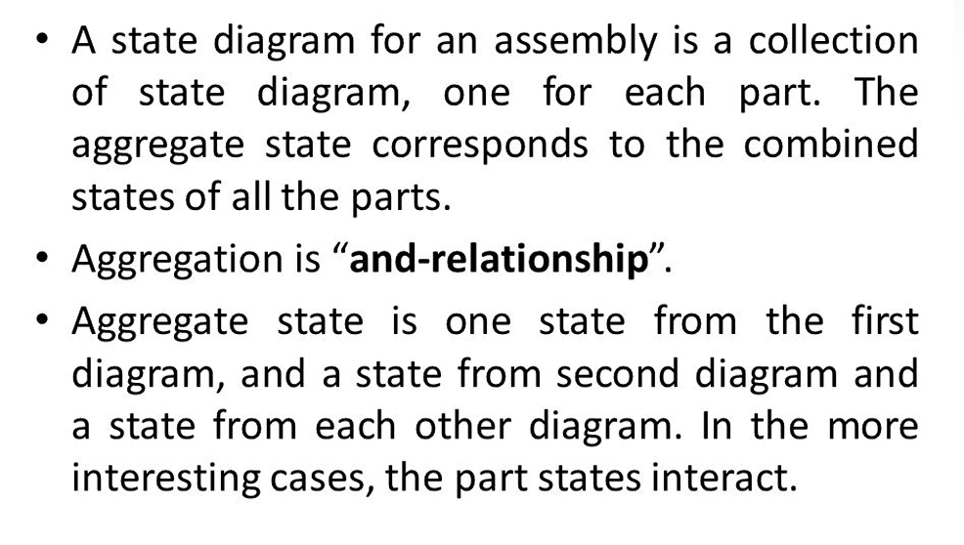
Aggregation Concurrency

Slide 13
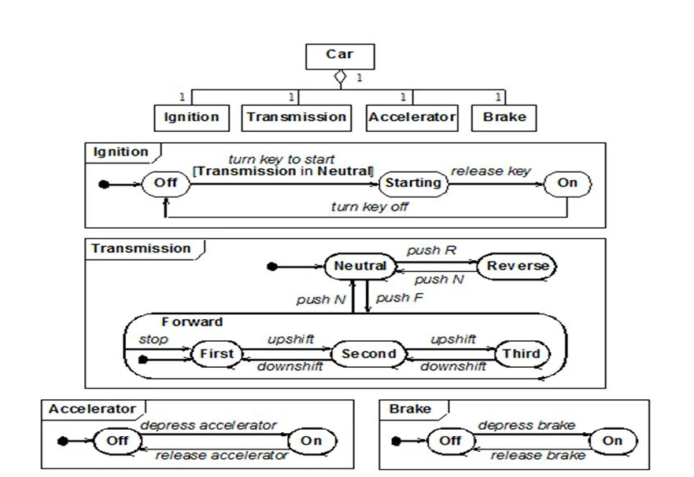
Aggregation Concurrency(Cont’d)

Slide 14
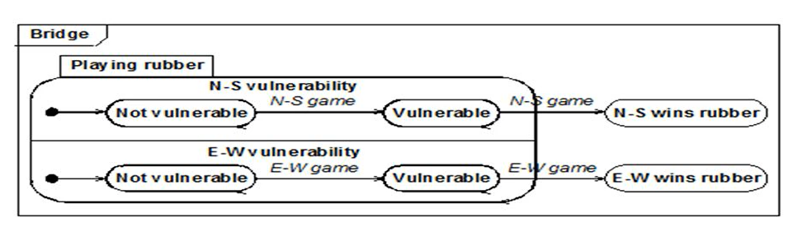
Concurrency within an object
The state model implicitly supports concurrency among objects. In general, objects are autonomous entities that can act and change state independent of one another.
Objects need not be completely independent and may be subject to shared constraints that cause some correspondence among their state changes.

Slide 15
THANK YOU
Prof Swati Shah
Department of Computer Science and Engineering
swatishahjaiswal@pes.edu

