Slide 1

Lecture #12
UNIT-III
OOPS

Slide 2
Inheritance
Inheritance is an important aspect of the object-oriented paradigm. Inheritance provides code reusability to the program because we can use an existing class to create a new class instead of creating it from scratch.
In inheritance, the child class acquires the properties and can access all the data members and functions defined in the parent class. A child class can also provide its specific implementation to the functions of the parent class. In this section of the tutorial, we will discuss inheritance in detail.
In python, a derived class can inherit base class by just mentioning the base in the bracket after the derived class name. Consider the following syntax to inherit a base class into the derived class.

Slide 3
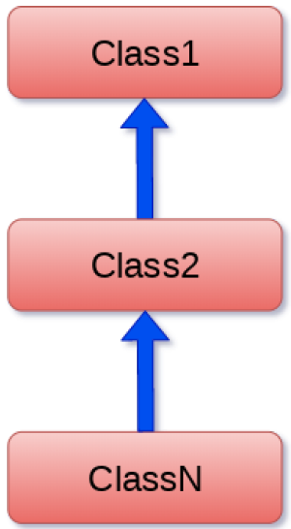
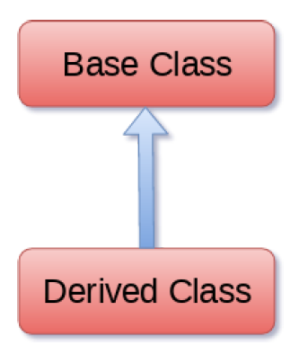
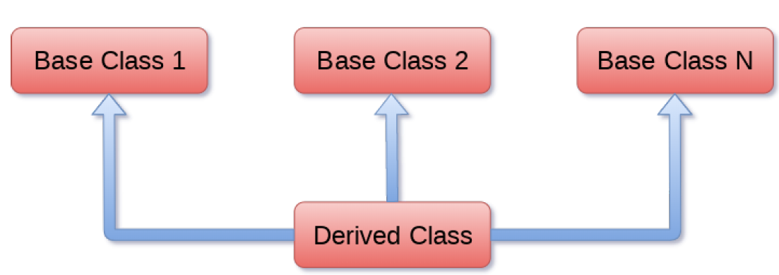
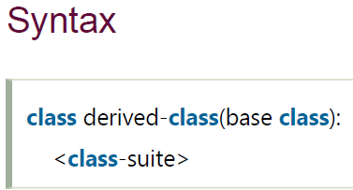
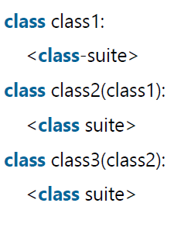
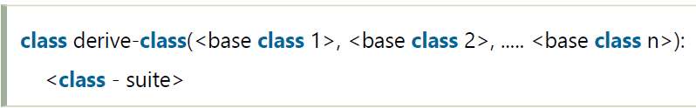
Inheritance

Slide 4
Single Inheritance Example
class Animal:
def speak(self):
print("Animal Speaking")
#child class Dog inherits the base class Animal
class Dog(Animal):
def bark(self):
print("dog barking")
d = Dog()
d.bark()
d.speak()

Slide 5
Multiple Inheritance Example
class Calculation1:
def Summation(self,a,b):
return a+b;
class Calculation2:
def Multiplication(self,a,b):
return a*b;
class Derived(Calculation1,Calculation2):
def Divide(self,a,b):
return a/b;
d = Derived()
print(d.Summation(10,20))
print(d.Multiplication(10,20))
print(d.Divide(10,20))

Slide 6
Multi Level Inheritance Example
class Animal:
def speak(self):
print("Animal Speaking")
#The child class Dog inherits the base class Animal
class Dog(Animal):
def bark(self):
print("dog barking")
#The child class Dogchild inherits another child class Dog
class DogChild(Dog):
def eat(self):
print("Eating bread...")
d = DogChild()
d.bark()
d.speak()
d.eat()

Slide 7
Overriding Methods
Polymorphism: It is a property of an object which allows it to take multiple forms.
Polymorphism is of two types:
Compile-time Polymorphism: method overloading
Run-time Polymorphism: method Overriding
You can always override your parent class methods. One reason for overriding parent's methods is because you may want special or different functionality in your subclass.

Slide 8
Overriding Methods Example
class Parent: # define parent class
def myMethod(self):
print ("Calling parent method")
class Child(Parent): # define child class
def myMethod(self):
print ("Calling child method")
c = Child() # instance of child
c.myMethod() # child calls overridden method

Slide 9
Base Overloading Methods
Sr.No. | Method, Description & Sample Call
1 | __init__ ( self [,args...] ) Constructor (with any optional arguments) Sample Call : obj = className(args)
2 | __del__( self ) Destructor, deletes an object Sample Call : del obj
3 | __repr__( self ) Evaluable string representation Sample Call : repr(obj)
4 | __str__( self ) Printable string representation Sample Call : str(obj)
5 | __cmp__ ( self, x ) Object comparison Sample Call : cmp(obj, x)

Slide 10
Overloading Operators
Suppose you have created a Vector class to represent two-dimensional vectors, what happens when you use the plus operator to add them? Most likely Python will yell at you.
You could, however, define the __add__ method in your class to perform vector addition and then the plus operator would behave as per expectation
class Vector:
def __init__(self, a, b):
self.a = a
self.b = b
def __str__(self):
return 'Vector (%d, %d)' % (self.a, self.b)
def __add__(self,other):
return Vector(self.a + other.a, self.b + other.b)
v1 = Vector(2,10)
v2 = Vector(5,-2)
print (v1 + v2)

Slide 11
Data Hiding
An object's attributes may or may not be visible outside the class definition. You need to name attributes with a double underscore prefix, and those attributes then are not be directly visible to outsiders.
class JustCounter:
__secretCount = 0
def count(self):
self.__secretCount += 1
print (self.__secretCount)
counter = JustCounter()
counter.count()
counter.count()
print (counter.__secretCount)
When the above code is executed, it produces the following result −
1
2
Traceback (most recent call last): File "test.py", line 12, in <module> print counter.__secretCount AttributeError: JustCounter instance has no attribute '__secretCount'

Slide 12
Python protects those members by internally changing the name to include the class name. You can access such attributes as object._className__attrName. If you would replace your last line as following, then it works for you −
.........................
Print( counter._JustCounter__secretCount)

Slide 13
Function Overloading
In Python you can define a method in such a way that there are multiple ways to call it. Depending on the function definition, it can be called with zero, one, two or more parameters. This is known as method overloading.
In the given code, there is a class with one method sayHello(). We rewrite as shown below. The first parameter of this method is set to None, this gives us the option to call it with or without a parameter.
An object is created based on the class, and we call its method using zero and one parameter. To implement method overloading, we call the method sayHello() in two ways: 1. obj.sayHello() and 2.obj.sayHello('Rambo')
We created a method that can be called with fewer arguments than it is defined to allow. We are not limited to two variables, given method can have more variables which are optional.

Slide 14
Function Overloading Example
class Human:
def sayHello(self, name=None):
if name is not None:
print ('Hello ' + name)
else:
print ('Hello ')
obj = Human()
print(obj.sayHello())
print(obj.sayHello('Rambo'))
More Details:
https://www.tutorialspoint.com/python/index.htm
https://www.javatpoint.com/python-tutorial

Slide 15
Difference between Method Overloading and Method Overriding in Python
S.NO | Method Overloading | Method Overriding
1. | In the method overloading, methods or functions must have the same name and different signatures. | Whereas in the method overriding, methods or functions must have the same name and same signatures.
2. | Method overloading is a example of compile time polymorphism. | Whereas method overriding is a example of run time polymorphism.
3. | In the method overloading, inheritance may or may not be required. | Whereas in method overriding, inheritance always required.
4. | Method overloading is performed between methods within the class. | Whereas method overriding is done between parent class and child class methods.
5. | It is used in order to add more to the behavior of methods. | Whereas it is used in order to change the behavior of exist methods.
6. | In method overloading, there is no need of more than one class. | Whereas in method overriding, there is need of at least of two classes.

Slide 16
Questions1(Account Class)
Design the class name account that contains:
  A private id for account
  A private balance for account
  A private intrate for annual interest rate
  A constructor that creates an account with specified id, initial balance and interest rate.
  A method name getmonthlyinterestrate() that return monthly interest rate.
  A method name checkbalance() that return balance amount from the account.
  A method name withdraw() that withdraws a specified amount from the account.
  A method name deposite() that deposits a specified amount to the account.
  == Create 10 accounts with initial balance 100 and rate of interest 4%.
  ==The system prompts the user to enter account ID, if it is correct open a main menu having chaises
  1. Check balance, 2. withdraw, 3. deposit and 4. exit.

Slide 17

CSE510, Lovely Professional University, Phagwara
12/12/14

