Slide 1
Titanic Survival Prediction
Machine Learning Classification Project
Rohit Narwal | March 2026
Tools: Python · Pandas · Scikit-learn · Seaborn · Matplotlib · Google Colab · GitHub

Slide 2
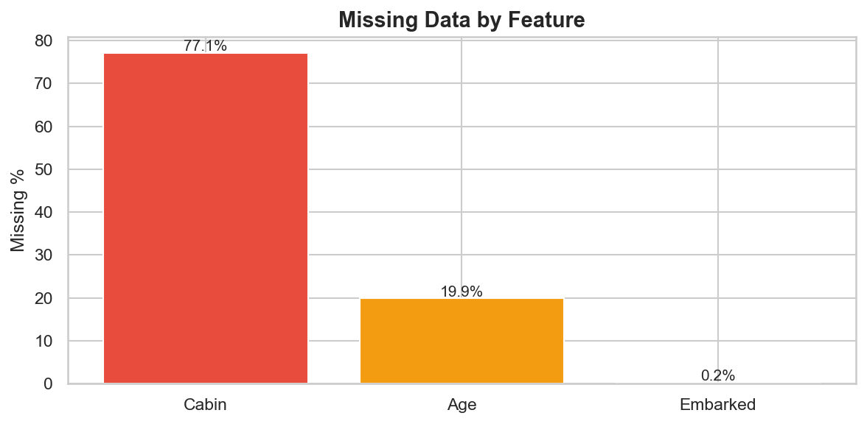
Problem Statement & Dataset
Problem
• Predict whether a Titanic passenger survived
based on features like age, sex, class, and fare
• Binary classification task (Survived: 0 or 1)
• Classic ML problem for learning the full pipeline
Dataset (Kaggle)
• Training set: 891 passengers, 12 features
• Test set: 418 passengers (no labels)
• Key columns: PassengerId, Survived, Pclass,
Sex, Age, SibSp, Parch, Fare, Embarked

Slide 3
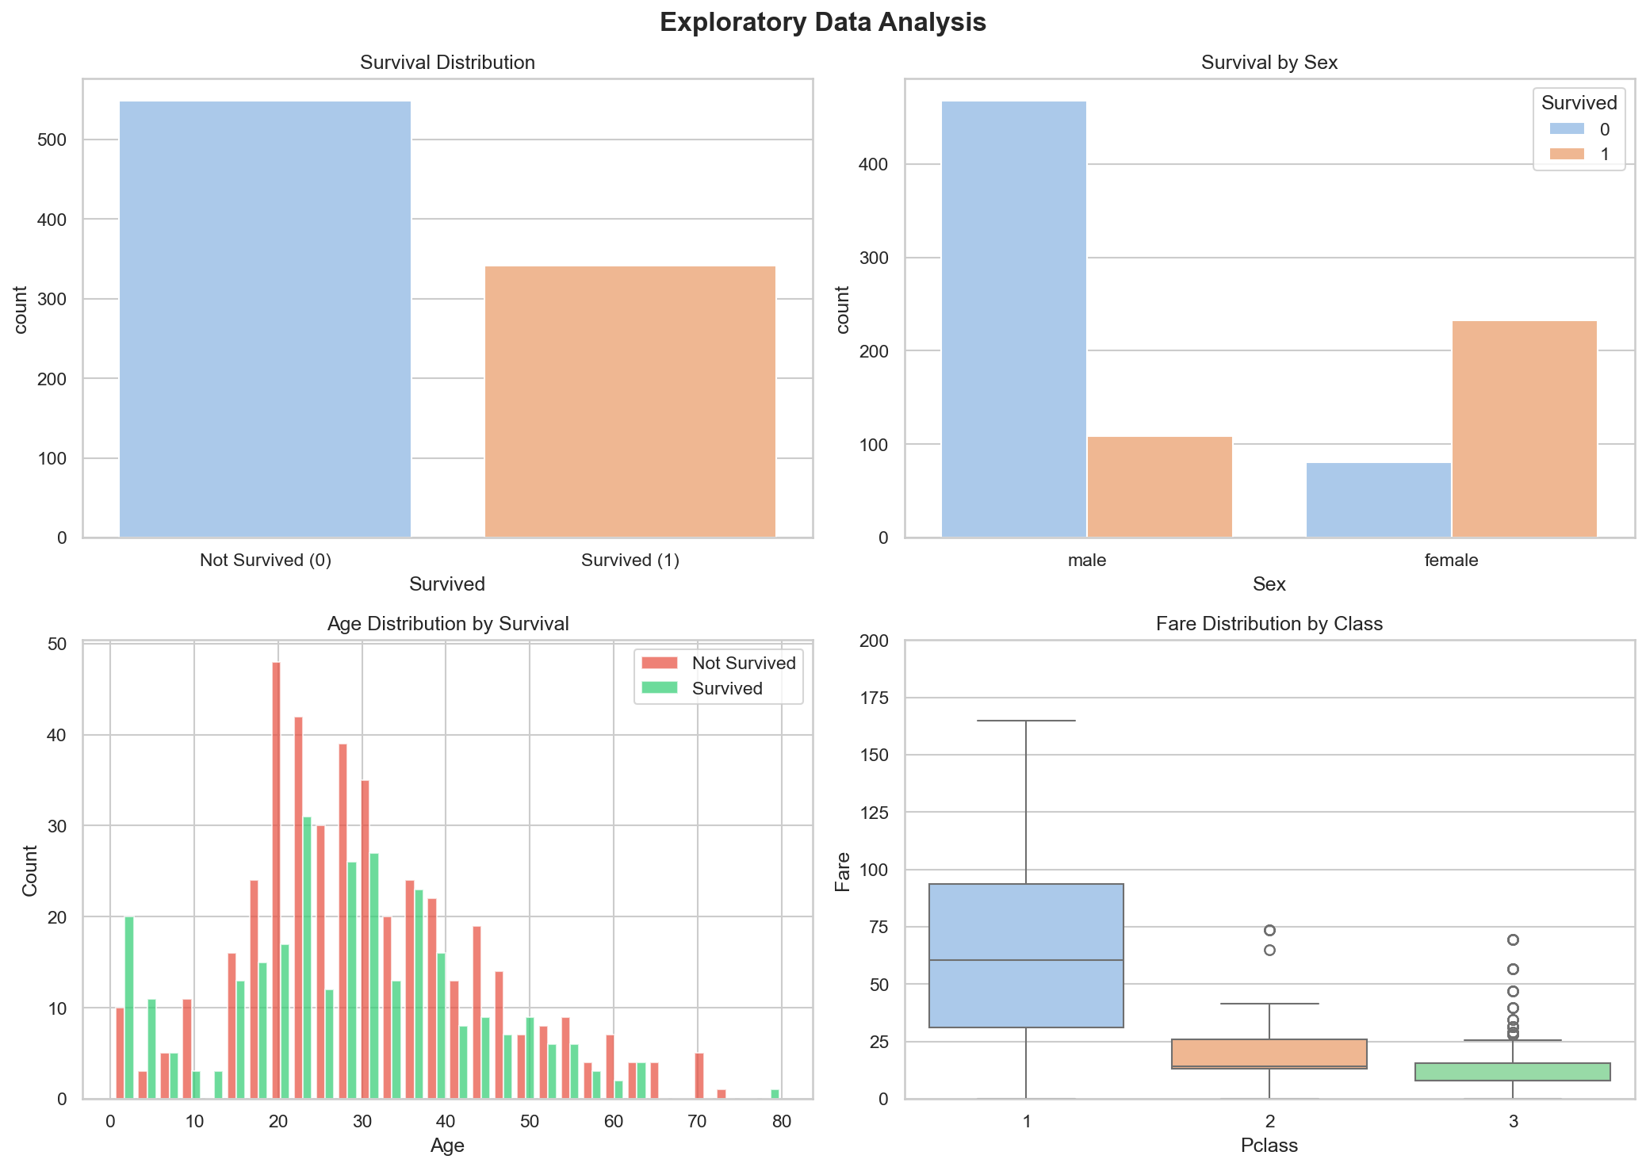
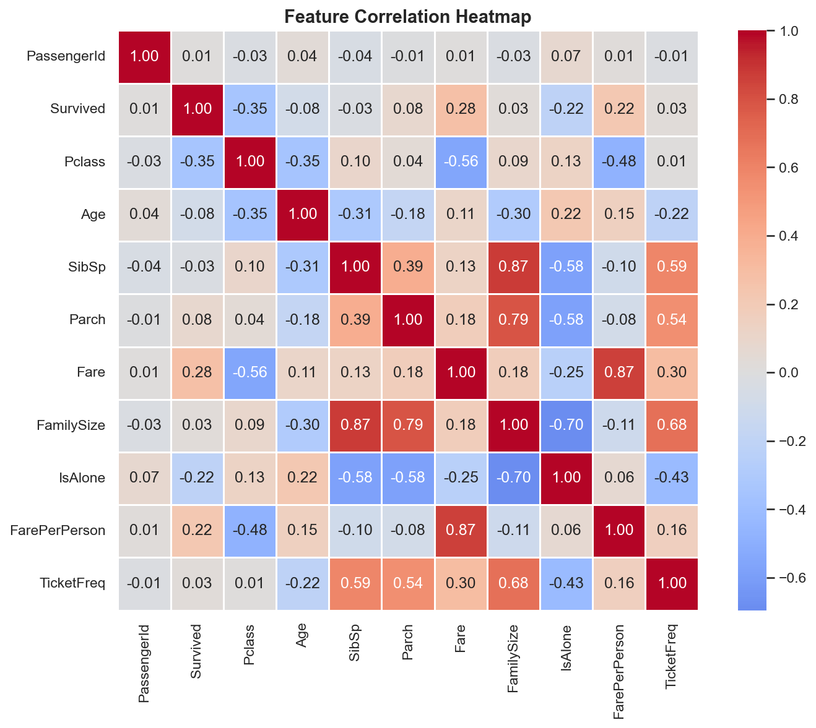
Exploratory Data Analysis

Slide 4
Feature Engineering & Data Cleaning
Data Cleaning
• Age: imputed with median (via sklearn Pipeline)
• Cabin: dropped (77% missing)
• Embarked: filled with most common port (S)
• Imputation fitted ONLY on training data
Engineered Features
• FamilySize = SibSp + Parch
• IsAlone = 1 if FamilySize == 0
• Title extracted from Name (Mr, Mrs, Miss, etc.)
• FarePerPerson, FareGroup, AgeGroup
• TicketFreq (per-split frequency encoding)
Leakage Prevention
• Train/test split (80/20) BEFORE any
preprocessing or feature engineering
• All imputation/scaling/encoding inside
sklearn Pipelines — fitted on train only
• Feature engineering is row-local
(no information leaks between splits)

Slide 5
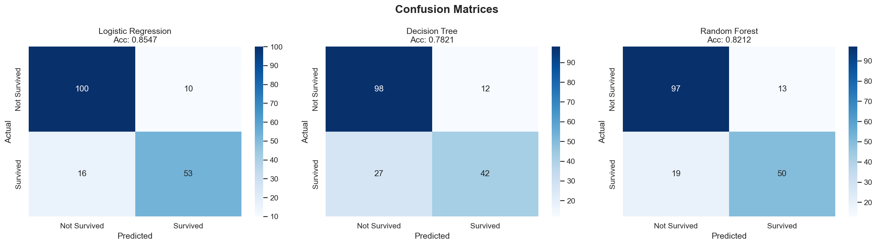
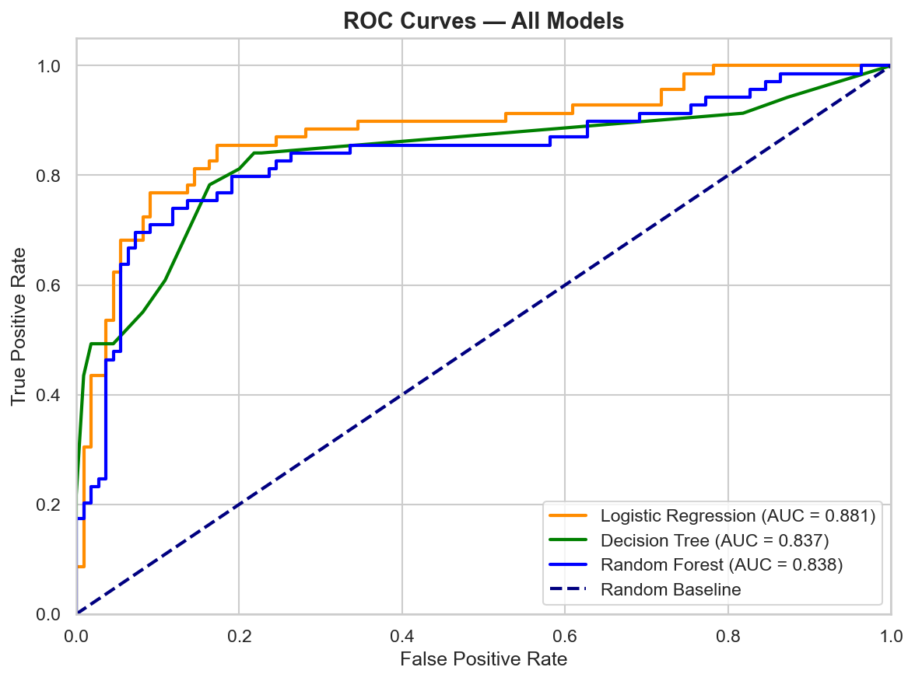
Model Training & Evaluation
Models Trained
1. Logistic Regression
2. Decision Tree (with GridSearchCV tuning)
3. Random Forest (with GridSearchCV tuning)
Evaluation Metrics
• Accuracy, Precision, Recall, F1-Score
• ROC-AUC, Confusion Matrix
• 10-Fold Cross Validation

Slide 6
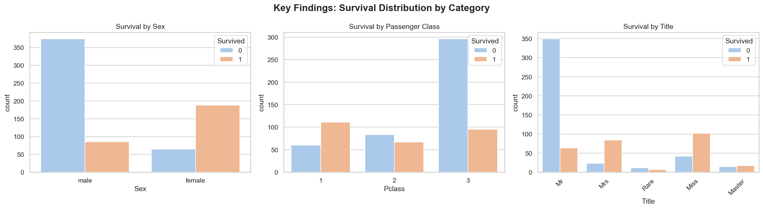
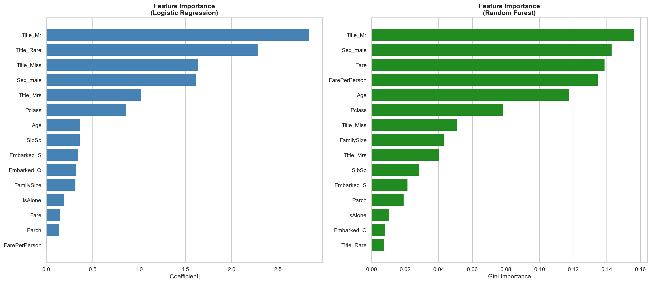
Key Findings & Feature Importance

Slide 7
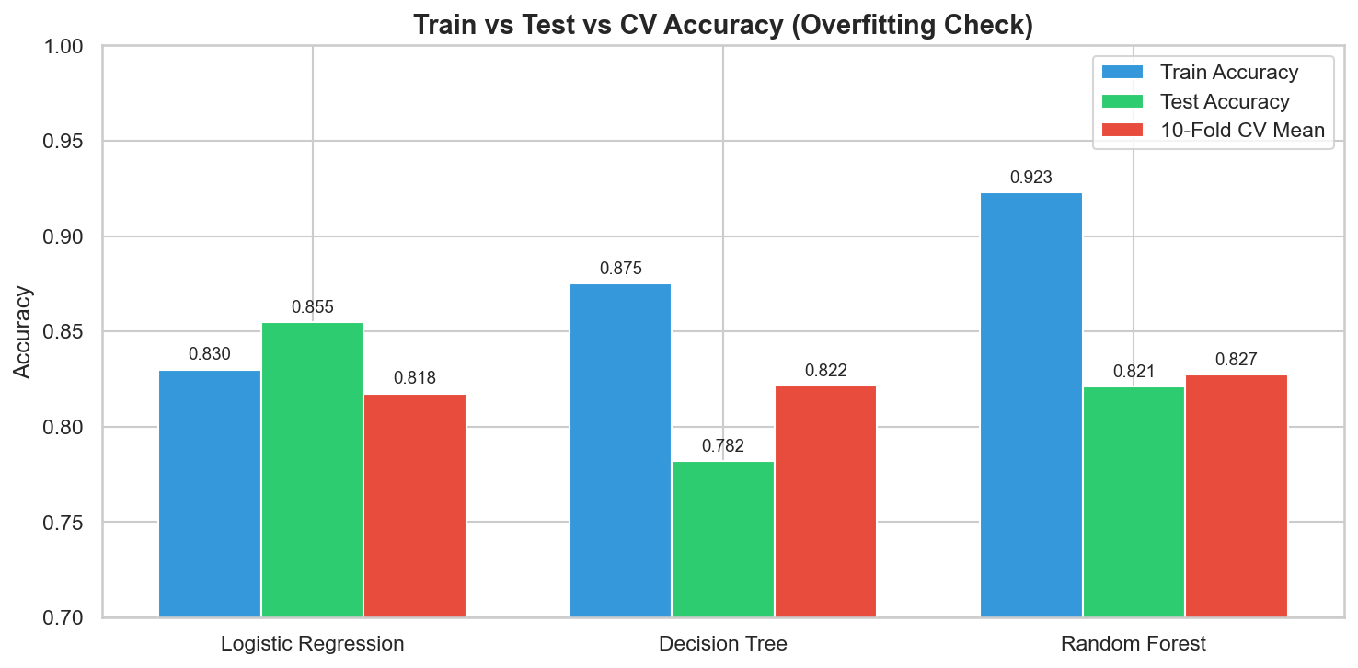
Conclusion & Takeaways
Results
• Logistic Regression delivered the best overall
performance across all evaluation metrics
• Sex, Pclass, and Title are the strongest
predictors of survival
• No data leakage — clean pipeline workflow
What I Learned
• Full ML pipeline: EDA → cleaning →
feature eng. → modeling → evaluation
• Importance of preventing data leakage
• sklearn Pipelines for reproducible workflows
• Hyperparameter tuning with GridSearchCV

