Slide 1
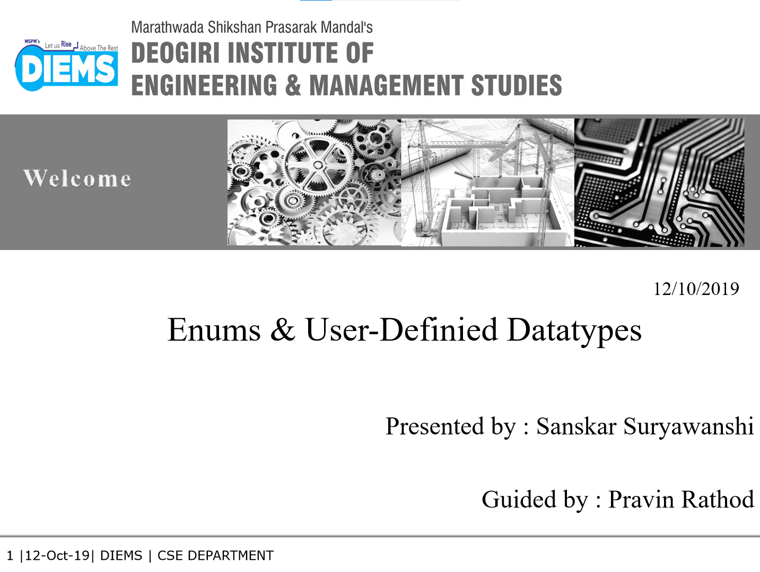

04/05/2023
RS EDITOR [SEMINAR 2]
[26023]
Rohit Raut [26023]
Prof. Priyanka Dhas
04/05/2023

Slide 2
We have IDEs :
VS Code
Sublime
Intelliji
…
What Do IDEs Do :
EDIT
COMPILE
RUN
MANAGE
…
BUT IDEs don’t really EXISTS
On Every
Device Pre-installed

Slide 3
TO TEST SOME LOGIC
IDEs With Their Full Potential
SETUP PROCESS
- Install Compiler
- Environment Variables
- Additional Extensions
…
Start Coding

Slide 4
Client
All Steps are already done on the server side
Online Compiler

Slide 5
Literature Survey
replit.com (code)
Google Drive (File Management)
github.com (File Management)

Slide 6
RS EDITOR
An online compiler
Code In Top 6 Languages
Sync Source Code In Repository
Edit Existing Source Code
Save Source Code On Local Device
Community Feed
Minimal Mode
More Features …

Slide 7
Compiler
6 Languages
Minimal
RS EDITOR
Syncing
Feed
Edit | Save

Slide 8
THANK YOU
Onto The Site

Slide 9


