Slide 1



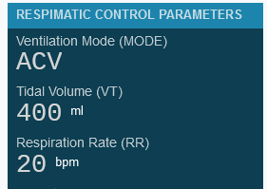
WEB APPS
RESPIMATIC 100
RESPIMATIC 100 WEB LOGGER
RESPIMATIC 100 WEB DASHBOARD
WEB LOGGER
RESPIMATIC 100
WEB DASHBOARD
RESPIMATIC 100

Slide 2
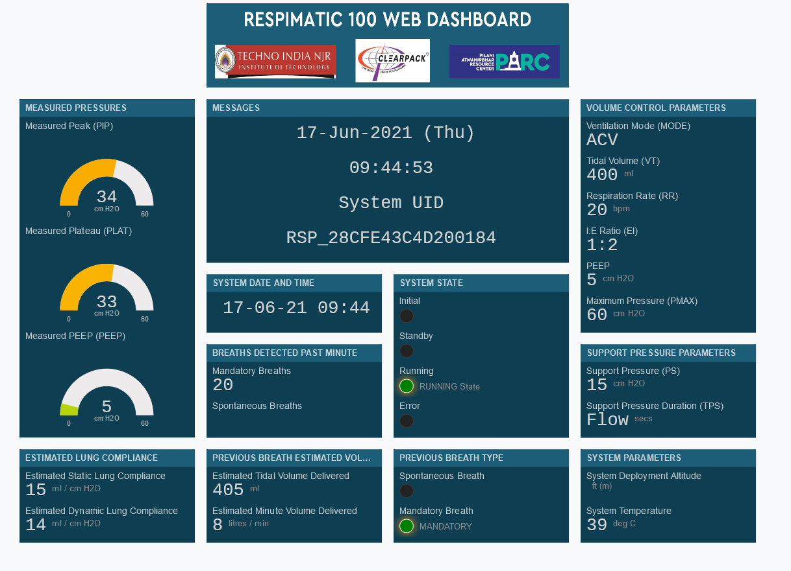

Slide 3
