Slide 1

INSPIRE-100 Web Applications
tekMedika
INSPIRE-100 Firmware
tekMedika
INSPIRE-100 Documentation
tekMedika

Slide 2
INSPIRE-100 FiO2 Calculator
tekMedika
INSPIRE-100 PSV Calculator
tekMedika
tekMedika

Slide 3
INSPIRE-100
Dashboard
tekMedika
INSPIRE-100
Analyzer
tekMedika
INSPIRE-100
Recorder
tekMedika

Slide 4

INSPIRE-100 Web Applications
tekMedika
INSPIRE-100 Update Firmware
tekMedika
INSPIRE-100 View Documents
tekMedika

Slide 5
INSPIRE-100 FiO₂ Calculator
tekMedika
INSPIRE-100 PSV Calculator
tekMedika

Slide 6
INSPIRE-100
Dashboard
tekMedika
INSPIRE-100
Analyzer
tekMedika
INSPIRE-100
Recorder
tekMedika

Slide 7
INSPIRE-100 Dashboard
tekMedika
INSPIRE-100 Analyzer
tekMedika
INSPIRE-100 Recorder
tekMedika

Slide 8



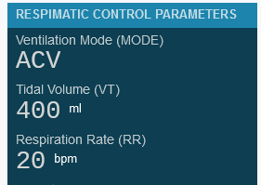
INSPIRE-100 WEB RECORDER
INSPIRE-100 WEB DASHBOARD
INSPIRE-100 WEB ANALYZER

Slide 9
INSPIRE-100
WEB APPS
INSPIRE-100
Documents
INSPIRE-100
O₂ Flow Rate Calculator
INSPIRE-100
PSV Settings Calculator
INSPIRE-100
Update Firmware
WEB RECORDER
INSPIRE-100
WEB DASHBOARD
INSPIRE-100

