Slide 1



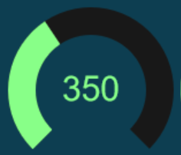

MESSAGES
PATIENT INFO
System Measurements
System State
System Parameters
Pressures (cm H₂O)
Delivered Volumes (ml)
System
Temp
Initial
PEEP
Peak
Tidal
Minute
Spontaneous
Spontaneous
SIMV
5
Standby
cm H2O
Active
VT
PMAX
Breaths Per Minute (bpm)
550
50
Plateau
Mandatory
Spontaneous
Error
Spontaneous
Spontaneous
ml
cm H2O
Pre-Use Checks
RR
PS
30
25
Current Breath
bpm
cm H2O
Peep
Instant Compliance (ml/cm H₂O)
Spontaneous
Dynamic
Static
Spontaneous
Spontaneous
I:E
TPS
Altitude
1:3
2.0
ratio
secs

