Slide 1



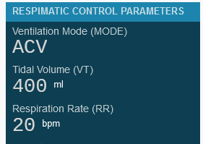
INSPIRE-100 WEB RECORDER
INSPIRE-100 WEB DASHBOARD
INSPIRE-100 WEB ANALYZER

Slide 2
INSPIRE-100
WEB APPS
INSPIRE-100
Documents
INSPIRE-100
O₂ Flow Rate Calculator
INSPIRE-100
PSV Settings Calculator
INSPIRE-100
Update Firmware
WEB RECORDER
INSPIRE-100
WEB DASHBOARD
INSPIRE-100

