Slide 1

TekMedika
INSPIRE-100 Documentation
TekMedika

Slide 2
INSPIRE-100
Dashboard
TekMedika
INSPIRE-100
Analyzer
TekMedika

Slide 3
INSPIRE-100
My Systems
TekMedika
INSPIRE-100
Recorder
TekMedika

Slide 4
INSPIRE-100 FiO₂ Calculator
TekMedika
INSPIRE-100 Update Firmware
TekMedika

Slide 5

TekMedika
INSPIRE-100 Documentation
TekMedika

Slide 6
INSPIRE-100
Dashboard
TekMedika
INSPIRE-100
Analyzer
TekMedika
INSPIRE-100
Recorder
TekMedika

Slide 7

INSPIRE-100 Web Applications
tekMedika
INSPIRE-100 Update Firmware
tekMedika
INSPIRE-100 View Documents
tekMedika

Slide 8
INSPIRE-100 FiO₂ Calculator
tekMedika
INSPIRE-100 PSV Calculator
tekMedika

Slide 9
INSPIRE-100
Dashboard
tekMedika
INSPIRE-100
Analyzer
tekMedika
INSPIRE-100
Recorder
tekMedika

Slide 10
INSPIRE-100 Dashboard
tekMedika
INSPIRE-100 Analyzer
tekMedika
INSPIRE-100 Recorder
tekMedika

Slide 11



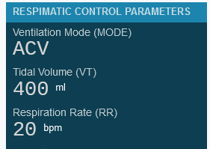
INSPIRE-100 WEB RECORDER
INSPIRE-100 WEB DASHBOARD
INSPIRE-100 WEB ANALYZER

Slide 12
INSPIRE-100
WEB APPS
INSPIRE-100
Documents
INSPIRE-100
O₂ Flow Rate Calculator
INSPIRE-100
PSV Settings Calculator
INSPIRE-100
Update Firmware
WEB RECORDER
INSPIRE-100
WEB DASHBOARD
INSPIRE-100

