Slide 1



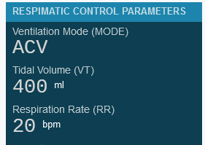
RESPIMATIC 100 WEB LOGGER
RESPIMATIC 100 WEB DASHBOARD
RESPIMATIC 100 WEB ANALYZER

Slide 2
WEB APPS
RESPIMATIC 100
WEB LOGGER
RESPIMATIC 100
WEB DASHBOARD
RESPIMATIC 100

Slide 3
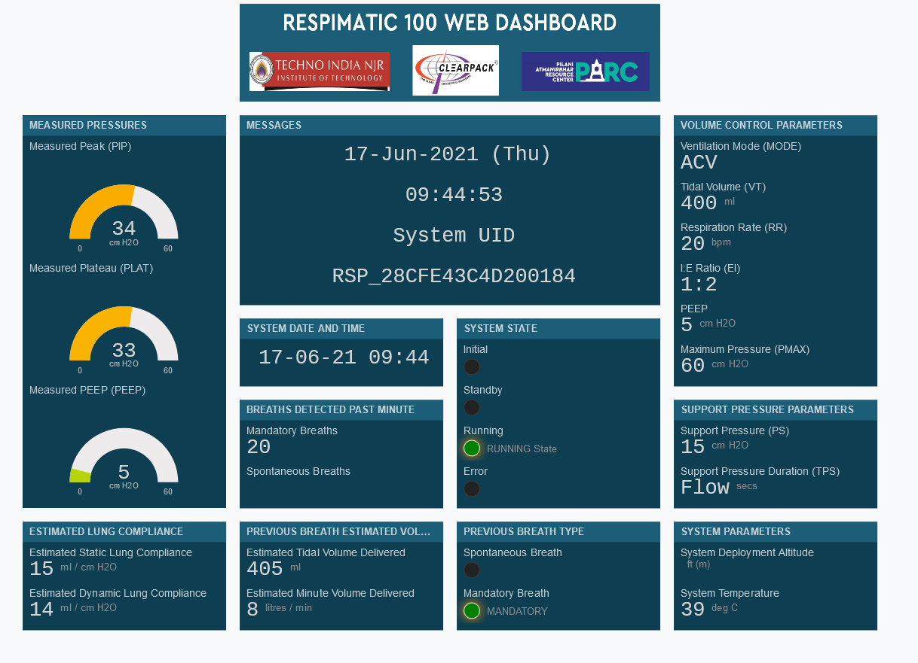

Slide 4
