Slide 1



RESPIMATIC 100 WEB DASHBOARD
WEB DASHBOARD
RESPIMATIC 100

Slide 2
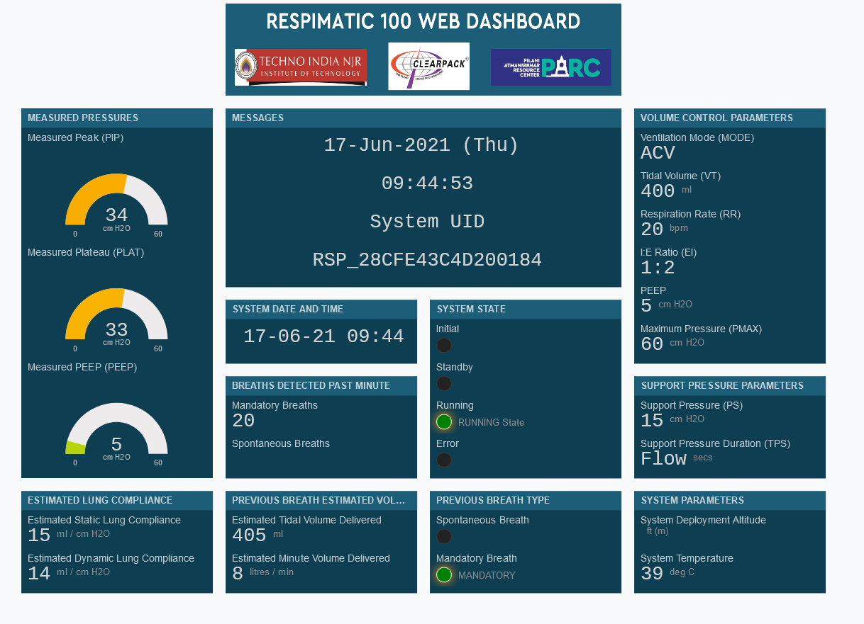

Slide 3
