Slide 1



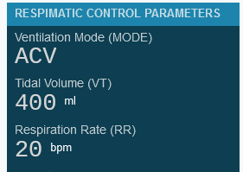
RESPIMATIC 100 WEB RECORDER
RESPIMATIC 100 WEB DASHBOARD
RESPIMATIC 100 WEB ANALYZER

Slide 2
RESPIMATIC 100
WEB APPS
RESPIMATIC 100
Documents
RESPIMATIC 100
O₂ Flow Rate Calculator
RESPIMATIC 100
PSV Settings Calculator
RESPIMATIC 100
Update Firmware
WEB RECORDER
RESPIMATIC 100
WEB DASHBOARD
RESPIMATIC 100

Slide 3
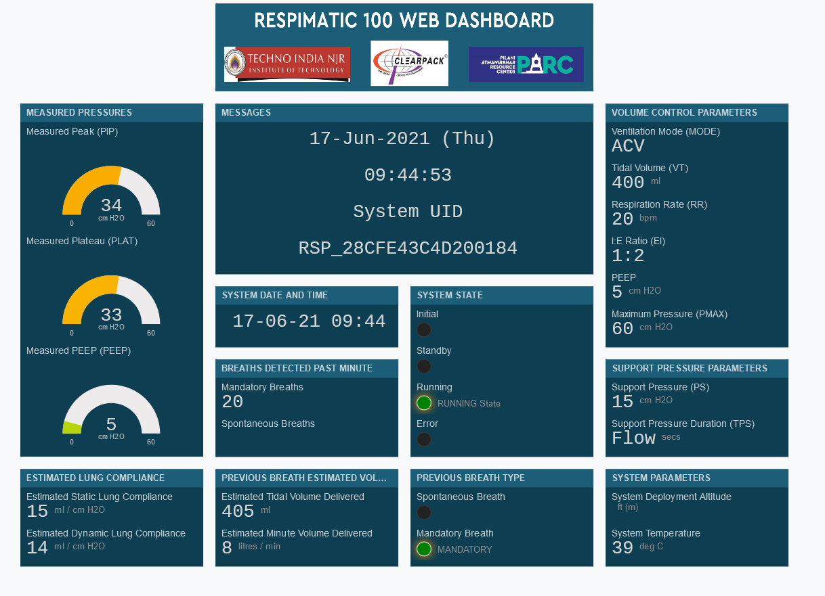

Slide 4
