Slide 1
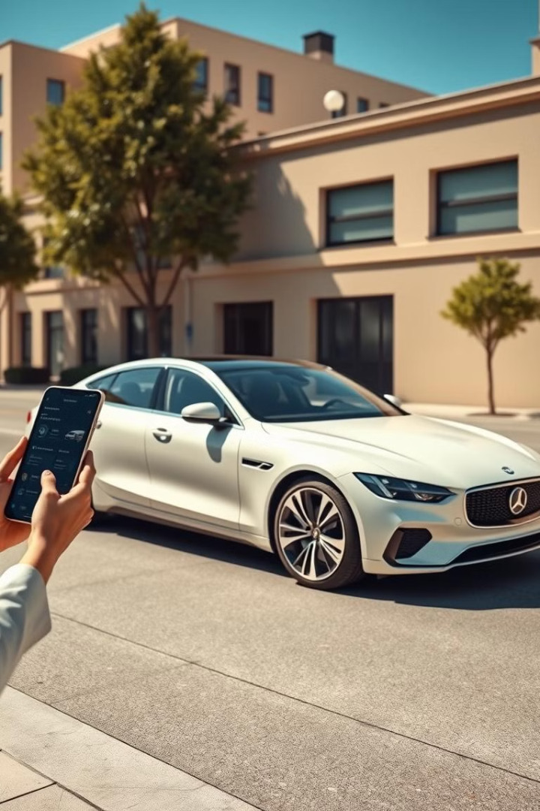
CARVILLA
This presentation explores the development of a comprehensive 4-wheeler vehicle inventory system designed to facilitate informed vehicle comparisons for international students and users. Our team leveraged our own experiences as international students in the USA to create this valuable resource.
By,
Priyadarshini Chadalawada,
Rohita Jahnavi Jala,
Chanikya Boggarapu

Slide 2
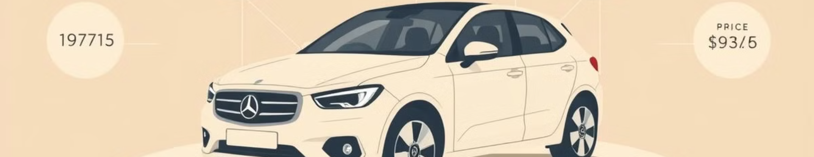
Project Overview
1
1. Gather Car Data
2
2. Develop Website Structure
3
3. Implement Search & Comparison Functionality
Collecting comprehensive information on various car models from both India and the USA.
Creating a user-friendly website with a home page, brand pages, and comparison features.
Allowing users to quickly and easily find specific car models based on their preferences.

Slide 3




Project Goals & Timeline
Gather Data
1
2 weeks
Home & Brand Pages
2
3 weeks
Comparison Feature
3
2 weeks
Search & Filter
4
2 weeks

Slide 4
Project Implementation
Data Collection
1
Gathering data from reliable sources for US and Indian car models.
Website Development
2
Creating a user-friendly interface with intuitive navigation.
Functionality Implementation
3
Adding search, filter, and comparison features for dynamic user experience.

Slide 5
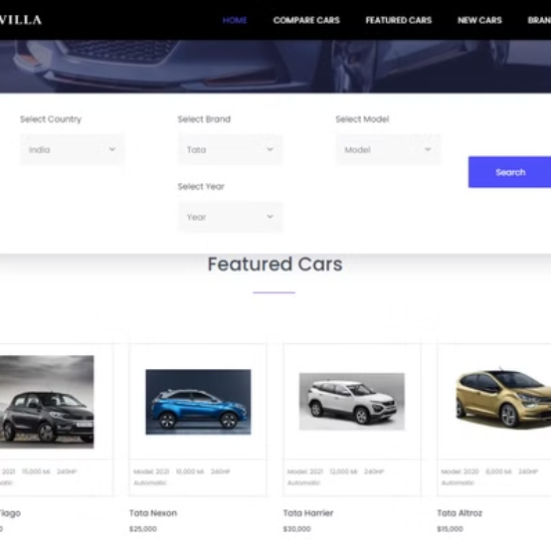
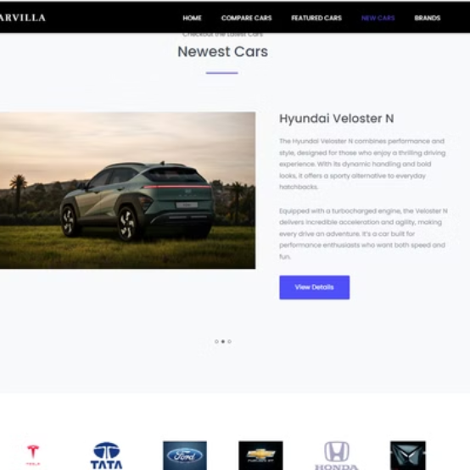
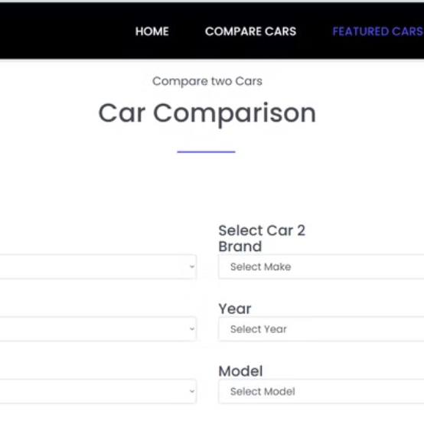
Demonstration
https://rohitajala.github.io/GVSU-CIS641-NinjaTurtles/

Slide 6
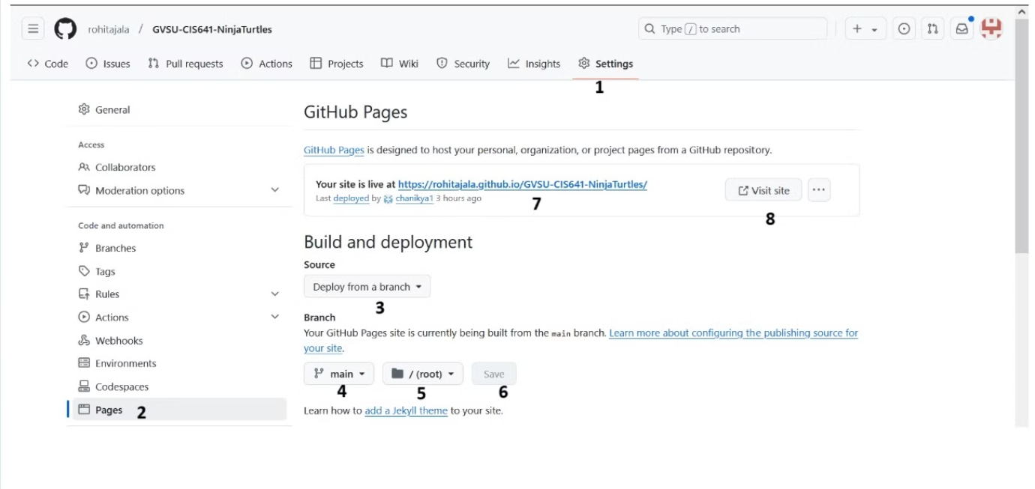
Deployment

Slide 7




Conclusion & Next Steps
Future Enhancements
Add security features to the website.
User Feedback
Gather user feedback to refine the system and address any usability issues.
Deployment
Deploy the application for public access and encourage user adoption.

Slide 8
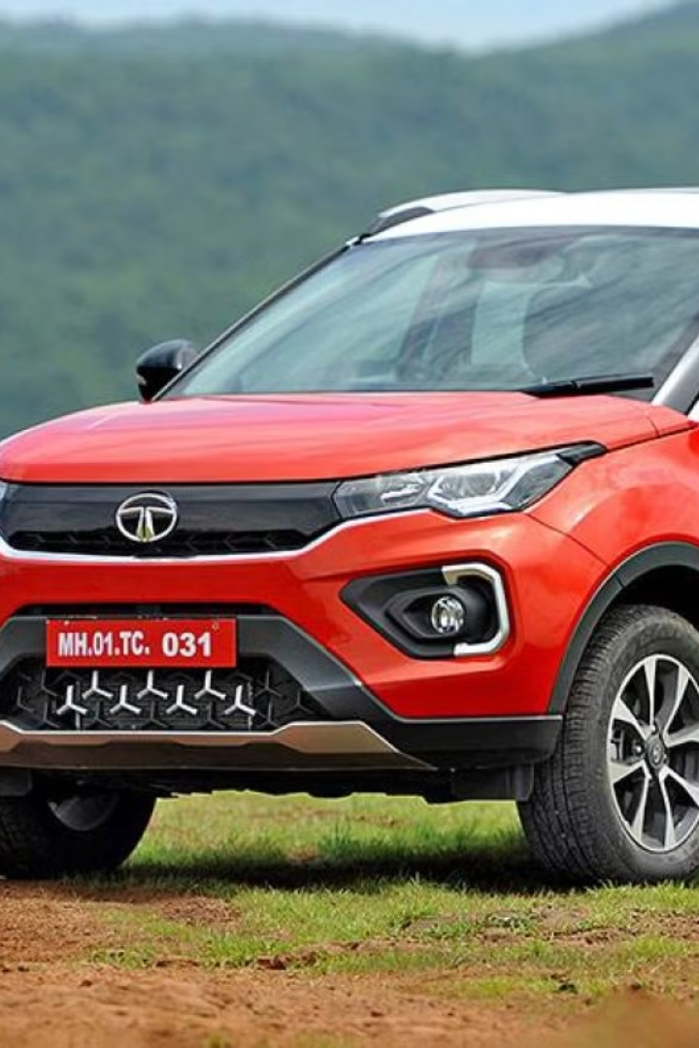
THANK YOU
We appreciate your time and interest in CARVILLA.

