Slide 1
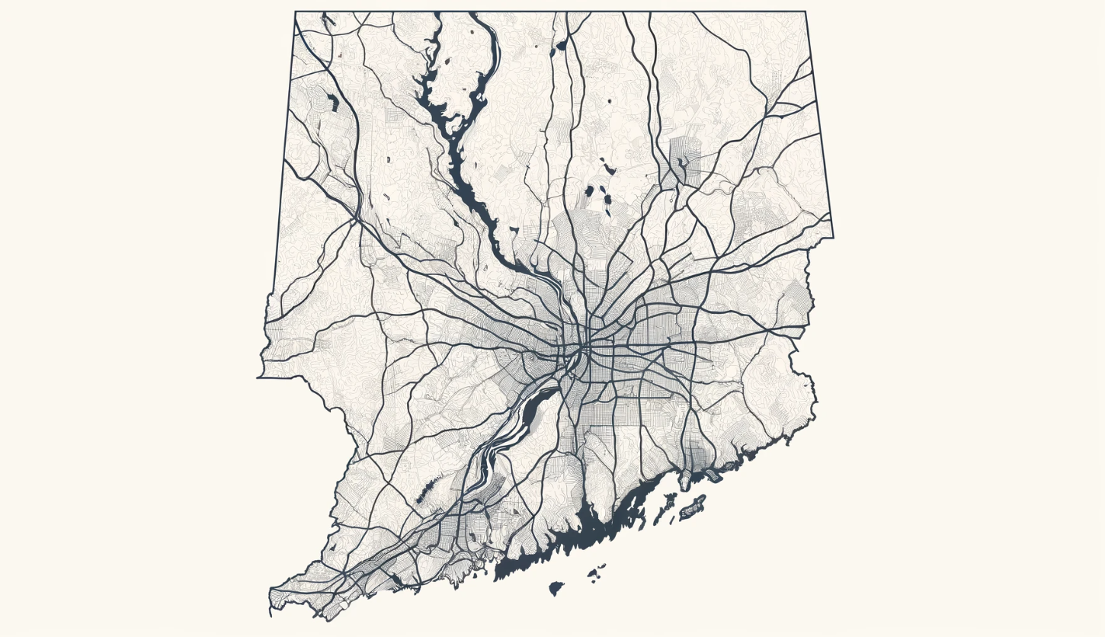

Ongoing Report

Slide 2

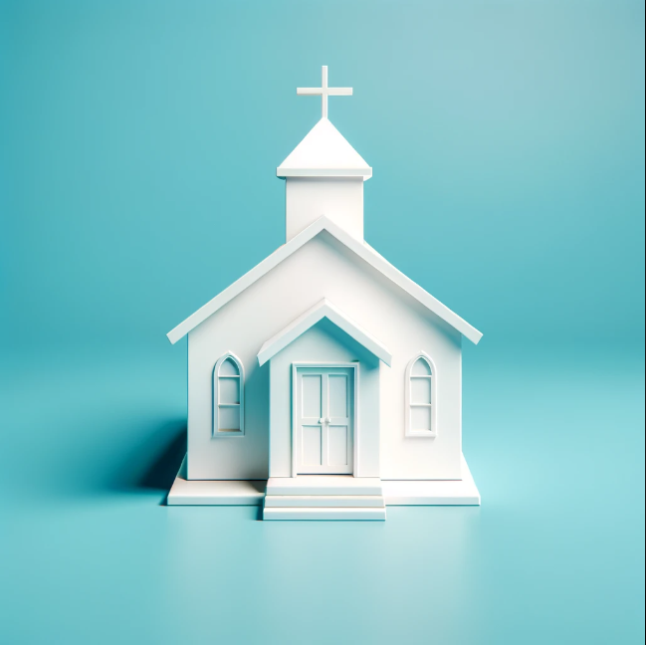





Our Process
DONATE HERE
DONATE HERE

Slide 3
What Worked
DONATE HERE
DONATE HERE

Slide 4
In Progress

Slide 5
Did Not Work

Slide 6
Results
Collected item’s estimated value: $2000+
Anticipated conversion rate: 20%
Facebook Marketplace conversion rate: 45%
Inspired givers on Freecycle to give more
Long term connections (in progress)
Connecting Churches
Connecting Real Estate Management Companies

Slide 7
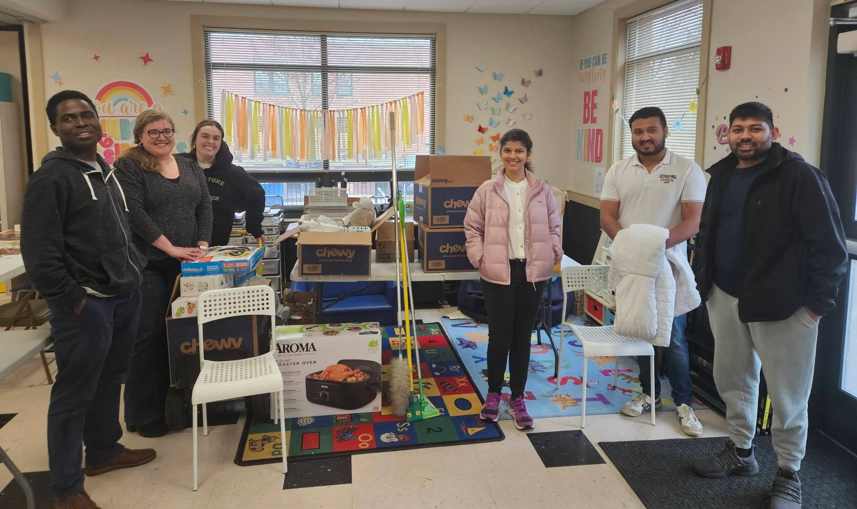

Slide 8

Thank you!
Support Our Cause: Make a Difference Today

