Slide 1
Upskilling and Getting Job Ready Roadmap
Team 1 – - Rohit Akole
- Yamini Bolloju
- Arun Chowdary Bezawada
2/14/2023

Slide 2
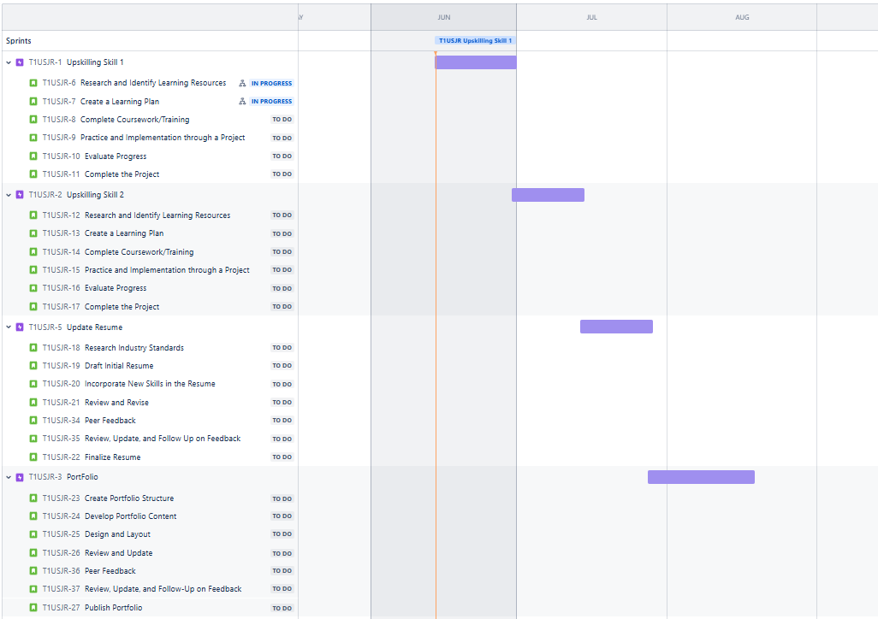
Key Milestones, Timelines and Deliverables

Slide 3
Key Milestones, Timelines and Deliverables
Epic | Due Date | Description
T1USJR-1 Upskilling Skill 1 | 06/30/2024 | This epic focuses on enhancing your proficiency in the first identified skill. The goal is to systematically build your knowledge and practical experience through structured learning, hands-on projects, and evaluations. The process includes researching resources, creating a learning plan, completing coursework, implementing practical exercises, and ultimately working on a project that showcases your newfound expertise. Regular assessments and feedback from mentors or experts will ensure continuous improvement and mastery of the skill.
T1USJR-2 Upskilling Skill 2 | 07/14/2024 | This epic is dedicated to acquiring and honing the second skill identified for career advancement. The approach is similar to Upskilling Skill 1, involving thorough research of learning materials, setting a structured learning path, engaging in comprehensive training, and applying the knowledge through practical projects. The emphasis is on not only learning but also demonstrating the ability to use the skill effectively. Progress evaluations and expert feedback will guide your development and ensure readiness for professional application.
T1USJR-5 Update Resume | 07/28/2024 | The objective of this epic is to create a resume that effectively highlights your skills, experiences, and achievements, making you a strong candidate for job opportunities. It involves researching industry standards, drafting and revising the resume, and incorporating feedback from peers. The process ensures that your resume reflects your latest skills and projects, follows best practices in format and content, and is tailored to the requirements of your target industry. This epic aims to produce a polished, professional resume that stands out to potential employers.
T1USJR-3 Portfolio | 18/08/2024 | This epic focuses on developing a professional portfolio that showcases your key projects and skills. The portfolio will serve as a tangible demonstration of your capabilities and achievements. The tasks include selecting relevant projects, structuring the portfolio, creating detailed content, and designing a visually appealing layout. Peer feedback and subsequent revisions will ensure the portfolio is comprehensive and effectively highlights your strengths. The final product will be published and ready to share with potential employers and professional networks, enhancing your job readiness and marketability.

Slide 4
Roles and Responsibilities
Roles and Responsibilities:
Epic | Product Owner | Scrum Master | Development Team
USJR-1 Upskilling Skill 1 | Skill Identification Lead | Coordination Oversight | Research and Skill Mapping
T1USJR-2 Upskilling Skill 2 | Learning Path Manager | Training Facilitation | Course Enrollment and Hands-on Practice
T1USJR-5 Update Resume | Documentation Lead | Review and Release Coordinator | Drafting, Reviewing, and Updating Resume
T1USJR-3 Portfolio | Portfolio Planning Manager | Continuous Improvement Leader | Portfolio Creation and Iteration
Product Owner:
Defines the overall vision for each phase of the upskilling project and communicates it to the team.
Manages and prioritizes the skill roadmap to ensure the focus is on the most critical and beneficial areas.
Reviews and approves the completion of each phase, ensuring alignment with project goals.
Scrum Master:
Ensures adherence to Agile methodologies, facilitating efficient progress through each sprint.
Manages the planning and execution of project activities, including daily stand-ups, sprint planning, and retrospectives.
Removes any obstacles that may hinder the team’s progress, ensuring a smooth workflow.
Development Team:
Self-organizes to execute tasks, focusing on research, learning, and applying new skills.
Engages in practical exercises and projects to enhance skill acquisition and application.
Collaborates on drafting, reviewing, and updating resumes and portfolios to reflect new skills and experiences.
*Agile Responsibility Matrix for the Epics with generic role titles instead of specific team member names and their responsibilities for each Epic.

Slide 5
Risk Management
R/I | Risk | Risk Rating | Risk Impact | Response Action
R | Inadequate Skill Acquisition | H | H | Ensure thorough research and selection of high-quality learning resources. Implement regular progress checks and mentor reviews.
R | Time Management Issues | M | M | Establish a detailed project timeline with milestones. Regularly review progress and adjust timelines as needed to stay on track.
R | Lack of Practical Application Opportunities | M | M | Integrate hands-on projects and real-world applications into the learning process. Seek feedback from industry professionals.
R | Technological Challenges in Portfolio Development | L | M | Provide training on relevant tools and platforms for portfolio creation. Ensure access to technical support and resources.
R | insufficient Feedback on Resume and Portfolio | M | H | Schedule regular peer reviews and seek input from career advisors and industry experts to ensure quality and relevance of documents.

Slide 6
Revision and Adjustment Mechanisms
In order to maintain the effectiveness and relevance of the roadmap, we will establish a strong revision and adjustment strategy with the following components
Sprint Evaluations and Reflections:
Team members present their advancements in skills, resume updates, and portfolio projects. Feedback is collected from all stakeholders to pinpoint areas for improvement and validate the work completed. Any necessary adjustments are deliberated and planned for the next sprint. Discuss successes, challenges, and strategies for improvement. Action items are formulated to address any issues and enhance team performance. Emphasis is placed on continuous improvement and teamwork.
Backlog Enhancement Sessions:
Scheduled mid-sprint to review and refine the backlog. Team assesses current tasks, reorganizes based on new information or goal changes. Ensures that the backlog is consistently updated with the latest tasks, and upcoming work is clearly defined. Incorporates feedback from Sprint Evaluations to enhance upcoming tasks and epics.
Adaptive Planning Process:
Adaptive planning allows for adaptability and responsiveness to changes. Regularly revisiting the roadmap and adjust the plan as needed based on progress and feedback. Utilizing the insights from sprint evaluations, reflections, and backlog enhancement to make informed decisions. Focuses on aligning with the overarching goal of improving skills and job readiness.

Slide 7
Communication Plan
The communication strategy is essential for the successful implementation of the roadmap.
Daily Stand-up Calls Daily Meetings:
Conducting meetings every evening to review daily objectives, progress, and challenges. Each team member gives a brief update on their achievements from the previous day, their plans for the current day, and any obstacles they are facing. Promotes quick issue resolution and ensures everyone is on the same page.
Sprint Planning Meetings Planning Sessions:
Held at the beginning of each sprint to outline the tasks for the upcoming sprint. The team discusses the backlog items, estimates the effort required, and commits to the deliverables for the sprint. Ensures a clear understanding of objectives and roles.
Stakeholder Updates Regular Updates:
Scheduled meetings with stakeholders to provide progress reports. Meetings can be weekly or bi-weekly based on stakeholder availability and project requirements. The updates include a summary of achievements, current tasks, and any challenges or risks. Seeks feedback and ensures alignment with stakeholder expectations.
Project Management Tools Used Collaboration and Tracking Tools:
JIRA: For task tracking, backlog management, and sprint planning.
Google Drive: For documentation, sharing learning plans, resume drafts, and portfolio content.
Webex: For virtual meetings, daily stand-ups, sprint reviews, and stakeholder updates.
By incorporating these strategies and tools, the team can adopt a structured yet adaptable approach to achieve their upskilling and job readiness objectives.

