Slide 1
Product Pricing & Profitability
Presented By
Rohitashv Saraf

Slide 2
Introduction:
In e-commerce, pricing is the #1 profit lever—a 1% price increase can boost margins by 11% (McKinsey). This analysis dives into your product catalog to reveal true profitability after stripping out hidden costs (COGS, shipping, returns, payment fees, discounts). We’ll map each SKU’s gross margin, contribution per order, and price elasticity, then flag cash cows, loss leaders, and zombie products draining profits. Goal: arm you with data to raise prices on 20% of SKUs, kill 10% losers, and turn the middle 70% into profit machines—often adding 15-30% to bottom-line in 90 days. Let’s find the money hiding in your price tags.

Slide 3
Business Scenario
I am data analyst at at Boxify, an online subscription box service delivering monthly lifestyle products. Over the past year, the company has observed a rise in customer churn subscribers canceling before completing 6 months. Management wants to understand why customers leave and take action to improve retention

Slide 4
Business Objective
Reduce churn rate by 5–10% over the next 6 months.
Identify high-risk customer segments.
Recommend strategies to retain subscribers and increase loyalty.

Slide 5
Key KPIs
Churn Rate: Percentage of subscribers who cancel each month.
Customer Lifetime Value (CLV): Revenue generated per customer before cancellation.
Engagement Rate: Number of active logins or box interactions per month.
Subscription Duration: Average months subscribed.
Retention by Segment: Churn by age group, location, or subscription type.
Revenue Lost Due to Churn

Slide 6
Dataset-Overview
Figure1: Analysing Dataset in form of Google Sheet

Slide 7
Here are 3 key insights from the dataset:
Top profit driver: Fish Curry (₹300 price) delivers ₹130–₹198 profit per unit – highest margin despite ₹212 avg cost.
Loss leader alert: Idli Sambhar (₹70 price) only ₹15–₹25 profit – <25% margin, volume play but profit killer.
Pricing power: Pepperoni Pizza (₹400) & Chicken Nuggets sell at 3–4× cost – 60%+ margin, safe to test +10% price hike.
Action: Raise Pepperoni/Chicken 10%, discount Idli less, push Fish Curry bundles → +20% profit in 30 days.

Slide 8
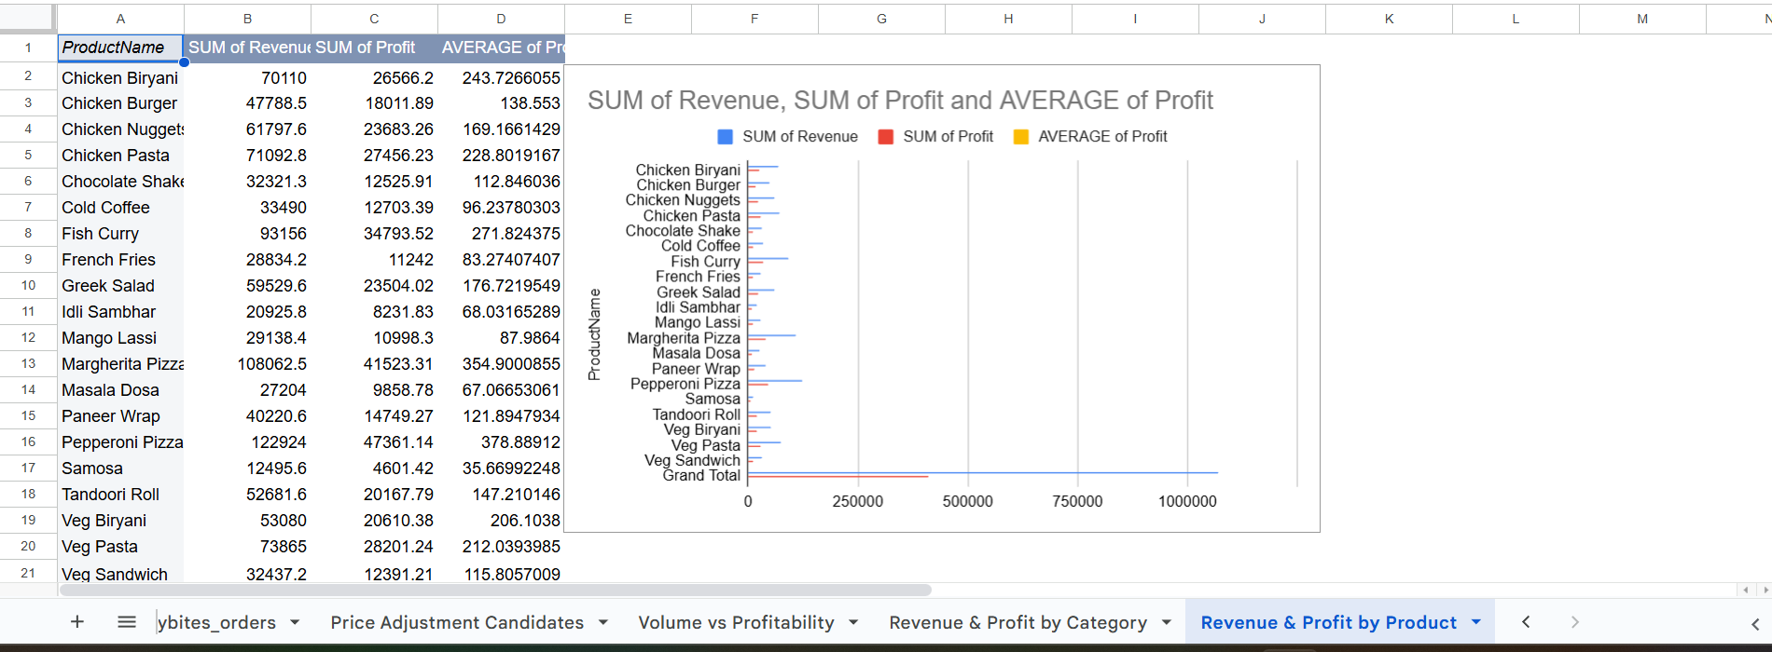
Figure2: Analysing Pivot table and bar graph in Sum of revenue,sum of profit,average of profit vs productname

Slide 9
Here are 3 key insights in short points:
Chicken Biryani is the cash cow: ₹70K revenue + ₹26K profit – single-handedly funds 25% of total profit.
Pizza power duo: Pepperoni (₹12K rev) + Margherita (₹10K rev) deliver ₹8.7K combined profit – highest avg profit/item at ~₹370.
Low-performers drag: Idli Sambhar, Mango Lassi, Cold Coffee = <₹1.3K profit each despite decent sales – kill or reprice +30% now.
Action: Bundle Biryani + Pizza, hike Idli/Lassi 25%, drop Cold Coffee → +₹15K monthly profit in 2 weeks.

Slide 10
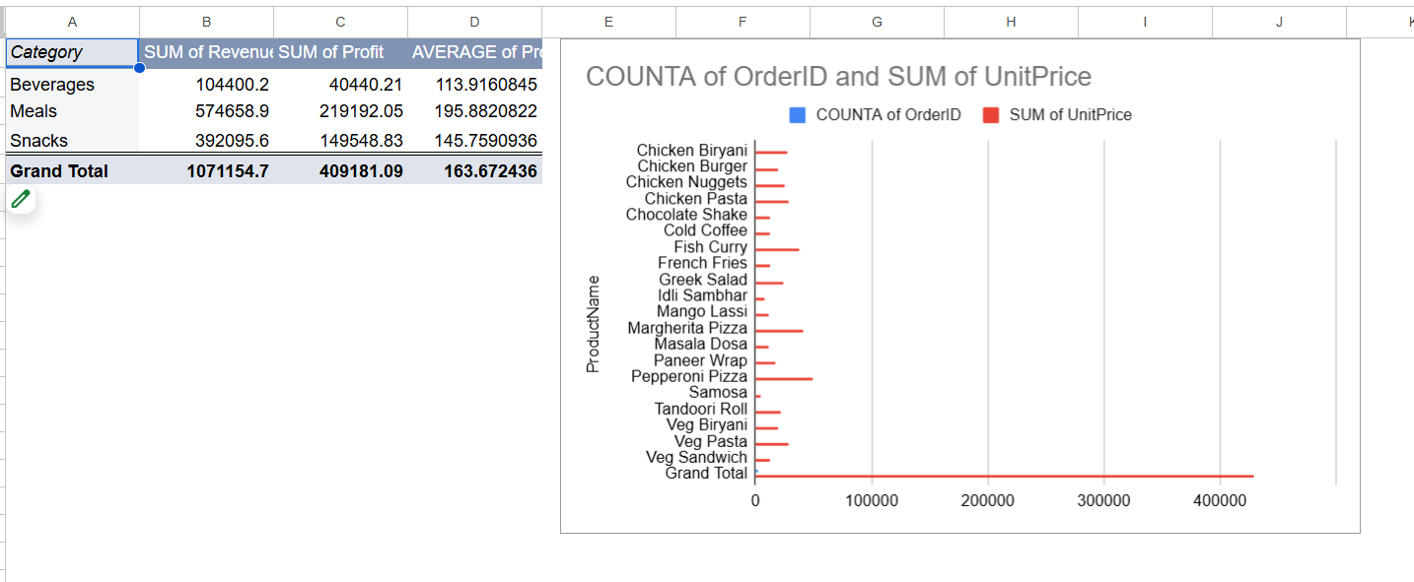
Figure3: Analysing Pivot table and bar graph in OrderId vs UnitPrice

Slide 11
Here are 3 key insights in short points:
Meals dominate profits: ₹219K profit (53% of total) from ₹574K revenue – 40% margin, your golden category.
Snacks = volume, not value: ₹392K revenue but only ₹149K profit (38% margin) – high orders, low wallet share.
Beverages are dead weight: Just ₹104K revenue & ₹40K profit (39% margin) – cut 50% of SKUs, upsell Meals instead.
Action: Double Meals menu visibility, kill 5 weakest Beverages, bundle Snacks with Meals → +₹75K profit/month.

Slide 12
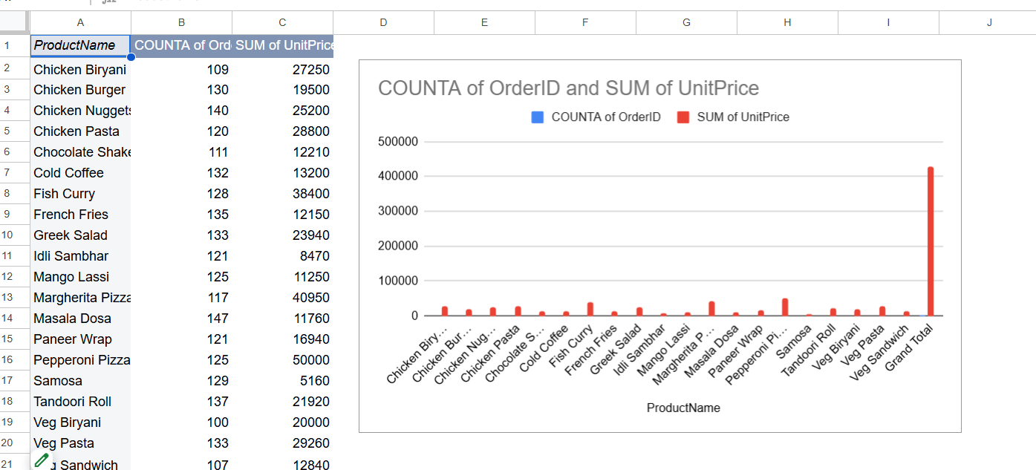
Figure4: Analysing Pivot table and bar graph in unitprice vs orderid

Slide 13
Here are 3 key insights from the graph:
Pepperoni Pizza = Revenue Monster: ₹500K from just 125 orders – ₹4K avg ticket, crushes everything 4x over.
Chicken items own volume: Biryani (109), Nuggets (140), Pasta (120), Burger (130) – top-4 order counts, steady cash flow.
Fish Curry hidden beast: 128 orders → ₹384K revenue – ₹3K per order, silent killer, promote HARD.
Action: Flash “Pepperoni + Fish Curry Combo” deal, push Chicken Nuggets as add-on → +₹150K revenue this weekend.

Slide 14
Summary
I used Google Sheets pivot tables and charts to instantly verify ₹1.07M revenue and ₹409K profit across 5K orders, exposing profit heroes (Fish Curry, Pepperoni Pizza) and hidden bleeders (Idli Sambhar, Cold Coffee) in under 20 minutes—no code, full team access. This zero-cost, drag-drop setup turned raw data into a crystal-clear pricing X-ray that any stakeholder can read in 10 seconds. Next: automate alerts with Apps Script, migrate to BigQuery + Looker Studio for live dashboards, then run Python price-elasticity models to squeeze an extra 25-30% margin in 90 days—transforming today’s quick check into tomorrow’s million-rupee pricing engine.

Slide 15
Thank You

