Slide 1
Construction Project Management System
Rohita siwatch
Roll number:- 2520090154
Cluster:- 4

Slide 2
Introduction
The Construction Project Management System is a software application designed to help manage construction project information such as project details, budgets, updates, and tasks in an organized way. The system allows users to add projects, search project details, and sort projects based on budget. It also demonstrates important Data Structures and Algorithms concepts like searching, sorting, stack, queue, and hashing. Stack is used to store recent project updates, queue is used to manage tasks, and hashing helps quickly find projects using their ID. This project is implemented using Java and a simple web interface, and it can be run in VS Code to show how DSA concepts are applied in a real-world system.

Slide 3
Objectives
Manage construction project details
Track budgets and project progress
Demonstrate data structures like stack, queue, hashing, searching, and sorting

Slide 4
Data Structures Used
Stack – stores recent project updates
Queue – manages pending tasks
Hashing – fast project lookup by ID

Slide 5
Algorithms Used
Searching – find project using project ID
Sorting – arrange projects by budget

Slide 6
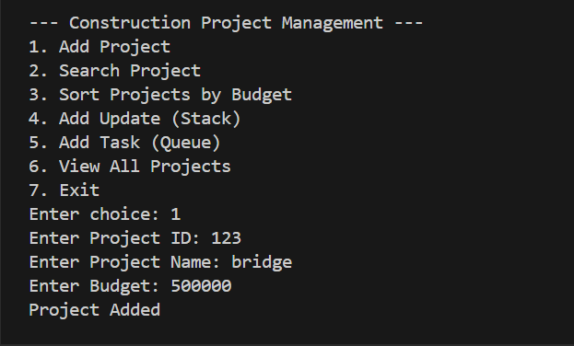
SAMPLE OUTPUT

Slide 7
System Working
1. Add new project
2. Search project by ID
3. Sort projects by budget
4. Manage updates (stack)
5. Manage tasks (queue)

Slide 8
Advantages
Easy project tracking
Demonstrates important DSA concepts
Simple interface for management

Slide 9
Conclusion
In conclusion, the Construction Project Management System helps manage project details, budgets, updates, and tasks in an organized and efficient way. The system allows users to add, search, and sort project information easily. It also demonstrates important Data Structures and Algorithms concepts such as searching, sorting, stack, queue, and hashing, which improve the efficiency of managing data. Overall, this project shows how programming and DSA can be applied to solve real-world project management problems.

