Slide 1
Introduction :-
SonarQube is a web-based open source platform used to measure and analyse the source code quality.
Code quality analysis makes your code more reliable and more readable.
Explain :
Yeah.. Thanks Pratiksha So before start I will just give you quick intro abut sonarqube. then I will tell how it integrate with zuul.
You already know that quality cannot be injected after the fact,
rather it should be part of the process and product from the very beginning.
As for good practice, it is strongly recommended to inspect the code as soon as possible.
For that SonarQube is a great choice
SonarQube is written in java but it can analyse and manage code of more than 20 programming languages, including c/c++, PL/SQL, Cobol etc through plugins.
Plugins extend the functionality of SonarQube. More than 50 plugins are available.
SonarQube is maintained by SonarSource.

Slide 2
How Does it work ?
SonarQube takes project code as the input, analyzes it using pre-defined coding rules and publishes web-based results giving overview of technical quality of code. Like find bugs, software smells
Explain :
It is as much as simple : it takes the project code then it analyze the code and check quality of code
Like find bugs , software smell and complexity
SonarQube is a central server that processes full analyses which is triggered by the SonarQube Scanners
you can host your projects and execute analysis
So as jay told how the zuul work and run the jobs on every commit So according to that here

Slide 3
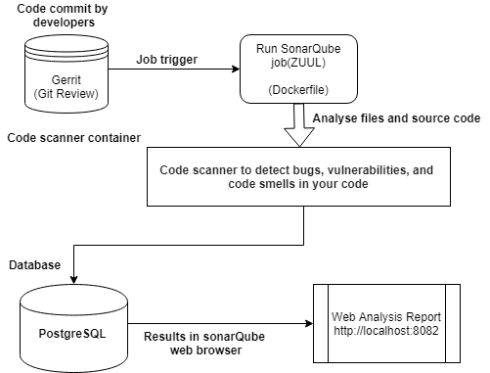
Gerrit :
The Continuous Integration when developer commit the code zuul triggers an automatic build pipeline So the execution of the SonarQube Scanner required to run the SonarQube analysis. Basically we write the ansible playbook job
Inside that job We mention code to run docker file
Analyse
The analysis report will send to the SonarQube Server for processing.
Database
SonarQube Server processes and stores the analysis report results in the SonarQube Database,
The database can be any relational \ database like
Oracle, MySQL. and it is used to store the analysis
results that can be displayed using the UI of the tool.
Review
Developers review, comment, challenge their Issues to manage and reduce their Technical Debt through the SonarQube UI. and zuul also display the log about job details.
Scanner is a Docker Image , and SonarQube server is not
containerized because in case container get destroyed user do not
Loos any data that reason we have keep sonar server in standalone
Mode , We can access from anywhere,
And we can change the port also

Slide 4
This part is pending till yet because we are merging two different tool sonarqube and zuul and we are facing some issues in this
Right now we are working on it I hope this too will complet very soon
Problem
Demon in not running
you can add if i miss anything
Madhuri will explain which part will include
I request to Madhuri to share the next part
correct me if i am wrong

Slide 5
Katapult VS sonarqube
---------------------------
Katapult is a source code analysis platform ,
Katapult is deployed on each user’s machine
So Individual users can do static analysis on their machine to increase their productivity.
Sonarqube is deployed on server and it is easily available on online platform
UI also very user faiendly
It is open source , support many languages java , c sharp
SonarQube reports for duplicate code, unit testing, code coverage, code complexity historical
that’s why we choose SonarQube.

Slide 6
-we will give small introduction about sonarqube
SonarQube is a web-based open source platform used to measure and analyse the source code quality.
Code quality analysis makes your code more reliable and more readable
-then we will tell how does it work normally like
SonarQube takes project code as the input, analyzes it using pre-defined coding rules and publishes
web-based results giving overview of technical quality of code. Like find bugs, software smells
-then we will explain about how sonarqube integreat with zuul using dig
whenever commit the code by developer zuul job can trigger it execute docker file to run sonar scanner for
sonarqube analysis
How analisis done by sonar scanner and will send to sonarqube server for processing
about database we use postgress to store the anylis report result
anaylsis report will displayed using ui of the tool so developer can easyli review , manage through this ui
Also zuul can display the logs about the job

