Slide 1
SystemDesk WorkInstruction
Application Software Development
Geetha Srinivasan
Auburn Hills , USA
Mayu 10th 2016

Slide 2
System Desk
RTC Sandbox Creation
AUTOSAR and System Desk Training slides https://teamsites.chrysler.com/sites/PTControls/7950/MBDE/AUTOSAR%20Training/AUTOSARBasics_SD_Training.pptx
Other document https://teamsites.chrysler.com/sites/PTControls/7950/MBDE/SitePages/Software%20Architecture.aspx

Slide 3
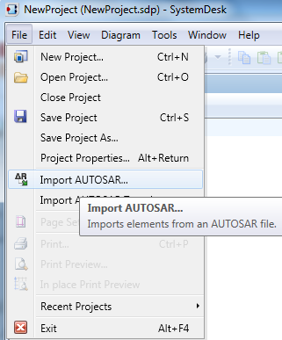
System Desk Project Creation
Launch System Desk application
Create new project File->New Project (Name can be feature name or CoE Name etc.)
Import following arxml files from the RTC Sandbox
SD Package name | File Name | Location | Remark
AUTOSAR_Platform | PlatformTypes_AR4.arxml | RTC path (..\AUTOSAR\AUTOSAR\PlatformTypes_AR4.arxml) | Contains Base data types and Implementation data types
MICROSAR | BswM_swc.arxml ComM_swc.arxml Dcm_swc.arxml Dem_swc.arxml Det_swc.arxml EcuM_swc.arxml IoHwAb_swc.arxml NvM_swc.arxml | \AUTOSAR\ServiceComponents\ | Import all the BSW files ( as required for the feature under development)
FCADataDefinition | FCADataDefinition.arxml | AUTOSAR\ApplicationComponents\ArchitectureSharedResources\DataDefinition\FCADataDefinition.arxml | Application data types, units, scaling and data constraints
FCASharedInterfaces | IFSWCName.arxml | AUTOSAR\ApplicationComponents\ | All the IF*.arxml files can be imported
FCASWCs | SWCName.arxml | AUTOSAR\ApplicationComponents\ | Import components that need to be updated

Slide 4
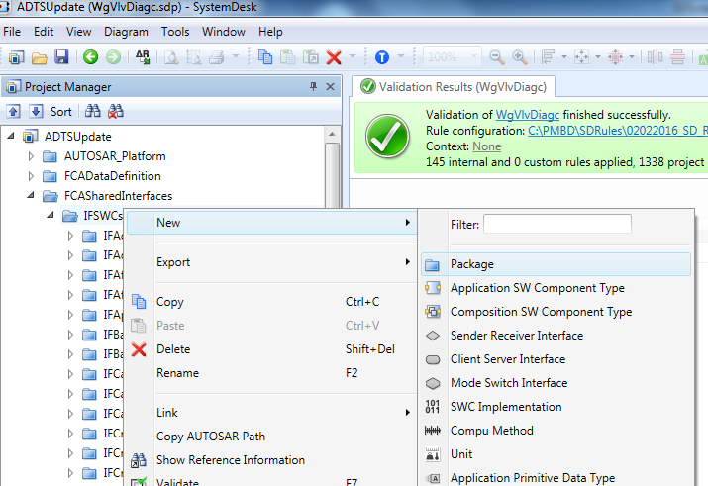
Interface – New Feature
If the feature is new, first create a new package with the name IFSWCName under FCASharedInterfaces->IFSWCs
Naming Convention - Package name in System Desk for Interface

Slide 5
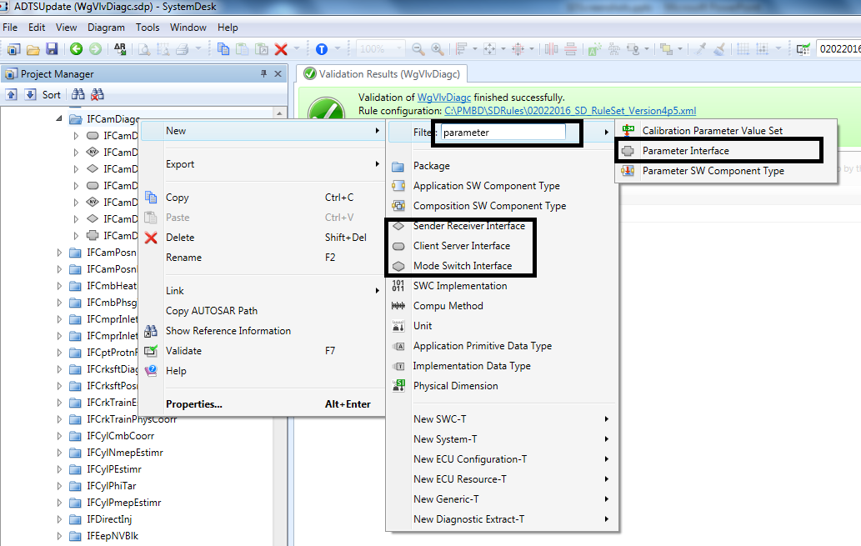
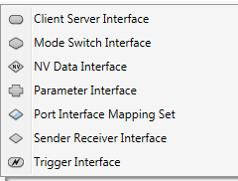
Interface – New Interface
Create new interface under the relevant package (FCASharedInterafces\IFSWCs\IFSWCName)
Select the relevant interface category ( Send Receive, Client server, Mode Switch, Parameter etc.. ) if not found in the first context menu list, type the interface type in the filter box as shown in the image for parameter interface
Interface Name :- SWCName with Suffix CS, SR, Parm
Naming Convention - Interface Name
Other Interface Types

Slide 6
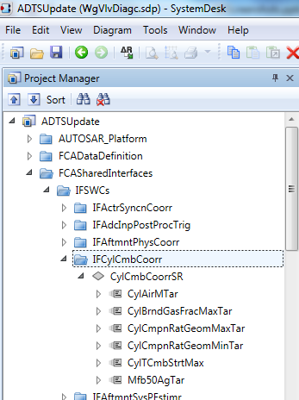
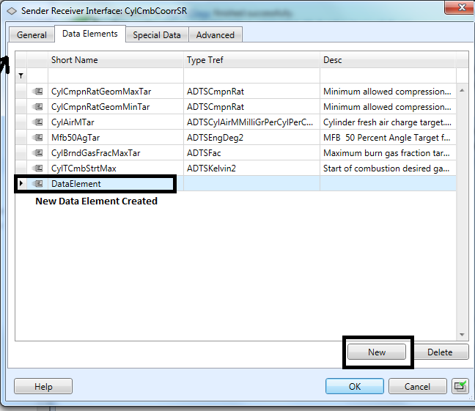
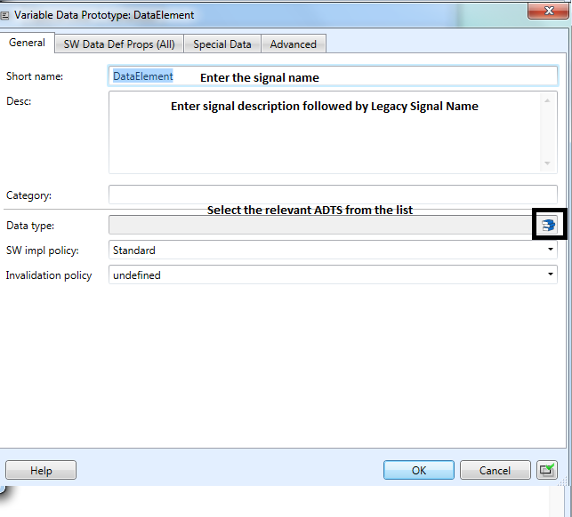
Interface – New Data Element
Double click the
interface in the
project manager window
Double click the
created data element
Naming Convention - Data Element (AUTOSAR Abbreviation)

Slide 7
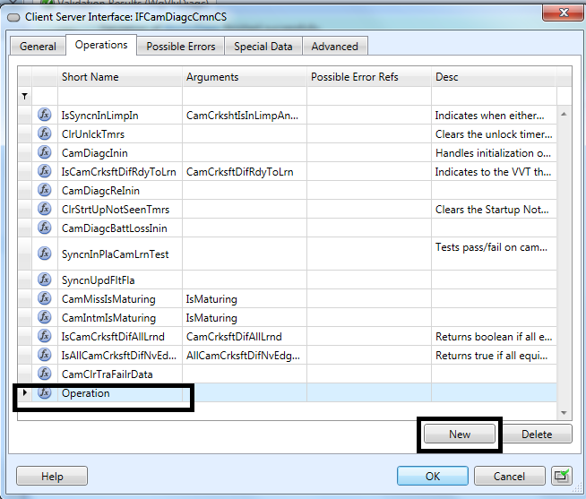
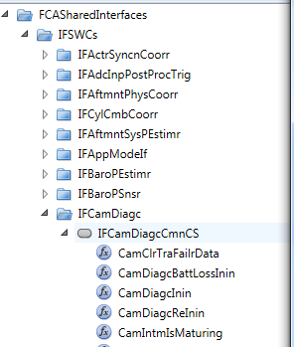
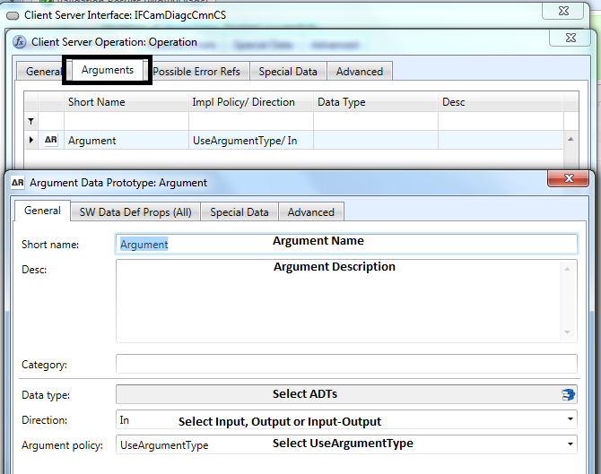
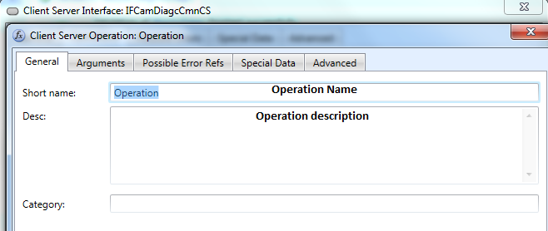
Interface – Client Server

Slide 8
Architecture Elements
Dimensions
Interface Element 1
Interface Element 2
Interface Element 3
Interface Element 4
……………….
ADTxxx
ADTyyy
ADTzzz
ADT123
Units
SWCs
Data Constraints
P
Interfaces
Compu
Method
Implementation DT
Base DT
Refer Data Elements (SR) ,operations directly(CS), Parameter elements
IB

Slide 9
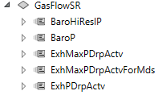
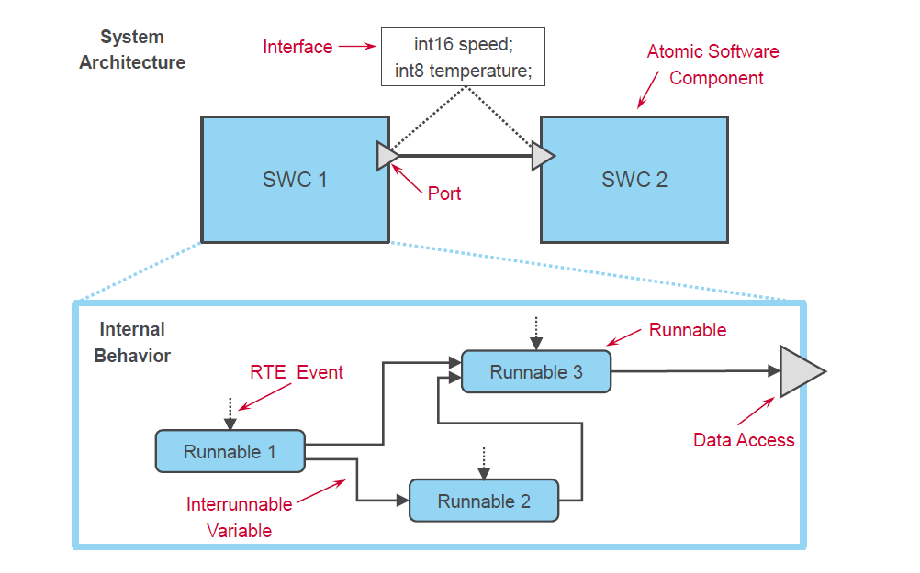
Architectural terminology
Note: source dSPACE

Slide 10
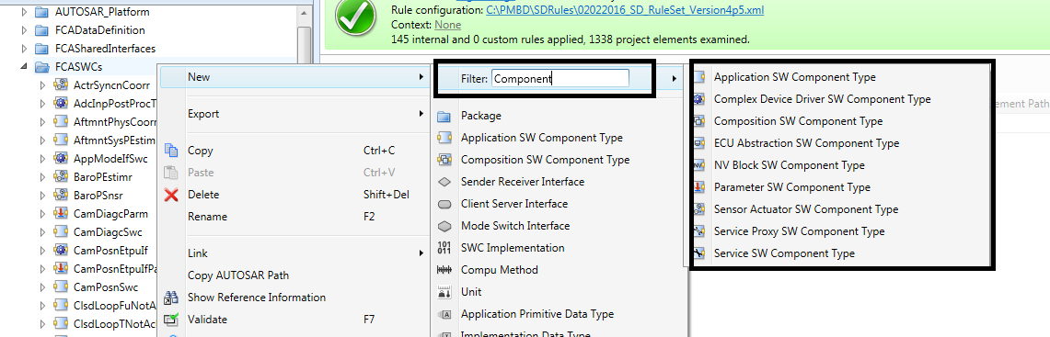
SWC - Creation
Select the relevant component type Application SW Component Type, Sensor Actuator Component Type etc..
Component Name : SWCName
Naming Convention - Component Name AUTOSAR Abbreviation

Slide 11
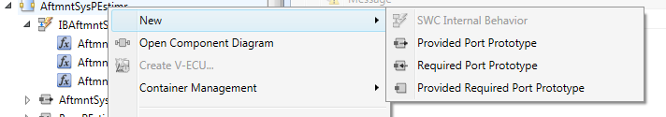
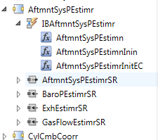
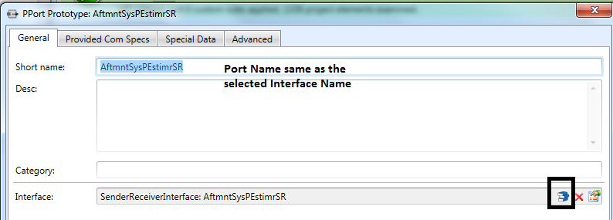

SWC Creation – Port Creation
Define the Provided and Required Port
Assign Interface to the Port
Port for Mode Disabling
Create a required Port RteModeEvents and assign it to
interface BswM_MSI_ESH_Mode
Naming Convention - Port Name

Slide 12
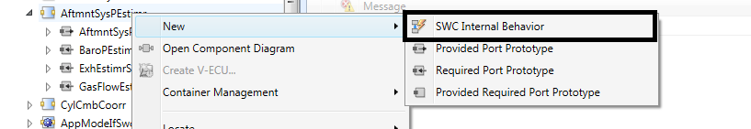
SWC Creation – Internal Behavior
Create Internal Behavior with the Name IBSWCName
Naming Convention - Internal Behavior Name Same as the SWCName with IB Prefix

Slide 13
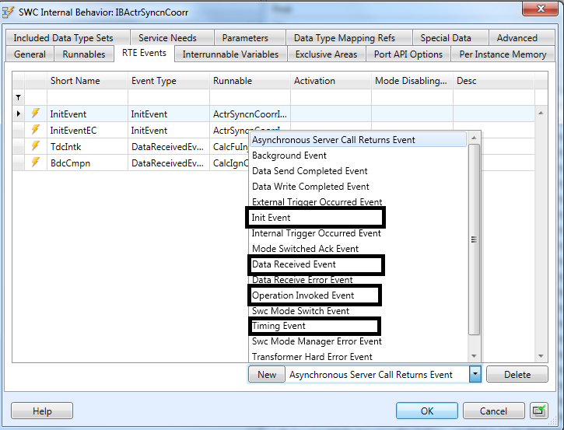
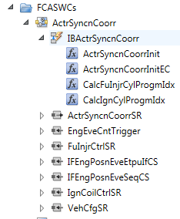
SWC Creation – RTE Event Creation
Select the type of the event and click New

Slide 14
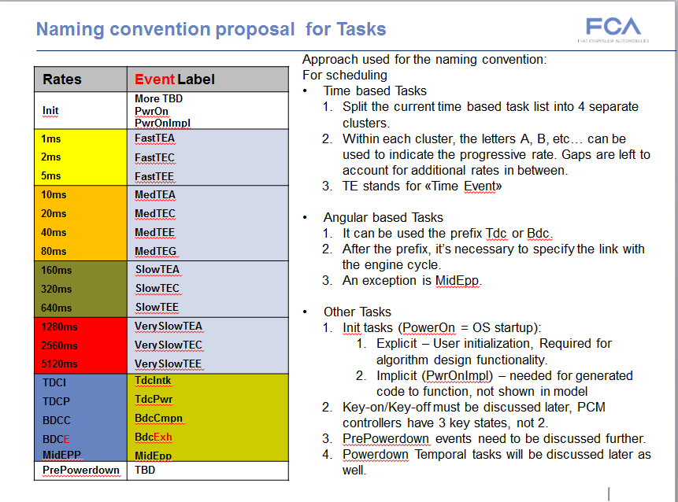
SWC Creation – RTE Task Name

Slide 15
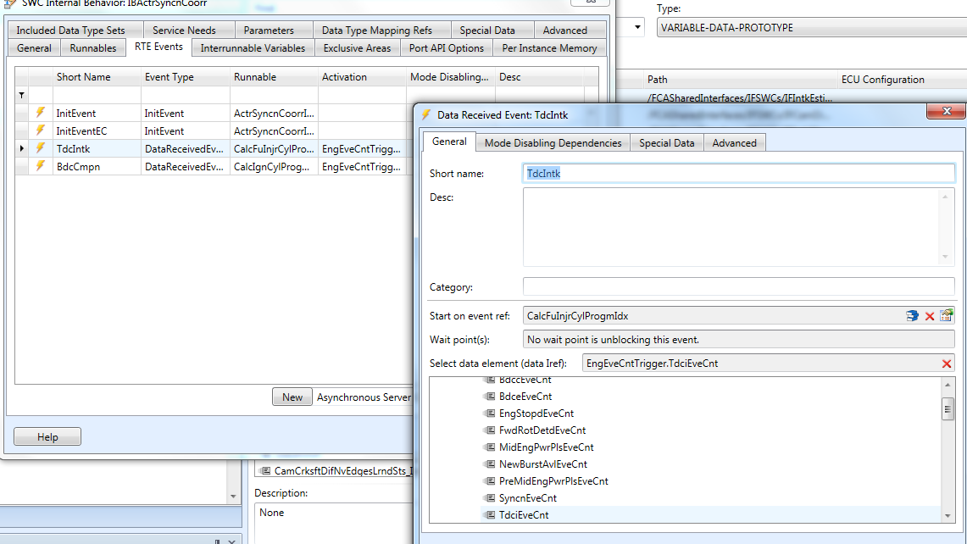
SWC Creation – RTE Event Property -1
Data Received Event
Task Name
Runnable triggered by this Event
Select the trigger for Data Received Event

Slide 16
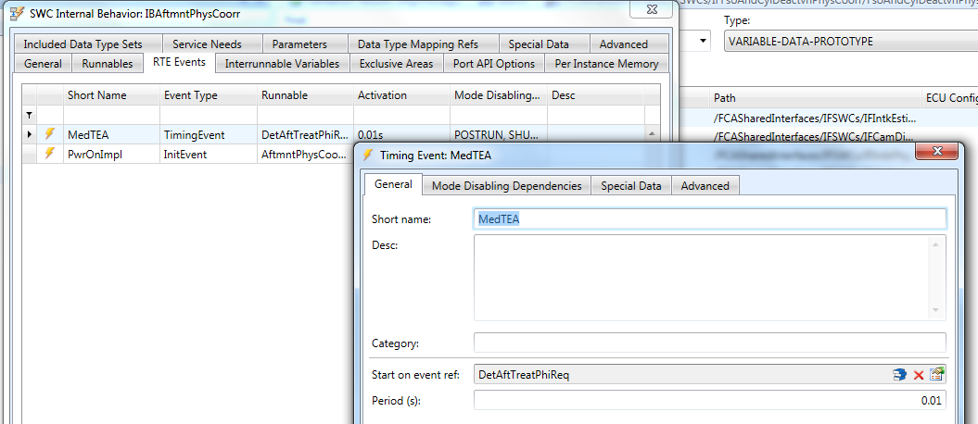
SWC Creation – RTE Event Property -2
Timing Event
Task Name
Runnable triggered by this Event
Period

Slide 17
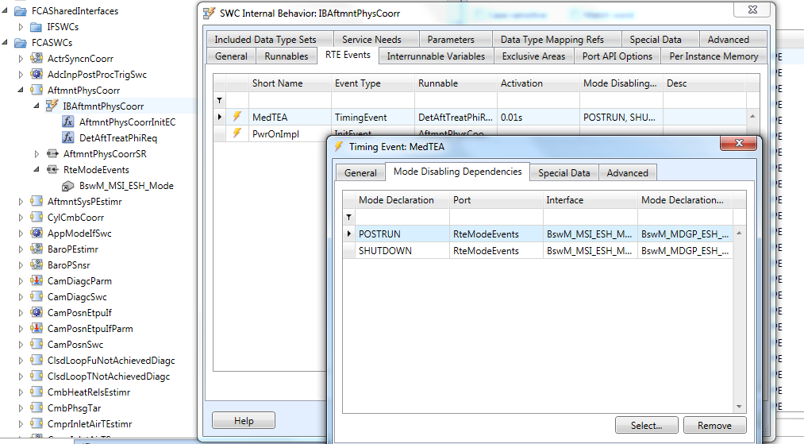
SWC Creation – RTE Event Mode Disable
Mode Disabling Dependencies can be set only if the Required Port “RteModeEvents” is created and assigned to the interface BswM_MSI_ESH_Mode

Slide 18
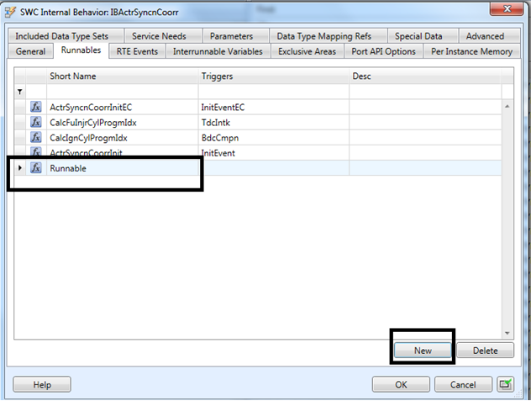
SWC Creation – Runnable Creation
Runnable name shall address the functionality handled by the runnable and shall not contain the Task details like 10ms, etc..

Slide 19
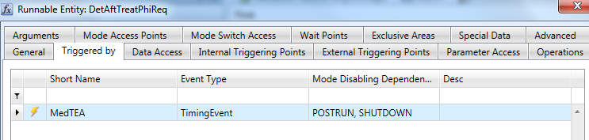
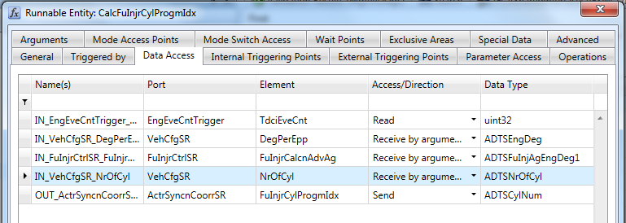
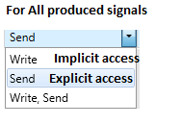
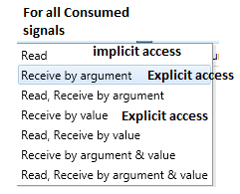
SWC Creation – Runnable Property
Triggered By - Select relevant RTE Event
Data Access

Slide 20
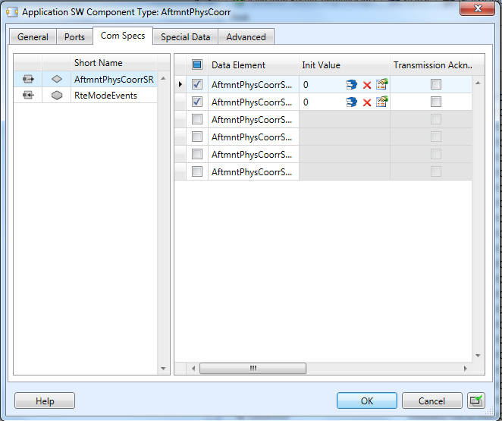
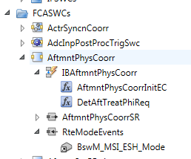
SWC Creation – ComSpecs
Double Click on the SWC
Select only the data element
consumed or produced by this
component and define init value

Slide 21
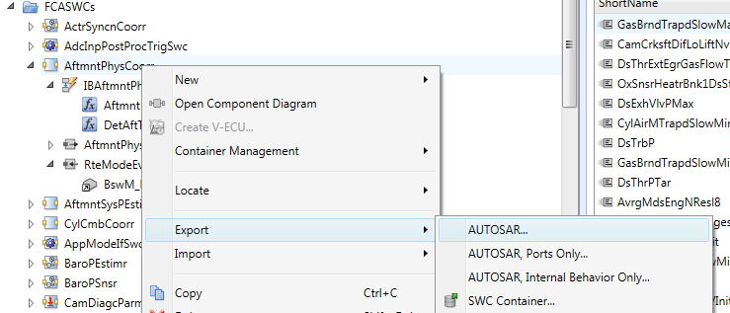
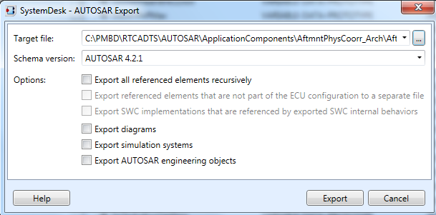
SWC Creation –Arxml Export
Export with no
referenced elements

Slide 22
Frame Model Creation
Create the Architecture File list SWCName_ArchFileList.xls
The SWCName.arxml must be the first entry in the xls ( usage by script to identify the model name)
With all the relevant interface files ( Based on the input signals)
Mandatory files are FCADataDefinition.arxml, PlatformTypes_AR4.arxml , SWCName.arxml, IFSWCName.arxml(if the component has any signal produced)
Ensure FCA_Custom_tools are checked out in RTC Sandbox from RTC
Run Create_model_from_ARXML or Update_model_from_ARXML script in Matlab command window
Setpath FCACustom tools and AUTOSAR Support package in Matlab
Run Commnad Create_model_from_ARXML or Update_model_from_ARXML based on the requriement
Update frame model doesn’t rename the ports. Run command “FixPortNames” in Matlab command window if needed
Save the .sldd and the frame model created

Slide 23
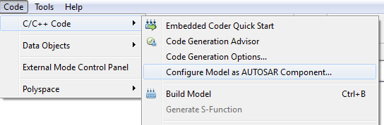
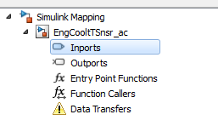
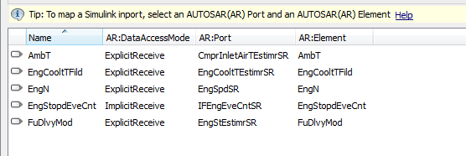
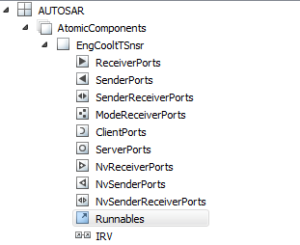
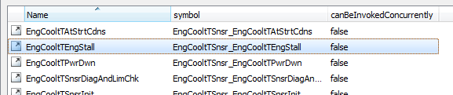
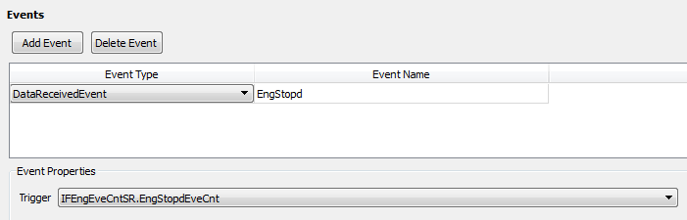
Frame model verification
Check SR Ports and CS ports created ( inside the subsystem)
Check AUTOSAR Properties
Check Simulink port mapping
Check Runnables and Trigger

Slide 24
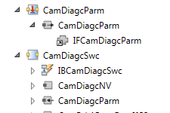
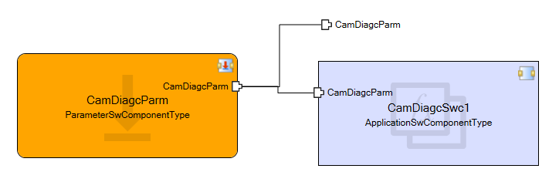
Interface – Parameter Interface
All shared calibrations are defined as Parameter interface
Parameter interface can be exported only from the component type Parameter SW Component Type
Create a Parameter SW Component Type SWCNameParm
Define the parameter elements that are shared across components
Calibration component export the parameter interface
Parameter interface imported by the feature
Exported for use by other features

Slide 25
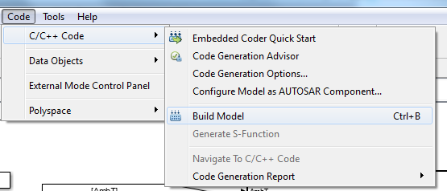


Round trip
Build Simulink model to auto code and generate 4 arxml files for roundtrip
Import the SWCName_ac_component.arxml file into SD project to initiate the roundtrip
Check Init values for Static memories , IRVs, Port Comp Specs
Run SD Validations and export the SWCName.arxml file to complete the roundtrip
Generated arxml and source files

Slide 26
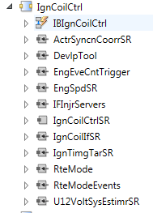
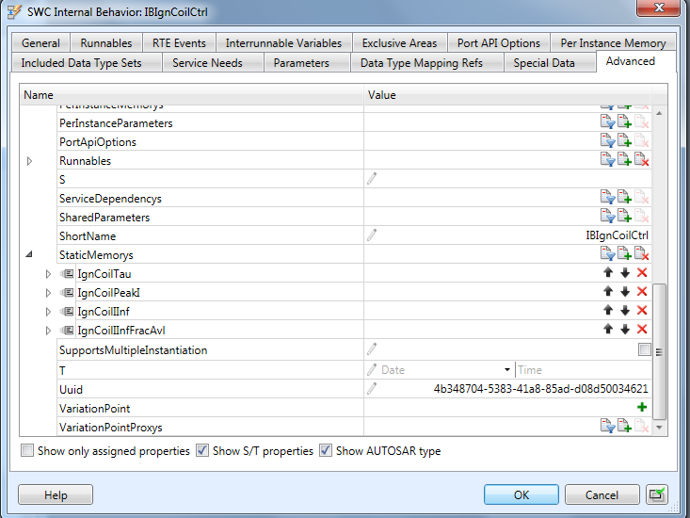
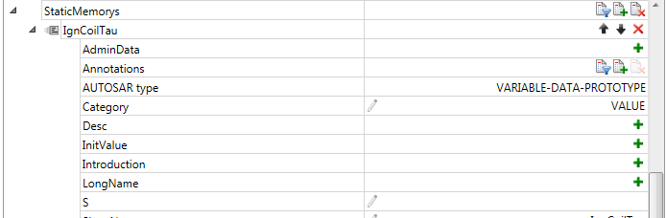
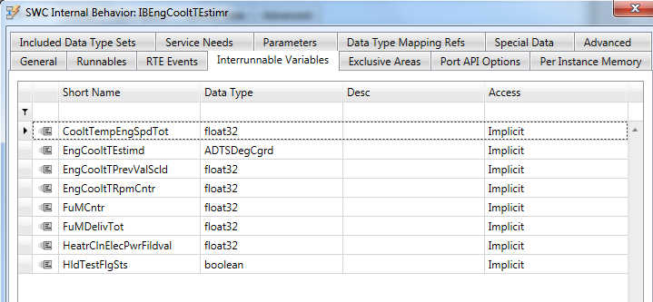
Check Static Memories and IRVs
Check and Update init values

