Slide 1
DBMS PROJECT
Database Management Systems (2501IT05)
UNIVERSITY MANAGEMENT SYSTEM
Project Guide: PARASA KEERTHANA Mam
TEAM MEMBERS:
25B11DS045 - B.ROHITH
25B11DS286 - K.ANANDH SAI
25B11DS331 - M.GOWRI SHANKAR
25B11DS034 - Ayush Kumar Singh
25B11DS211 - K.SIVA LAKSHMI RAHUL

Slide 2



Project Overview
INTRODUCTION
Problem
Solution
Why It Matters
Managing student, faculty, course, enrolment, and academic records manually can be complex, time-consuming, and prone to errors.
A centralized MySQL-based University Management System that organizes academic data using related tables, keys, constraints, and relationships.
The system reduces data redundancy, improves data consistency, maintains relationships between records, and enables efficient access to university information.
2

Slide 3

Project Objective
INTRODUCTION
Main Goal
Centralize Data: Design a relational database to organize university academic and administrative data.
Identify Entities: Define the major entities such as College, Department, Student, Faculty, Course, and Enrolment along with their attributes
Define Relationships: Establish meaningful relationships between entities using appropriate cardinalities.
Ensure Data Integrity: Define Primary Keys and Foreign Keys to uniquely identify records and maintain referential integrity.
Prepare Database Schema: Convert the ER model into a structured relational schema suitable for implementation as a relational database.
3

Slide 4
What We Found
DATABASE DESIGN APPROACH
1
Structured Data
University information can be organized into related entities such as College, Department, Student, Faculty, Course, and Enrolment.
2
Reduced Redundancy
A well-designed relational database organizes data into separate related tables, reducing unnecessary duplication and making records easier to maintain.
3
Data Integrity
Keys establish relationships between tables and help maintain consistency and accuracy of university records.
Key Insight
A well-structured database makes university data organized, consistent, and easy to manage.
4

Slide 5

Entity Descriptions
College: Represents the university/institution. Attributes include CollegeID, CollegeName, Address, ContactInfo, EstablishedDate.
•Department: Represents an academic division within a college. Attributes include DepartmentID, DepartmentName, HeadOfDepartment, Location, Contact.
•Student: Stores student information. Attributes include StudentID, Name, Email, Phone, Gender, AdmissionDate, Status, DepartmentID.
•Faculty: Stores faculty information. Attributes include FacultyID, Name, Qualification, Experience, Salary, DepartmentID.
•Course: Defines academic courses. Attributes include CourseID, CourseName, CourseCode, Credits, Duration, Prerequisites, DepartmentID.
•Enrollment: Represents a student's registration for a course. Attributes include EnrollmentID, StudentID, CourseID, EnrollmentDate, Grade.
5

Slide 6
Attributes are the individual data fields that describe the properties of an entity in a database.
They act as columns in a table, storing specific information about each record.
ATTRIBUTES
Examples
College: CollegeID, CollegeName, Address, ContactInfo, EstablishedDate
Department: DepartmentID, DepartmentName, HeadOfDepartment, Location, Contact
Student: StudentID, Name, Email, Phone, Gender, AdmissionDate, Status, DepartmentID
Faculty: FacultyID, Name, Qualification, Experience, Salary, DepartmentID
Course: CourseID, CourseName, CourseCode, Credits, Duration, Prerequisites, DepartmentID
Enrollment: EnrollmentID, StudentID, CourseID, EnrollmentDate, Grade
6

Slide 7
Relationships define how entities in a database are connected to each other.
They show how entities are connected and help maintain meaningful relationships between tables.
RELATIONS
Examples from UMS
College → Department
One college can have many departments.
CollegeID in Department is a foreign key referencing College.
Department → Student / Faculty / Course
Each department manages multiple students, faculty, and courses.
DepartmentID in these tables links them to their department. Student → Course (via Enrolment)
Students can enrol in multiple courses, and each course can have many students.
This is a many-to-many relationship handled through an Enrolment table.
7

Slide 8
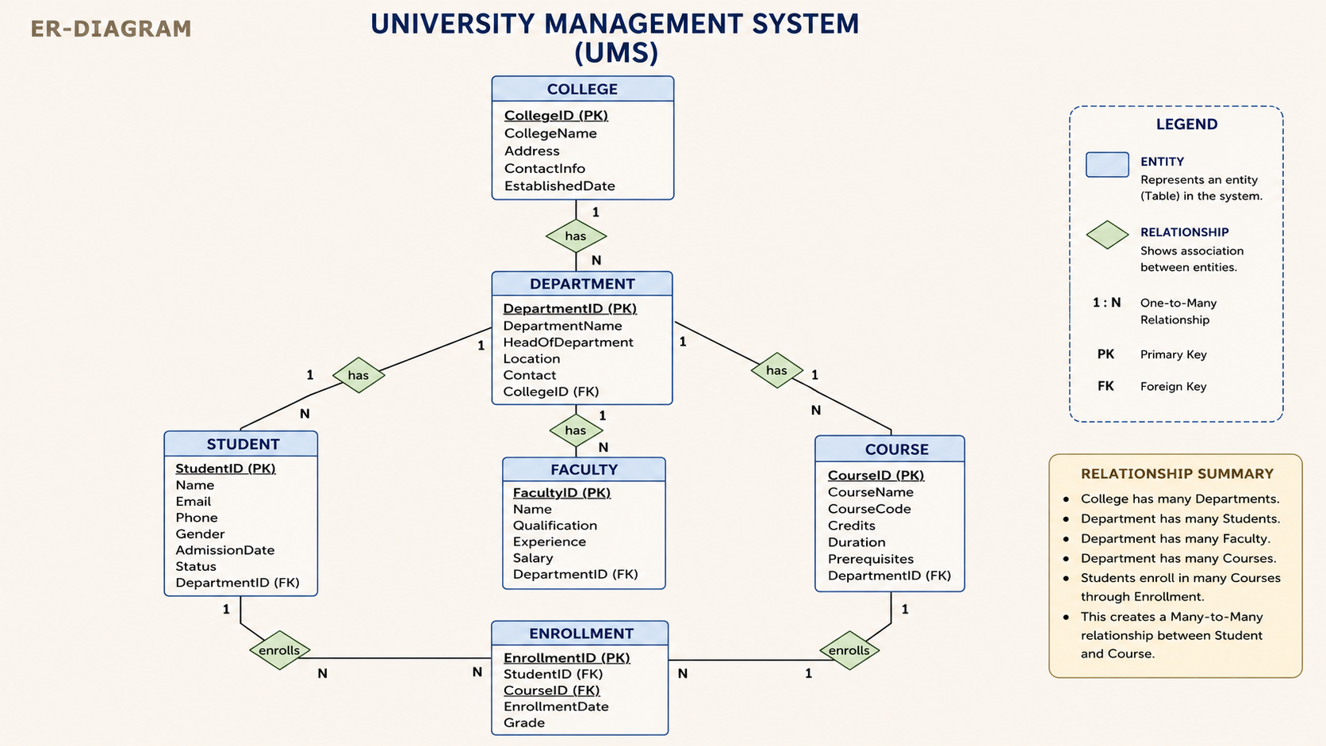
8

Slide 9
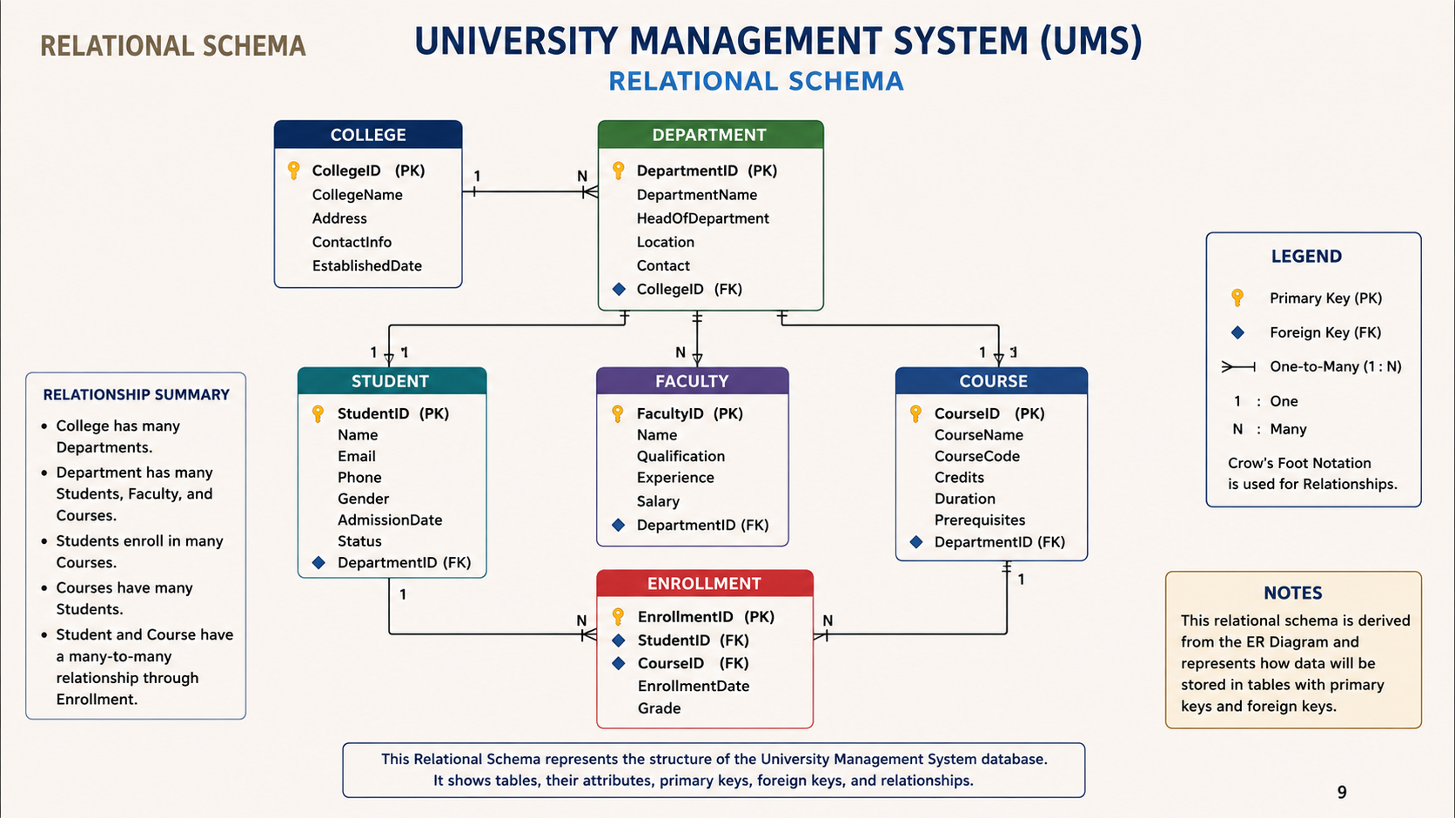

Slide 10
IMPLEMENTATION AND RULES
1. Primary Key Constraints
Each table has a unique Primary Key.
Example: StudentID, CourseID, DepartmentID.
2. Foreign Key Constraints
Foreign Keys connect related tables.
Example:DepartmentID in Student, Faculty, and Course references DepartmentID in Department.
3. NOT NULL Constraints
Required fields should not contain NULL values.
Example: Student Name and Course Name.
4. UNIQUE Constraints
Prevent duplicate values in important fields.
Example: Student Email.
5. Referential Integrity
Foreign Key values must match existing records in the referenced table.
Prevents invalid relationships between tables.
10

Slide 11
QUERIES TO PERFORM TASK
DML (Data Manipulation Language):
1.Insert a record into the Student table (INSERT)
INSERT INTO Student
(StudentID, Name, Email, Phone, Gender, AdmissionDate, Status, DepartmentID)
VALUES
('STU001', 'Rahul Kumar', 'rahul@gmail.com', '9876543210',
'M', '2026-06-10', 'Active', 'D001');
2. Update a student's phone number (UPDATE)
UPDATE Student
SET Phone = '9876543211'
WHERE StudentID = 'STU001';
3. Delete a student record (DELETE)
DELETE FROM Student
WHERE StudentID = 'STU001';
11

Slide 12
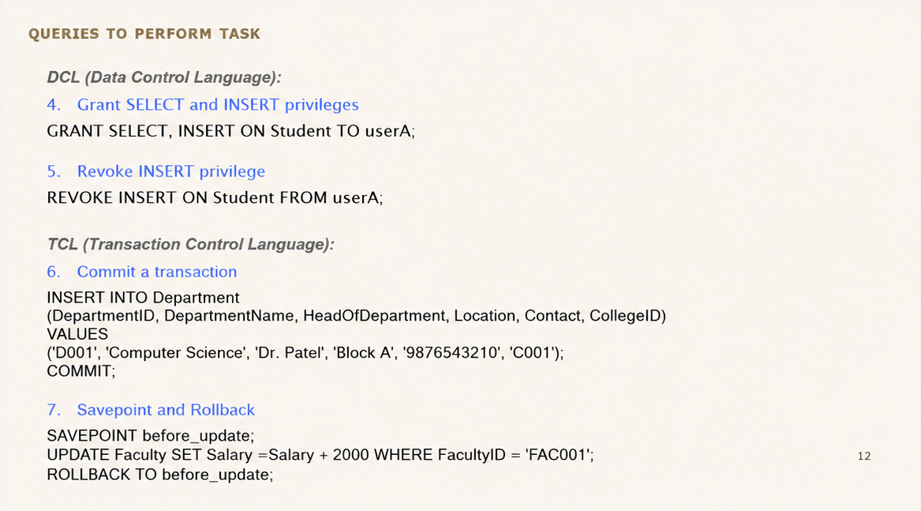

Slide 13
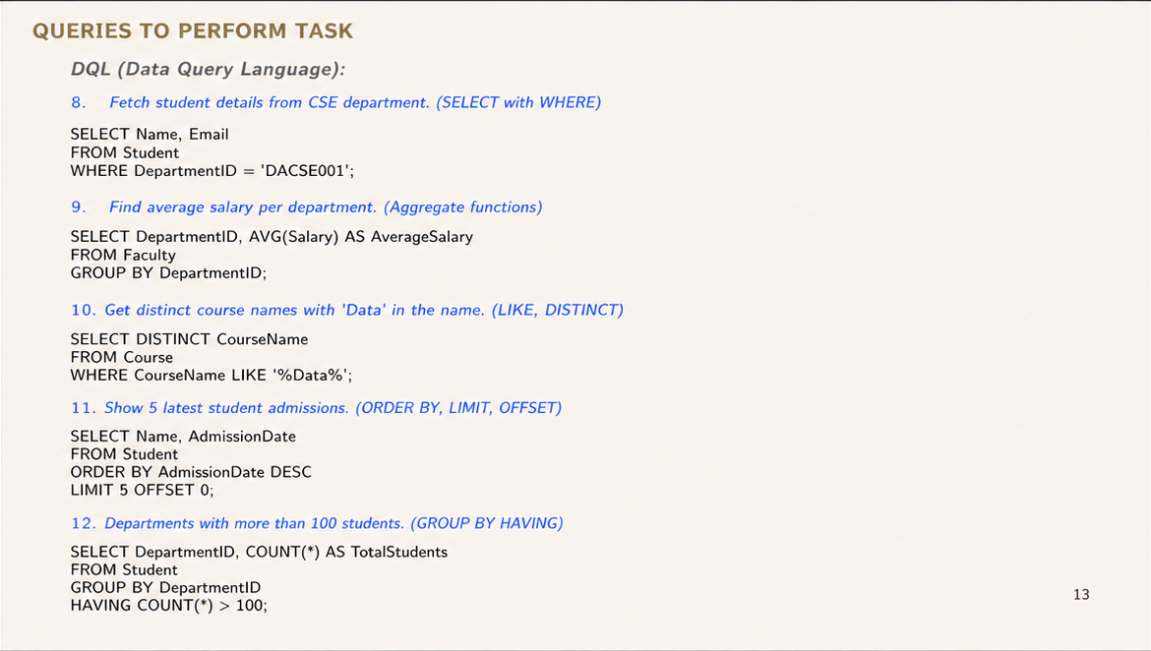

Slide 14
QUERIES TO PERFORM TASK
13. List students with their department names. (JOIN)
SELECT s.Name, d.DepartmentName FROM student s INNER JOIN department d
ON s.DepartmentID = d.DepartmentID;
14. Get all students whether enrolled or not. (LEFT JOIN)
SELECT s.Name, e.CourseID FROM student s LEFT JOIN enrollment e ON s.StudentID = e.StudentID;
15. Combine StudentIDs from CSE and EC departments. (UNION)
SELECT StudentID FROM student WHERE DepartmentID='DACSE001' UNION
SELECT StudentID FROM student WHERE DepartmentID='DAEC001';
16. Find faculties earning more than all EC faculty members. (ALL)
SELECT Name FROM faculty
WHERE Salary > ALL (SELECT Salary FROM faculty WHERE DepartmentID='DAEC001');
17. Select students who took courses taught by a specific faculty. (Subquery)
SELECT Name FROM student WHERE StudentID IN (
SELECT StudentID FROM enrollment WHERE CourseID IN (
SELECT CourseID FROM schedule WHERE FacultyID='DACSF001')
);
14

Slide 15
QUERIES TO PERFORM TASK
Views
Create a View
CREATE VIEW ActiveStudents AS
SELECT StudentID, Name, DepartmentID FROM student WHERE AdmissionDate IS NOT NULL;
Stored Procedures
19.Increase all faculty salaries by 5% in a given department. (Stored Procedure)
DELIMITER //
CREATE PROCEDURE IncreaseSalary(IN deptID VARCHAR(20))
BEGIN
UPDATE Faculty
SET Salary = Salary * 1.05
WHERE DepartmentID = deptID;
END //
DELIMITER ;
15

Slide 16
KEY FEATURES
1. Student Management
Store and manage student details
Maintain admission and department information
2. Department & Faculty Management
Manage departments and faculty records
Maintain faculty qualifications and salary details
3. Course & Enrollment Management
Manage courses and prerequisites
Track student course enrollments and grades
4. Database Integrity & Security
Primary and foreign key constraints
NOT NULL and UNIQUE constraints
Role-based access and referential integrity
5. Query & Transaction Support
DML, DQL, DCL and TCL operations
Views and stored procedures
Commit, rollback and savepoint operations
16

Slide 17

Project Summary
What We Created
We created a University Management System using MySQL that manages students, faculty, courses, enrolments, and grades.
It includes normalized tables with primary and foreign keys to maintain data integrity.
The system supports queries for enrollment, grading, scheduling, and student performance tracking.
What It Does
Manages academic data: Stores and organizes student, faculty, course, enrolment, and grade information
Supports academic operations: Handles enrollment, grading, and scheduling through SQL queries and relationships.
Ensures data integrity: Uses constraints and
access control to maintain accurate and secure records.
17

Slide 18
TECHNICAL LEARNINGS
PROJECT LEARNINGS
Database Design
Learned to convert requirements into entities and relationships.
Designed tables using primary and foreign keys.
Applied normalization to reduce data redundancy.
Data Integrity & Security
Applied PRIMARY KEY, FOREIGN KEY, NOT NULL and UNIQUE constraints.
Maintained referential integrity between related tables.
Used GRANT and REVOKE for access control.
SQL & Queries
Implemented DML, DQL, DCL and TCL commands.
Used JOINs, subqueries, aggregate functions and GROUP BY.
Created views and stored procedures.
Practical Experience
Designed and implemented a University Management System using MySQL.
Tested database operations using practical SQL queries.
18

Slide 19
FUTURE ENHANCEMENTS
1. Develop a user-friendly web interface for the database system.
2. Provide secure login and role-based access control.
3. Add student performance and attendance tracking.
4. Generate academic and attendance reports.
5. Use data analytics for better academic insights.
6. Improve security, scalability, and data management.
19

Slide 20
Thank You
• 25B11DS045 (B. Rohith) – Database Design & College/Department Tables
• 25B11DS286 (K. Anandh Sai) – ER Diagram, Documentation & Presentation
• 25B11DS331 (M. Gowri Shankar) – Faculty & Course Management
• 25B11DS034 (Ayush Kumar Singh) – Attendance & Grade Management
• 25B11DS211 (K. Siva Lakshmi Rahul) – Student & Enrollment Management

