Slide 1


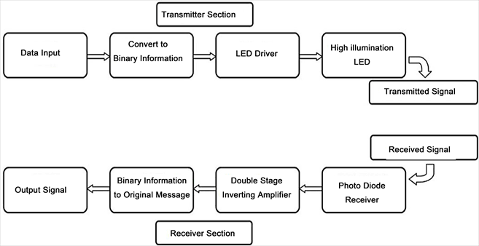
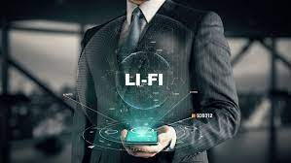
“Audio And Data Transmission Using LI-FI Technology”
AISSMS Institute Of Information Technology Pune, Maharashtra
ABSTRACT
LITERATURE STUDY
RESULT
CONCLUSION
As the demand for high-speed data in wireless communications increases day by day with the significant increase of the number of users, Radio Frequency (RF) spectrum become one of the scantest resources in the world. RF technologies have limitations of the regulated spectrum, spectrum congestion, expensive licensing, low bandwidth and low-speed broadband connection. The available huge visible light communication (VLC) spectrum band ranges from 428 THz to 750 THz. So the new wireless technology known as light fidelity (Li-Fi ) has become a new source for communication of data and it has been identified as a powerful and promising complementary and/or alternative to the existing radio frequency(RF) wireless communication technology which uses visible light as a medium to deliver high-speed data communication..
Sr.no. Founder/Author Methodology Remark
Satya Jaswanth (Badri Computer Science and Engineering Indian Institute of Technology, Ropar satyajaswanth.badri@gmail.com "Audio and Video Transmission Using Visible Light Transmission" ANTS 1570-566372 ©2019 IEEE
Sabita Mali, Department of EIE, ITER Siksha ‘O’ Anusandhan (Deemed to be University) Khandagiri Square Bhubaneswar-751030, Odisha, India "Design and Implementation of Text and Audio Signal Transmission using Visible Light Communication."-978- 1-7281-5464-0/20/$31.00 ©2020 IEEE
G Madhuri, K Anjali and R Sakthi Prabha Department of Electronics and Communication Engineering, Sathyabama Institute of Science & Technology, Chennai, India “Transmission of data, audio and text signal using Li-fi. technology “ IOP Conf. Series: Materials Science and Engineering 872 (2020) 012010 IOP Publishing doi:10.1088/175 899
LI-FI uses gigabits class communication speeds for short, medium and long ranges and directional data transfer using line-of-sight, reflections. A German Physicist Herald Hass concluded from invention that data transmitted at the range of 500Mbps with all kind of light spectrum like white light, infrared.
In this project, proposed, explained and demonstrated a real- time text and audio broadcast prototype by using LED and solar panel and examine the transmission of both text and audio signals using visible light communication. It is observed that transmission of text with the distances up to 0.5m and transmission of audio with distances up to 1.5m can be achieved. The VLC technology will be more explored in near future as demand for high-speed communication increases with application to transportation and home network.
ACHNOWLEDGMENTS
1. Yashodeep Deshmukh
2. Rohit Bobade
3. Sarvesh Mali
OUTPUT
OBJECTIVES
LiFi, the internet at the speed of light. LiFi technology will allow us to connect to the internet using light from lamps, streetlights or LED televisions. In addition to being cheaper, safer and faster than WIFI, it does not need a router.

