Slide 1
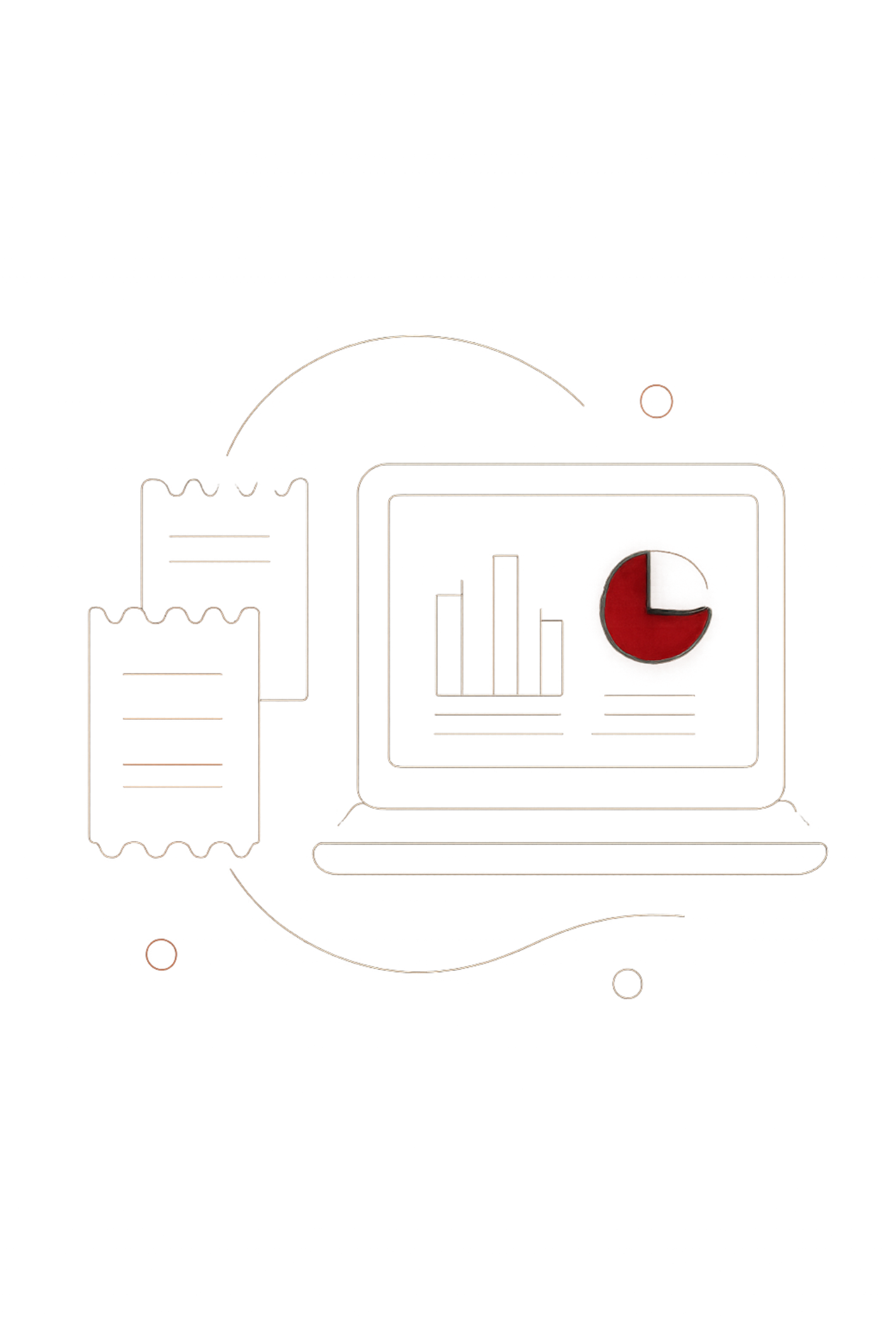
Customer Shopping Behavior Analysis
3,900 purchases — 18 features — strategic insights

Slide 2
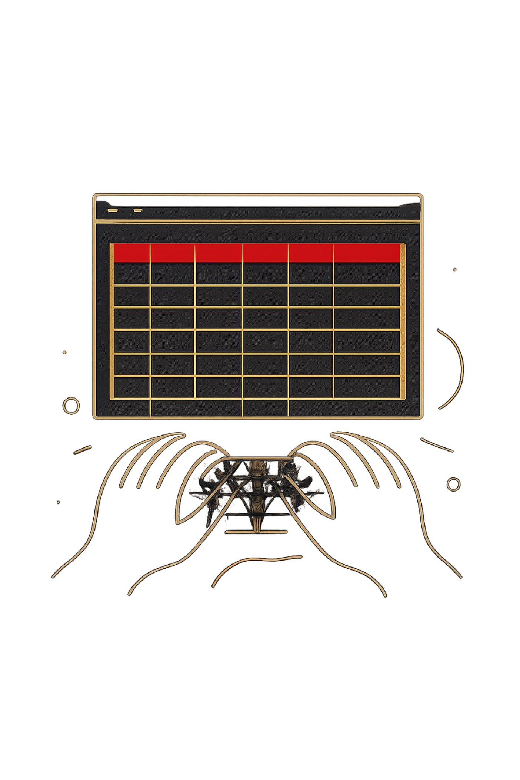
Dataset Summary
Rows & Columns
Key Features
3,900 rows · 18 columns
Demographics, Purchase details, Behavior
Missing Data
37 values missing in Review Rating

Slide 3

EDA & Preparation (Python)
01
Load & Inspect
pandas, df.info(), describe()
02
Missing Handling
Imputed review ratings by category median
03
Standardize & Engineer
snake_case, age_group, purchase_frequency_days
04
De-dup
Dropped promo_code_used (redundant)

Slide 4

Database Integration
PostgreSQL
Cleaned DataFrame loaded for SQL analysis
Structured queries for business metrics
Reusable tables for dashboarding

Slide 5
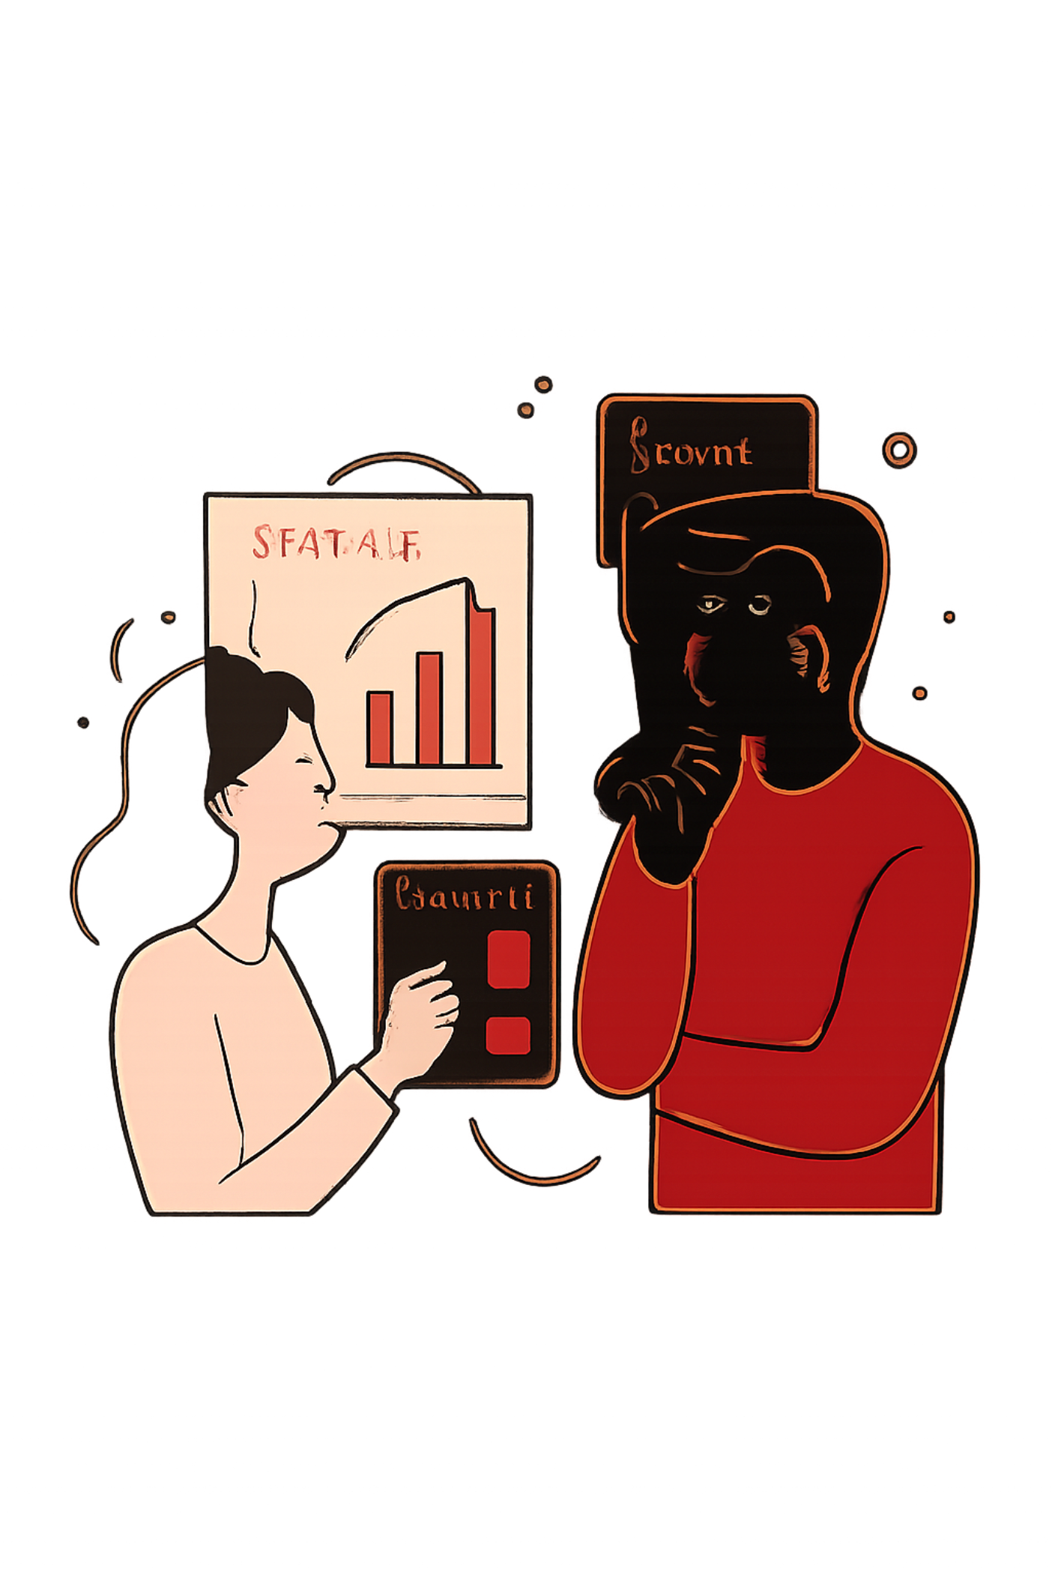
Revenue by Gender
Male
Female
$157,890
$75,191

Slide 6

Discounts & High-Spenders
High-Spending Discount Users
839 rows identified — users who used discounts but spent above average
Top Discount-Dependent Items
Hat 50% · Sneakers 49.66% · Coat 49.07% · Sweater 48.17% · Pants 47.37%

Slide 7

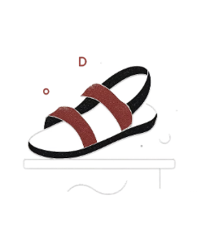
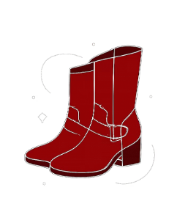
Top Products & Categories
Gloves
Sandals
Boots
Avg rating 3.86
Avg rating 3.84
Avg rating 3.82

Slide 8
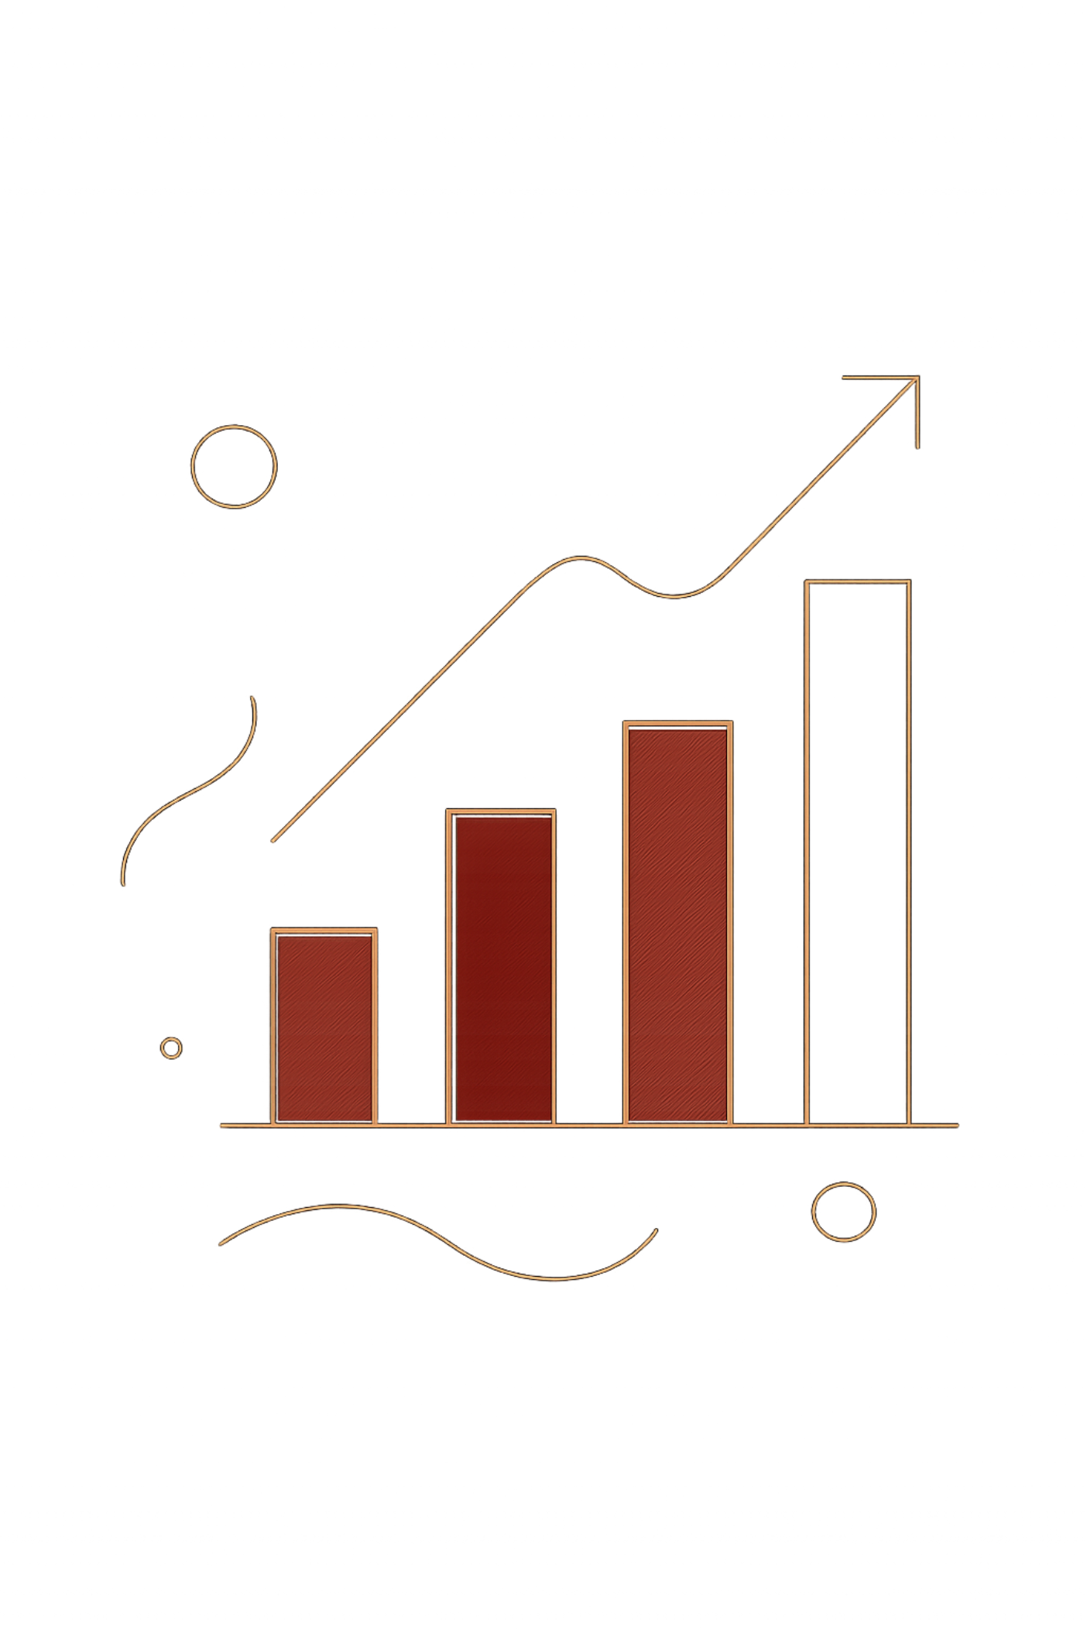
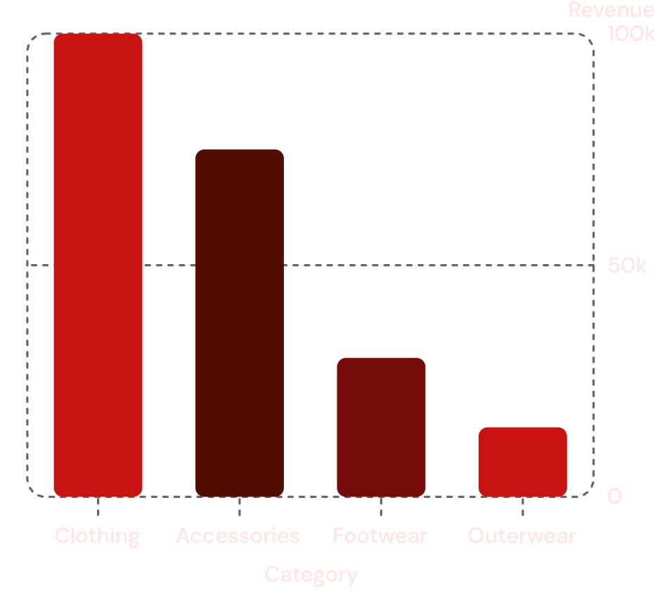
Sales & Revenue by Category
Sales by Category: Clothing 1.75K · Accessories 1.25K · Footwear 0.65K · Outerwear 0.35K
Avg purchase amount: $59.76 · Avg review rating: 3.75

Slide 9
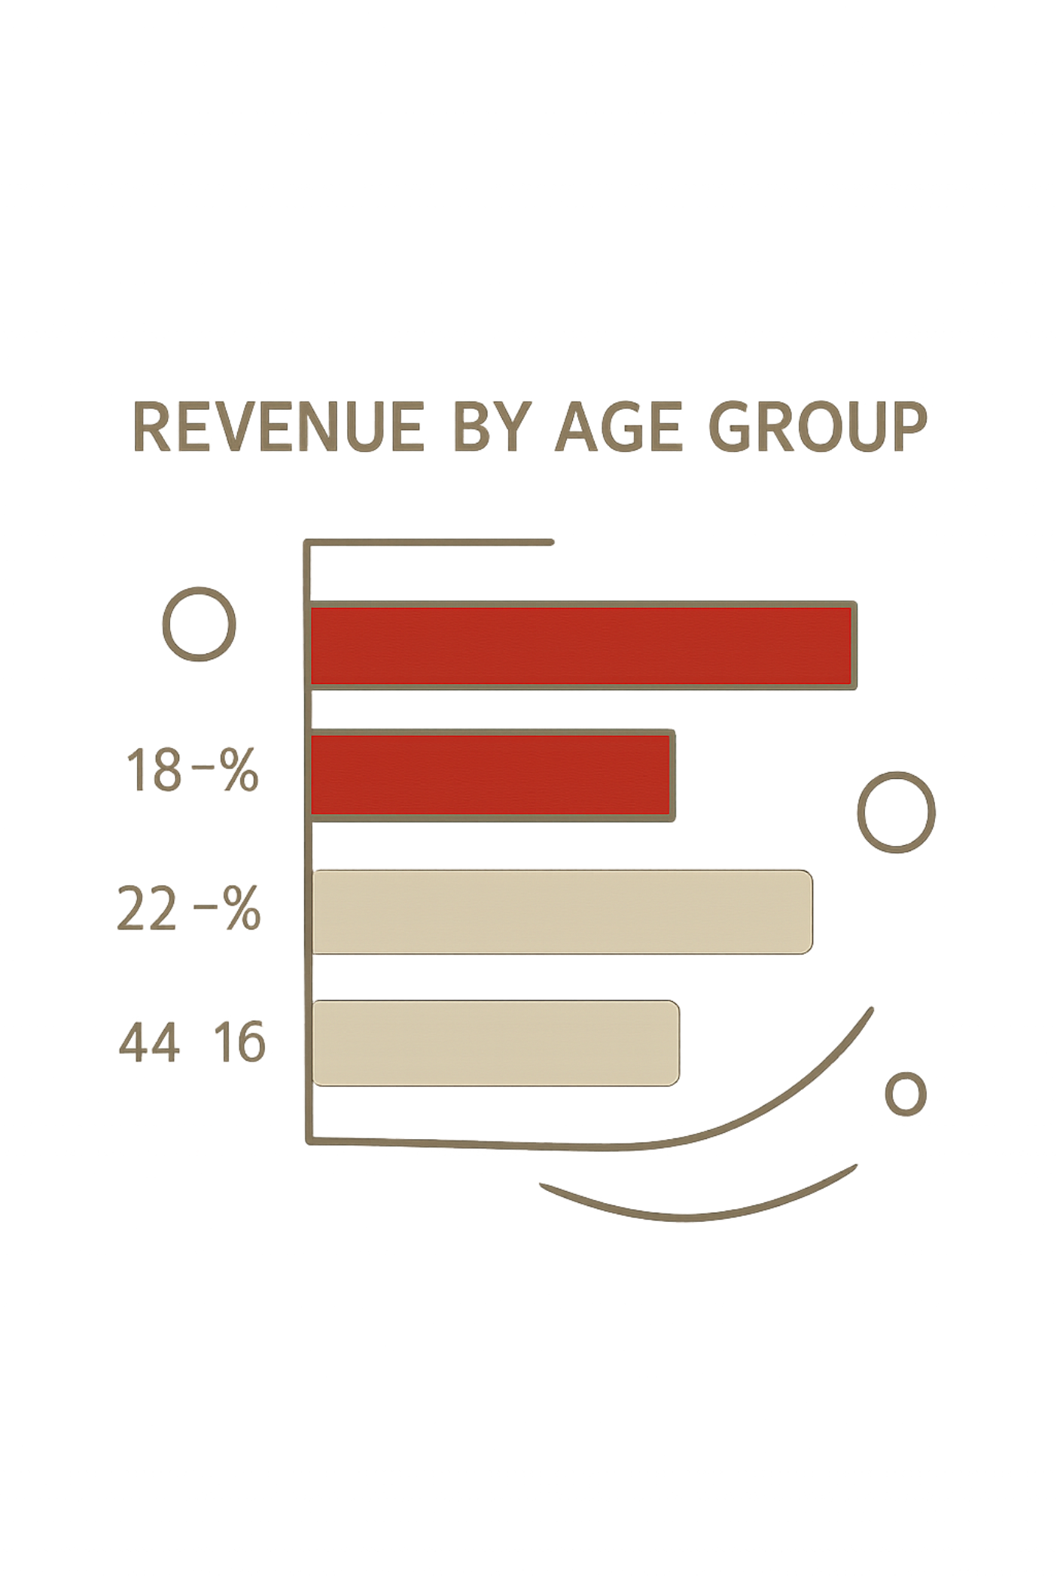
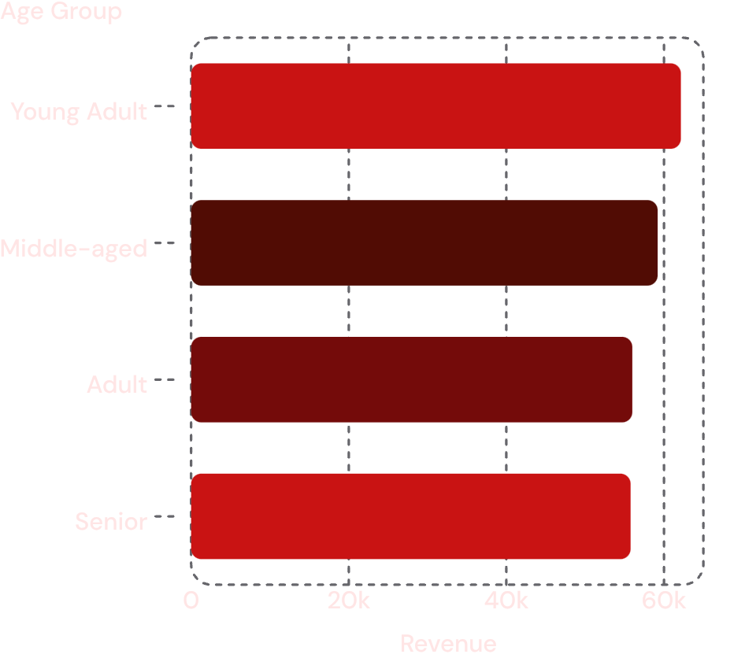
Age Groups & Subscriptions
Subscription Snapshot
Yes: 1.05K · No: 2.85K
Subscribers — avg spend $59.49 · Non-subscribers — avg $59.87
Segments
Loyal 3,116 · Returning 701 · New 83

Slide 10
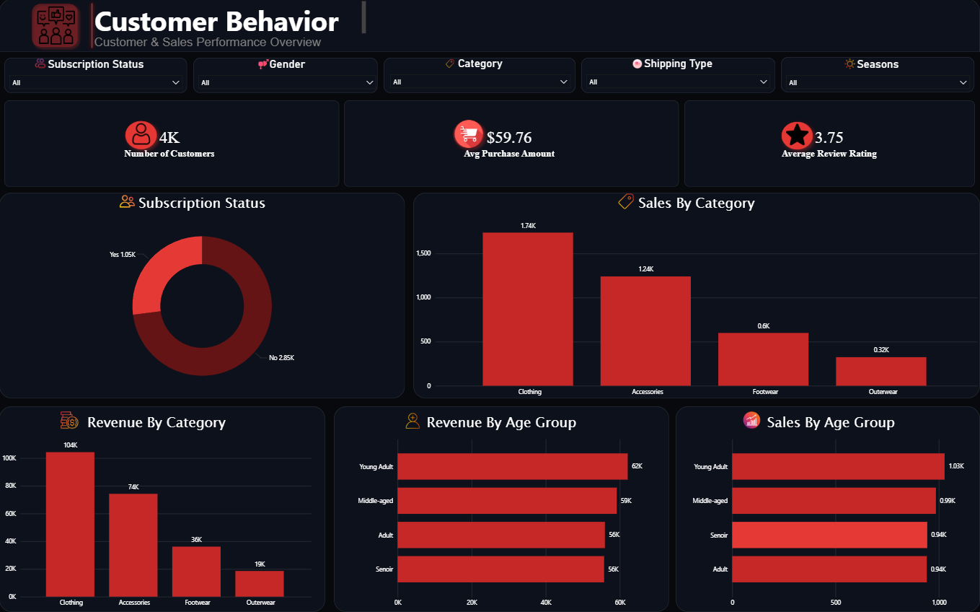

Recommendations
Boost Subscriptions
Loyalty Programs
Review Discounts
Product Positioning
Promote exclusive subscriber benefits
Reward repeat buyers to grow Loyal segment
Balance sales lift vs margin impact
Highlight top-rated & best-selling items
Targeted Marketing
Focus on high-revenue age groups & express-shipping users

