Slide 1

MARKETING DATA ANALYSIS
Project overview and
the business problem
2,240
28
customer records
fields
Campaign response, demographics, household, product spending, channels, and web activity.
Who responds, what drives spending, and who is most valuable?
Supports campaign targeting, segmentation, product focus, channel strategy, and engagement.
Excel → Python (Pandas, NumPy) → SQL/PostgreSQL → three-page Power BI dashboard. Historical associations, not proof of cause.

Slide 2
BUSINESS QUESTIONS
Sixteen business questions drive the analysis
Campaigns
Customers
Which campaign had the highest acceptance?
Do campaigns drive extra purchases?
Does previous engagement predict response?
Which characteristics and segments respond?
Who is most valuable?
Do tenure, family size, and newer cohorts differ?
Products and channels
Offers and markets
Which products earn most spend?
Which channels perform best?
What drives online purchasing?
How does web conversion vary by segment?
Is discount buying an opportunity or a dependency?
Which countries engage most?
What should we target next?

Slide 3
DATA FOUNDATION
The dataset, its quality, and the toolset
2,240 rows · 28 columns
Quality treatment
Profile | Observed
Duplicates | 0
Missing incomes | 24
Education levels | 5
Marital statuses | 8
Countries | 8
Enrollment | 2012 to 2014
Income filled with median 51,381.50.
Dates parsed as DD-MM-YYYY.
11 web conversion nulls where monthly visits are zero.
year_birth replaced by age.
Toolset
Excel for first look; Python with Pandas and NumPy for cleaning; PostgreSQL for analysis; Power BI for dashboards.
No Excel workbook was supplied, so Excel techniques are not verified.
Demographics, household, recency, six product spend columns, deals, web/catalog/store purchases, five campaign flags, response, complaints, and country.

Slide 4
END-TO-END WORKFLOW
From raw CSV to analysis-ready data
1
2
3
4
Raw dataset
Excel exploration
Python cleaning
Feature engineering
Customer records and the structure later checked in Python.
First-stage exploration of the raw data.
Standardized names, median income fill, date parsing; checks for nulls, duplicates, types, and category counts.
Age, customer year/month, total spend/purchases, children plus teens, campaigns accepted, web conversion rate, web visit flag.
5
6
7
SQL analysis
Power BI
Insights and recommendations
36 columns loaded into PostgreSQL table marketing.
A three-page dashboard presents the analysis.
Business questions become targeting and planning decisions.
Credentials redacted in the appendix.

Slide 5
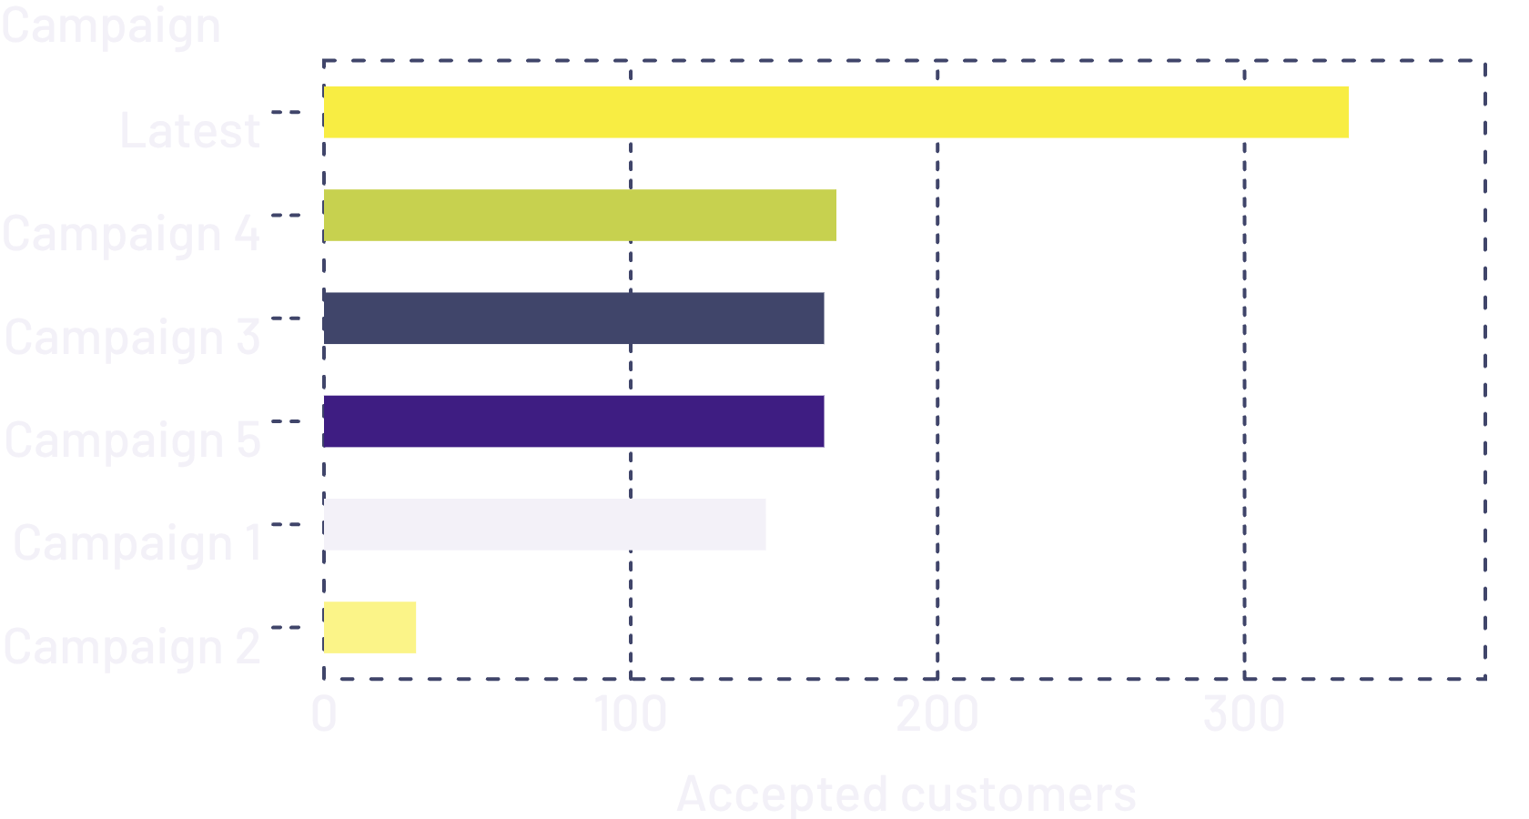
SQL ANALYSIS · PART 1
Campaigns, responders, products, channels
Accepted customers by campaign
Responders vs non-responders
Metric | Responders | Non-responders
Income | 60,183 | 50,846
Spend | 987.39 | 538.93
Purchases | 15.37 | 12.04
Age | 43.3 | 44.4
Product spend
Wines 680,816; meat 373,968; gold 98,609; fish 84,057; sweets 60,621; fruits 58,917.
The latest campaign roughly doubled the best earlier result.
Education response
Channel purchases
PhD 20.78%; Master 15.41%; Graduation 13.49%; 2n Cycle 10.84%; Basic 3.70%. Tiny marital groups are unreliable.
Store 12,970; web 9,150; catalog 5,963.
Responders buy more; ages are similar. Causation is not shown.

Slide 6
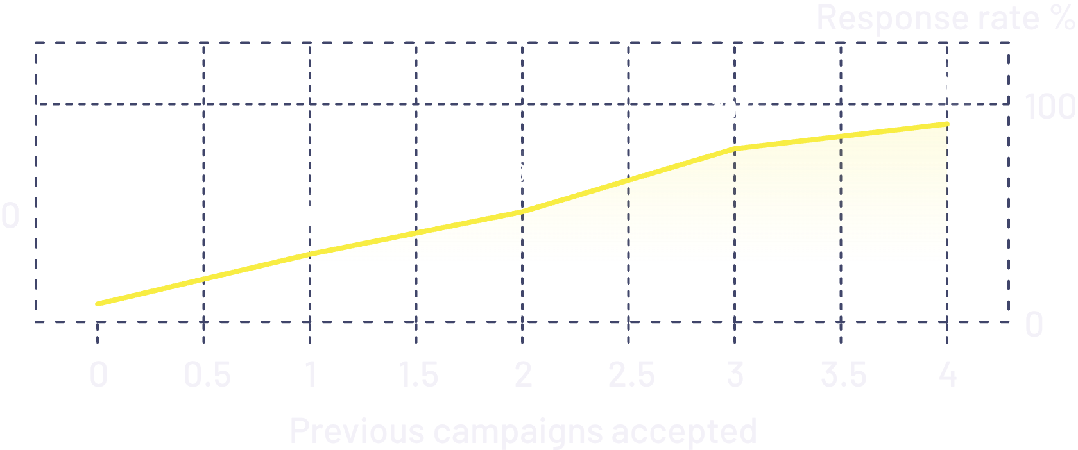
SQL ANALYSIS · PART 2
Value, offers, markets, tenure, family, engagement
Latest response by prior acceptances
Customer value
High: 48 customers (spend 2,169.81); Medium: 552 (1,395.60); Low: 1,640 (294.19).
Thresholds are business rules.
Enrollment cohort
2012: response 26.72%, spend 745; 2013: 12.95%, 602; 2014: 8.62%, 491.
Family
Response climbs steeply with each prior acceptance.
No children: spend 1,106, response 26.49%. One child: 473; two: 246; three: 275.
Offers and targeting
Deals have a mixed relationship with spend, not clear discount dependency. Top targeting combinations are very small; use broader segments.
Markets and web
Spain: 1,095 customers, 16.07% response. India lowest: 8.78%. Mexico: 66.67% on only 3 customers. Web conversion: responders 1.39 vs non-responders 1.04, a project-defined ratio.

Slide 7
POWER BI
A three-page dashboard turns the SQL into insight
2,240
1,356,988
28,083
14.91%
76.83%
customers
total spending
purchases
campaign response
web conversion
Web conversion is aggregate web purchases over visits.
Executive Overview
Customer and Campaign Analysis
Product and Channel Analysis
Campaign bars, product columns, channel donut, response by education, country map, and five slicers.
Response by age group; spend by income and children; prior engagement vs response; spend and response by customer year.
Product spend; web visits vs purchases; deals vs purchases; web purchases by response; value segments.
Latest campaign is the benchmark; Campaign 2 needs investigation. Wines and stores dominate. Prior engagement, cohort, and household are strong segmentation signals.

Slide 8
FINDINGS TO ACTION
Key findings and what we recommend
14.91% overall response; latest campaign 334. Responders spend more; prior acceptance strongly predicts response; wines lead spend, stores lead volume; 2012 outperforms 2014.
Planning focus | Recommendation
Previous engagement | Prioritize previously engaged customers: response rises from 8.22% to 90.91%.
High Value segment | Protect and grow it with differentiated retention or loyalty treatment.
Products and channels | Pair wine and meat promotions with store activity; monitor web separately.
Enrollment cohort | Use cohort in planning and test onboarding for newer customers.
Markets and discounts | Weigh country response by customer count. Test discounts against value rather than raising them uniformly.

Slide 9
INTERPRETATION AND CAPABILITY
Limitations and the skills this project demonstrates
Limits on interpretation
Demonstrated skills
Median-filled income reduces variability; web conversion mixes monthly visits with longer-period purchases; small groups give unstable rates.
Value thresholds are rule-based; findings are observational; Excel work and SQL result grids were not supplied; data covers 2012 to 2014 only.
Data exploration: Python, Pandas, NumPy
SQL: GROUP BY, CASE, UNION ALL
Power BI: KPIs, maps, scatter, combo charts, slicers
Analytics: segmentation, cohort and value analysis, storytelling

Slide 10

CONCLUSION
From raw customer data
to decisions
The full analytical journey
Inspect in Excel, clean with Python, Pandas and NumPy, validate, load to PostgreSQL, answer business questions in SQL, then present in Power BI.
Strongest signals
Responders spend more; prior acceptance predicts response; wines and stores lead; cohorts and households differ.
A structured analytical product
Insights and recommendations support campaign targeting, segmentation, and product and channel planning.
Appendix: data loaded with a SQLAlchemy engine into table marketing via to_sql; credentials redacted.

