Slide 1
Mini Project
Football Analysis
Team Members:
Ashish Mohan
Aditi Agarwal
Gautam Hans
Rizwan Ahmed
Shivangi Shakya

Slide 2
Introduction:
Problem Definition
Mappings used in our project
Reports generated

Slide 3
Problem definition
From the raw data present in the two source files provided, we aim to extract, transform and load data from the two files and perform analysis accordingly to generate reports based on the requirements.

Slide 4
Tools used:
Database used:
Oracle Database 11g
ETL Tool used:
Informatica 9.6.1
Reporting tool used:
IBM Cognos

Slide 5
Schema used:
Our schema uses 6 dimension tables and 2 fact tables arranged in a fact constellation architecture.
Fact Constellation: It is an architecture that contains multiple fact tables that share many dimension tables. It is also known as the galaxy schema.
Dimension table:
They are used to describe dimensions; they contain dimension keys, values and attributes.
Fact table:
It consists of the measurements metrics or facts of a business process. It is located at the center of star schema or a snowflake schema surrounded by dimension tables.

Slide 6
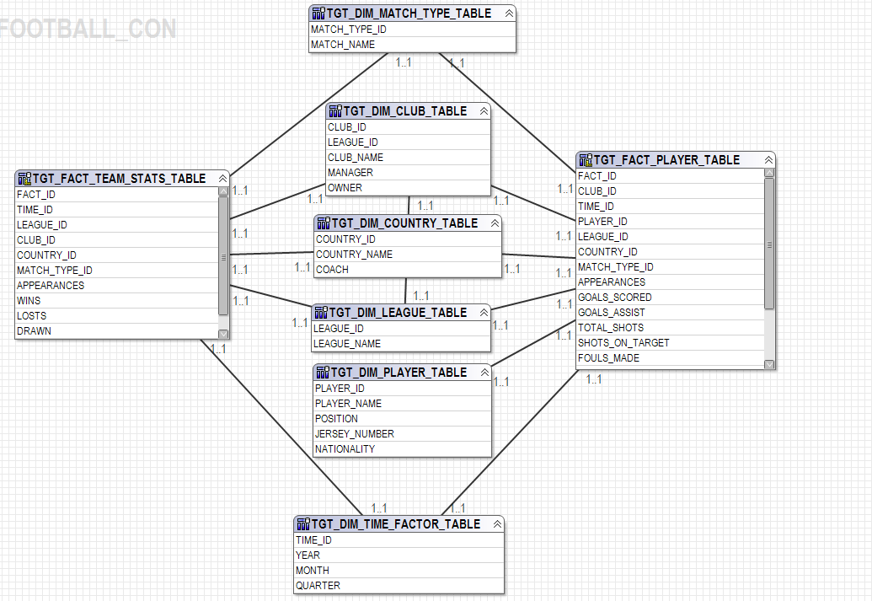
The Schema:

Slide 7
Mappings Used

Slide 8
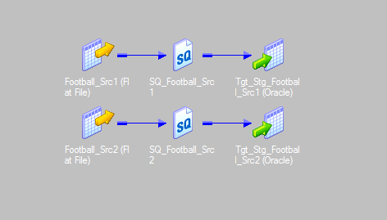
Data Staging:
This mapping involves fetching of the data present in the csv flat files provided and loading it onto the Oracle database.
Source Files: Football_Src1.csv,Football_Src2.csv
Target Files:Tgt_Stg_Football_src1,Tgt_Stg_Football_src1

Slide 9
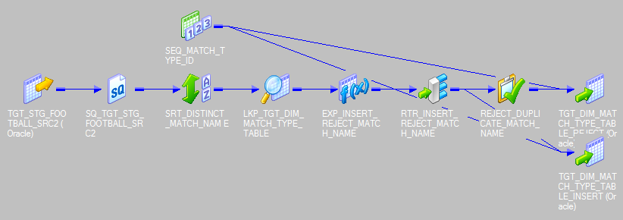
Loading data to the match type dimension table:

Slide 10
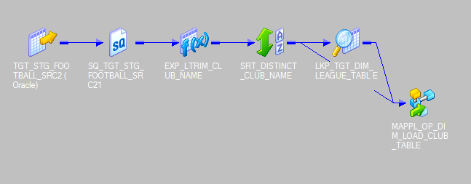
Loading data to the club dimension table:

Slide 11
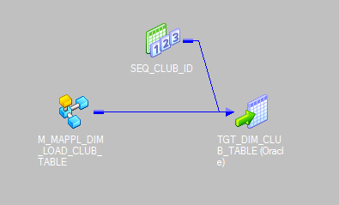
Loading data to the club dimension table: (Cont..)

Slide 12
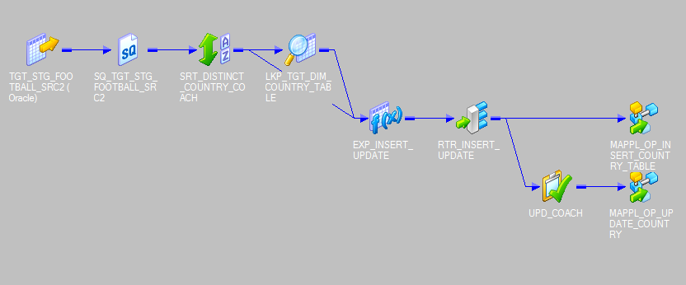
Loading data to the country dimension table:

Slide 13
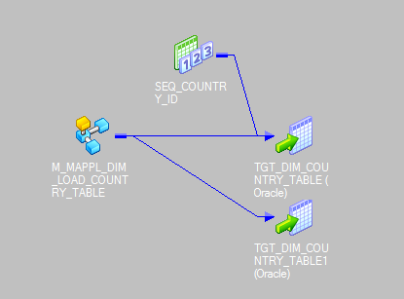
Loading data to the country dimension table:

Slide 14
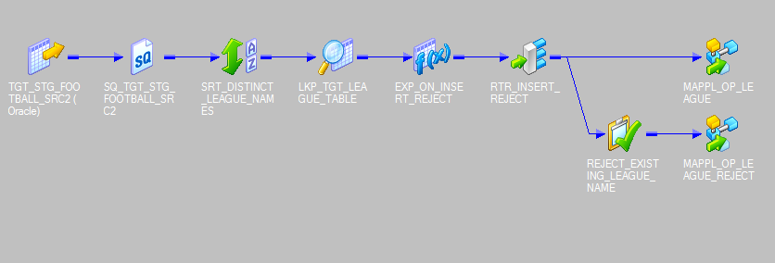
Loading data to the league dimension table:

Slide 15
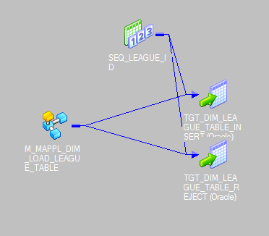
Loading data to the league dimension table: (cont..)

Slide 16
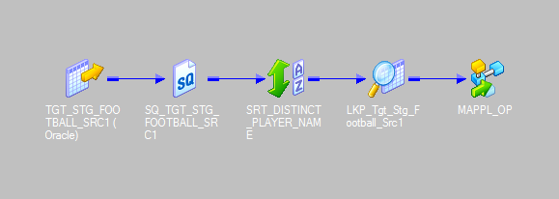
Loading data to the player dimension table:

Slide 17
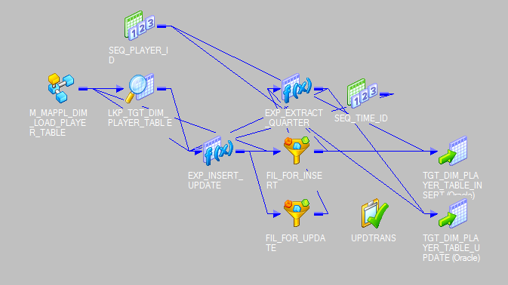
Loading data to the player dimension table: (Cont..)

Slide 18
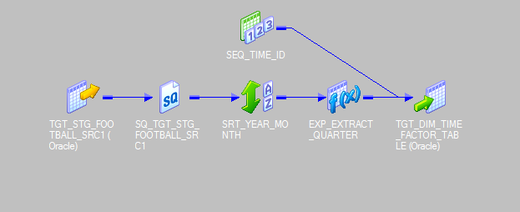
Loading data to the time factor dimension table:

Slide 19
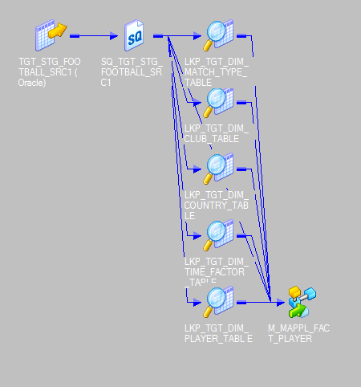
Loading data into the player fact table:

Slide 20
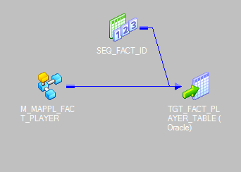
Loading data into the player fact table: (cont..)

Slide 21
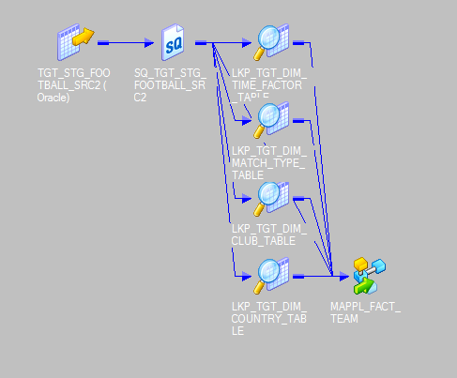
Loading data into the team fact table:

Slide 22
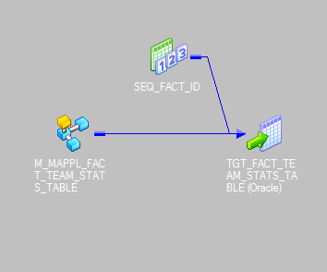
Loading data into the team fact table: (cont..)

Slide 23
Reporting

Slide 24
About the tool used
IBM Cognos:
It is a complete enterprise business intelligence solution with a range of BI capabilities.
Enables users to author, share, and use reports that retrieve data from all enterprise sources which helps to take efficient business decisions.\
Easy to deploy.
Highly scalable.

Slide 25
Analysis performed by us:
The top 10 attacking players.
Player Analysis.
Country Analysis along with team analysis.
Player shot accuracy.
Nominees for fair play.
Nominees for golden glove.
Position wise top goal scorer.

Slide 26
Samples of some reports generated

Slide 27
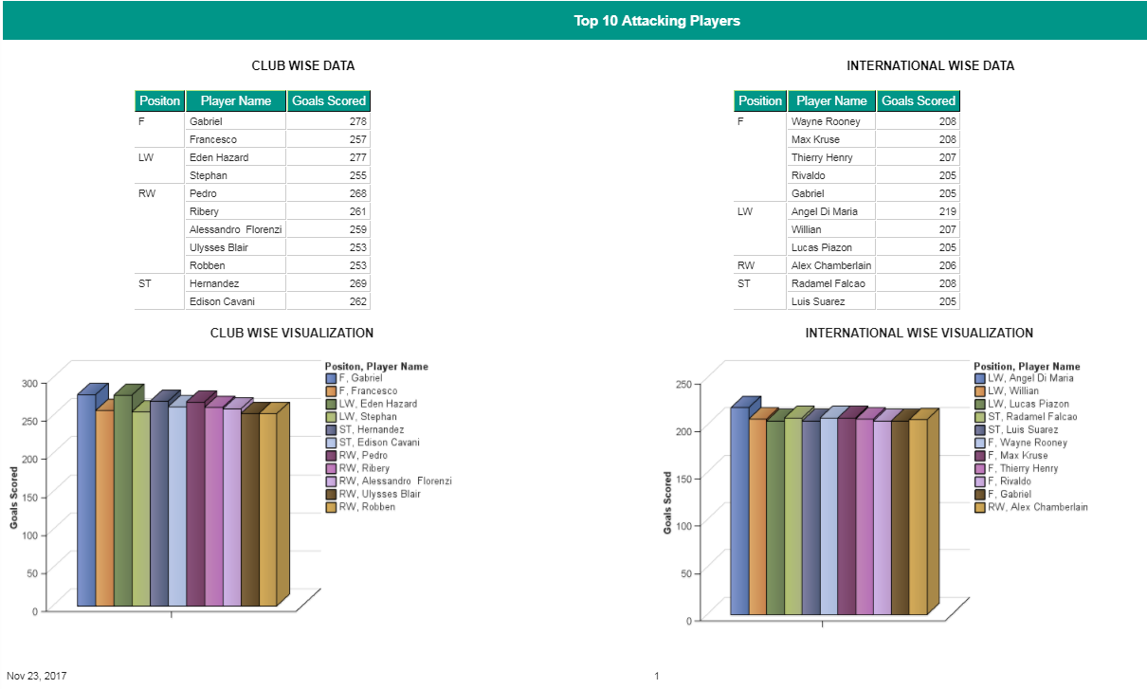

Slide 28
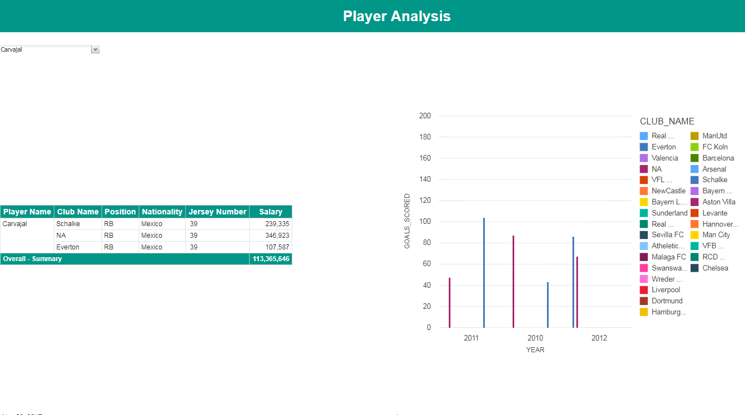

Slide 29
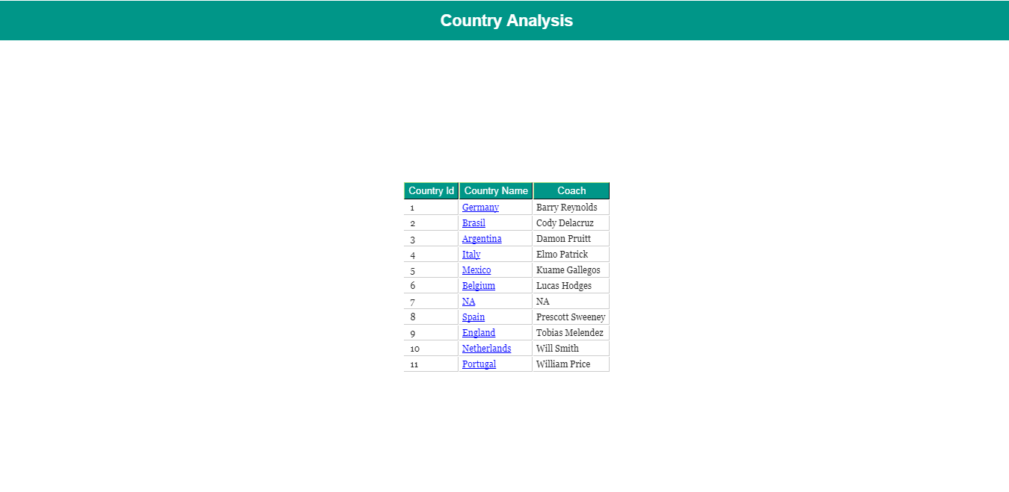

Slide 30
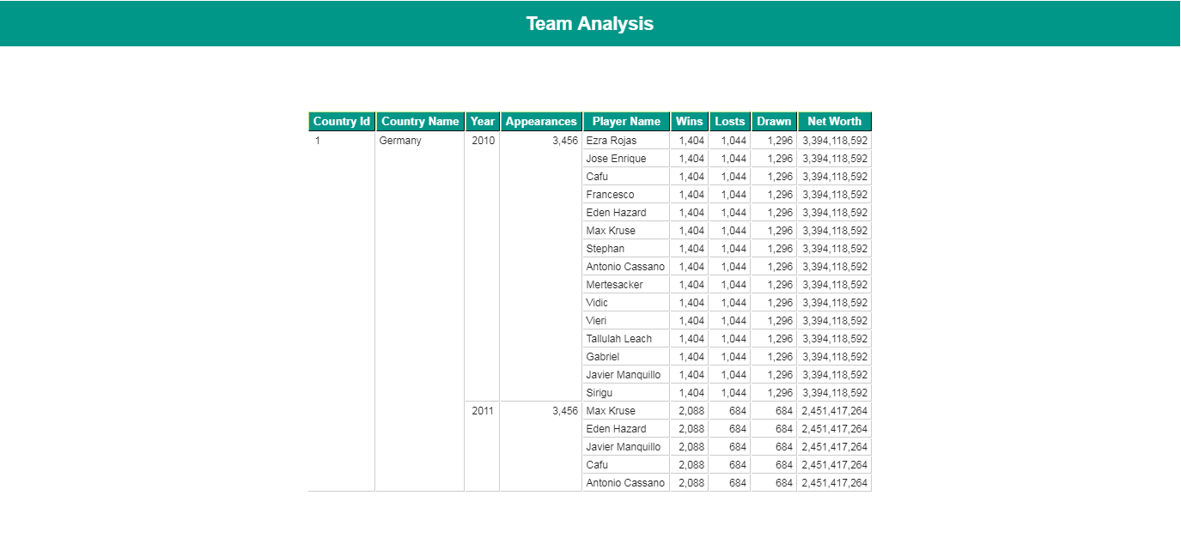

Slide 31
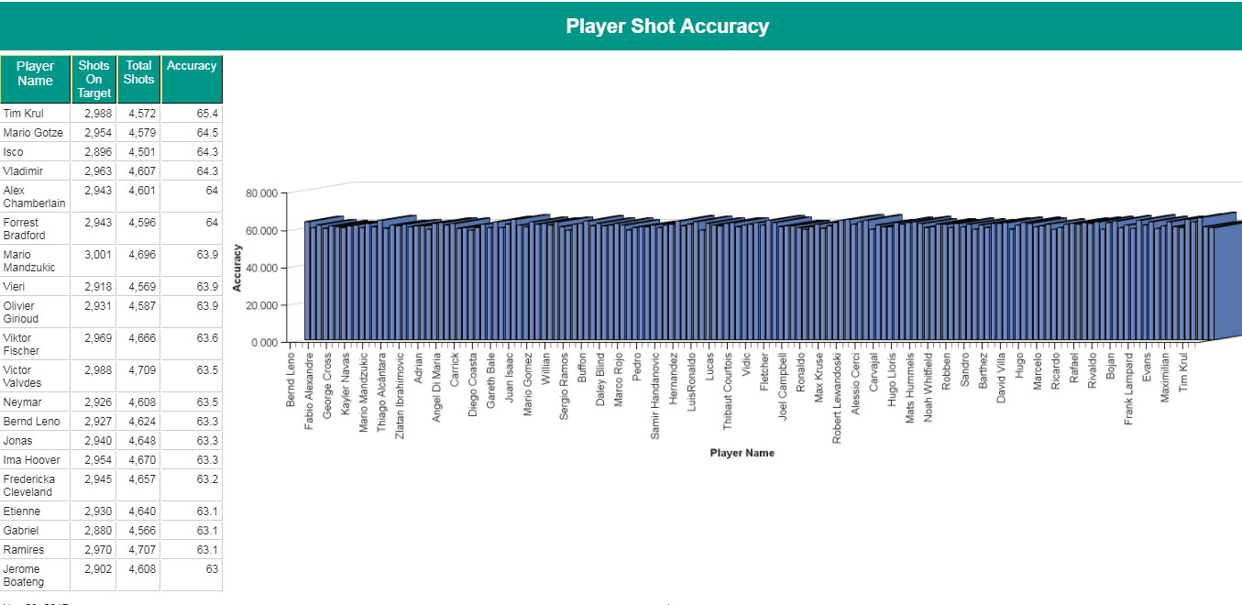

Slide 32
Thank you.

