Slide 1
Human 3D face annotation
Rohit Kumar supervised by Dr.Nils Hasler
A work for The Captury, Saarland, Germany

Slide 2
Overview
Problem statement
Understanding dataset
Setting up development
Blender Mesh setup
Solution chart
Results
Conclusion

Slide 3
Problem Statement
To understand 3D face annotation, it’s easy to derive the relation from 2D face annotation.
2D face annotation
  We are given an image
  We need to detect the face
  We need to do landmark annotation on detected face
3D face annotation
  We are given a mesh with texture. Consider that person in mesh keeps moving, it is not static.
  Since it’s 3D there can be multiple perspective to view the mesh.
  Problem 1 : How do you find a camera location so that we can detect a face in the camera view ( a 2D image ) ?
  Once we detect face in some camera view, it’s a 2D landmarks annotation problem.
  Problem 2 : We solve problem 1, than we have landmarks of 2D image, how do you find the 3D correspondances ?

Slide 4
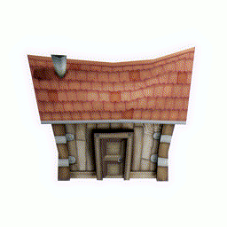
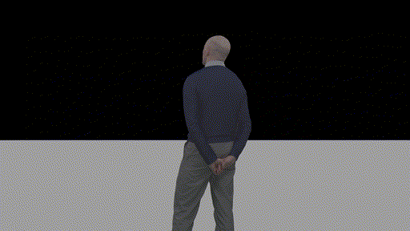
Understanding Dataset
From Wikipedia
Three-dimensional (3D) models represent a physical body using a collection of points in 3D space, connected by various geometric entities such as triangles, lines, curved surfaces, etc. Being a collection of data (points and other information), 3D models can be created manually, algorithmically (procedural modeling), or by scanning. Their surfaces may be further defined with texture mapping.
In our case, the dataset is a human frames of 3D meshes, just like how 2D frames are but in form of 3D meshes at each frame.
A circular view around the mesh looks like the image attached.

Slide 5




Setting up the development Environment
To interpret a 2D image, we need an image viewer.
To interpret a 3D mesh, we need a 3D software.
Our task is to construct a pipeline from human face annotation. A software that supports scripting would be nice.
Blender provides a support for python scripting, as well as it is open-source and free to use.
Used OpenCV’s implementation for face detection ( DNN as well as Haar Cascade ).
Used Dlib’s facial landmarks annotation support.

Slide 6
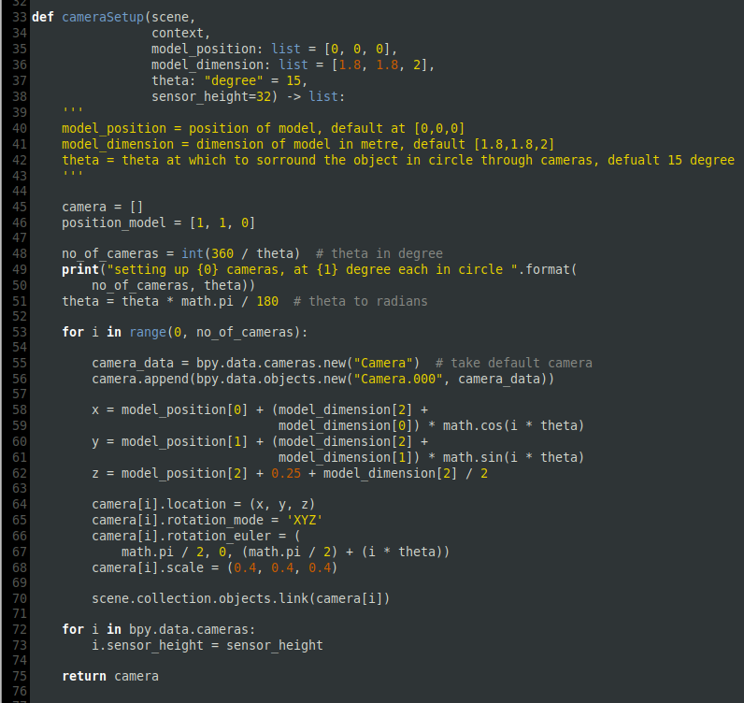
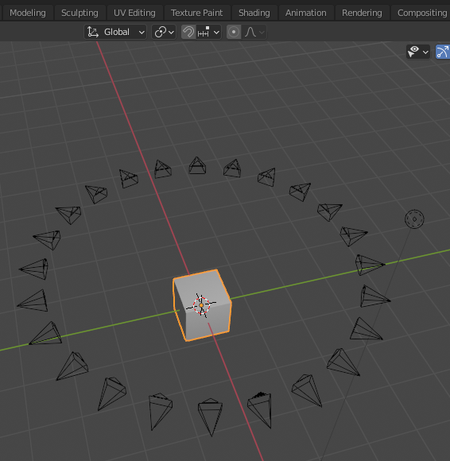
Blender Mesh Setup
Setup cameras in a circle around the mesh. 15 degree separation would be good.
A python code similar to this would work.

Slide 7
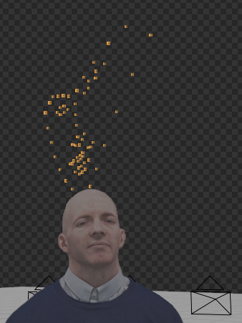
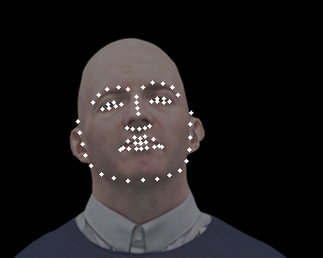
Solution Chart
Import mesh in Blender
Get 2D images in all
cameras perspectives
Find the most frontal
view in all images
Annotate the face
landmarks
Solve Classically
Multiview-geometry problem
Backproject to 3D
Blender Raycast
method

