Slide 1
IBM University Engagement Project Submission
“Exploring the Power of Agentic AI with IBM Granite and LangFlow”

Slide 2
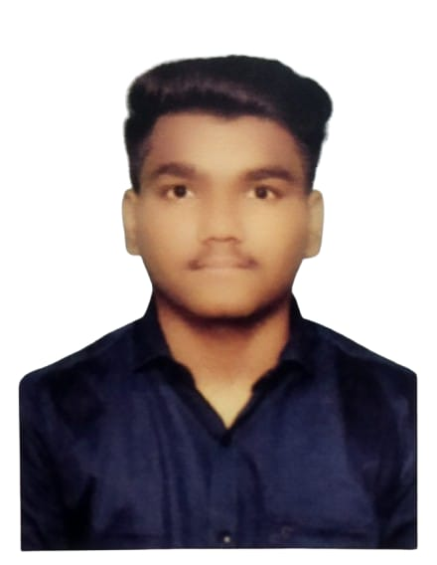
Project Tile – [AI Agent for Smart Farming Advice]
Domain of Project – [Agriculture]
Student Name | Recent Passport Photo | Email ID | Mobile number [WhatsApp]
Rohit Deepak Denge |  | rohitdenge07@gmail.com | +91 7030706006

Slide 3
Problem Statement -
Problem Statement : AI Agent for Smart Farming Advice
The Challenge
Small-scale farmers often face difficulties in accessing reliable and timely agricultural information.
Making informed decisions regarding crop selection, soil management, fertilizer usage, and pest control remains a significant challenge. Additionally, language barriers and limited access to modern technology restrict the adoption of smart farming practices.
The Objective
The objective of this project is to develop an AI-powered Smart Farming Advisor using IBM watsonx Orchestrate and a knowledge-based RAG system to provide accurate agricultural guidance to farmers.
• Crop Recommendation – Suggest suitable crops based on soil conditions, season, and farming requirements.
• Soil & Fertilizer Guidance – Provide recommendations for soil health management and appropriate fertilizer usage.
• Pest & Disease Management – Help farmers identify and control crop pests and diseases effectively.
• Knowledge-Based Information Retrieval – Deliver accurate responses using uploaded agricultural documents and knowledge sources.
• Farmer-Friendly Assistance – Provide simple, easy-to-understand agricultural guidance for better decision-making.
• Sustainable Farming Support – Encourage smart and sustainable farming practices to improve productivity and reduce risks.
• Multilingual Support – Enable farmers to interact with the system in simple language and receive understandable agricultural guidance.
• Improved Decision Making – Assist farmers in making informed decisions regarding crop planning, resource utilization, and farm management.

Slide 4
Technology Used
Tech Stack (Mandatory) :
IBM Cloud + IBM watsonx Orchestrate,
RAG, Knowledge Base, HTML, CSS, GitHub.

Slide 5
Proposed Solution -
Proposed Solution – AI Agent for Smart Farming Advice
The proposed solution is an AI-powered Smart Farming Advisor developed using IBM watsonx Orchestrate and a Retrieval-Augmented Generation (RAG) knowledge base. The system assists farmers by providing accurate and reliable agricultural guidance based on uploaded farming documents and knowledge sources.
The solution helps farmers make informed decisions regarding crop selection, soil management, fertilizer usage, and pest control. By retrieving information from agricultural PDFs, the agent delivers context-aware responses and reduces dependency on manual research
The system consists of the following key modules:
Crop Recommendation Module – Suggests suitable crops based on soil conditions, season, and farming requirements.
Soil & Fertilizer Guidance Module – Provides recommendations for maintaining soil health and selecting appropriate fertilizers.
Pest & Disease Management Module – Assists farmers in identifying common pests and diseases and suggests preventive measures.
Knowledge Retrieval Module – Uses RAG to retrieve relevant information from agricultural documents and generate accurate responses.
Farmer Assistance Module – Offers simple and easy-to-understand guidance for day-to-day farming activities.
This content is tailored to the project- with actually built with IBM Cloud + IBM watsonx Orchestrate + RAG + Agricultural PDFs + HTML/CSS/GitHub.

Slide 6
Orchestrate component Used -
1) Chat Input – Interface where farmers enter queries related to crops, soil health, fertilizers, pests, and farming practices.
2) IBM watsonx Orchestrate Agent – Processes user queries and provides intelligent agricultural guidance using the configured knowledge base.
3) Knowledge Source (RAG) – Retrieves relevant information from uploaded agricultural documents such as crop cultivation guides, soil management manuals, and pest control resources.
4) Chat Output – Displays AI-generated responses and recommendations related to farming activities and agricultural decision-making.
5) File Component – Stores and accesses uploaded agricultural PDF documents used as the knowledge base for the agent.
6) Web Integration Component – Integrates the IBM watsonx Orchestrate chat agent into a web application using HTML, CSS, and JavaScript.
7) Guidelines & Behavior Component – Defines agent behavior, response rules, and farming-specific recommendations to ensure accurate and relevant outputs.

Slide 7
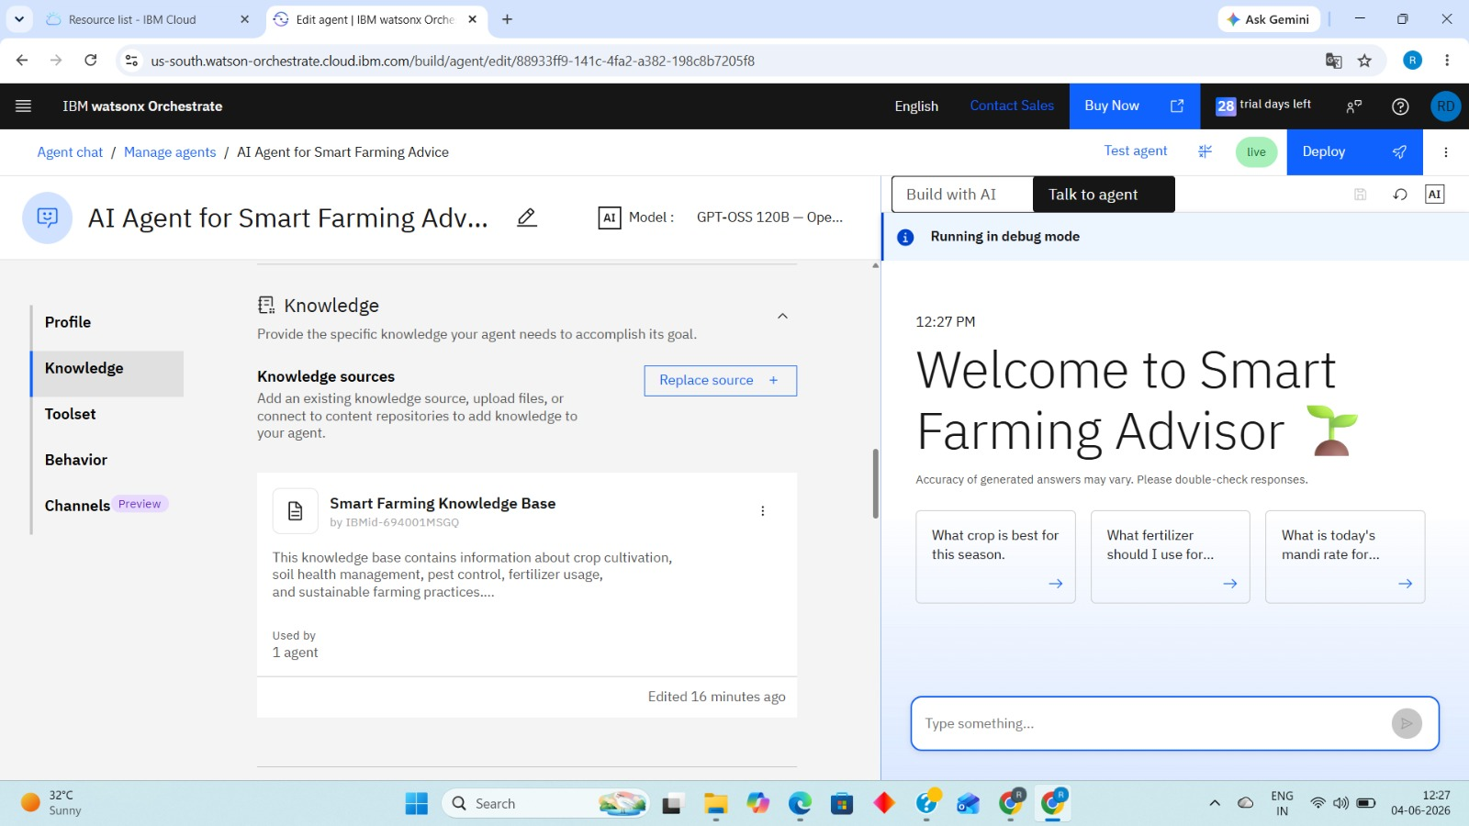
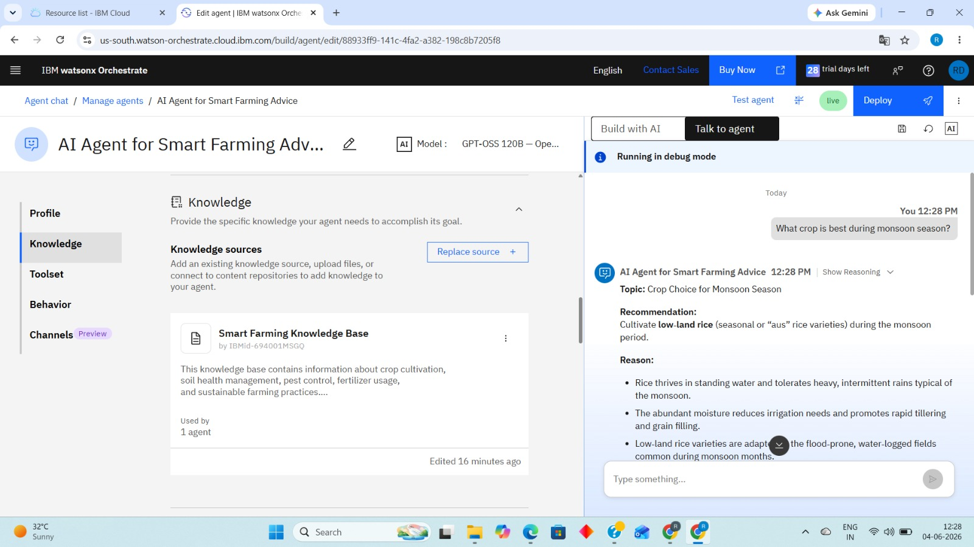
Screenshots -

Slide 8
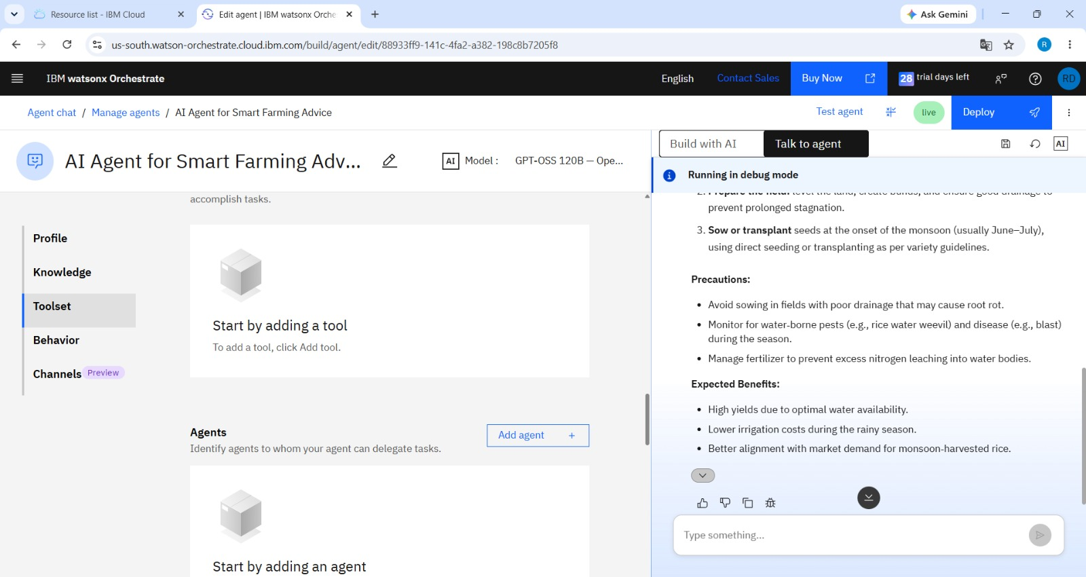
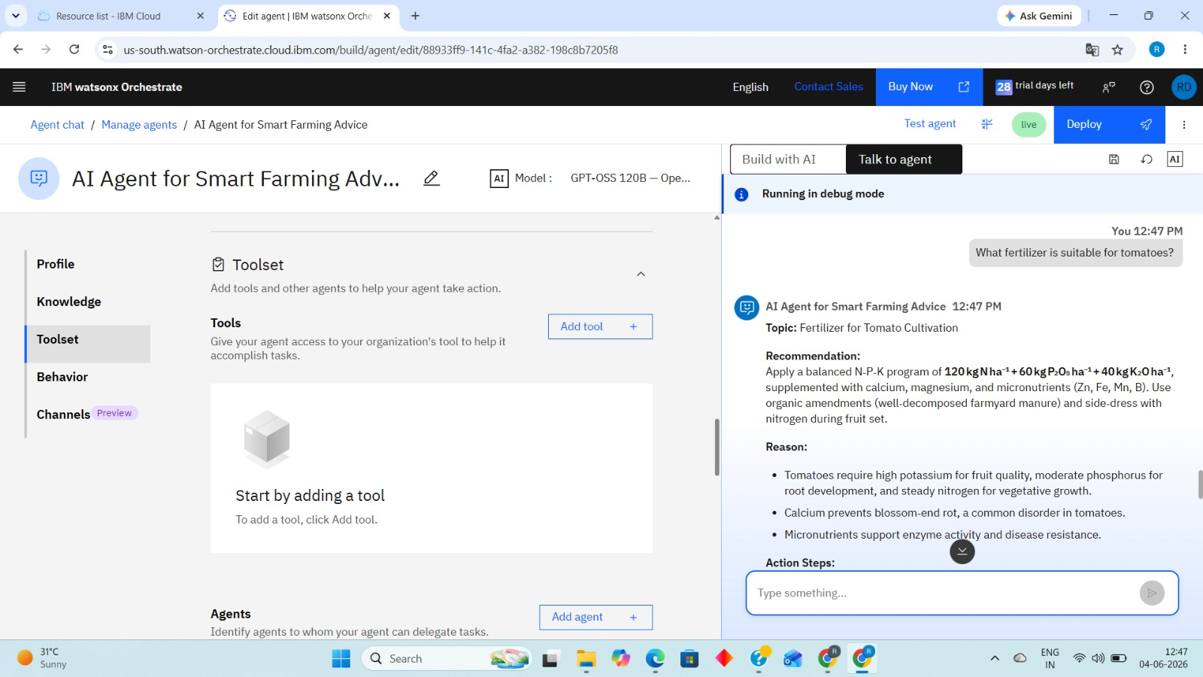

Slide 9
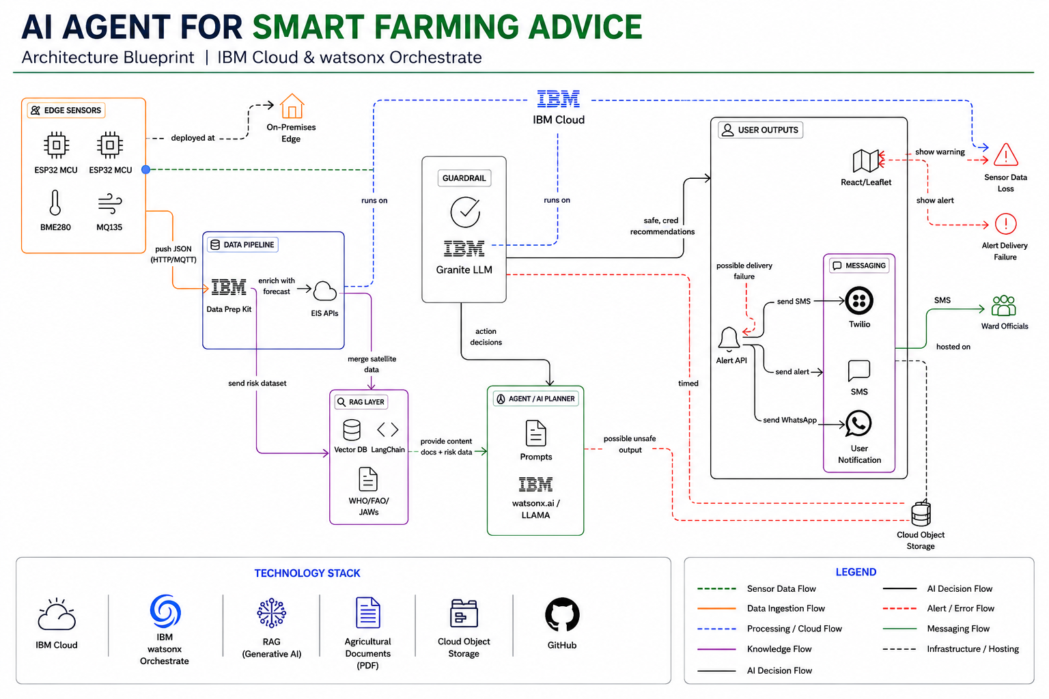
Architecture blueprint

Slide 10

Role of Agentic AI in the solution
Agentic AI plays a crucial role in the AI Agent for Smart Farming Advice by acting as an intelligent decision-making assistant for farmers. It understands user queries related to crop selection, soil management, fertilizer usage, and pest control. The Agentic AI autonomously retrieves relevant information from the agricultural knowledge base using the RAG (Retrieval-Augmented Generation) approach. It analyzes the retrieved information and generates accurate, context-aware responses. The AI agent follows predefined guidelines to ensure reliable and farmer-friendly recommendations. It can handle multiple agricultural queries efficiently without human intervention. The system improves accessibility to agricultural knowledge and supports informed decision-making. By providing timely and personalized guidance, it helps farmers adopt smart farming practices. The Agentic AI also supports future enhancements such as multilingual communication, weather-based recommendations, and market insights. Thus, it serves as the core intelligence of the Smart Farming Advice system, enhancing productivity and sustainable agriculture.

Slide 11
Novelty and Uniqueness
AI-Powered Smart Farming Assistant - The project uses Agentic AI to provide intelligent agricultural guidance, making farming knowledge easily accessible to farmers.
Integration with IBM watsonx Orchestrate - Utilizes IBM watsonx Orchestrate for building an advanced AI agent capable of understanding and responding to agricultural queries.
Retrieval-Augmented Generation (RAG) Approach - Combines Large Language Models with document retrieval to provide accurate and knowledge-based answers instead of generic AI responses.
Agriculture-Specific Knowledge Base - Uses dedicated farming documents such as crop cultivation guides, soil management manuals, and pest control handbooks to generate reliable recommendations.
Personalized Farming Recommendations - Provides crop, soil, fertilizer, and pest management advice based on the user's specific farming requirements.

Slide 12
Git Hub Link
· Please create public github repository (Enable Add README button while creating repository) with format –
Please test and Paste the working Github URL – https://github.com/rohitdenge07/AI-Agent-for-Smart-Farming-Advice-
Make sure you have Uploaded following three files into your github repository 1) app.json file , 2) yourproblemstatement.pdf file 3) your projectpresntation.pptx file 4)any other files
·
·
·

Slide 13
Future Scope
Integration of Real-Time Agricultural Data In the future, the Smart Farming Advisor can be integrated with real-time weather forecasting systems, market price databases, and government agricultural portals. This enhancement will enable farmers to receive up-to-date information regarding climate conditions, crop prices, and farming advisories. Access to real-time data will improve decision-making, reduce risks, and increase agricultural productivity.
Mobile Application and Multilingual Support The system can be extended into a dedicated mobile application with support for multiple regional languages and voice-based interaction. This will make the platform more accessible to farmers who may have limited technical knowledge or literacy skills. By providing easy access through smartphones, the solution can reach a larger farming community and promote the adoption of smart farming practices.
·
·
·

Slide 14


