Slide 1
Stock Market Analysis
Group-4

Slide 2
Project Overview
Objective: Analyze and forecast Apple stock prices
Dataset: AAPL historical stock data (CSV)
Tools: Python, Streamlit, Google Colab, Jupyter
Deliverable: Forecasting web app

Slide 3
Exploratory Data Analysis (EDA)
Displayed plot trends, seasonal decomposition and correlation heatmap
Line chart of historical closing prices
Identified trends, missing data, and stationarity

Slide 4
Plot Trends
Trend plots help visualize the general direction of stock prices over time (upward, downward, or stable).
They reveal long-term movements, ignoring short-term fluctuations or noise.
Useful for detecting phases like bull or bear markets in historical data.

Slide 5
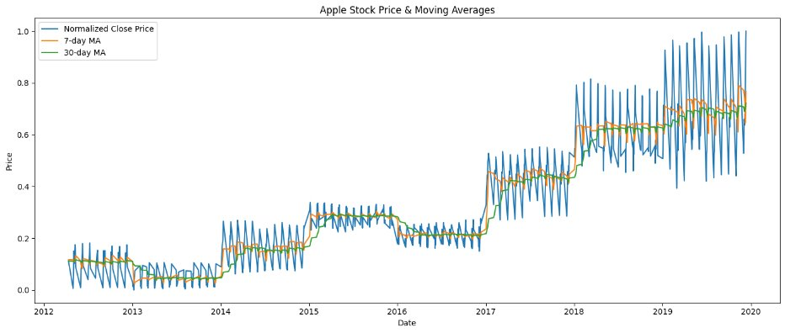

Slide 6
Seasonal decomposition
Decomposes time series into trend, seasonal, and residual components.
Highlights periodic behavior like monthly or quarterly cycles in stock prices.
Makes it easier to model and forecast by isolating consistent patterns.

Slide 7
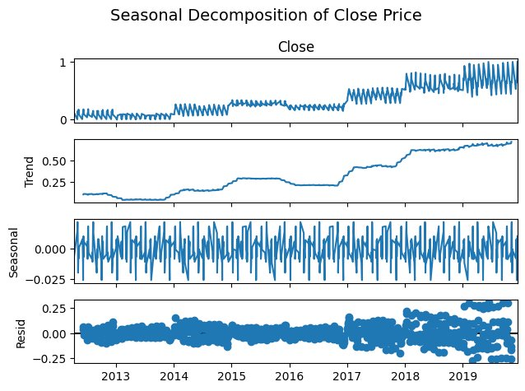

Slide 8
Correlation heatmap
Displays correlation values between features using color intensity.
Helps identify which variables move together (e.g., volume and price).
Useful in feature selection for multivariate time series models or hybrid models.

Slide 9
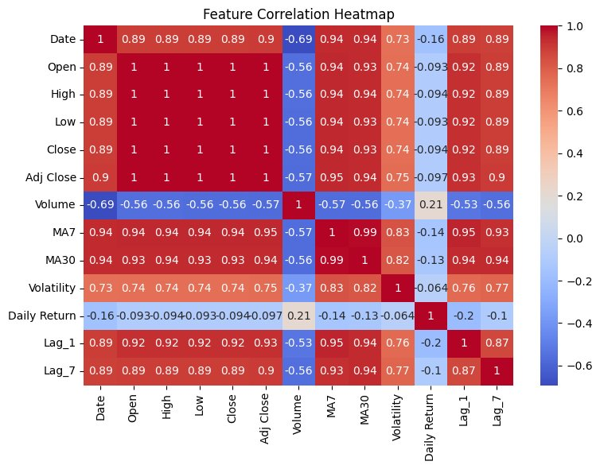

Slide 10
Model Building
Model | MAE (↓) | RMSE (↓) | MAPE (↓) | Notes
ARIMA | 50.58 | 60.37 | NaN | Poor for non-linear, noisy data
SARIMA | 43.41 | 52.22 | NaN | Slight improvement with seasonality
Random Forest | 22.51 | 33.27 | — | Good general-purpose model
XGBoost | 22.13 | 32.85 | — | High performance on structured data
LSTM | ⭐ 22.10 | ⭐ 32.27 | — | Best overall, captures temporal dependencies

Slide 11
Why LSTM?
Stock prices are time-dependent; LSTMs are built to capture these trends and dependencies over time.
LSTM has "memory" that helps it retain important past information.
Can learn complex nonlinear relationships that traditional models (like linear regression or ARIMA) might miss.

Slide 12
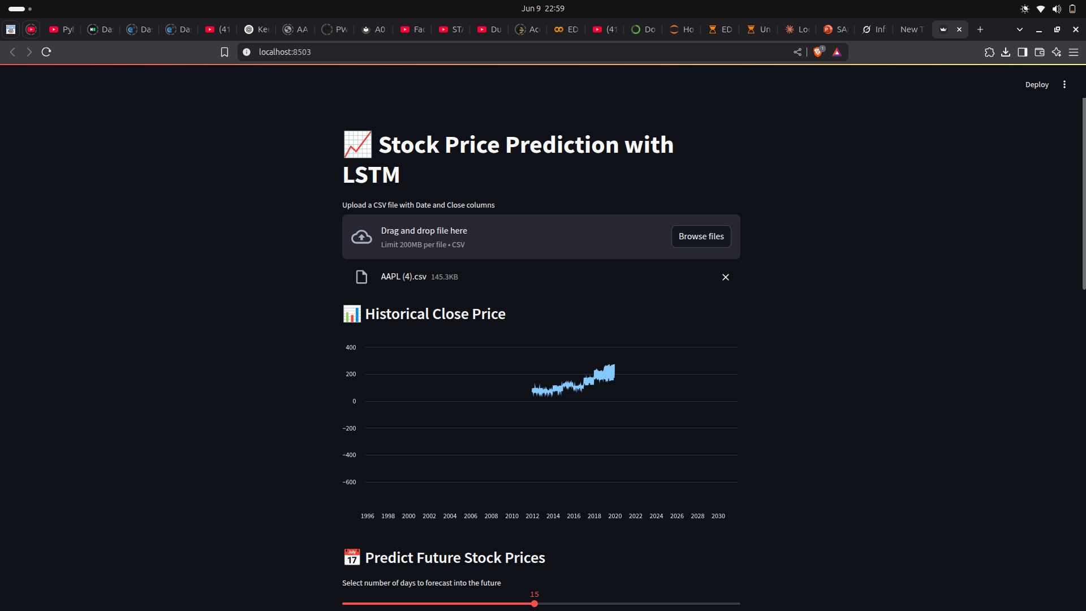
Model Deployment

Slide 13
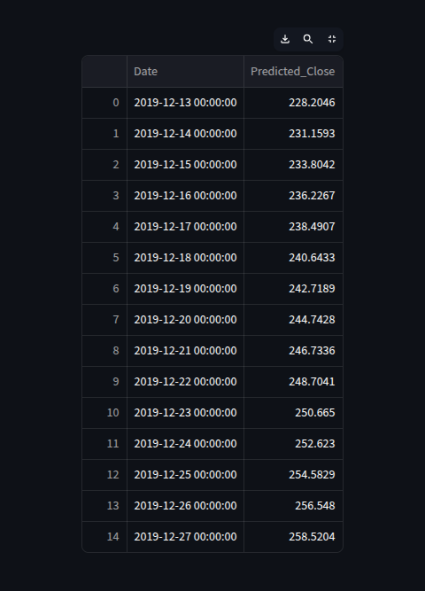
Output:
Consistent Uptrend: The predicted close prices show a steady upward trend, indicating model confidence in continued growth in AAPL stock over the next month.
Low Volatility: The gradual increase without sharp spikes or dips suggests stable market expectations and low short-term volatility.
Momentum Continuation: The trend aligns with previous bullish behavior, supporting the idea that the stock’s momentum is likely to persist in the near future.

Slide 14
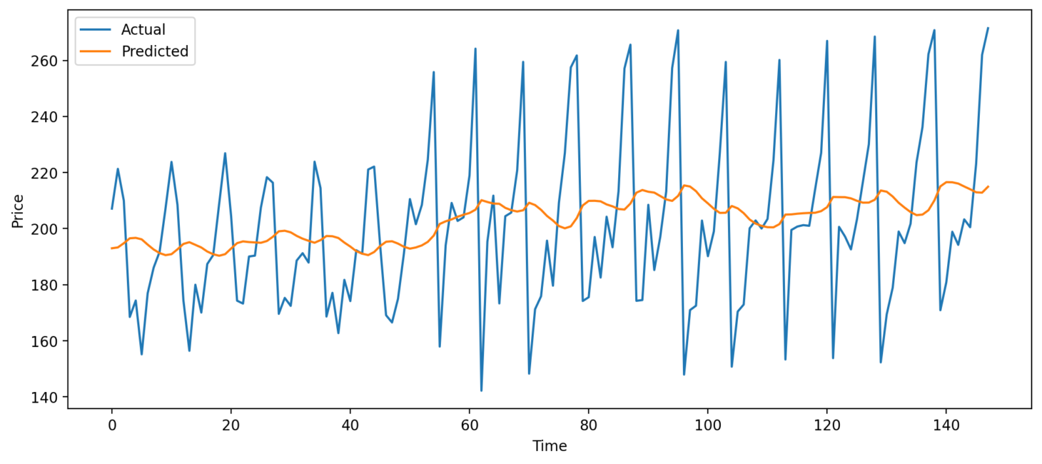
Predicted vs Actual Close Price

Slide 15
Challenges Faced
LSTM models can overfit due to their high capacity, especially with limited historical data or improper tuning.
LSTM models can be too large to load quickly in online platforms like Streamlit Cloud.
Cold-start time for loading models and predictions can lead to a sluggish user experience.

Slide 16
Future Scope
Integrate real-time data APIs (e.g., Yahoo Finance).
Explore deep learning models like Prophet and others using real time data.
Deploy permanently on Hugging Face or Render.

Slide 17

Thank You

