Slide 1
Cloud

Slide 2
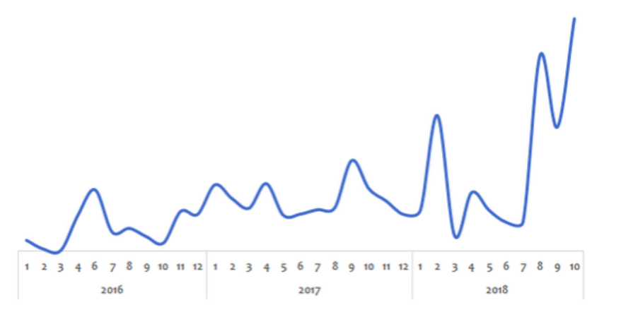
Why Cloud?
Peak loads vary (high during weekends and holidays), High costs
Solution before Cloud: Peak Load Provisioning – Buy infrastructure for peak load – Wasted during less load
Earlier: Own Data Center (In premises, also called in-prim)
Now: Cloud

Slide 3
Challenges Before Cloud
High cost of infrastructure procurement
Need to plan ahead of time – Can we guess if a start up will be successful?
Low utilization of infrastructure due to peak load provisioning
Dedicated infrastructure team for maintenance

Slide 4
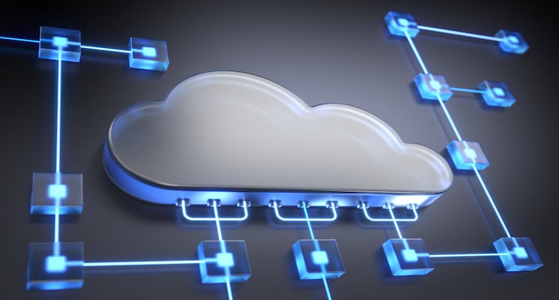
The Cloud Solution
Provision (i.e. rent) resources only when we need them, and release them when we do not need them
On demand resource provisioning
Hence called as elastic

Slide 5
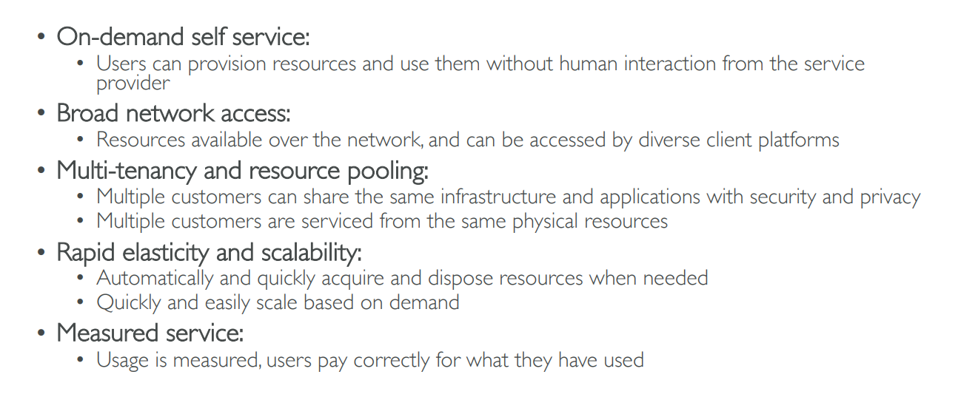
Five Characteristics of Cloud Computing

Slide 6
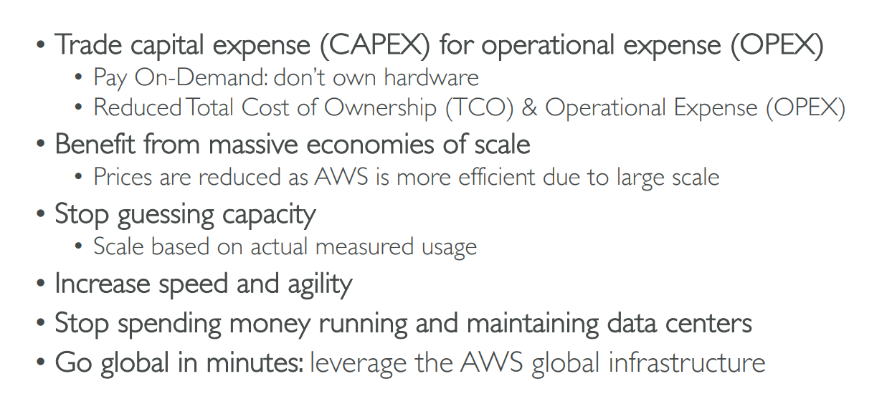
Six Advantages of Cloud Computing

Slide 7
Managed Services / Cloud Computing Types
IaaS (Infrastructure as a Service) – Hosting
PaaS (Platform as a Service) – App Development
SaaS (Software as a Service) – Everything
Sometimes also called as the SPI model (Saas, Paas, Iaas)

Slide 8
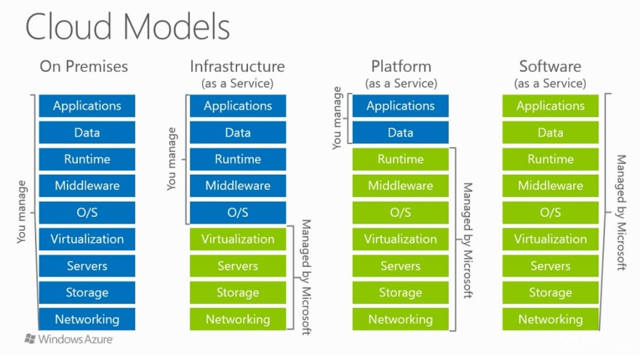
IaaS, PaaS, SaaS

Slide 9
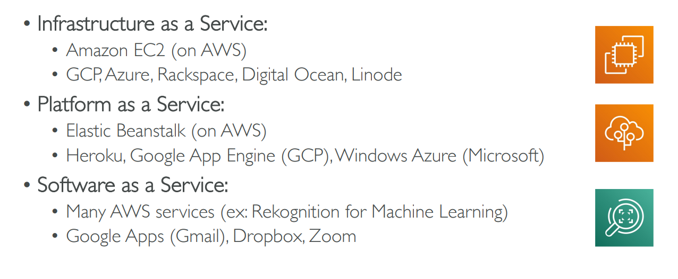
Example of Cloud Computing Types

Slide 10
AWS Introduction

Slide 11
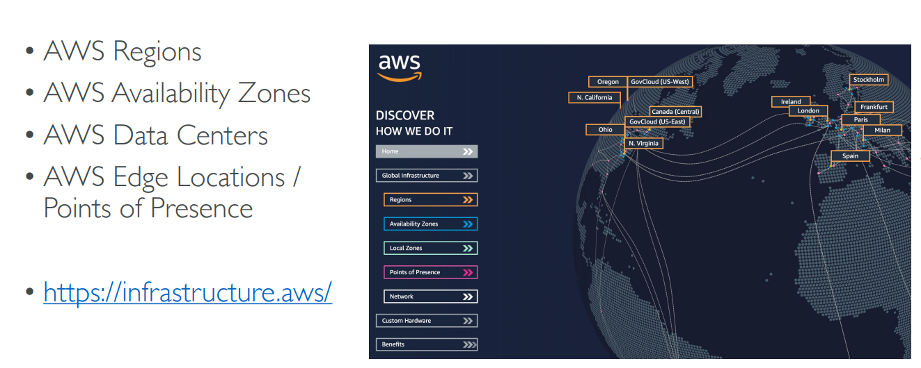
AWS Global Infrastructure

Slide 12
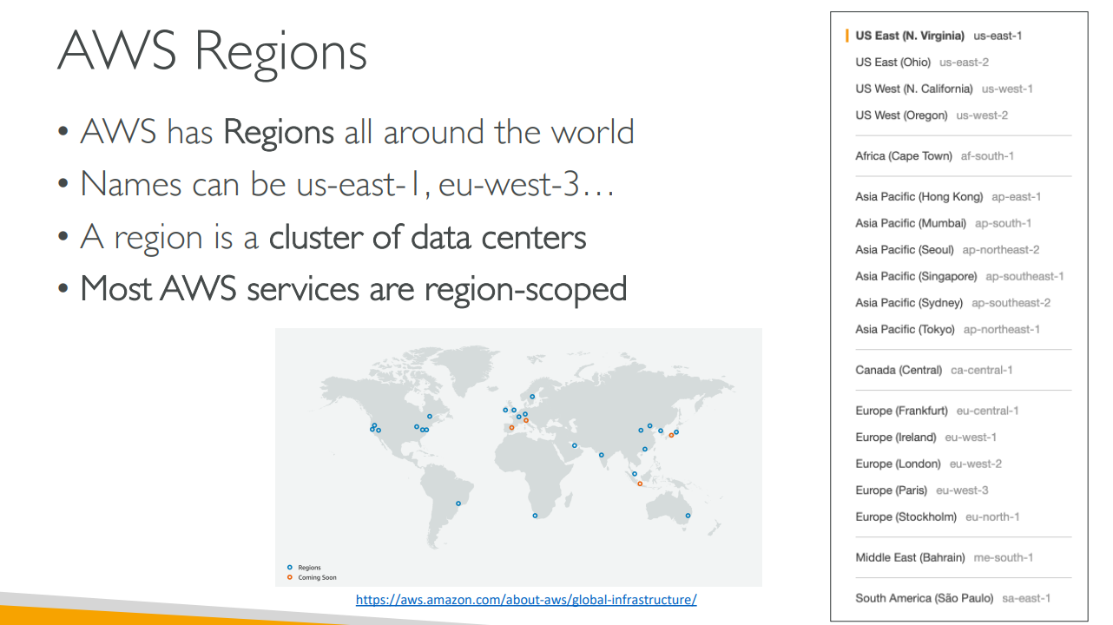
AWS Regions

Slide 13
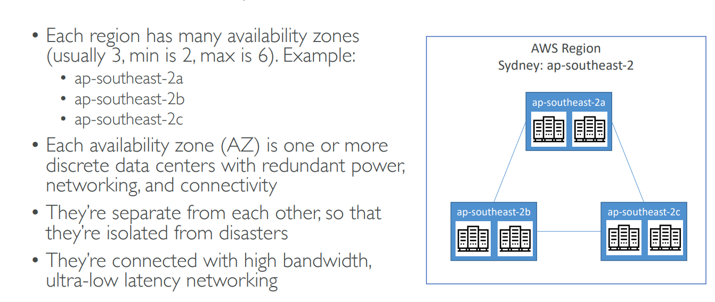
AWS Availability Zones

Slide 14
Signup
Signup for AWS with your email id
Remember the id, password and also the AWS account id (different from your email id) – This creates a root account
You will require your phone and credit card

Slide 15
EC2

Slide 16
EC2 Basics
EC2 = Elastic Compute Cloud
Part of IaaS
Allows creation of a “rented” virtual machine
We decide the machine type, OS, capabilities, etc
Accessible from the Internet (Gets a public IP address)
We can install any software on it and use it for any purpose

Slide 17
EC2 User Data
EC2 User Data: A user-defined script only once at the first start (instance creation)
Purpose: Automate tasks
  Installing updates, Software, Downloading common files from the internet
Note: If we want to run this every time, we need to put the script in /var/lib/cloud/scripts/per-boot/

Slide 18
Create an EC2 Instance using EC2 User Data
Search for EC2, then click on Instances, Launch Instances
Leave everything as default, but click on Create new key pair, as it is required – Give some name, and select defaults
Under Network, select Allow Http traffic from the internet
In Advanced details-User data, enter the following script
  #!/bin/bash
  yum update -y
  yum install -y httpd
  systemctl start httpd
  systemctl enable httpd
  echo "<h1>Hello World from $(hostname -f)</h1>" > /var/www/html/index.html
Launch instance and test it using its public IP address

Slide 19
Test the EC2 Instance
When the instance is running, open its public IP address in the browser

Slide 20
AWS S3
Block Storage
File Storage
Object Storage

Slide 21
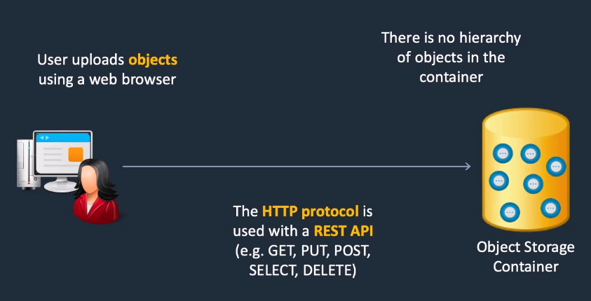
AWS Storage Options: Object Storage
Object storage: Allows storage and retrieval of files as if they are objects

Slide 22
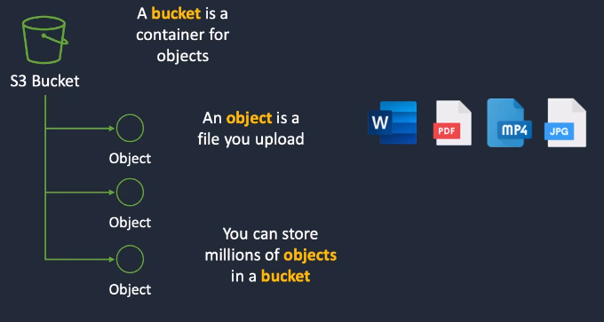
Simple Storage Service (S3): Object Storage in AWS
Bucket: Collection of objects

Slide 23
S3: Object Storage in AWS
Search for S3->Create bucket->Bucket name: Must be globally unique->Leave all defaults->Create bucket
Click on the bucket name->Upload->Upload 1-2 files from your disk->Upload

Slide 24
Serverless and AWS Lambda

Slide 25

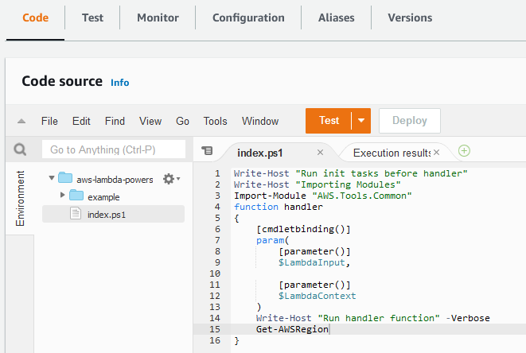


Lambda and Serverless Computing
Serverless computing: Does not mean no server, But it means that the developers do not have to worry about servers
Developers just need to deploy code, AWS will manage the servers
AWS Lambda: Event-driven, serverless computing platform
import json
import logging
import boto3
# Initialize logging
logger = logging.getLogger()
logger.setLevel(logging.INFO)
def lambda_handler(event, context):
# Log the raw event
logger.info("Event: " + json.dumps(event))
An event (e.g. file upload in S3) triggers it
Developer creates and deploys a Lambda Function

Slide 26
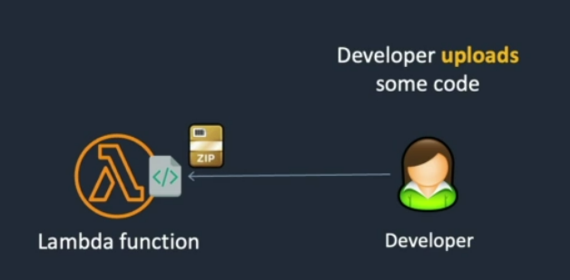
Lambda Overview
AWS Lambda: A serverless compute service
Developer uploads some code – no payment at this stage
Charges only apply to the usage of the code

Slide 27
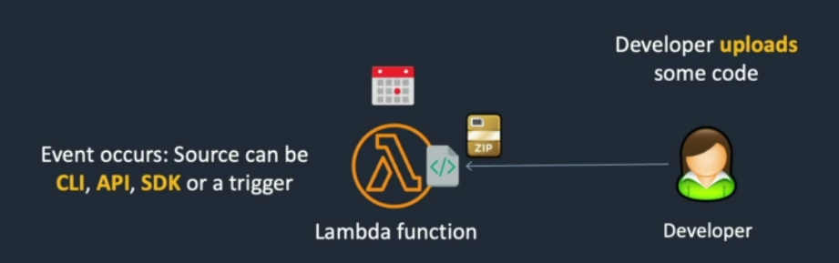
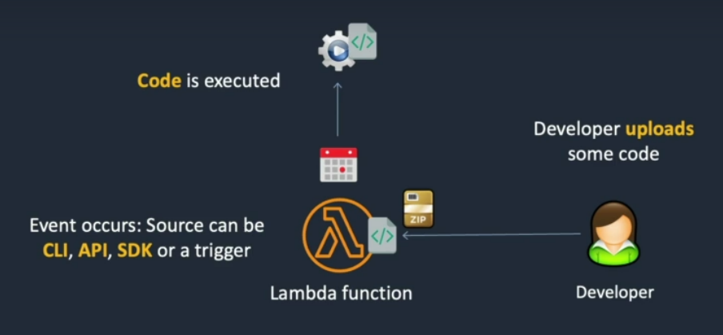
Lambda Overview
An event occurs
Triggers the Lambda function
It can run for max 15 mins

Slide 28
Creating Lambda Function
Search for Lambda->Create function->Author from scratch->Function name:my-lambda-s3-function->Runtime:Python 3.11->Create function
Code: Remove the existing code and copy and paste the code from the next slide->Deploy
Configuration->Permissions->Click on the Execution role name link->Add permissions->Attach policies->Search for S3->Select AmazonS3FullAccess ->Add permission
Go to Lambda->Triggers->Add Trigger->Select a source: S3->Bucket:Select your bucket->Leave everything else as default->Acknowledge->Add
In S3, Click on the Bucket name->Properties->Scroll down->Event notifications will show our Lambda event

Slide 29
Lambda Function Code
# Create an event notification for S3 upploads
# Write the names of files uploaded to an S3 bucket to CloudWatch Logs
import json
import logging
import boto3
# Initialize logging
logger = logging.getLogger()
logger.setLevel(logging.INFO)
def lambda_handler(event, context):
# Log the raw event
logger.info("Event: " + json.dumps(event))
# Process each record within the event
for record in event['Records']:
# Extract the bucket name and file key from the event
bucket_name = record['s3']['bucket']['name']
file_key = record['s3']['object']['key']
# Log the bucket name and file key to CloudWatch
logger.info(f"New file uploaded: {file_key} in bucket {bucket_name}")
return {
'statusCode': 200,
'body': json.dumps('Processed S3 upload event successfully!')
}
# 2. Edit the execution role to add permissions to Lambda to read from S3
# 3. Create an event notification for all S3 object create events by adding a trigger to AWS Lambda
# 4. Upload a file and check if a message is written to CloudWatch Logs that includes the file name

Slide 30
Testing Lambda Function
Go to S3 Bucket and upload 2-3 files
Go to Lambda->Monitor->View CloudWatch logs->Scroll down to Log streams->Click on the URL
We should see the logs for the uploaded files

Slide 31
Cleanup
Remove all objects from the S3 bucket
Remove S3 bucket
Remove Lambda function

Slide 32
VPC

Slide 33
VPC
VPC = Virtual Private Cloud … Logically isolated portion of a network within an AWS region … Like our own private network within a region
Basic hierarchy: Region->AZ
VPC can be inside one AZ or can span across multiple AZ
Subnets partition our network inside a VPC
Subnet types:
  Public subnet: Accessible from the internet
  Private subnet: Not accessible from the internet

Slide 34






VPC Hierarchy
Outside networks
Region
Internet Gateway
VPC
Availability Zone
Public subnet
Servers accessible from the outside
NAT Gateway
Availability Zone
Private subnet
Internal network

Slide 35
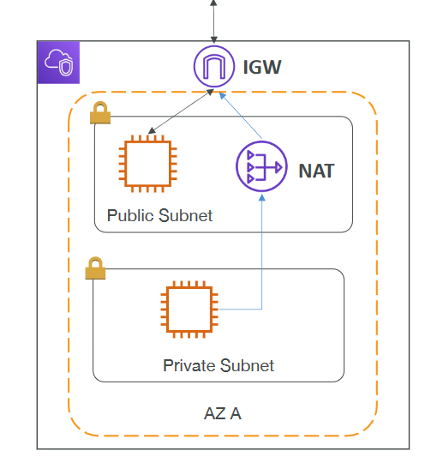
Internet Gateway and NAT Gateway
Internet gateway: Connect the public subnet in the VPC to the Internet
NAT gateway (AWS-managed): Allow private subnet in the VPC to access the Internet via the Internet Gateway
Public Subnet Route Table
Destination | Target
172.31.0.0/16 | Local
0.0.0.0/0 | IGW-id
Private Subnet Route Table
Destination | Target
172.31.0.0/16 | Local
0.0.0.0/0 | NAT-GW-id

