Slide 1
Docker: Containerization
Atul Kahate

Slide 2
DevOps Lifecycle
Stage | What Happens | Typical Activities
Plan | Define what needs to be developed | Requirements, features, priorities, release planning
Code | Develop the application | Coding, Git, code review, collaboration
Build | Create a deployable application | Install dependencies, package application, build Docker image
Test | Verify application quality | Unit testing, integration testing, API testing, automated testing
Deploy | Release the application | Deploy to development, staging, or production
Monitor | Observe the running application | Logs, performance, errors, availability, anomaly detection

Slide 3
Agile versus DevOps
Agile | DevOps
Focuses on software development | Focuses on development + operations
Uses short iterations/sprints | Uses continuous delivery and deployment
Emphasizes customer feedback | Emphasizes automation and continuous monitoring
Frequent software releases | Continuous/frequent releases
Collaboration between development team members | Collaboration between Dev + Ops + QA

Slide 4
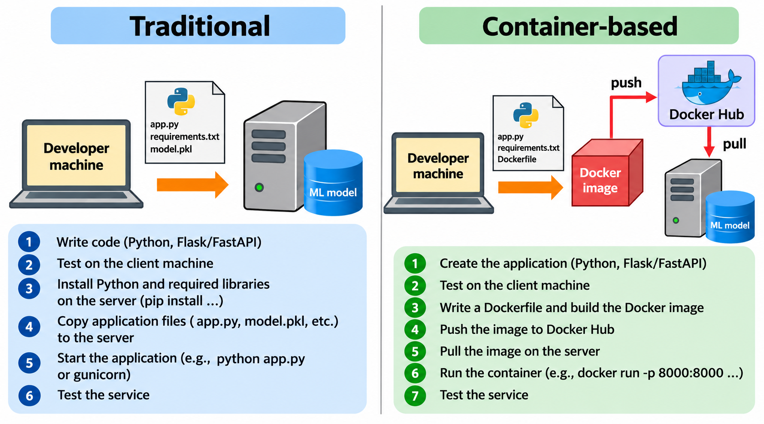

Slide 5
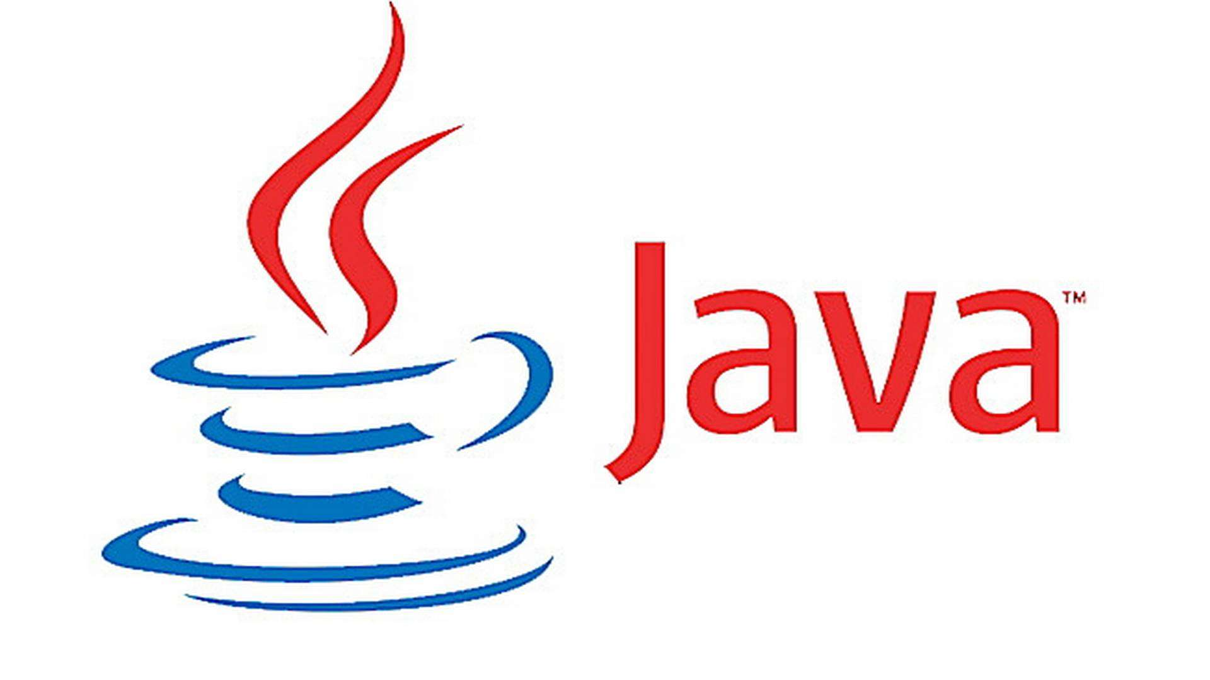
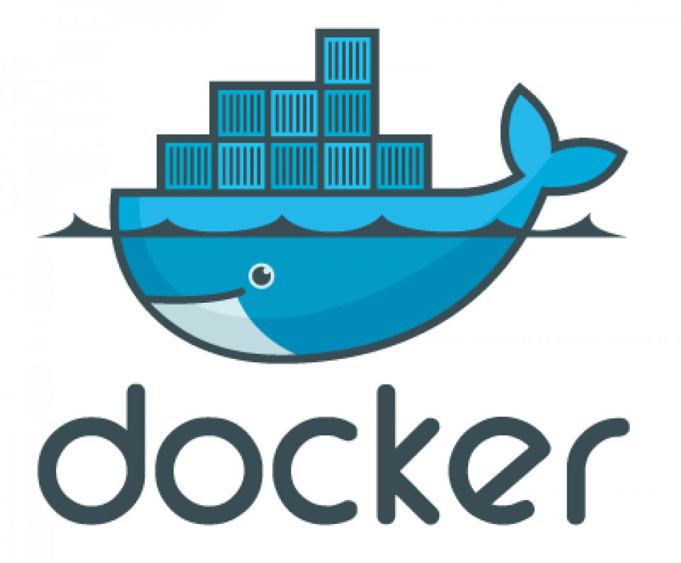

What is Docker?
HelloWorld.class
Docker: Container technology
Container = Complete and isolated software
Runs an application in a sandbox
Portable
Contains all dependencies
We can run several containers on a machine at the same time
Self-contained: Do not alter the host system they run on
Docker is light-weight, unlike VM
If something works in Development, it will work in Production, too

Slide 6
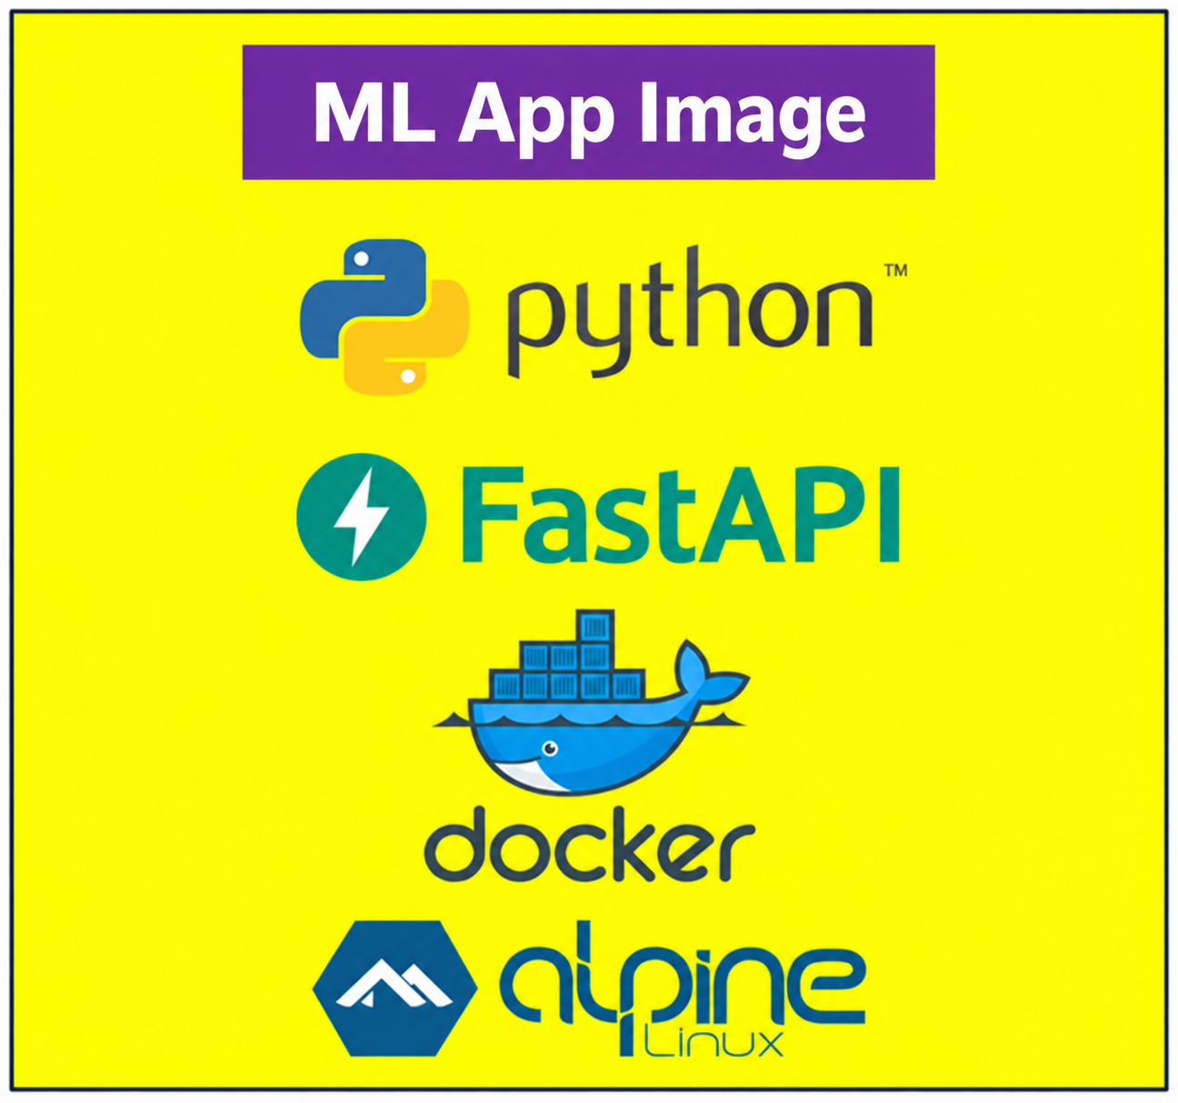
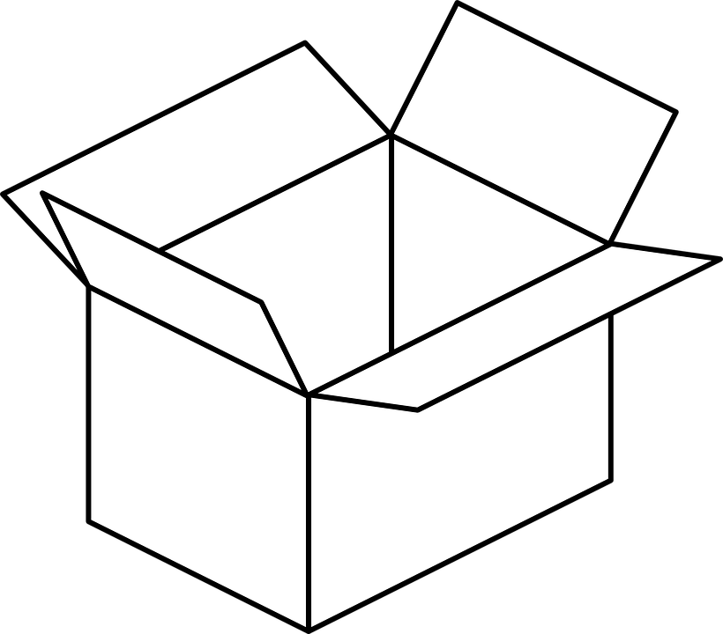
Image and Container
Build: Create an image
Run: Run the image as a container
Image
docker build command
Image
Container
docker run command

Slide 7
Container versus Virtual Machine
Containers
Virtual Machines
Container A
Container B
Container C
VM A
VM B
VM C
App A
App A
App B
App C
Libs
Libs
Libs
Libs
App B
App C
Docker
Libs
Libs
Hypervisor
Host Operating System
Guest OS
Guest OS
Guest OS
Host Operating System
Hardware
Hardware

Slide 8
Installing Docker on Ubuntu
Step | Command / Action
1 | Go to https://docs.docker.com/engine/install/ubuntu/
2 | Copy all commands together from “1. Set up Docker's apt repository” and run in terminal together
3 | Copy the command from “2. Install the Docker packages” and run
4 | sudo groupadd docker
5 | sudo usermod -aG docker $(whoami)
6 | sudo reboot
7 | docker ps

Slide 9
Ready Docker Images
Image | Use | Example Command
ubuntu | Base OS | docker run -it ubuntu
nginx | Web server | docker run -d -p 80:80 nginx
mysql | Database | docker run -d -e MYSQL_ROOT_PASSWORD=1234 mysql
mongo | NoSQL DB | docker run -d -p 27017:27017 mongo
python | Runtime | docker run -it python

Slide 10
Run a Container
Command / Syntax | Description / Behavior
docker run -d -it <container name> | Runs a container in detached mode with interactive terminal support
docker run ubuntu | Starts a container but it immediately stops (no interactive process running)
docker ps | Lists all currently running containers
docker run -it ubuntu | Runs container in interactive mode; stays active until you exit the terminal
docker run -dit ubuntu | Runs container in background (detached mode); continues running even after exiting terminal
docker exec -it <container id> /bin/bash | Opens an interactive terminal inside a running container

Slide 11
Docker Container Lifecycle
Syntax | Purpose | Example
docker run <image> | Start and stop a container | docker run ubuntu docker ps
docker run -it <image> | Start a container and directly open an interactive terminal in it | docker run -it ubuntu exit docker ps
docker run -dit <image> | Run in detached mode, so container is running in the background | docker run -dit ubuntu docker ps
docker exec -it <container_id> /bin/bash | Access container | docker exec -it b3 /bin/bash
docker stop <container_id> | Stop container (by ID) | docker stop b3
docker stop <container_name> | Stop container (by name) | docker stop beautiful_joe
docker ps | Verify running containers | docker ps
docker ps -a | List all containers | docker ps -a

Slide 12
Docker Image Commands
Command | Purpose | Example
docker pull <image> | Download image from Docker Hub | docker pull ubuntu
docker images | List all downloaded images | docker images
docker rmi <image> | Remove an image | docker rmi ubuntu

Slide 13
docker prune – Containers
Step | Command | What happens
1 | docker run -d --name c1 nginx | Container c1 created
2 | docker run -d --name c2 nginx | Container c2 created
3 | docker stop c1 c2 | Both containers stopped
4 | docker ps -a | Shows c1, c2 (stopped)
5 | docker container prune | Deletes ALL stopped containers
6 | docker ps -a | No stopped containers should appear

Slide 14
Build Image Using Dockerfile
Dockerfile: Contains instructions that we want to give to Docker for building an image … Main instructions …
Instruction | Use
FROM | Set the base image
CMD | Command to be executed when the image is run as a container (Or pass options to ENTRYPOINT)
RUN | Executes a command to help build our image
EXPOSE | Opens network ports
VOLUME | Sets a disk share
COPY | Copies files from the local disk to the image
ENV | Add an environment variable
ENTRYPOINT | Determines which executable runs when a container starts (Use CMD to pass options to the executable)

Slide 15
Python “Hello World”
Step | Command / File | Content / Action | Purpose
1 | Create directory | mkdir ~/docker_python_hello | Project folder
2 | Create Python file | hello.py | print("Hello World")
3 | Create Dockerfile | Dockerfile | Next slide
4 | Build image | docker build -t my-hello-python . | Build Docker image
5 | Run container | docker run my-hello-python | Executes program

Slide 16
Files
hello.py
Dockerfile
print("Hello World from Python!")
FROM python:3.11-slim
WORKDIR /app
COPY hello.py .
CMD ["python", "hello.py"]
After creating these files, run the following commands
docker build -t hello-python .
docker run hello-python

Slide 17
Python-Flask Hello World
app.py
from flask import Flask
app = Flask(__name__)
@app.route("/")
def hello():
return "Hello World from Flask in Docker!"
if __name__ == "__main__":
app.run(host="0.0.0.0", port=5000)

Slide 18
Python-Flask Hello World
Dockerfile
FROM python:3.11-slim
WORKDIR /app
COPY app.py .
RUN pip install flask
EXPOSE 5000
CMD ["python", "app.py"]
After creating these files, run the following commands
docker build -t flask-hello .
docker run -p 5000:5000 flask-hello
Open browser and try localhost:5000

Slide 19
Pushing Image to DockerHub
Create an ID for yourself on DockerHub
docker tag flask-hello yourdockerusername/flask-hello:1.0
docker push yourdockerusername/flask-hello:1.0
To test: docker run yourdockerusername/flask-hello:1.0

