Slide 1
Linux
Atul Kahate

Slide 2
Linux History
Linux: World’s most widely used kernel
Origins in UNIX: Ken Thompson – 1969
Richard Stallman created GNU (1984): Free software alternative to UNIX, created UNIX utilities, but kernel was missing
Linux kernel: Created by Linus Torvalds in 1991

Slide 3
Linux Kernel
Linux Kernel = Core of the Operating System
Applications -> Kernel -> Hardware
Manages system resources and provides services
Function | Description
Process Management | Controls running programs
Memory Management | Allocates RAM to programs
Device Management | Communicates with hardware devices
File System Management | Manages files and storage
System Calls | Interface between applications and kernel

Slide 4
Kernel Architecture
Linux = Monolithic kernel — all core services run in kernel space, giving high performance and direct hardware access.
Flow: User programs → System calls → Kernel → Hardware
Feature | User Space | Kernel Space
Runs | Apps (Firefox, Python) | Kernel code (scheduler, drivers)
Hardware access | None (indirect) | Full
Security | Restricted | Privileged

Slide 5
Linux Distribution (“Distro”)
Linux Distribution (Distro): Complete operating system built around the Linux kernel
Linux Distribution = Kernel + Software + Tools
Purpose | Example Distribution
Desktop users | Ubuntu
Enterprise servers | Red Hat Enterprise Linux
Security testing | Kali Linux
Lightweight systems | Lubuntu
Developers | Fedora

Slide 6
Major Distribution Families
Family | Example Distributions
Debian-based | Ubuntu, Linux Mint
Red Hat-based | Fedora, CentOS, RHEL
Arch-based | Arch Linux, Manjaro
SUSE-based | openSUSE
Ubuntu: an example - Component | Example
Kernel | Linux kernel
Desktop | GNOME
Package Manager | APT
Shell | Bash
Installer | Ubiquity

Slide 7
Linux Command Line
Command line interface (CLI) is provided by a Shell
Shell | Program Name | Description
Bourne shell | sh | Original UNIX shell developed at AT&T
C shell | csh | Shell developed as part of BSD UNIX
TC shell | tcsh | Enhanced version of csh
Korn shell | ksh | Improved Bourne shell developed at AT&T
Bourne Again Shell | bash | Default shell in most Linux distributions

Slide 8
Various Aspects of Linux
Component | What It Is | Role in Linux | Example
Terminal | A program that provides a text interface | Lets users type commands | GNOME Terminal, xterm
Shell | A command interpreter | Reads commands and sends requests to the kernel | bash, sh, zsh
Command | Instruction given by the user | Performs a task using shell and kernel | ls, pwd, cp
Kernel | Core of the operating system | Manages hardware and system resources | Linux Kernel

Slide 9
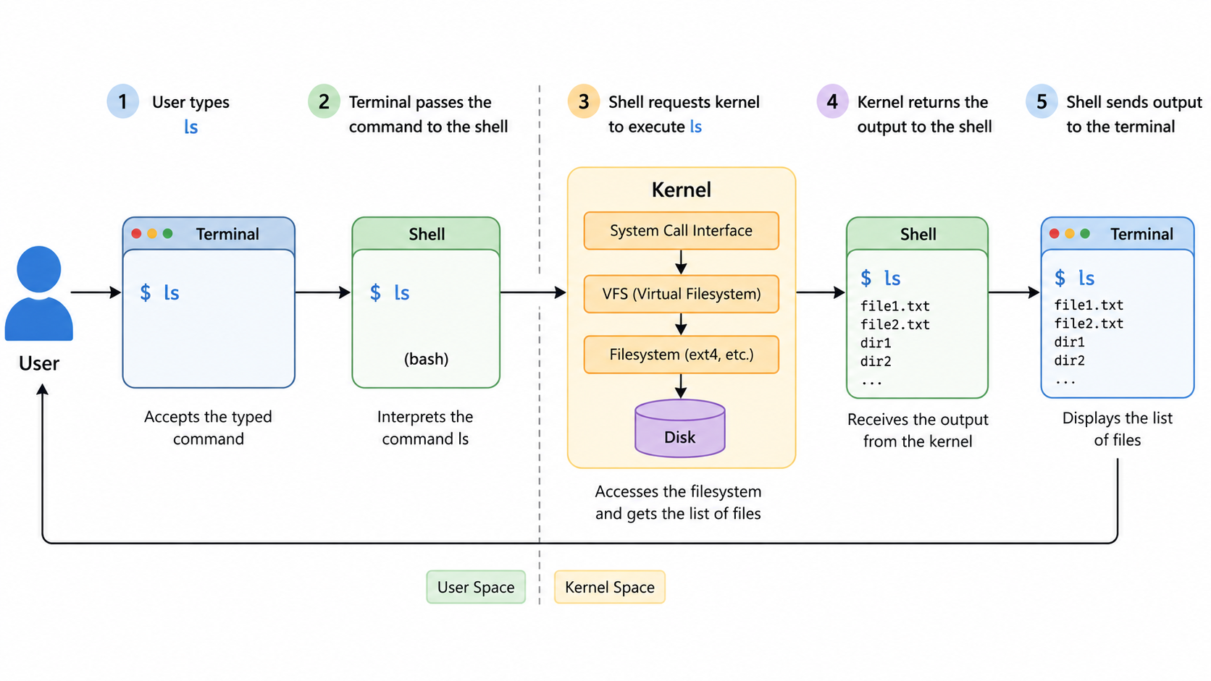
How a User Command is Processed? (e.g. ls)
Component | Action
Terminal | Accepts the typed command
Shell | Interprets the command ls
Kernel | Accesses the filesystem
Terminal | Displays the list of files

Slide 10
The Shell Prompt
Format: username@machine:directory$
Example: atul@lubuntu:~$
Summary: the prompt tells you who you are, where you are, and what power you have
Symbol | Means
$ | Normal user
# | Root user

Slide 11
Valid and Invalid Commands
Type | Meaning | Example
Valid | Correct syntax, runs successfully | ls, pwd, date
Invalid | Wrong syntax or unknown command → shows error | lss, password, abc123
Common mistake: Forgetting to close a quote
  echo “Hello C-DAC
The shell thinks the command isn't finished (waiting for the closing "), so the prompt won't return
Fix: Press Ctrl+C to cancel and get your prompt back

Slide 12
The date Command
Show current date/time: date
Custom format: date +"%A, %d %B %y" → Tuesday, 17 March 26
More examples
  date +"%d-%m-%Y" # 17-03-2026
  date +"%d %b %Y" # 17 March 2026
Specifier | Meaning | Example
%A | Full weekday name | Tuesday
%d | Day of month (01–31) | 17
%B | Full month name | March
%y | Year (last 2 digits) | 26

Slide 13
The Manual Page
The man command
  Provides documentation/help for Linux commands
  Shows detailed information about command usage
Syntax: man command
Example: man sort
q to quit

Slide 14
The which Command
The which command
  Finds the location (path) of a command’s executable file
  Searches in directories listed in the PATH variable
Syntax: which command
Examples
  which clear
  which python

Slide 15
Linux Editors
Editor | Description | Key Features | Installation | Start Command
vi | Original Linux editor | Lightweight, available on all systems | Pre-installed | vi filename
vim | Improved version of vi | Syntax highlighting, better usability | Usually pre-installed / sudo apt install vim | vim filename
emacs | Highly customizable editor | Can be configured for different programming languages, extensible | sudo apt install emacs | emacs filename
nano | Simple and user-friendly editor | Easy for beginners, on-screen shortcuts | sudo apt-get update sudo apt-get install nano | nano filename
VS Code | Modern GUI-based editor | Extensions, debugging, Git integration | sudo snap install --classic code | code

Slide 16
vi: Create a Document
Step | Action | Keys / Command
1 | Open/Create file | vi myfile.txt
2 | Enter insert mode | Press i
3 | Type text | Hello Linux
4 | Exit insert mode | Press Esc
5 | Save file | :w + Enter
6 | Quit editor | :q + Enter
7 | (Shortcut) Save & quit | :wq + Enter

Slide 17
vi: Edit File Contents
Step | Action | Keys / Command
1 | Open existing file | vi myfile.txt
2 | Move cursor | Arrow keys
3 | Enter insert mode to edit | Press i
4 | Modify text | (edit as needed)
5 | Exit insert mode | Press Esc
6 | Delete a character | Press x
7 | Delete a full line | Press dd
8 | Save changes | :w + Enter
9 | Quit editor | :q + Enter
10 | (Shortcut) Save & quit | :wq + Enter

Slide 18
Basic vi Commands
Action | Keys / Command | Description
Move left | h | Move cursor left
Move right | l | Move cursor right
Move up | k | Move cursor up
Move down | j | Move cursor down
Go to beginning of line | 0 | Move to start of line
Go to end of line | $ | Move to end of line
Insert at cursor | i | Start typing at cursor
Insert at beginning of line | I | Start typing at start
Append after cursor | a | Insert after cursor
Open new line below | o | New line below and insert
Copy (yank) a line | yy | Copy current line
Paste | p | Paste copied text
Undo last change | u | Undo previous action
Redo (in Vim) | Ctrl + r | Redo undone action
Search word | /word | Search forward
Next search result | n | Move to next match

Slide 19
Linux Command Format
General format: command -option argument
Options can be short or long
Examples
Component | Meaning | Example
Command | Name of the command to execute | date, ls, cp
Option | Modifies command behavior | -l, -a, --help
Argument | Input given to the command | filename, path
Type | Format | Description
Short option | -I | Single hyphen, single letter
Long option | --iso-8601 | Double hyphen, full name
Command | Explanation
date -I | Displays date in ISO format
date --iso-8601 | Same as above (long option)
date -r /path/to/file | Shows last modified date of a file

Slide 20
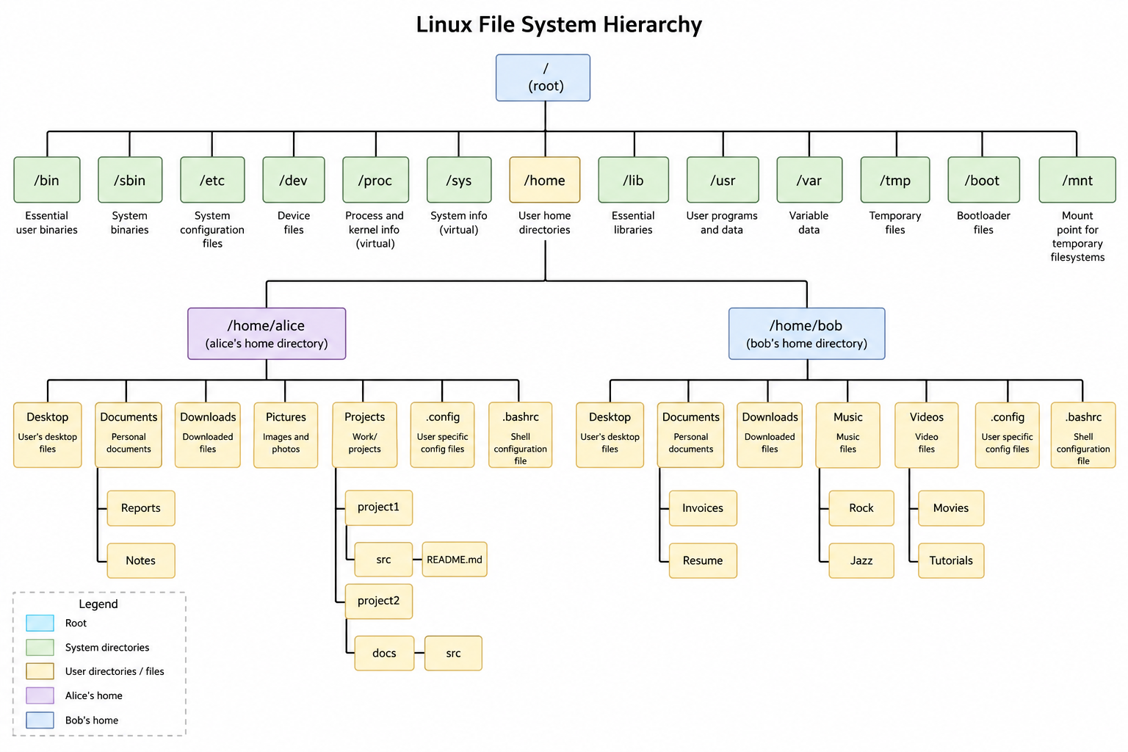

Slide 21
Linux File System
Directory | Purpose | Key Contents
/ | Root | The primary directory that contains all other directories and files.
/bin | User Binaries | Essential command binaries for all users (e.g., ls, cp, ping).
/boot | Boot Files | Static files of the boot loader, including the Linux kernel and Grub configuration.
/dev | Device Files | Representation of hardware components as files (e.g., /dev/sda for a disk).
/etc | Configuration | System-wide configuration files and startup scripts for services.
/home | User Home | Personal directories for users to store documents and settings (e.g., /home/atul).
/lib | System Libraries | Shared library files required by binaries in /bin and /sbin.
/media | Removable Media | Mount points for removable devices like USB drives or CD-ROMs.
/mnt | Mount | A temporary mount point for filesystem installations or external drives.
/opt | Optional Software | Add-on application software packages from third-party vendors.
Tree-like structure starting from the root directory (/)
This structure ensures that users and software can reliably find files across different Linux distributions

Slide 22
Directory Commands
Command | Action | Example
pwd | Print Working Directory: Shows exactly where you are. | pwd
ls | List: Shows files and folders in your current spot. | ls -l (long format)
cd | Change Directory: Moves you to a new folder. | cd /home/user
mkdir | Make Directory: Creates a new folder. | mkdir new_folder
rmdir | Remove Directory: Deletes an empty folder. | rmdir old_folder
rm -r | Remove Recursive: Deletes a folder and everything inside it. | rm -r project_dir
mv | Move/Rename: Moves a folder or changes its name. | mv folder1 folder2
cp -r | Copy Recursive: Copies a folder and its entire contents. | cp -r source backup

Slide 23
File Creation and Viewing
Command | Purpose | Example
touch | Create empty file | touch file.txt
cat | Display file content | cat file.txt
less | View file page by page | less file.txt
head | First 10 lines | head file.txt
tail | Last 10 lines | tail file.txt

Slide 24
File Editing and Copying
Command | Purpose | Example
cp | Copy file | cp file.txt backup.txt
mv | Move or rename file | mv file.txt newfile.txt
vi | Edit file | vi file.txt
nano | Edit file (easy) | nano file.txt

Slide 25
File Deletion
Command | Purpose | Example
rm | Delete file | rm file.txt
rm -i | Delete with confirmation | rm -i file.txt
rm -r | Delete directory recursively | rm -r myfolder

Slide 26
File Information
Command | Purpose | Example
ls | List files | ls
ls -l | Detailed list | ls -l
stat | Detailed file info | stat file.txt
file | File type | file file.txt

Slide 27
Directory Operations
Command | Purpose | Example
mkdir | Create directory | mkdir mydir
rmdir | Remove empty directory | rmdir mydir
cd | Change directory | cd mydir
pwd | Show current directory | pwd

Slide 28
Exercise
Step | Task
1 | Display current directory
2 | Create a directory named lab1
3 | Move into lab1
4 | Create a file named file1.txt
5 | Open the file and add some text
6 | Display the file contents
7 | Copy file1.txt to file2.txt
8 | Rename file2.txt to file_renamed.txt
9 | List all files
10 | Display detailed file information
11 | Show file type of file1.txt
12 | Delete file_renamed.txt
13 | Go back to parent directory
14 | Delete the directory lab1

Slide 29
Step | Task | Command
1 | Display current directory | pwd
2 | Create a directory named lab1 | mkdir lab1
3 | Move into lab1 | cd lab1
4 | Create a file named file1.txt | touch file1.txt
5 | Open the file and add some text | vi file1.txt
6 | Display the file contents | cat file1.txt
7 | Copy file1.txt to file2.txt | cp file1.txt file2.txt
8 | Rename file2.txt to file_renamed.txt | mv file2.txt file_renamed.txt
9 | List all files | ls
10 | Display detailed file information | ls -l
11 | Show file type of file1.txt | file file1.txt
12 | Delete file_renamed.txt | rm file_renamed.txt
13 | Go back to parent directory | cd ..
14 | Delete the directory lab1 | rm -r lab1

Slide 30
Absolute and Relative Path
Feature | Absolute Path | Relative Path
Definition | Full path from root directory | Path relative to current directory
Starts with | / (root) | Does not start with /
Depends on current location | No | Yes
Always same? | Yes | Changes based on location
Example | /home/user/docs/file.txt | docs/file.txt
Another Example | /etc/passwd | ../file.txt

Slide 31
Absolute and Relative Path Examples
Absolute path
  cd /home/user/docs
Relative path
  cd docs
  cd ../docs

Slide 32
Special Symbols in Linux Paths
Symbol | Meaning | Example | Explanation
. | Current directory | ./file.txt | Refers to current location
.. | Parent directory | ../file.txt | One level up
/ | Root directory | /home/user | Top of the filesystem
~ | Home directory | ~/file.txt | User’s home folder
cd . # Stay in current directory
cd .. # Go to parent directory
cd / # Go to root directory
cd ~ # Go to home directory
cd ~/docs # Go to docs inside home

Slide 33
Exercises
No. | Task
1 | Stay in the current directory
2 | Move one level up from current directory
3 | Go to the root directory from anywhere
4 | Go to your home directory and create a docs directory
5 | From any location, go to docs folder inside home directory
6 | From /home/user/docs, go to /home/user
7 | From /home/user/docs, go to /home
8 | From /home/user/docs, access file.txt in the same directory using relative path
9 | From /home/user/docs, access file.txt in parent directory
10 | From /home/user/docs, go to root and then to /home

Slide 34
Solutions
No. | Task | Command
1 | Stay in the current directory | cd .
2 | Move one level up from current directory | cd ..
3 | Go to the root directory from anywhere | cd /
4 | Go to your home directory and create a docs directory | cd ~ mkdir docs
5 | From any location, go to docs folder inside home directory | cd ~/docs
6 | From /home/user/docs, go to /home/user | cd ..
7 | From /home/user/docs, go to /home | cd ../..
8 | From /home/user/docs, access file.txt in the same directory using relative path | cat ./file.txt
9 | From /home/user/docs, access file.txt in parent directory | cat ../file.txt
10 | From /home/user/docs, go to root and then to /home | cd /home

Slide 35
Superuser Commands
su = become someone else, sudo = borrow the power of the superuser for a command
Feature | su | sudo
What it does | Switch to another user (usually root) | Run one command as another user
Password | Target user's password | Your own password
Duration | Stays logged in as that user | Only for that one command
Security | Less secure (shares root password) | More secure (logs who did what)
Setup | Works by default | Needs to be added to sudo/wheel group

Slide 36
How to Become a Root User?
In a standard Ubuntu installation, the root user account is locked by default for security
Result: There is no root password to enter, so you cannot log in directly as root
Solution: Open an interactive shell
  sudo -i
  This simulates a root login, loading the root user's environment variables and changing your directory to /root
  Your prompt will typically change from $ to #
  To exit, type exit and ENTER key, or use Ctrl+D
  Alternate command: sudo su -

Slide 37
Comparison Table
Method | Command | Best For
Standard Sudo | sudo <cmd> | One-off tasks (installs, updates)
Login Shell | sudo -i | Heavy configuration, multi-step work
Substitute Shell | sudo su | Quick tasks needing root for a few minutes

Slide 38
User Creation/Modification Commands
Task | Command | Description
Create User (Simple) | sudo useradd [username] | Creates a user with default settings (no home directory by default)
Create User (Interactive) | sudo adduser [username] | A friendly script that prompts for password, name, and creates /home – Debian/Ubuntu only
Set/Change Password | sudo passwd [username] | Assigns or updates the password for the specified user
Modify User | sudo usermod -aG [group] [user] | Adds a user to a supplementary group (e.g., adding to sudo)
Delete User | sudo userdel -r [username] | Removes the user. The -r flag also deletes their home directory
Check User Info | id [username] | Displays the UID, GID, and groups the user belongs to

Slide 39
Adding Users to Sudoers Group
Method 1: Add user to sudoers group directly
sudo usermod -aG sudo username
Method 2: Edit the /etc/sudoers file
sudo visudo
Then add this line to the opened file
username ALL=(ALL:ALL) ALL

Slide 40
Group Command
Group: Allows us to manage permissions for multiple users simultaneously
Task | Command | Description
Create Group | sudo groupadd [groupname] | Creates a new group.
Delete Group | sudo groupdel [groupname] | Removes an existing group.
List Groups | groups [username] | Shows all groups a specific user is a member of.
List All Groups | getent group | Displays a list of all groups defined on the system.
Command | Action | Description
sudo usermod -aG marketing john | Add user to group | Adds the user john to the marketing group without removing them from existing groups.
sudo gpasswd -d john marketing | Remove user from group | Removes the user john from the marketing group.

Slide 41
Key Files for User Information
File Path | Purpose | Key Fields (Separated by :)
/etc/passwd | User Account Info | Username, Password (usually x), UID, GID, User Info, Home Directory, Default Shell.
/etc/shadow | Hashed Passwords | Username, Hashed Password, Last Change Date, Minimum/Maximum Password Age, Expiration.
/etc/group | Group Definitions | Group Name, Group Password (rarely used), GID, List of Users in the group.
/etc/gshadow | Group Passwords | Secure group information (similar to /etc/shadow but for groups).
/etc/sudoers | Sudo Privileges | Controls which users or groups can run commands as root (managed sudo visudo).

Slide 42
Exercise
# | Task Description
1 | Create a new user named student1 with a default home directory.
2 | Set or change the password for the user student1.
3 | Create a new group named developers.
4 | Add the existing user student1 to the developers group as a secondary group.
5 | Change the login name of student1 to intern1 keeping the home directory unchanged.
6 | Delete the user intern1 and remove their home directory simultaneously.
7 | Lock a user's account (e.g., user2) to prevent login.
8 | Unlock a previously locked user account (e.g., user2).
9 | Display all groups that the current user belongs to.
10 | Change the primary group of user2 to developers.
11 | Create a user tempuser with an account expiry date of 2026-12-31.
12 | View the password aging/expiry details for a specific user.
13 | Remove a user named user2 from the group developers without deleting the user.
14 | Delete the group named developers from the system.
15 | Find the UID and GID information for a specific user.

Slide 43
Solutions
# | Task Description | Solution
1 | Create a new user named student1 with a default home directory. | sudo useradd -m student1
2 | Set or change the password for the user student1. | sudo passwd student1
3 | Create a new system group named developers. | sudo groupadd developers
4 | Add the existing user student1 to the developers group as a secondary group. | sudo usermod -aG developers student1
5 | Change the login name of student1 to intern1. | sudo usermod -l intern1 student1
6 | Delete the user intern1 and remove their home directory simultaneously. | sudo userdel -r intern1
7 | Lock a user's account (e.g., user2) to prevent login. | sudo usermod -L user2
8 | Unlock a previously locked user account (e.g., user2). | sudo usermod -U user2
9 | Display all groups that the current user belongs to. | groups
10 | Change the primary group of user2 to developers. | sudo usermod -g developers user2
11 | Create a user tempuser with an account expiry date of 2026-12-31. | sudo useradd -e 2026-12-31 tempuser
12 | View the password aging/expiry details for a specific user. | sudo chage -l user2
13 | Remove a user named user2 from the group developers without deleting the user. | sudo gpasswd -d user2 developers
14 | Delete the group named developers from the system. | sudo groupdel developers
15 | Find the UID and GID information for a specific user. | id user2

Slide 44
File Permissions
Control who can access a file and what they can do
Symbol | Meaning
r | Read (view file)
w | Write (modify file)
x | Execute (run file/program)
Category | Meaning
User (u) | Owner of the file
Group (g) | Users in same group
Others (o) | Everyone else
All (a) | Everyone in the system

Slide 45
File Permissions
-rwxr-xr--
Part | Meaning
- | File type
rwx | User permissions
r-x | Group permissions
r-- | Others permissions

Slide 46
Octal File Permissions
Read | Write | Execute | Permission | Meaning | Binary | Decimal
0 | 0 | 0 | - - - | No permission | 000 | 0
0 | 0 | 1 | - - x | Execute only | 001 | 1
0 | 1 | 0 | - w - | Write only | 010 | 2
0 | 1 | 1 | - w x | Write and Execute | 011 | 3
1 | 0 | 0 | r - - | Read only | 100 | 4
1 | 0 | 1 | r - x | Read and Execute | 101 | 5
1 | 1 | 0 | r w - | Read and Write | 110 | 6
1 | 1 | 1 | r w x | Read, Write, and Execute | 111 | 7

Slide 47
Changing Permissions
chmod 755 file.txt
chmod u=rwx,g=rx,o=rx file.txt
Number | Permission
7 | rwx
5 | r-x
4 | r--

Slide 48
Examples
Command | Effect
chmod u+x script.sh | Adds execute permission for the owner only.
chmod g-w report.txt | Removes write permission from the group.
chmod o+r public.html | Adds read permission for everyone else (others).
chmod a+rw notes.txt | Adds read and write permissions for all (user, group, and others).
chmod ug=rwx data.sh | Sets exactly read, write, and execute for user and group, ignoring previous settings.

Slide 49
Numeric Examples
Command | Numeric Code Breakdown | Effect
chmod 777 file.txt | 7(rwx) 7(rwx) 7(rwx) | Full access for everyone (highly insecure).
chmod 755 script.sh | 7(rwx) 5(r-x) 5(r-x) | Owner can do everything; others can read and execute (standard for scripts).
chmod 644 config.conf | 6(rw-) 4(r--) 4(r--) | Owner can read/write; others can only read (standard for docs).
chmod 600 private.key | 6(rw-) 0(---) 0(---) | Only the owner can read and write; no one else has access.
chmod 700 secret.sh | 7(rwx) 0(---) 0(---) | Only the owner can read, write, and execute.

Slide 50
Exercises
No. | Task
1 | Give read, write, execute permission to owner only for file.txt
2 | Give read permission to everyone for file.txt
3 | Remove write permission from group for file.txt
4 | Set permissions to rwxr-xr-x for file.txt using numeric mode
5 | Set permissions to rw-r--r-- for file.txt using numeric mode
6 | Add execute permission for owner in script.sh
7 | Remove all permissions for others in file.txt
8 | Give full permissions to all users for file.txt
9 | Set permissions to read and write for owner, read for group and others
10 | Remove execute permission for all users from file.txt
11 | Add read permission for group in file.txt
12 | Remove all permissions from file.txt
13 | Set permissions to rwx------ using numeric mode
14 | Add execute permission for all users to script.sh
15 | Change permissions of all .sh files to executable in current directory

Slide 51
No. | Task | Command
1 | Give read, write, execute permission to owner only for file.txt | chmod 700 file.txt
2 | Give read permission to everyone for file.txt | chmod a+r file.txt
3 | Remove write permission from group for file.txt | chmod g-w file.txt
4 | Set permissions to rwxr-xr-x for file.txt using numeric mode | chmod 755 file.txt
5 | Set permissions to rw-r--r-- for file.txt using numeric mode | chmod 644 file.txt
6 | Add execute permission for owner in script.sh | chmod u+x script.sh
7 | Remove all permissions for others in file.txt | chmod o-rwx file.txt
8 | Give full permissions to all users for file.txt | chmod 777 file.txt
9 | Set permissions to read and write for owner, read for group and others | chmod 644 file.txt
10 | Remove execute permission for all users from file.txt | chmod a-x file.txt
11 | Add read permission for group in file.txt | chmod g+r file.txt
12 | Remove all permissions from file.txt | chmod 000 file.txt
13 | Set permissions to rwx------ using numeric mode | chmod 700 file.txt
14 | Add execute permission for all users to script.sh | chmod a+x script.sh
15 | Change permissions of all .sh files to executable in current directory | chmod +x *.sh

Slide 52
Access Control Lists (ACL)
ACL = Access Control List
Provides fine-grained permissions beyond chmod
Allows permissions for specific users and groups
Without ACL | With ACL
Only owner, group, others | Multiple users/groups
Limited control | Flexible control
chmod only | setfacl, getfacl

Slide 53
ACL Commands
Command | Purpose | Example
getfacl | View ACL | getfacl file.txt
setfacl -m | Set ACL | setfacl -m u:john:rwx file.txt
setfacl -x | Remove ACL | setfacl -x u:john file.txt
setfacl -b | Remove all ACLs | setfacl -b file.txt
Note: Just giving permission to user John using ACL will not allow him to access the file
Reason: John needs access to the entire path
Solution: After the above setfacl command, also run the following command:
setfacl -m u:john:x /home/atul
Then try sudo su john and cat /home/atul/file.txt, it will work

Slide 54
ACL Demo
Step 1: Create a new user called alice using adduser command
Step 2: Create a new file called share.txt and add a line in it using nano
Step 3: Check ACL on the file: getfacl share.txt
Step 4: Give permission to Alice on the file using setfacl: setfacl -m u:alice:rwx share.txt
Step 5: Recheck ACL on the file: getfacl share.txt
Step 6: Switch to user Alice and try to access the file
(a) sudo su alice
(b) cat /home/atul/share.txt
We will get permission denied error
Step 7: Type exit to come back to original user
Step 8: Add ACL on the user home directory to allow Alice access: setfacl -m u:alice:rwx /home/atul
Step 9: Switch to user Alice and try to access the file
(a) sudo su alice
(b) cat /home/atul/share.txt
We should be able to view the file
Step 10: Now try nano /home/atul/share.txt and edit something and save - it should allow

Slide 55
Shell Metacharacters
Characters that have a special meaning
ls *.txt
ls > output.txt
ls -l | sort
pwd; ls; date
name="Rahul"
echo $name

Slide 56
Misc Commands - sort
Sorts lines of text from a file or standard input
# Alphabetical sort
sort names.txt
# Reverse order
sort -r names.txt
# Numeric sort
sort -n numbers.txt
# Numeric sort, descending
sort -nr numbers.txt
# Remove duplicate lines while sorting
sort -u names.txt
# Sort by a specific column
sort -k2 data.txt
# Sort numerically by the second column
sort -k2,2n data.txt
# Sort human-readable sizes (KB, MB, GB)
sort -h sizes.txt

Slide 57
Misc Commands – diff
Compares two files line by line and shows the difference
diff file1.txt file2.txt
diff -i file1 file2 -- Ignore case
diff -q file1 file2 -- Only say if the files differ

Slide 58
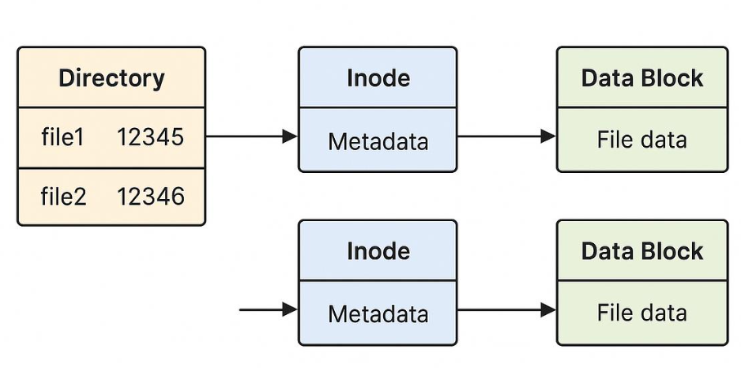
Links
Two types: Hard link and Soft link (Symbolic link)
Hard link: Same data/inode as the original file
  ln file1.txt file2.txt
  Both names refer to the same file data
  ls -li -- Both files will have the same inode number
  If we delete the original, the link still works: rm file1.txt and cat file2.txt
Soft link: Shortcut/path to a file
  ln -s file1.txt link.txt
  If the original file is deleted, symbolic link becomes a broken/dangling link

Slide 59
Global Regular Expression Print (grep) Command
Searches for specific patterns within files or command output and displays the matching lines
Option | Description | Example
-i | Ignore Case: Searches for the pattern regardless of uppercase or lowercase. | grep -i "error" log.txt
-v | Invert Match: Displays all lines that do not contain the pattern. | grep -v "success" log.txt
-r | Recursive: Searches for the pattern in all files within a directory and its subdirectories. | grep -r "function" ./src
-n | Line Number: Displays the line number where the match was found. | grep -n "main" script.py
-c | Count: Returns the total number of lines that match the pattern instead of the text itself. | grep -c "failed" auth.log
-l | File Names Only: Lists only the names of files that contain the match. | grep -l "TODO" *.md
-w | Whole Word: Matches the pattern only if it is a whole word (not a substring). | grep -w "is" file.txt
-E | Extended Regex: Allows the use of complex symbols like | (OR), +, and ?. | grep -E "cat|dog" animals.txt

Slide 60
Regex Using grep
Symbol | Meaning | Example
^ | Matches the beginning of a line. | grep "^Start" file.txt
$ | Matches the end of a line. | grep "End$" file.txt
. | Matches any single character. | grep "b.t" (matches bat, bet, bit)
* | Matches zero or more of the preceding character. | grep "ho*p" (matches hp, hop, hoop)
[ ] | Matches any character inside the brackets. | grep "[0-9]" (matches any digit)

Slide 61
find Command
Command | Description | Example
find /path -name file | Search by name | find /home -name file.txt
find /path -iname file | Case-insensitive search | find /home -iname file.txt
find /path -type f | Find files only | find /home -type f
find /path -type d | Find directories only | find /home -type d
find /path -size +100k | Files by size | find /home -size +100k
find /path -mtime -7 | Modified in last 7 days | find /home -mtime -7
find /path -name "*.txt" | Find by extension | find /home -name "*.txt"

Slide 62
locate Command
Task | Command | Example | Output | Notes
Search file by name | locate filename | locate file.txt | Full path(s) of file | Fast search
Case-insensitive search | locate -i name | locate -i file | Matches File, FILE, etc. | Ignores case
Limit number of results | locate -n N name | locate -n 5 file | First 5 results | Useful for large output
Count matches | locate -c name | locate -c file | Number of matches | No file list
Exact match | locate -b name | locate -b file.txt | Exact filename match | Avoid partial matches

Slide 63
Differences: find and locate
Feature | find | locate
Search method | Searches actual filesystem | Uses pre-built database (index)
Speed | Slower | Very fast
Accuracy | Always up-to-date | May be outdated
Syntax complexity | More complex | Very simple
Search scope | Specific directory (e.g., /home) | Entire system
Requires database | No | Yes (updatedb)
Real-time results | Yes | No
Advanced filters | Yes (size, type, time, permissions) | Limited
Example | find /home -name file.txt | locate file.txt

Slide 64
The tar Command
tar = Tape Archive
Used to combine multiple files/folders into one file
Does NOT compress by default
Concept | Meaning | Example | Size Reduction
Archive | Combines many files into one | data.tar | No
Compression | Reduces file size | data.gz | Yes
Archive + Compression | Both together | data.tar.gz | Yes

Slide 65
tar Usage
c = Create
v = Verbose
f = File name
x = Extract
z = Compress
Command | Purpose | Example
tar -cvf | Create archive | tar -cvf data.tar file1.txt dir/
tar -xvf | Extract archive | tar -xvf data.tar
tar -tf | List contents | tar -tf data.tar
Task | Command | Explanation | Output
Create compressed archive (files) | tar -czvf data.tar.gz file1.txt file2.txt | Combines + compresses files | data.tar.gz
Archive a directory | tar -czvf project.tar.gz project/ | Compress entire folder (recursive) | project.tar.gz
Extract archive | tar -xzvf data.tar.gz | Extract all files | Files restored
Extract to specific folder | tar -xzvf data.tar.gz -C output/ | Extract into output/ directory | Files in output/
List contents | tar -tzvf data.tar.gz | View files without extracting | File list displayed

Slide 66
The gunzip and gzip Commands
Command | Purpose | Syntax | Example | Input | Output | Key Behavior
gzip | Compress a file | gzip file | gzip data.txt | data.txt | data.txt.gz | Original file is removed after compression
gzip -k | Compress + keep original | gzip -k file | gzip -k data.txt | data.txt | data.txt + data.txt.gz | Keeps both files
gunzip | Decompress file | gunzip file.gz | gunzip data.txt.gz | data.txt.gz | data.txt | Compressed file is removed
gzip -d | Decompress (same as gunzip) | gzip -d file.gz | gzip -d data.txt.gz | data.txt.gz | data.txt | Alternate way to unzip
zcat | View without extracting | zcat file.gz | zcat data.txt.gz | data.txt.gz | Output on screen | No file created

Slide 67
The gunzip/gzip Commands
Task | Command | Explanation | Output
Compress file | gzip file.txt | Compresses file | file.txt.gz (original removed)
Decompress file | gunzip file.txt.gz | Restores original file | file.txt
Decompress (alternate) | gzip -d file.txt.gz | Same as gunzip | file.txt
Keep original while compressing | gzip -k file.txt | Keeps both files | file.txt + file.txt.gz
View compressed content | zcat file.txt.gz | Displays content without extracting | Output on screen

Slide 68
The zip-unzip Commands
Command | Purpose | Syntax | Example | Input | Output | Key Behavior
zip | Compress files into archive | zip archive.zip files | zip data.zip file1.txt file2.txt | Files/folders | data.zip | Original files are kept
zip -r | Compress directory | zip -r archive.zip dir/ | zip -r project.zip project/ | Folder | project.zip | Includes subfolders
unzip | Extract archive | unzip archive.zip | unzip data.zip | .zip file | Files restored | Extracts in current directory
unzip -d | Extract to folder | unzip archive.zip -d dir/ | unzip data.zip -d output/ | .zip file | Files in output/ | Custom location
unzip -l | List contents | unzip -l archive.zip | unzip -l data.zip | .zip file | File list | No extraction

Slide 69
Shell Scripting
Shell script: A series of Linux commands in a file for task automation
Example
  #!/bin/bash
  # This is a comment
  echo "Hello World”
Execute
  Create file: nano script.sh
  Add commands shown above
  Give permission: chmod u+x script.sh
  Run: ./script.sh

Slide 70
Variables
Used to store data (value)
No data type declaration needed
Value is treated as string by default
Examples
  name="John"
  age=25
  echo $name
  echo $age

Slide 71
Add Two Numbers
#!/bin/bash
a=10
b=20
sum=$((a + b))
echo "Sum is $sum"

Slide 72
User Input
#!/bin/bash
read -p "Enter your name: " name
echo "Hello $name“
read -p "Enter two numbers: " a b
echo "A = $a, B = $b“
# See the impact of removing –p option, user does not know what to enter
read n
echo $n

Slide 73
User Input
#!/bin/bash
read -p "Enter two numbers: " x y
sum=$((x + y))
echo "Sum = $sum"

Slide 74
Arithmetic Using Variables
#!/bin/bash
read -p "Enter two numbers: " a b
sum=$((a + b))
prod=$((a * b))
echo "Sum = $sum"
echo "Product = $prod"

Slide 75
Make New Scripts Executable: Easy Method
Create this file (template.sh) with a single line and save it
  #!/bin/bash
Come back to shell and type: chmod u+x template.sh
Create new shell scripts using this: cp template.sh my_script.sh
New script is automatically executable and has the shebang operator

Slide 76
Floating Point Arithmetic With Hardcoded Inputs
#!/bin/bash
a=5.5
b=2.2
# With scale (How many floating point digits?)
sum=$(echo "scale=2; $a + $b" | bc)
prod=$(echo "scale=4; $a * $b" | bc)
echo "A = $a, B = $b"
echo "Sum = $sum"
echo "Product = $prod"

Slide 77
Floating Point Arithmetic: Taking User Input
#!/bin/bash
read -p "Enter two numbers: " a b
sum=$(echo "scale=2; $a + $b" | bc)
prod=$(echo "scale=2; $a * $b" | bc)
echo "Sum = $sum"
echo "Product = $prod"

Slide 78
Exercises
No. | Exercise
1 | Accept a user's name and age, store in variables, and display: Hello <name>, you are <age> years old.
2 | Accept two integers from the user and display their sum, difference, and product.
3 | Accept two numbers and calculate division using bc (show result up to 2 decimal places).
4 | Accept radius of a circle and calculate area using bc (π ≈ 3.14).
5 | Accept temperature in Celsius and convert it to Fahrenheit using bc (F = (9/5 x C) + 32)
6 | Accept length and breadth of a rectangle and calculate area and perimeter. Area = Length x Breadth, Perimeter = 2 x (Length + Breadth)
7 | Accept 3 subject marks and calculate total and average (use bc for average).
8 | Accept a number and calculate its square and cube.
9 | Accept principal, rate, and time, and calculate simple interest using bc. Simple interest = P * N * R

Slide 79
Solutions
#!/bin/bash
echo "----- Exercise 1: Name and Age -----"
read -p "Enter your name: " name
read -p "Enter your age: " age
echo "Hello $name, you are $age years old."
echo
echo "----- Exercise 2: Basic Arithmetic -----"
read -p "Enter two integers: " a b
sum=$((a + b))
diff=$((a - b))
prod=$((a * b))
echo "Sum = $sum"
echo "Difference = $diff"
echo "Product = $prod"
echo
echo "----- Exercise 3: Division using bc -----"
read -p "Enter two numbers: " x y
div=$(echo "scale=2; $x / $y" | bc)
echo "Division = $div"
echo
echo "----- Exercise 4: Area of Circle -----"
read -p "Enter radius: " r
area=$(echo "scale=2; 3.14 * $r * $r" | bc)
echo "Area of Circle = $area"
echo
echo "----- Exercise 5: Celsius to Fahrenheit -----"
read -p "Enter temperature in Celsius: " c
f=$(echo "scale=2; (9/5)*$c + 32" | bc)
echo "Temperature in Fahrenheit = $f"
echo
echo "----- Exercise 6: Rectangle Area & Perimeter -----"
read -p "Enter length and breadth: " l b
area_rect=$((l * b))
peri=$((2 * (l + b)))
echo "Area = $area_rect"
echo "Perimeter = $peri"
echo
echo "----- Exercise 7: Total and Average Marks -----"
read -p "Enter 3 marks: " m1 m2 m3
total=$((m1 + m2 + m3))
avg=$(echo "scale=2; $total / 3" | bc)
echo "Total = $total"
echo "Average = $avg"
echo
echo "----- Exercise 8: Square and Cube -----"
read -p "Enter a number: " n
sq=$((n * n))
cube=$((n * n * n))
echo "Square = $sq"
echo "Cube = $cube"
echo
echo "----- Exercise 9: Simple Interest -----"
read -p "Enter Principal, Rate, Time: " p r t
si=$(echo "scale=2; ($p * $r * $t) / 100" | bc)
echo "Simple Interest = $si"
echo
echo "----- Exercise 10: Compare Two Numbers -----"
read -p "Enter two numbers: " num1 num2
result=$(echo "$num1 > $num2" | bc)
if [ "$result" -eq 1 ]; then
echo "$num1 is greater than $num2"
else
echo "$num2 is greater than or equal to $num1"
fi

Slide 80
Simple Interest Calculation with an if Condition
#!/bin/bash
# Simple interest calculator
# p = principal amount
# i = interest
# t = term
# r = rate of interest
read -p "Enter principal, term, rate of interest separated by space: " p t r
interest=$(echo "scale=2; $p * $t * $r / 100" | bc)
echo "Interest is $interest"
if [ $(echo "$interest > 100" | bc) -eq 1 ]; then
echo "You are rich"
else
echo "You are poor"
fi

Slide 81
Swap Two Numbers
#!/bin/bash
read -p "Enter two numbers: " a b
temp=$a
a=$b
b=$temp
echo "After swap: A = $a, B = $b"

Slide 82
Area of Rectangle
#!/bin/bash
read -p "Enter length and width: " l w
area=$((l * w))
echo "Area = $area"

Slide 83
Temperature Conversion
#!/bin/bash
read -p "Enter temperature in Celsius: " c
f=$(( (c * 9/5) + 32 ))
echo "Fahrenheit = $f"

Slide 84
Temperature Conversion using Bash Calculator
#!/bin/bash
read -p "Enter temperature in Celsius: " c
f=$(echo "scale=2; ($c * 9/5) + 32" | bc)
echo "Fahrenheit = $f“
#################
#!/bin/bash
read -p "Enter temperature in Fahrenheit: " f
c=$(echo "scale=2; ($f - 32) * 5/9" | bc)
echo "Celsius = $c"

Slide 85
Average Calculation
Accept marks of a student in 3 subjects and display total marks and average marks
#!/bin/bash
read -p "Enter marks for Subject 1: " m1
read -p "Enter marks for Subject 2: " m2
read -p "Enter marks for Subject 3: " m3
# Calculate total marks
total=$(echo "$m1 + $m2 + $m3" | bc)
# Calculate average marks with 2 decimal places
avg=$(echo "scale=2; $total / 3" | bc)
echo "Total Marks = $total"
echo "Average Marks = $avg"

Slide 86
Result
Modify to decide if the student passed
#!/bin/bash
read -p "Enter marks for Subject 1: " m1
read -p "Enter marks for Subject 2: " m2
read -p "Enter marks for Subject 3: " m3
# Calculate total marks
total=$(echo "$m1 + $m2 + $m3" | bc)
# Calculate average marks with 2 decimal places
avg=$(echo "scale=2; $total / 3" | bc)
echo "Total Marks = $total"
echo "Average Marks = $avg"
# Check if the student has passed (minimum 50 average)
passed=$(echo "$avg >= 50" | bc)
if [ "$passed" -eq 1 ]; then
echo "Result: Passed"
else
echo "Result: Failed"
fi

Slide 87
Parameter Passing
#!/bin/bash
echo "First argument = $1“
To run: ./script.sh Hello

Slide 88
Parameter Passing
#!/bin/bash
sum=$(( $1 + $2 ))
echo "Sum = $sum“
To run: ./script.sh 5 10

Slide 89
Count Number of Parameters/Arguments
#!/bin/bash
echo "Total arguments = $#“
To run: ./script.sh a b c

Slide 90
Display All Arguments
#!/bin/bash
echo "All arguments: $@“
To run: ./script.sh one two three

Slide 91
Script Name and Arguments
#!/bin/bash
echo "Script name = $0"
echo "First argument = $1"
echo "Second argument = $2“
To run: ./script.sh Linux Shell

Slide 92
String Length
#!/bin/bash
read -p "Enter a string: " str
length=${#str}
echo "Length = $length"

Slide 93
Reverse String
#!/bin/bash
read -p "Enter a string: " str
rev_str=$(echo "$str" | rev)
echo "Reversed string = $rev_str"

Slide 94
Count Vowels in a String
#!/bin/bash
read -p "Enter a string: " str
count=$(echo "$str" | grep -o -i "[aeiou]" | wc -l)
echo "Number of vowels = $count"

Slide 95
Numeric and String Relational Operators
Operator | Meaning | Example
-eq | Equal to | [ $a -eq $b ]
-ne | Not equal | [ $a -ne $b ]
-gt | Greater than | [ $a -gt $b ]
-lt | Less than | [ $a -lt $b ]
-ge | Greater than or equal | [ $a -ge $b ]
-le | Less than or equal | [ $a -le $b ]
Operator | Meaning | Example
= | Equal | [ "$a" = "$b" ]
!= | Not equal | [ "$a" != "$b" ]
-z | String is empty | [ -z "$a" ]
-n | String not empty | [ -n "$a" ]

Slide 96
Numeric Comparison
#!/bin/bash
a=10
b=20
if [ $a -lt $b ]
then
echo "a is smaller"
fi

Slide 97
String Comparison (Default: Case Sensitive)
a="hello"
b="Hello"
if [ "$a" = "$b" ]
then
echo "Equal"
else
echo "Not Equal"
fi
a="hello"
b="Hello"
if [ "${a,,}" = "${b,,}" ] # ignore case
then
echo "Equal"
fi

Slide 98
Conditions using if
if [ condition ]
then
commands
else
commands
fi
#!/bin/bash
read -p "Enter a number: " num
if [ $((num % 2)) -eq 0 ]
then
echo "Even number"
else
echo "Odd number"
fi

Slide 99
More if Examples
#!/bin/bash
read -p "Enter a number: " num
if [ $num -gt 0 ]
then
echo "Positive"
elif [ $num -lt 0 ]
then
echo "Negative"
else
echo "Zero"
fi

Slide 100
Voting Eligibility
#!/bin/bash
read -p "Enter your age: " age
if [ $age -ge 18 ]
then
echo "Eligible to vote"
else
echo "Not eligible to vote"
fi

Slide 101
Check If Digit
#!/bin/bash
read -p "Enter a character: " ch
if [[ $ch =~ ^[0-9]+$ ]]
then
echo "It is a digit"
else
echo "Not a digit"
fi

Slide 102
Largest of Three Numbers
#!/bin/bash
read -p "Enter three numbers: " a b c
if [ $a -gt $b ]
then
if [ $a -gt $c ]
then
echo "Largest = $a"
else
echo "Largest = $c"
fi
else
if [ $b -gt $c ]
then
echo "Largest = $b"
else
echo "Largest = $c"
fi
fi

Slide 103
Same Example Using AND Condition
#!/bin/bash
# Find largest of three numbers using logical AND
read -p "Enter three numbers: " a b c
if [ $a -gt $b ] && [ $a -gt $c ]; then
echo "Largest = $a"
elif [ $b -gt $a ] && [ $b -gt $c ]; then
echo "Largest = $b"
else
echo "Largest = $c"
fi

Slide 104
Grade Classification
#!/bin/bash
read -p "Enter marks: " m
if [ $m -ge 50 ]
then
if [ $m -ge 75 ]
then
echo "Distinction"
else
echo "Pass"
fi
else
echo "Fail"
fi

Slide 105
Student Marks and Grade Calculation
#!/bin/bash
read -p "Enter marks in subject 1: " sub1
read -p "Enter marks in subject 2: " sub2
read -p "Enter marks in subject 3: " sub3
if [ sub1 -ge 35 && sub2 -ge 35 && sub3 -ge 35 ]; then
echo "Result: Pass"
total=$(echo "$sub1 + $sub2 + $sub3" | bc)
average=$(echo "scale=2; $total / 3" | bc)
echo "Total Marks: $total"
echo "Average Marks: $average"
# Determine grade based on average using bc
is_first_class=$(echo "$average >= 75" | bc)
if [ "$is_first_class" -eq 1 ]; then
echo "Grade: First Class"
else
echo "Grade: Pass"
fi
else
echo "Result: Fail"
fi

Slide 106
Use of && and ||
#!/bin/bash
read -p "Enter Username: " username
read -sp "Enter Password: " password
echo
# Allows login if (admin credentials) OR (root credentials)
if [[ ( "$username" == "admin" && "$password" == "secret123" ) || ( "$username" == "root" && "$password" == "rootpass" ) ]]; then
echo "Login successful!"
else
echo "Invalid credentials."
fi

Slide 107
Even/Odd and Positive/Negative
#!/bin/bash
read -p "Enter a number: " num
if [ $num -gt 0 ]
then
if [ $((num % 2)) -eq 0 ]
then
echo "Positive Even"
else
echo "Positive Odd"
fi
else
if [ $((num % 2)) -eq 0 ]
then
echo "Negative Even"
else
echo "Negative Odd"
fi
fi

Slide 108
Login Validation
#!/bin/bash
read -p "Enter username: " user
read -p "Enter password: " pass
if [ "$user" = "admin" ]
then
if [ "$pass" = "1234" ]
then
echo "Login successful"
else
echo "Wrong password"
fi
else
echo "Invalid username"
fi

Slide 109
Using AND
#!/bin/bash
read -p "Enter three numbers: " a b c
if [ $a -gt $b ] && [ $a -gt $c ]
then
echo "Largest = $a"
elif [ $b -gt $a ] && [ $b -gt $c ]
then
echo "Largest = $b"
else
echo "Largest = $c"
fi

Slide 110
Login Validation Using AND
#!/bin/bash
read -p "Enter username: " user
read -p "Enter password: " pass
if [ "$user" = "admin" ] && [ "$pass" = "1234" ]
then
echo "Login successful"
else
echo "Invalid username or password"
fi

Slide 111
OR
#!/bin/bash
read -p "Enter marks for 2 subjects: " m1 m2
if [ $m1 -ge 40 ] || [ $m2 -ge 40 ]
then
echo "Pass in at least one subject"
else
echo "Fail in both"
fi

Slide 112
Combining AND and OR
#!/bin/bash
read -p "Enter username: " user
read -p "Enter password: " pass
if { [ "$user" = "admin" ] && [ "$pass" = "1234" ]; } || \
{ [ "$user" = "root" ] && [ "$pass" = "root" ]; }
then
echo "Login successful"
else
echo "Invalid username or password"
fi

Slide 113
OR with Strings
day="Sunday"
if [ "$day" = "Saturday" ] || [ "$day" = "Sunday" ]
then
echo "Weekend"
else
echo "Weekday"
fi

Slide 114
Login Validation
#!/bin/bash
read -p "Enter username: " user
read -p "Enter password: " pass
if { [ "$user" = "admin" ] && [ "$pass" = "1234" ]; } || \
{ [ "$user" = "guest" ] && [ "$pass" = "guest123" ]; }
then
echo "Login successful"
else
echo "Invalid credentials"
fi

Slide 115
NOT
#!/bin/bash
read -p "Enter a number: " num
if [ ! $num -eq 0 ]
then
echo "Number is not zero"
fi

Slide 116
NOT for String
a="hello"
b="world"
if [ "$a" != "$b" ]
then
echo "Strings are different"
fi

Slide 117
Student Result Calculation
#!/bin/bash
# Input marks
read -p "Enter marks for 3 subjects: " m1 m2 m3
# Calculate total
total=$((m1 + m2 + m3))
# Calculate average
avg=$((total / 3))
echo "Total = $total"
echo "Average = $avg"
# Pass/Fail condition (assume pass if avg >= 40)
if [ $avg -ge 40 ]
then
echo "Result: Pass"
else
echo "Result: Fail"
fi

Slide 118
Handling Decimal Points
#!/bin/bash
# Input marks
read -p "Enter marks for 3 subjects: " m1 m2 m3
# Calculate total
total=$((m1 + m2 + m3))
# Floating-point average
avg=$(echo "scale=2; $total / 3" | bc)
echo "Total = $total"
echo "Average = $avg"
# Pass/Fail (compare using bc)
if [ $(echo "$avg >= 40" | bc) -eq 1 ]
then
echo "Result: Pass"
else
echo "Result: Fail"
fi

Slide 119
System/Shell Variables
Variable | Meaning | Example Value | Use Case
HOME | User’s home directory | /home/atul | Navigate to home
USER | Current username | atul | Display logged-in user
PWD | Present working directory | /home/atul/docs | Show current location
OLDPWD | Previous directory | /home/atul | cd - uses this
PATH | Executable search path | /usr/bin:/bin | Run commands without full path
SHELL | Current shell | /bin/bash | Know shell type
HOSTNAME | System hostname | ubuntu | Identify machine
TERM | Terminal type | xterm | Terminal compatibility
LOGNAME | Login name | atul | Similar to USER
EDITOR | Default editor | vi / nano | Used by programs
LANG | Language/locale | en_US.UTF-8 | Language settings

Slide 120
System/Shell Variables
#!/bin/bash
if [ "$UID" -eq 0 ]; then
echo "$USER is the root user."
else
echo "$USER is NOT the root user."
fi

Slide 121
List Files in Home Directory and Show Disk Usage of Current Directory
#!/bin/bash
echo "Files in your home directory ($HOME):"
ls $HOME
echo "Checking disk usage for: $PWD"
du -sh $PWD

Slide 122
Create a Directory in the User Home Directory
#!/bin/bash
# Check if the "my_test" directory already exists under $HOME
if [ ! -d "$HOME/my_test" ]; then
mkdir -p "$HOME/my_test"
echo "Directory 'my_test' has been created successfully at $HOME/my_test."
else
echo "Directory 'my_test' already exists at $HOME/my_test."
fi

Slide 123
Create a File in the Directory
#!/bin/bash
mkdir -p "$HOME/my_test"
echo "Test is successful" > "$HOME/my_test/message.txt"
echo "Verifying file contents …"
cat "$HOME/my_test/message.txt"

Slide 124
Backup Current Directory
#!/bin/bash
backup_name="backup_$(date +%Y%m%d).tar.gz"
tar -czf $backup_name $PWD
echo "Backup created: $backup_name"
read -p "Press a key to continue ..." user_key
echo "Now displaying the contents of the backup file"
tar -tzf $backup_name

Slide 125
Special Shell Variables
Variable | Meaning | Example
$0 | Script name | script.sh
$1, $2... | Command-line arguments | $1 = input1
$# | Number of arguments | 2
$@ | All arguments (separately) | arg1 arg2
$* | All arguments (as one string) | "arg1 arg2"
$$ | Current process ID | 1234
$? | Exit status of last command | 0 (success)

Slide 126
Sample Usage of Shell Variables
echo $HOME
echo $USER
echo $PATH
echo $$
echo $?

Slide 127
The case Statement
Used for multiple conditions (like switch-case in C/Java)
Cleaner than multiple if-elif
Matches a value against different patterns
case variable in
pattern1)
commands ;;
pattern2)
commands ;;
*)
default commands ;;
esac

Slide 128
case Example
#!/bin/bash
echo "Enter a number (1-3): "
read num
case $num in
1) echo "You selected ONE" ;;
2) echo "You selected TWO" ;;
3) echo "You selected THREE" ;;
*) echo "Invalid choice" ;;
esac

Slide 129
case Example With Default Input Values and Editing Enabled (-e)
#!/bin/bash
# Read first number with default value … -e means arrow keys, backspace etc allowed, since we are providing default input values that user may want to edit
read -e -i "10" -p "Enter first number: " a
echo
# Read second number with default value
read -e -i "5" -p "Enter second number: " b
echo
# Read operation with default value
read -e -i "+" -p "Enter operation (+, -, *, /): " op
echo
# Case statement
case $op in
+) echo "Result = $((a + b))" ;;
-) echo "Result = $((a - b))" ;;
\*) echo "Result = $((a * b))" ;;
/) echo "Result = $((a / b))" ;;
*) echo "Invalid operation" ;;
esac

Slide 130
Display if Today is a Weekday or Weekend
#!/bin/bash
# Get the current day of the week (e.g., Mon, Tue, Sat, Sun)
current_day=$(date +%a)
# Check the day using a case statement
case "$current_day" in
Sat|Sun)
echo "Weekend"
;;
*)
echo "Weekday"
;;
esac

Slide 131
Loops
Loop | Use Case
for | Known number of iterations
while | Run till condition is true
until | Run until condition becomes true

Slide 132
Loop Syntaxes
#!/bin/bash
# Loops
for i in 1 2 3 4 5
do
echo "Number: $i"
done
i=1
while [ $i -le 5 ]
do
echo "Number: $i"
((i++))
done
i=1
until [ $i -gt 5 ]
do
echo "Number: $i"
((i++))
done
# Another syntax - for loop
for (( i=1; i <= 10; i++ ))
do
echo "The next number is $i"
done

Slide 133
Sum of 10 Student Marks using “for”
#!/bin/bash
sum=0
echo "Enter marks of 10 students:"
for ((i=1; i<=10; i++))
do
read -p "Marks $i: " num
sum=$((sum + num))
done
echo "The sum of the 10 marks is: $sum"

Slide 134
Sum of 10 Student Marks using “while”
#!/bin/bash
sum=0
i=1
echo "Enter marks of 10 students below ..."
while (( i <= 10 ))
do
read -p "Marks $i: " num
sum=$((sum + num))
((i++))
done
echo "The sum of the 10 marks is: $sum"
avg=$((sum / 10))
echo "The average of the 10 marks is: $avg"

Slide 135
Sum of 10 Student Marks using “while” and “break”
#!/bin/bash
sum=0
count=0
echo "Enter marks below (enter a negative value to stop)..."
while true
do
read -p "Marks $((count + 1)): " num
if (( num < 0 )); then
break
fi
sum=$((sum + num))
((count++))
done
if (( count > 0 )); then
echo "The sum of the $count marks is: $sum"
avg=$((sum / count))
echo "The average of the $count marks is: $avg"
else
echo "No valid marks were entered."
fi

Slide 136
Modify to Count Passed and Failed Students
#!/bin/bash
sum=0
count=0
pass_count=0
fail_count=0
echo "Enter marks (enter a negative value to stop)..."
while true
do
read -p "Marks $((count + 1)): " num
if (( num < 0 )); then
break
fi
if (( num >= 35 )); then
((pass_count++))
else
((fail_count++))
fi
sum=$((sum + num))
((count++))
done
if (( count > 0 )); then
echo "The sum of the $count marks is: $sum"
avg=$((sum / count))
echo "The average of the $count marks is: $avg"
echo "Passed students (>= 35): $pass_count"
echo "Failed students (< 35): $fail_count"
else
echo "No valid marks entered."
fi

Slide 137
Modify to Find Maximum and Minimum Marks
#!/bin/bash
sum=0
count=0
pass_count=0
fail_count=0
max=0
min=0
echo "Enter marks (enter a negative value to stop)..."
while true
do
read -p "Marks $((count + 1)): " num
if (( num < 0 )); then
break
fi
if (( num >= 35 )); then
((pass_count++))
else
((fail_count++))
fi
if (( count == 0 )); then
max=$num
min=$num
else
if (( num > max )); then
max=$num
fi
if (( num < min )); then
min=$num
fi
fi
sum=$((sum + num))
((count++))
done
if (( count > 0 )); then
echo "The sum of the $count marks is: $sum"
avg=$((sum / count))
echo "The average of the $count marks is: $avg"
echo "Passed students (>= 35): $pass_count"
echo "Failed students (< 35): $fail_count"
echo "Maximum marks: $max"
echo "Minimum marks: $min"
else
echo "No valid marks entered."
fi

Slide 138
Factorial
#!/bin/bash
read -p "Enter a non-negative integer: " num
fact=1
for (( i=1; i<=num; i++ ))
do
fact=$((fact * i))
done
echo "Factorial of $num = $fact"

Slide 139
Reverse the Digits of an Integer
#!/bin/bash
read -p "Enter an integer: " num
rev=0
temp=$num
while [ $temp -ne 0 ]
do
remainder=$(( temp % 10 ))
rev=$(( rev * 10 + remainder ))
temp=$(( temp / 10 ))
done
echo "Reversed of $num = $rev"

Slide 140
Loop Examples – Add All Even Numbers from to 100
sum=0
for ((i=2; i<=100; i+=2))
do
sum=$((sum + i))
done
echo "Sum (for loop) = $sum“
sum=0
i=2
while [ $i -le 100 ]
do
sum=$((sum + i))
((i+=2))
done
echo "Sum (while loop) = $sum“
sum=0
i=2
until [ $i -gt 100 ]
do
sum=$((sum + i))
((i+=2))
done
echo "Sum (until loop) = $sum"

Slide 141
No. | Exercise
1 | Write a shell script to print numbers from 1 to 10 using a for loop.
2 | Write a shell script to print numbers from 10 to 1 using a while loop.
3 | Write a shell script to display the multiplication table of 5 using a for loop.
4 | Write a shell script to find the sum of numbers from 1 to 10 using a while loop.
5 | Write a shell script to print all even numbers from 1 to 20 using a for loop.
6 | Write a shell script to count how many numbers are there from 1 to 15 using a while loop.
7 | Write a shell script to print the squares of numbers from 1 to 10 using a for loop.
8 | Write a shell script to display each character of the word LINUX one by one using a while loop.
9 | Write a shell script to calculate the factorial of 5 using a for loop.
10 | Write a shell script to print numbers from 1 to 20 and stop when the number becomes 12 using a while loop.

Slide 142
Solutions
  #!/bin/bash
  echo "-------------------------------"
  echo "Solution 1: Print 1 to 10 using for loop"
  echo "-------------------------------"
  for i in 1 2 3 4 5 6 7 8 9 10
  do
  echo $i
  done
  echo
  echo "-------------------------------"
  echo "Solution 2: Print 10 to 1 using while loop"
  echo "-------------------------------"
  i=10
  while [ $i -ge 1 ]
  do
  echo $i
  i=$((i - 1))
  done
  echo
  echo "-------------------------------"
  echo "Solution 3: Multiplication table of 5 using for loop"
  echo "-------------------------------"
  for i in 1 2 3 4 5 6 7 8 9 10
  do
  echo "5 x $i = $((5 * i))"
  done
  echo
  echo "-------------------------------"
  echo "Solution 4: Sum of numbers from 1 to 10 using while loop"
  echo "-------------------------------"
  i=1
  sum=0
  while [ $i -le 10 ]
  do
  sum=$((sum + i))
  i=$((i + 1))
  done
  echo "Sum = $sum"
  echo
  echo "-------------------------------"
  echo "Solution 5: Even numbers from 1 to 20 using for loop"
  echo "-------------------------------"
  for i in 2 4 6 8 10 12 14 16 18 20
  do
  echo $i
  done
  echo
  echo "-------------------------------"
  echo "Solution 6: Count numbers from 1 to 15 using while loop"
  echo "-------------------------------"
  i=1
  count=0
  while [ $i -le 15 ]
  do
  count=$((count + 1))
  i=$((i + 1))
  done
  echo "Count = $count"
  echo
  echo "-------------------------------"
  echo "Solution 7: Squares of numbers from 1 to 10 using for loop"
  echo "-------------------------------"
  for i in 1 2 3 4 5 6 7 8 9 10
  do
  echo "$i squared = $((i * i))"
  done
  echo
  echo "-------------------------------"
  echo "Solution 8: Display each character of LINUX using while loop"
  echo "-------------------------------"
  word="LINUX"
  i=0
  while [ $i -lt 5 ]
  do
  echo "${word:$i:1}"
  i=$((i + 1))
  done
  echo
  echo "-------------------------------"
  echo "Solution 9: Factorial of 5 using for loop"
  echo "-------------------------------"
  fact=1
  for i in 1 2 3 4 5
  do
  fact=$((fact * i))
  done
  echo "Factorial of 5 = $fact"
  echo
  echo "-------------------------------"
  echo "Solution 10: Print 1 to 20, stop at 12 using while loop"
  echo "-------------------------------"
  i=1
  while [ $i -le 20 ]
  do
  echo $i
  if [ $i -eq 12 ]
  then
  break
  fi
  i=$((i + 1))
  done

Slide 143
Same Example, Added if
sum=0
for ((i=1; i<=100; i++))
do
if ((i % 2 == 0))
then
sum=$((sum + i))
fi
done
echo "Sum (for loop) = $sum“
sum=0
i=1
while [ $i -le 100 ]
do
if ((i % 2 == 0))
then
sum=$((sum + i))
fi
((i++))
done
echo "Sum (while loop) = $sum“
sum=0
i=1
until [ $i -gt 100 ]
do
if ((i % 2 == 0))
then
sum=$((sum + i))
fi
((i++))
done
echo "Sum (until loop) = $sum"

Slide 144
Loop Example
#!/bin/bash
choice="y"
# until loop → repeat program until user says no
until [ "$choice" = "n" ]
do
read -p "Enter number of students: " n
total=0
i=1
echo "Enter marks:"
# for loop → input + sum
for ((i=1; i<=n; i++))
do
read -p "Student $i: " mark
total=$((total + mark))
done
avg=$((total / n))
echo "Total = $total"
echo "Average = $avg"
# while loop → display numbers till n
i=1
echo "Displaying student numbers:"
while [ $i -le $n ]
do
echo "Student $i"
((i++))
done
echo
read -p "Do you want to continue? (y/n): " choice
done
echo "Program ended."

Slide 145
Useful Scripts: Accept a String from User and Search in All Files
#!/bin/bash
read -p "Enter word to search: " word
echo "Searching for '$word' in all files..."
grep -rn "$word" *

Slide 146
Sort a File and Remove Duplicates
#!/bin/bash
read -p "Enter filename: " file
echo "Sorted unique contents:"
sort "$file" | uniq

Slide 147
Count Lines, Words, Bytes in All Files
#!/bin/bash
echo "File-wise count (lines, words, bytes):"
echo "------------------------------------------"
for file in *
do
if [ -f "$file" ]; then
wc "$file"
fi
done

Slide 148
Backup Files into a Zip Archive
#!/bin/bash
read -p "Enter folder name to backup: " folder
read -p "Enter zip file name: " zipname
zip -r "$zipname.zip" "$folder"
echo "Backup created: $zipname.zip"

Slide 149
Check If a File Exists and Show its Permissions
#!/bin/bash
read -p "Enter filename: " fname
if [ -e "$fname" ]; then
echo "File exists"
[ -r "$fname" ] && echo "Readable"
[ -w "$fname" ] && echo "Writable"
[ -x "$fname" ] && echo "Executable"
else
echo "File does not exist"
fi

Slide 150
Copy All Files of a Particular Extension in a Different Directory
#!/bin/bash
mkdir -p backup
for file in *.txt
do
if [ -f "$file" ]; then
cp "$file" backup/
echo "Copied: $file"
fi
done
echo "Backup completed."

Slide 151
Create a New User
#!/bin/bash
# Check if script is run as root
if [ "$EUID" -ne 0 ]; then
echo "Please run as root (use sudo)"
exit 1
fi
# Accept username
read -p "Enter new username: " username
# Check if user already exists
if id "$username" &>/dev/null; then
echo "User already exists!"
else
# Create user with home directory
useradd -m "$username"
# Set password
passwd "$username"
echo "User '$username' created successfully."
fi

Slide 152
Linux Process Commands
Process = A running program
ps Basic view
ps aux Detailed view
top Live processes

Slide 153
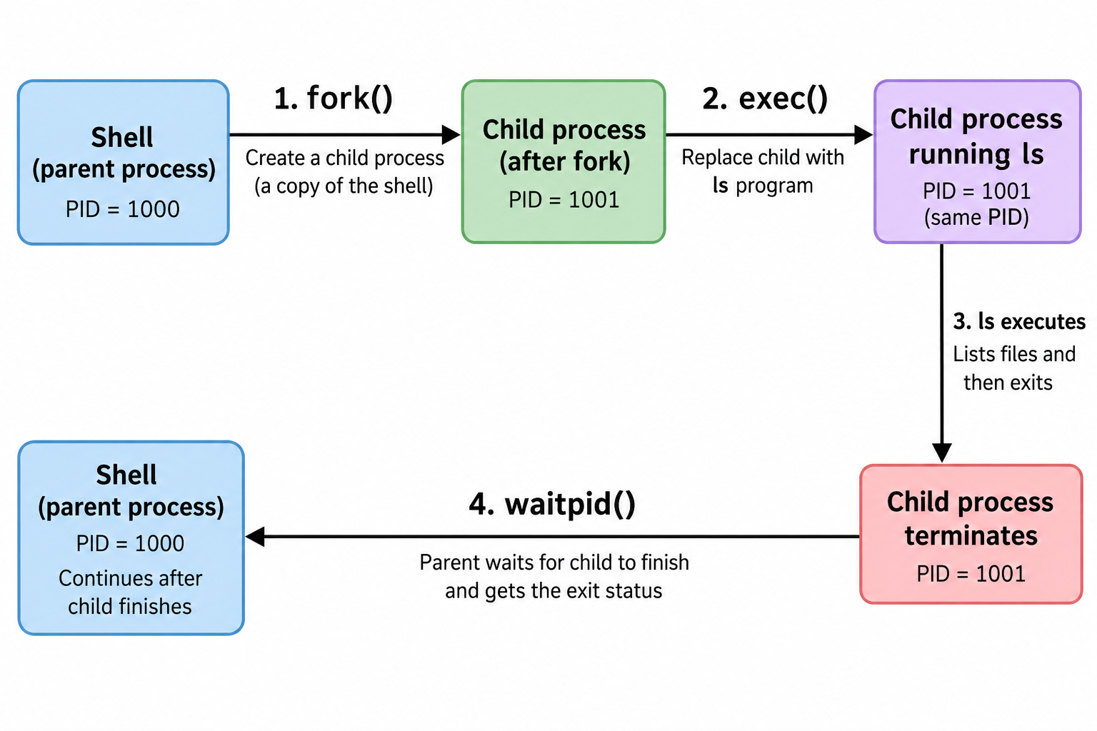

Slide 154
Linux Processes
Type | Description
Parent | A process that creates other processes
Child | A process created by another (via fork())
Daemon | Background service (e.g., sshd, httpd)
Zombie | Finished process, but still in process table (not cleaned up)
Orphan | Child whose parent has terminated
To see all running processes: ps -ef | less
First process (init/systemd) always has a process id = 1 –> adopts orphan processes
Process creation: Parent process -> fork () -> Child process

Slide 155
Foreground and Background Processes
Commands run in the foreground and occupy the terminal
Adding & runs a command in the background
Example: sleep 10 & This is called controlling a job
Command | Purpose
jobs | List background jobs
fg | Bring job to foreground
bg | Resume job in background
Ctrl + Z | Suspend foreground process

Slide 156
Foreground vs Background Execution
$ sleep 10
# Runs in foreground → terminal is blocked
$ sleep 60 &
[1] 1150
# Runs in background → terminal is free, [1] = Job ID, 1150 = Process ID (PID)
$ echo "hello there"
hello there
# Another foreground command runs immediately
$ jobs
[1]+ Running sleep 60 &
# Background process is still running
$ fg %1
sleep 60
# Bring job 1 back to foreground

Slide 157
Killing a Process
kill <PID>, e.g. kill 1947
Signal: An asynchronous message sent to a process
Used to control process behavior (stop, terminate, pause, etc.)
Examples
  kill -9 1947 # Force kill
  kill -15 1947 # Graceful kill (default)
  kill -STOP 1947 # Pause process
  kill -CONT 1947 # Resume process
Signal | Number | Purpose
SIGTERM | 15 | Graceful termination (default)
SIGKILL | 9 | Force kill (cannot be ignored)
SIGSTOP | 19 | Pause process
SIGCONT | 18 | Resume paused process

