Slide 1

UTM coordinate system and its transformation to spherical coordinate system
Term paper report by:-Shubham Kumar (19103080)
Rohit Jagannath Dhote (19103065)

Slide 2
OBJECTIVE
To know what is UTM coordinate system and become familiar with it.
To find coordinate of a point in a UTM system
To transform UTM coordinate to spherical coordinate system

Slide 3
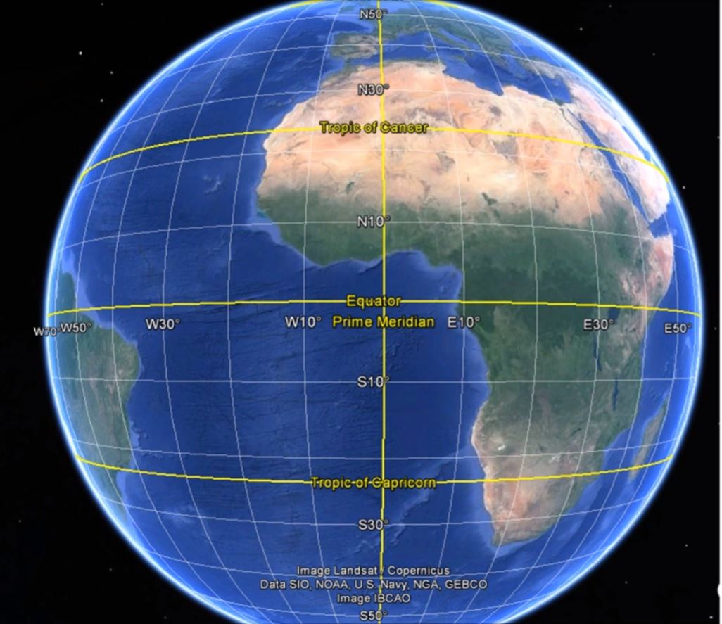
Introduction
What is Coordinate system?
A coordinate system is a grid used to identify locations on a page or screen that are equivalent to grid locations on the globe.

Slide 4

What is UTM?
UTM is a projection which helps to display 3 dimensional features into 2 dimensional space.
Here (x,y) coordinate is used to find the location of the point in the plane.

Slide 5
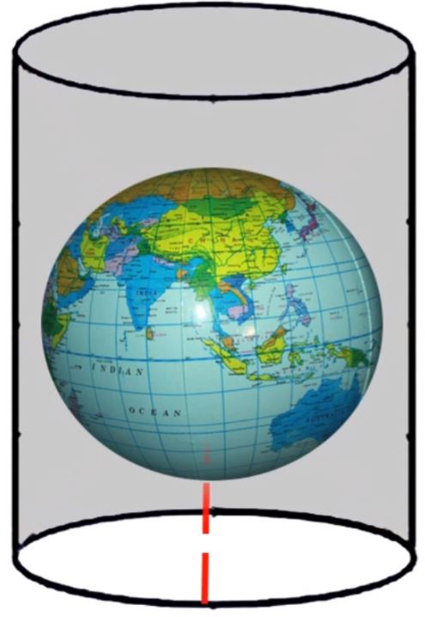
How Universal Transverse Mercator (UTM) works
It is one of the most used and common map projection.
Let us assume that we put the globe in the cylinder.
Now we put a bulb inside the globe, at the centre.
The light of the bulb will project the surface of the earth at the wall of the cylinder.
Now cylinder is cut into the half.

Slide 6
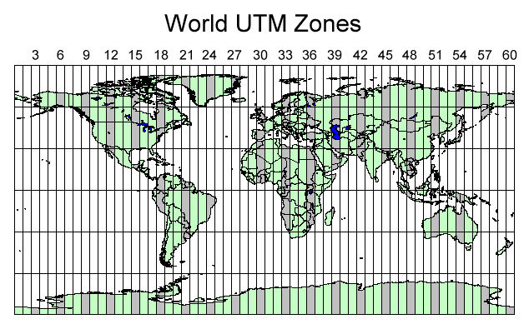

Slide 7
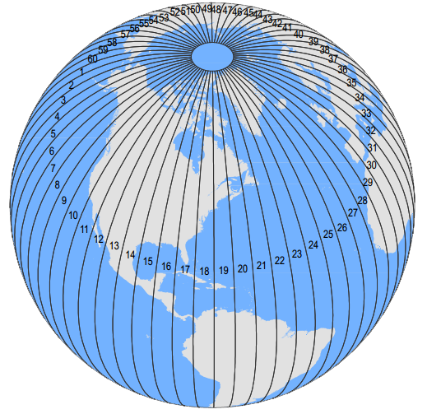
We assume earth as a sphere or ellipsoid and we peel it off like an orange into 60 segments where each segments is called zone. We then flattened each zone and we UTM projection. Here each zone have 6 degree segment of the earth.

Slide 8
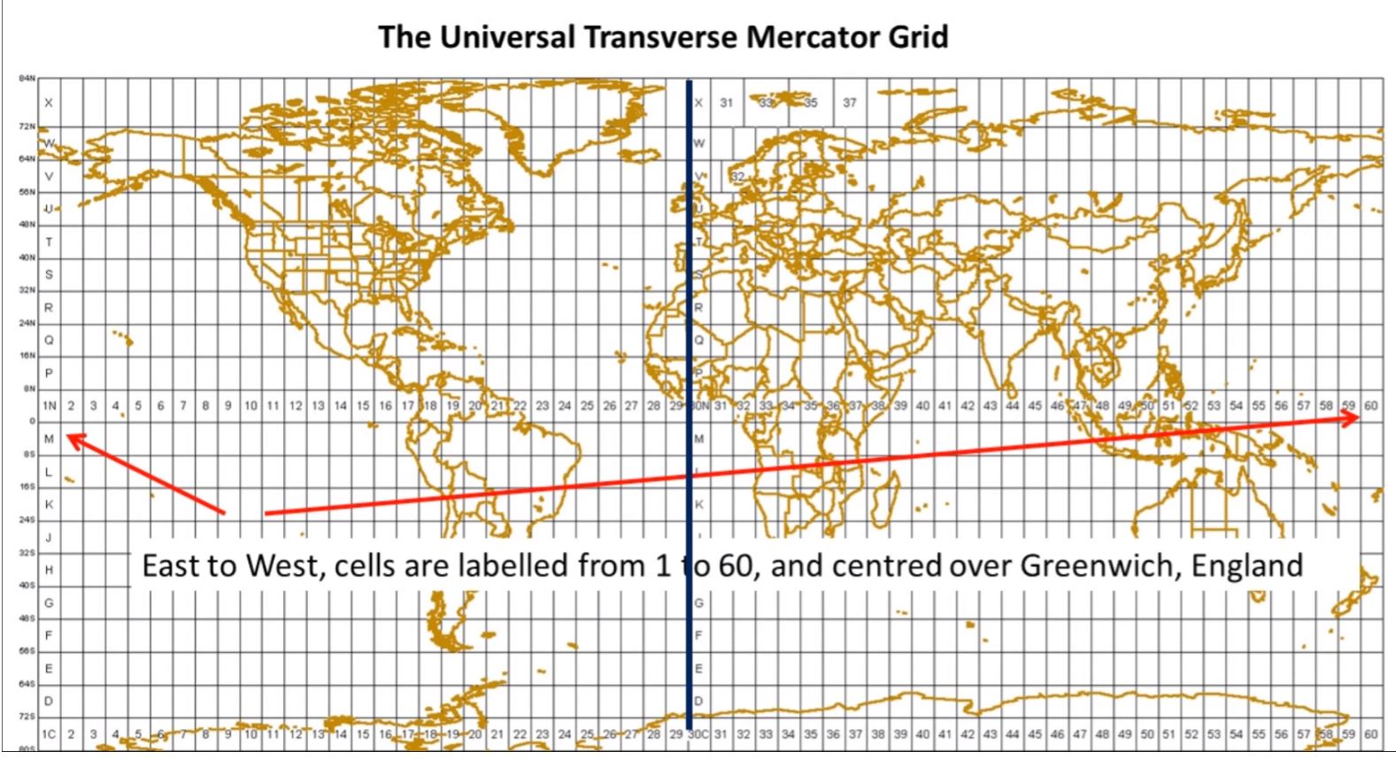

Slide 9
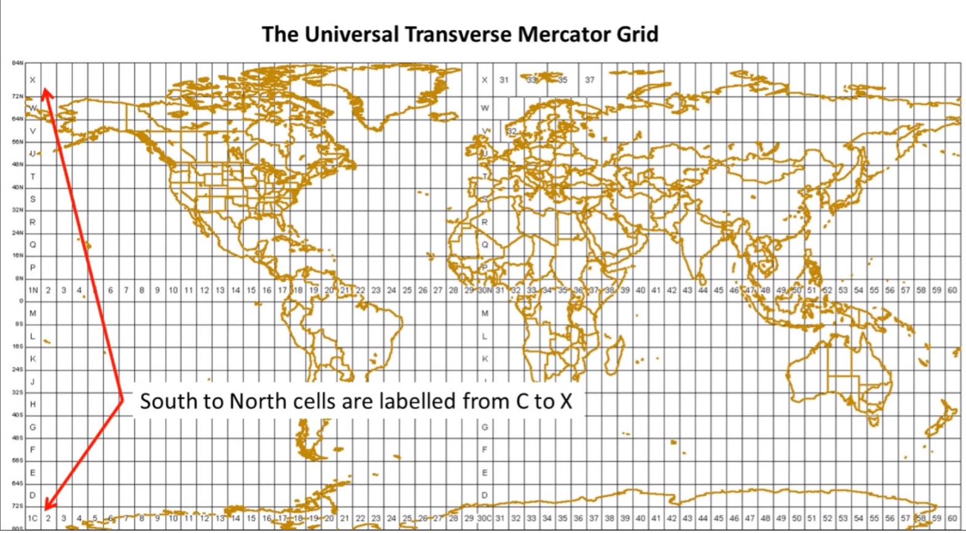

Slide 10
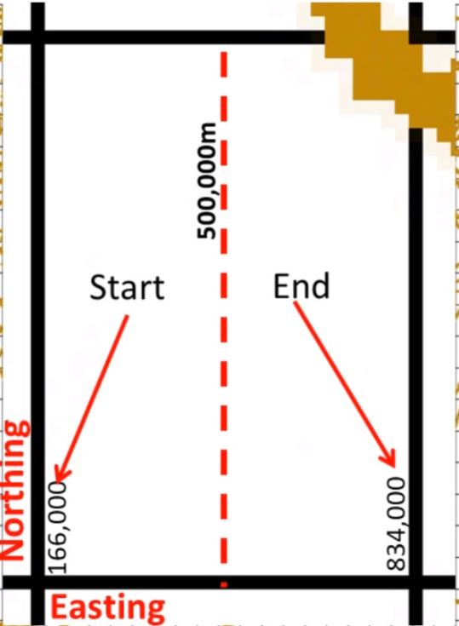
When we use UTM cell, X-axis is called easting, and Y-axis is called northing. Unit of measurement is metres.
Along the centre of the grid easting is always taken as 500000.

Slide 11
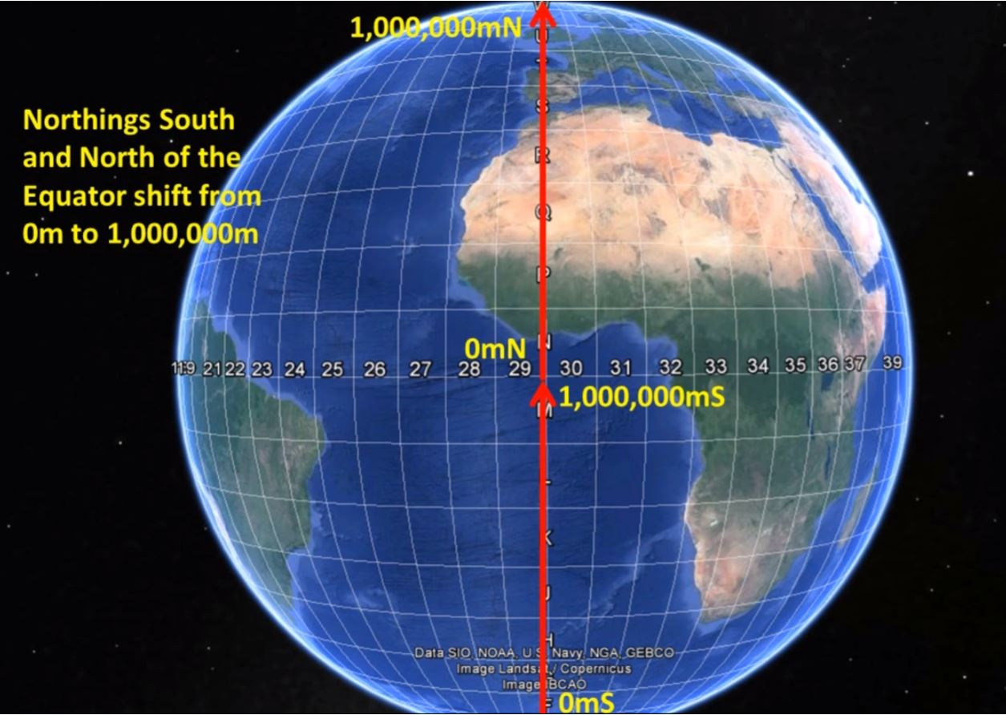
In the northern hemisphere, the equator has a northing value of 0 meters.
In the southern hemisphere, the equator starts at 10,000,000 meters northing values.

Slide 12
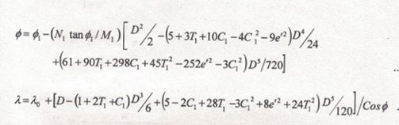


Conversion from UTM coordinate system to Geodetic coordinate system

Slide 13

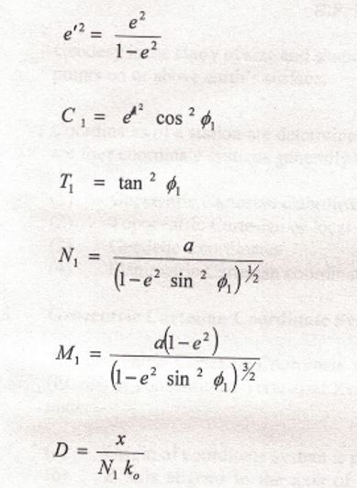



Slide 14
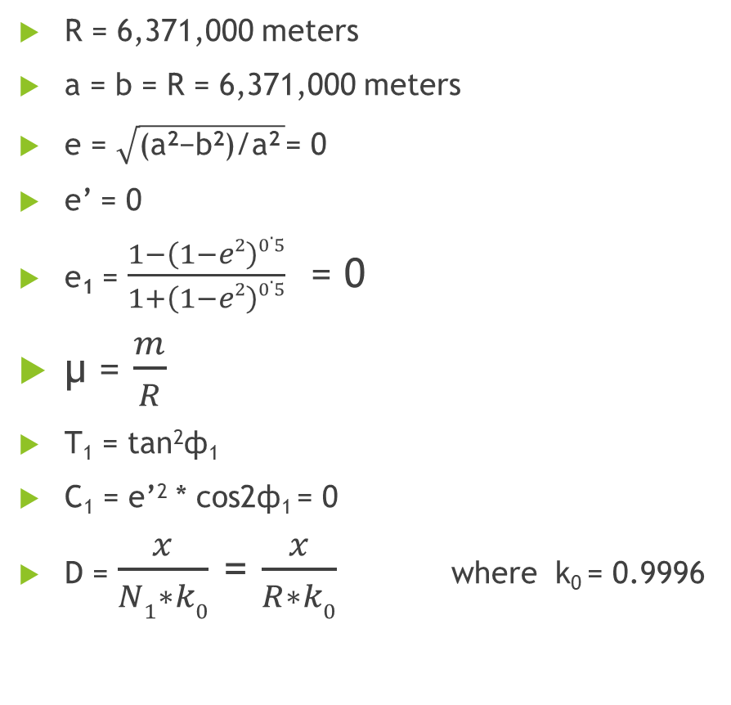
We need Spherical coordinate system
R = 6,371,000 meters
a = b = R = 6,371,000 meters
e = $\sqrt{\text{(}\text{a}\text{2}\text{−}\text{b}\text{2}\text{)/}\text{a}\text{2} }$= 0
e’ = 0
e₁ = $\frac{1−\left(1−e2\right)0.5}{1+\left(1−e2\right)0.5}$ = 0
μ = $\frac{m}{R}$
T₁ = tan²ф₁
C₁ = e’² * cos2ф₁ = 0
D = $\frac{x}{N1∗k0}$ = $\frac{x}{R∗k0}$ where k₀ = 0.9996
N₁ = R
M₁ = R

Slide 15
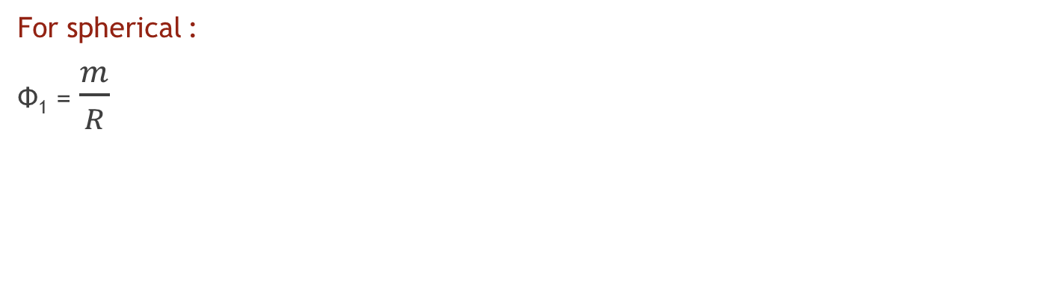
Why ф1 ?
‘Foot point latitude’ or latitude at the central meridian which has the same y coordinate as that of point (Ф,λ)
For spherical :
Ф₁ = $\frac{m}{R}$
We get Ф, λ

Slide 16
Problem
For Borivali, Mumbai, Maharashtra
UTM Easting | 274,415.09 m
UTM Northing | 2,127,538.47 m
Solution : R = 6,371,000 meters
Ф= 19.0000 ⁰ 7.0000’ 21.4418”
Λ = 77.0000⁰ 36.0000’ 43.3729”

Slide 17
Thank you!

