Slide 1






1.5
App
config
2.1
Build
Deploy
Test
Release
DB
Env

Slide 2



Build
Deploy
Test
Release
continuous
delivery

Slide 3

Build
Deploy
Test
Release
Continuous
delivery

Slide 4
1.0
App
Build
Deploy
Test
Release
1.2
config
DB
Env
1.5
App
1.3
config
2.1
App
2.3
config
DB
Env
Env
DB

Slide 5
DB
App
1.5
2.1
config
Host
Environment

Slide 6
Jenkins, Bamboo, etc
DB
App
Vagrant, Puppet, Chef etc
Virtual Machines,
Instructions,
Commands,
etc
1.5
2.1
config
Host
Environment

Slide 7
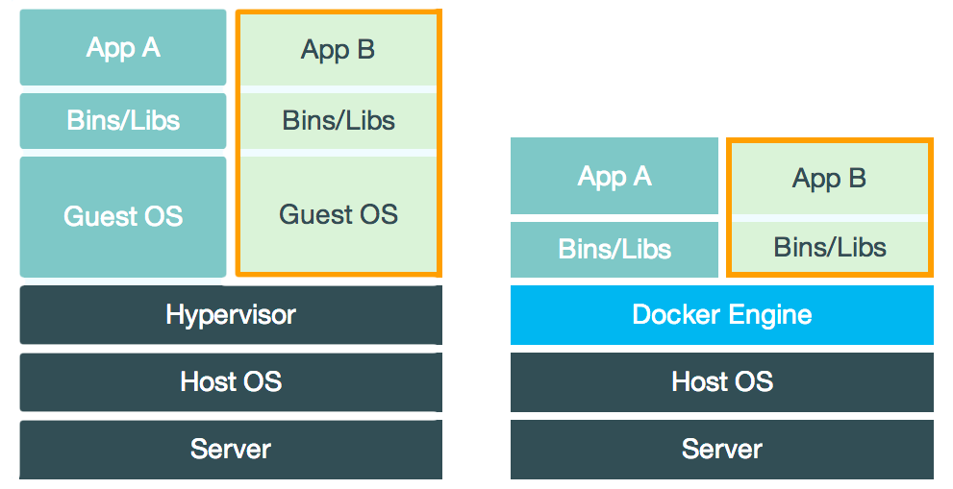
Virtual Machine
Container

Slide 8

Docker Hub
Images
Your Laptop
$>docker search mongo
Docker

Slide 9
Pull w/o tag always fetches the latest image. To get specific image, we need to provide tag.
Docker Hub
Images
Your Laptop
$>docker pull mongo
mongo
Docker
Images

Slide 10

Docker Hub
Images
Your Laptop
$>docker run –d –p 27017:27017 mongo
Run as a Daemon
Open Port
mongo
Port 27017 Open
Docker
Images

Slide 11
Docker Hub
Images
Your Laptop
$>docker run –t –i mongo /bin/bash
Run in interactive mode
$>vi /etc/mongo.cfg //Added config file
mongo
Docker
Images

Slide 12
Docker Hub
Images
Your Laptop
$>docker commit 3ea2832 rohitghatol/mongo
mongo
Docker
Images

Slide 13
Team
Docker search & pull
Docker Hub
Images
Your Laptop
$>docker push rohitghatol/mongo
mongo
Docker
Images

Slide 14
Docker Hub
Images
Your Laptop
Create a Dockerfile
Dockerfile
mongo
Docker
Docker
Images
Web
DB

Slide 15
Docker Hub
Images
Your Laptop
$>docker build –t “rohitghatol/web” .
Create a Dockerfile
Dockerfile
web
mongo
Docker
Docker
Images
Web
DB

Slide 16
Add Env Variable to Web which points to port 27017 of db container
Docker Hub
Images
Your Laptop
$>docker run -d --link db:db_1 -p 3000:3000
-e "NODE_ENV=development" "rohitghatol/web"
Passing Env Variable
Env Variable DB_1_PORT_27017_TCP_ADDR=172.17.0.65
web
mongo (172.167.0.65)
Docker
Docker
Images
Port 3000
Web
DB

Slide 17
Based on Docker Image
Docker Hub
DockerFile
Docker Image
AngularJS
ExpressJS
NodeJs
App
Mongo DB
web
db

Slide 18

Web
Cache
DB
http://172.168.10.2:3000
Web
Docker Containers
Boot2Docker
(172.168.10.2)
Docker Host
Virtual Box
Docker Client
Mac OSX/Windows
(192.168.10.4)

Slide 19
Web
Cache
DB
http://192.168.10.4:3000
Web
Docker Containers
Docker Host
Docker Client
Linux
(192.168.10.4)

