Slide 1





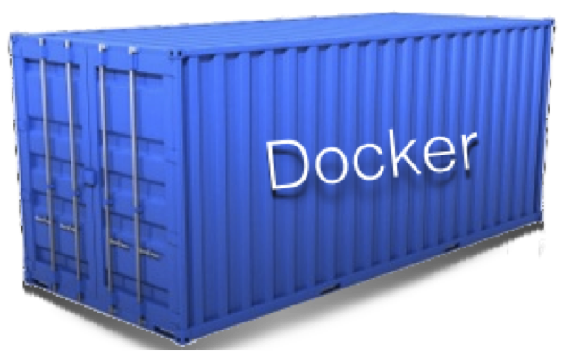
1.5
App
config
2.1
Build
Deploy
Test
Release
DB
Env

Slide 2
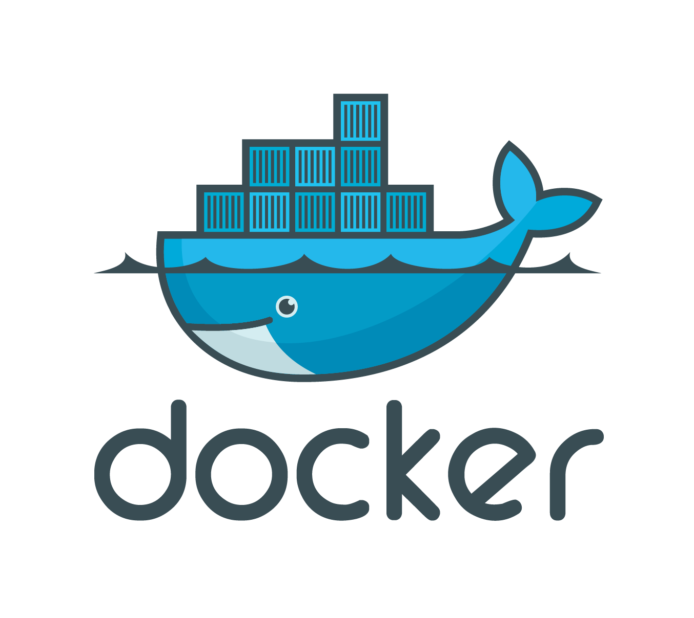


Build
Deploy
Test
Release
continuous
delivery

Slide 3
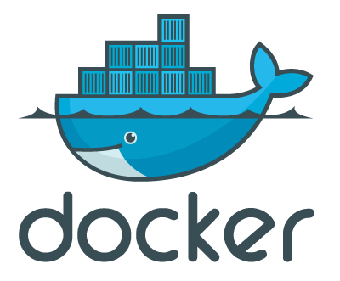
Build
Deploy
Test
Release
Continuous
delivery

Slide 4
1.0
App
Build
Deploy
Test
Release
1.2
config
DB
Env
1.5
App
1.3
config
2.1
App
2.3
config
DB
Env
Env
DB

Slide 5
DB
App
1.5
2.1
config
Host
Environment

Slide 6
Jenkins, Bamboo, etc
DB
App
Vagrant, Puppet, Chef etc
Virtual Machines,
Instructions,
Commands,
etc
1.5
2.1
config
Host
Environment

Slide 7
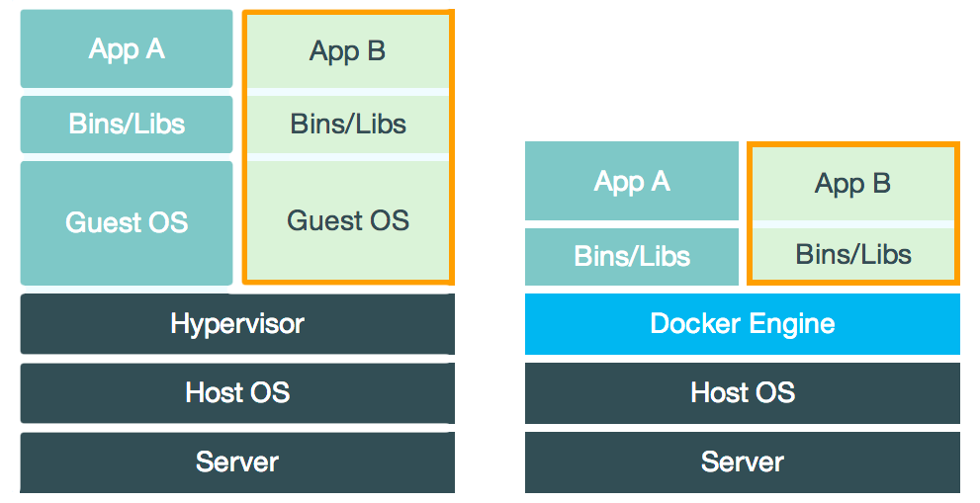
Virtual Machine
Container

Slide 8

Docker Hub
Images
Your Laptop
$>docker search mongo
Docker

Slide 9
Docker Hub
Images
Your Laptop
$>docker pull mongo
mongo
Docker
Images

Slide 10

Docker Hub
Images
Your Laptop
$>docker run –d –p 27017:27017 mongo
Run as a Daemon
Open Port
mongo
Port 27017 Open
Docker
Images

Slide 11
Docker Hub
Images
Your Laptop
$>docker run –t –i mongo bash
Run in interactive mode
$>vi /etc/mongo.cfg //Added config file
mongo
Docker
Images

Slide 12
Docker Hub
Images
Your Laptop
$>docker commit 3ea2832 rohitghatol/mongo
mongo
Docker
Images

Slide 13
Team
Docker search & pull
Docker Hub
Images
Your Laptop
$>docker push rohitghatol/mongo
mongo
Docker
Images

Slide 14
Docker Hub
Images
Your Laptop
Create a Dockerfile
Dockerfile
mongo
Docker
Docker
Images
Web
DB

Slide 15
Docker Hub
Images
Your Laptop
$>docker build –t “rohitghatol/web” .
Create a Dockerfile
Dockerfile
web
mongo
Docker
Docker
Images
Web
DB

Slide 16
Add Env Variable to Web which points to port 27017 of db container
Docker Hub
Images
Your Laptop
$>docker run -d --link db:db_1 -p 3000:3000
-e "NODE_ENV=development" "rohitghatol/web"
Passing Env Variable
Env Variable DB_1_PORT_27017_TCP_ADDR=172.17.0.65
web
mongo (172.167.0.65)
Docker
Docker
Images
Port 3000
Web
DB

Slide 17
Based on Docker Image
Docker Hub
DockerFile
Docker Image
AngularJS
ExpressJS
NodeJs
App
Mongo DB
web
db

