Slide 1

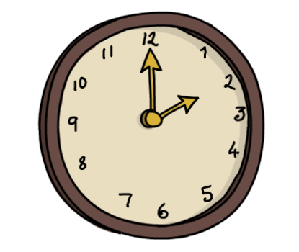
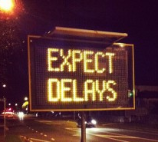

Service
Outage
Release
Failure

Slide 2


DevOps
Step 1
Step 2
Step 3
Process

Slide 3


DevOps is a Culture of Trust and Collaboration in which People use the Right Tools for Automation to achieve Continuous Delivery
Continuous Delivery
http://serkworks.blogspot.com/2010/11/super-hero-day-jobs-flash-pizza.html
http://openclipart.org/detail/188471/people---pessoas-by-leandrosciola-188471

Slide 4


Rule of Thumb
Culture
Individual
Tools
Order of Emphasis

Slide 5


Slide 6


Define Common Goal
Dev
QA
Ops

Slide 7

Facilitate Regular Dev & Ops Collaboration
Sprint 1
Sprint 2
Sprint 3
Release
Planning
Production
Release

Slide 8

Take care of Ops needs in Release/Sprint Planning
Non Functional Requirements
AWS

Slide 9

List things that are NOT automated, repeatable and documented
Builds
Regression
Testing
Code Quality Analysis
Unit Testing
Staging Setup
Deployments
Migrations
Rollback

Slide 10
List things that are NOT measured today
SLAs
Adherence to Release Dates
Downtime
Release to Production Time
Performance
User Traffic
# Support Defects

Slide 11




Virtual Box
Sync folder
VMware
AWS
$>ssh
Dev
QA
Ops
Vagrant
Fire
Puppet
Chef
Providers
Machine Conf
Virtual Machine
VMWare
AWS
etc
OS
RAM
Network Conf
Sync Folder

Slide 12
VAGRANTFILE_API_VERSION = "2"
Vagrant.configure(VAGRANTFILE_API_VERSION) do |config|
config.vm.box = "precise64"
config.vm.box_url = "http://files.vagrantup.com/precise64.box”
config.vm.define "hadoop" do |hadoop|
hadoop.vm.hostname = "hadoop"
hadoop.vm.network :private_network, ip: "192.168.33.10"
config.vm.provision :puppet do |puppet|
puppet.manifests_path = "puppet/manifests"
puppet.module_path = "puppet/modules"
puppet.manifest_file = "site.pp"
puppet.options = "--verbose --debug"
end
end
end
1
2
3
4

Slide 13

Puppet Master
Example of a Resource –
file {‘ /etc/hosts':
ensure => file,
content => ”127.0.0.1 localhost",
mode => '0644',
}
Nodes
Modules
Agent
Config
Agent
Classes
Resources
Agent
Redhat
Ubuntu
Suse
Windows

Slide 14
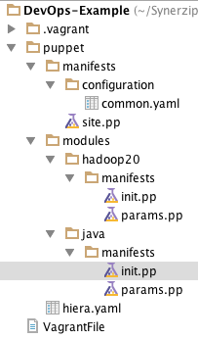
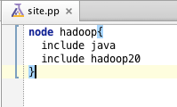
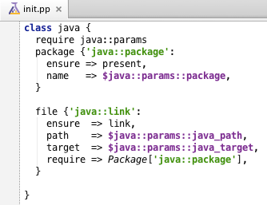
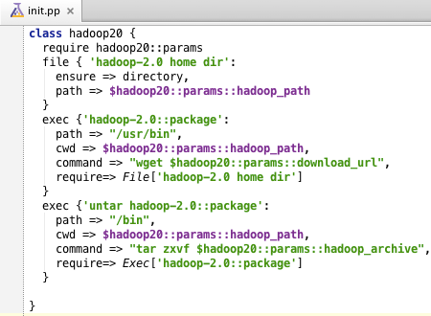

Slide 15
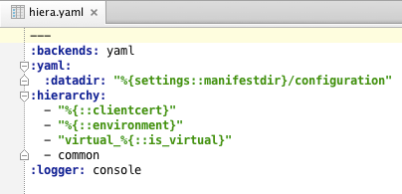
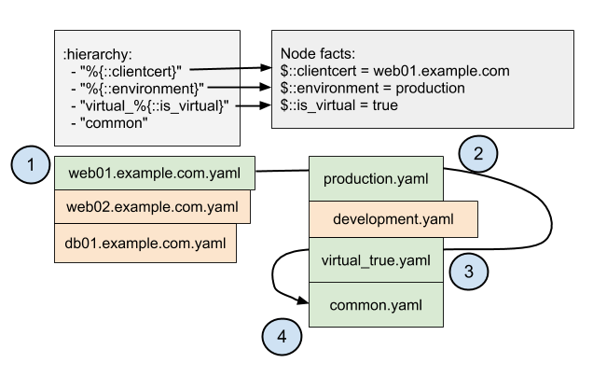
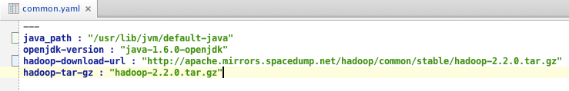
1. Placeholder for Data
2. Lookup Hierarchy
Code
Configuration

Slide 16
Vagrant
Puppet
Hiera
2
Java
Delegate
to Puppet
4
Site.pp
Puppet Modules
1
VagrantFile
Hadoop
Provision
Machine
Provision
Software
3
Lookup
Data
hadoop…..yaml
Heira
Config Files
common.yaml

Slide 17
Action
Events
Agent
Checks
Monitoring Tool
Active
Passive
Agent
Configuration
Agent

Slide 18
Server
Check CPU
Check Disk
NRPE Agent
Active Check
Check HTTP
Notify
Web Server
Active Check
Nagios/Icinga2
State Change
Event
Handler
Passive Check
Custom
Script
http://……
NRDP
Agent
Remote Server
UI

