Slide 1


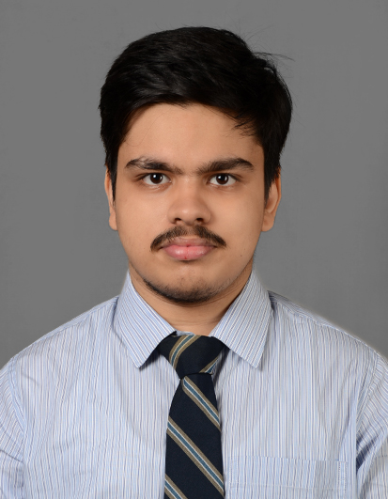
INFRASTRUCTURE & IT COMMITTEE
ROHIT GHOSH
Why You Should Hire Me
Experience in building and deploying web apps with automation
Experience in developing AI driven project
Strong problem-solving mindset with proven adaptability across projects and internships
My Plans for the Committee
Propose a tech-driven hostel management system (digital complaint tracking, maintenance logs, real-time updates)
Strengthen IT infrastructure (Wi-Fi monitoring, data security awareness, cloud-based storage)
Implement student-centric solutions for example , an app for facility booking would be good.
What I Bring to the Table
Process orientation: Experience in building cloud based systems and ensuring usability.
Collaborative spirit: Comfortable working in cross-functional teams.
Passion for campus improvement: Keen interest in making hostel & IT facilities efficient, safe, and student- friendly.

