Slide 1
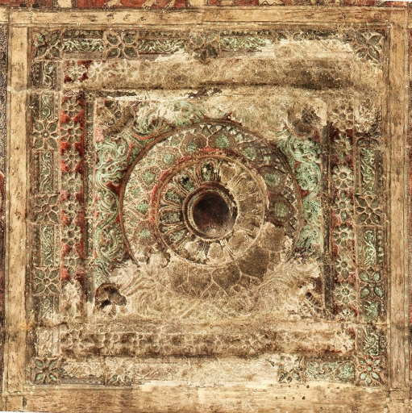
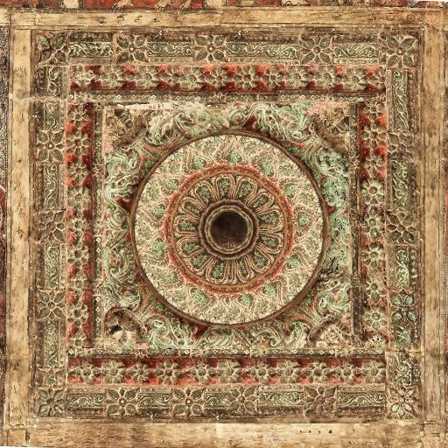
Digital Restoration of Art and Paintings
Current State: Distorted
Digital Version: Restored
Automated Techniques
[Ref: P. Purkait and B. Chanda. Digital mural image restoration. In ICVGIP, 2012 ]

Slide 2
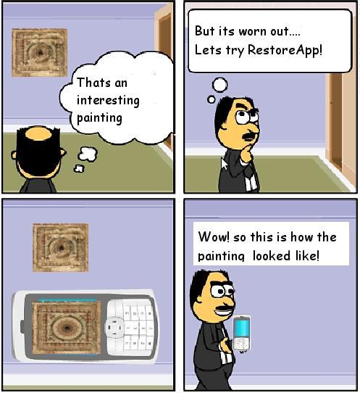
Use Case: How can “Aam Aadmi” Benefit?

Slide 3
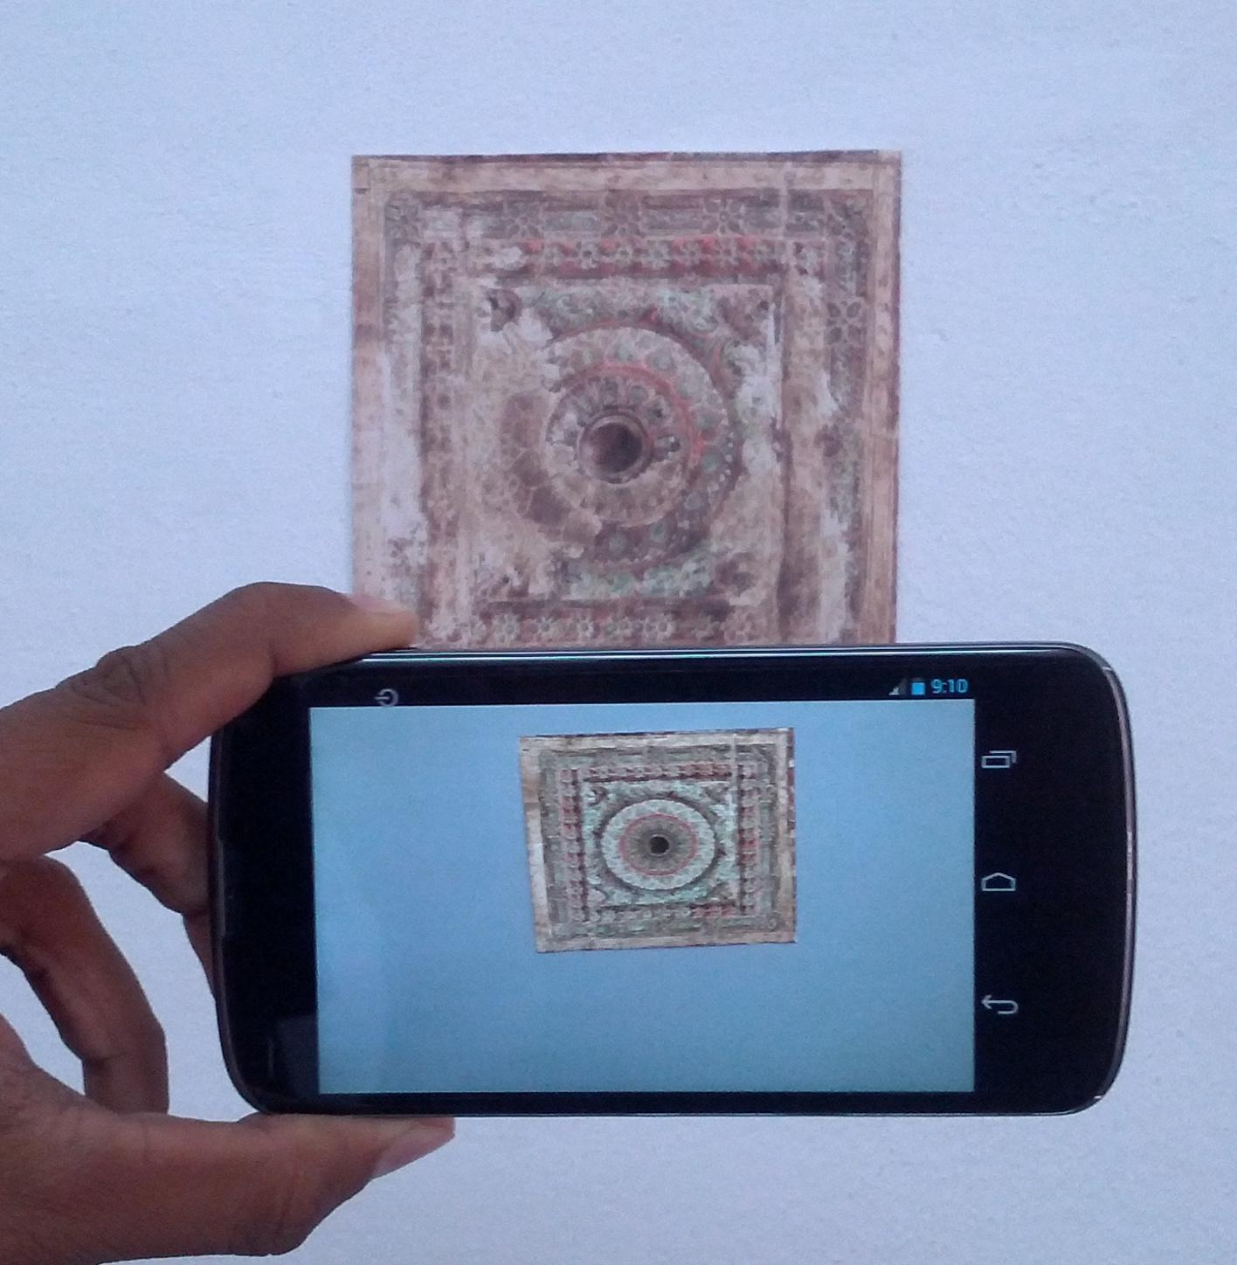
Mobile Phone as Restoring Lens !

Slide 4
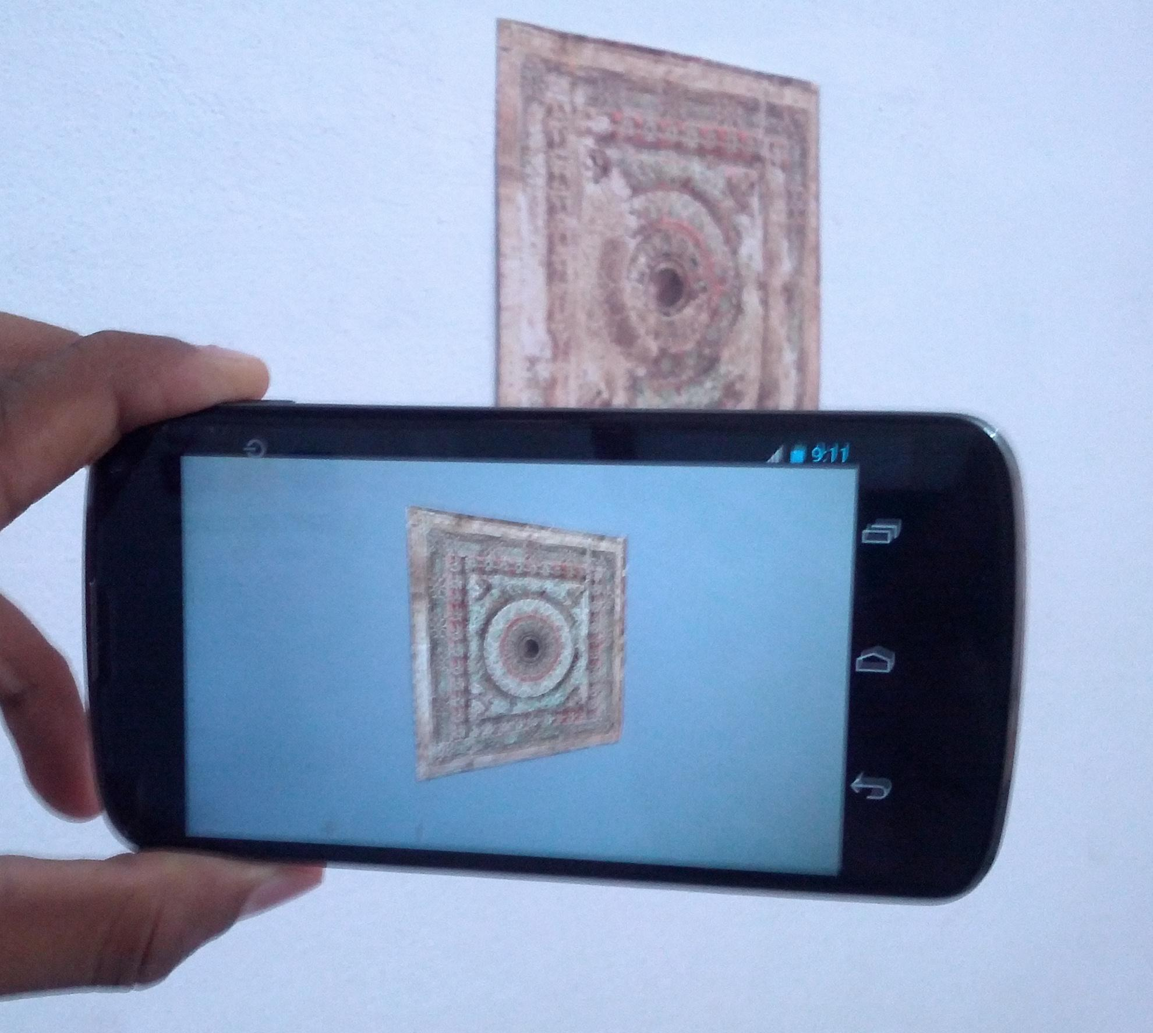
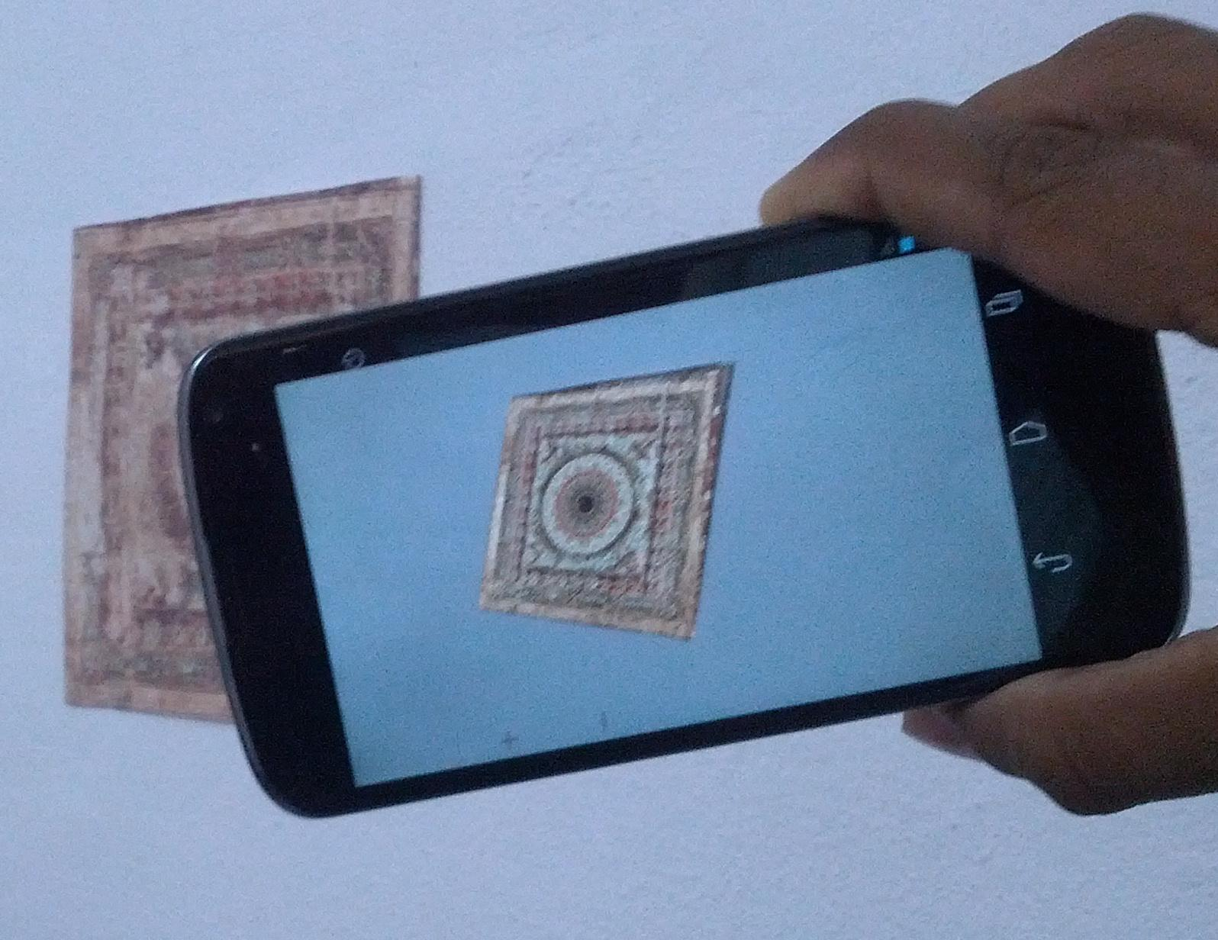
Realistic views from different angles

Slide 5
Demo video

