Slide 1
DEVELOPER WALKTHROUGH
AgentOps
Enterprise Agentic P2P & Procurement Platform
Sixteen agents. Twenty-eight skills. Zero write access.
16
28
33
29
79
agents
skills
actions
tables
tests
30 live screenshots captured from the running application
Notes:
A developer walkthrough: the product screen by screen from live captures, then the code that makes the guarantees hold.

Slide 2
START HERE
One rule explains the whole system
An agent returns proposals, never mutations.
There is no code path from an agent to a business table. Not a convention, not a review rule — a structural fact.
1
2
3
A proposal is inert
One consumer
One writer
ProposedAction is a dataclass. No session, no ORM object, no executor reference. It cannot write because there is nothing in it to write with.
The only code that reads a proposal is hitl.create_checkpoint(), which writes a HumanTask row and nothing else.
Business data is written only by an @action(...) executor, reachable only from hitl.decide() after an authority check.
Everything else in this guide is a consequence of that sentence.
AgentOps · Developer Walkthrough
1
Notes:
If a rebuild breaks this, it has the same screens and none of the guarantees.

Slide 3
HOW THIS GUIDE RUNS
Three parts, in the order you need them
01
Orientation
Repository layout, the three ways to run it, and the authority ladder that governs everything you will click.
02
The product, screen by screen
All 22 screens from live captures — what each one shows and, for each, what a developer should actually notice.
03
The code
The run loop, the anatomy of an agent, the policy engine, the executor registry, and how to add your own.
Every screenshot in Part 02 was captured from this application running locally, after a live agent sweep. Nothing is a mock-up.
2

Slide 4
PART 01 · ORIENTATION
Where everything lives
Roughly 25,000 lines. The four files that carry the guarantees are marked.
THE FOUR THAT MATTER
AgentOps-EnterpriseAgentic-P2P-Platform/
├── backend/app/
│ ├── enums.py roles, stages, 33 action kinds, IRREVERSIBLE_ACTIONS
│ ├── models.py 29 tables in seven domains
│ ├── agents/ base.py + 16 agents + registry + orchestrator
│ ├── skills/ 28 analysis capabilities — no writes
│ ├── services/
│ │ ├── policy.py the seven gates, default deny
│ │ ├── hitl.py checkpoints + the ONLY business writes
│ │ ├── artifacts.py draft → released lifecycle, parsers
│ │ └── audit.py the hash chain
│ └── api/ auth · core · hitl · agents · procurement
│ · analytics · admin · explain
├── frontend/src/ 22 screens, React + TS + Tailwind
├── agents/<key>/AGENT.md 16 generated build specifications
├── skills/<name>/SKILL.md 28 generated skill contracts
├── docs/SPECIFICATION.md the platform specification of record
└── scripts/ the two documentation generators
policy.py
The seven gates. Read this before changing any threshold.
hitl.py
The only place business data is written. 33 executors, one per action.
agents/base.py
The run loop every agent shares — which is why the guarantees hold uniformly.
enums.py
Everything downstream references it. Change here, regenerate everywhere.
Part 01 · Orientation
3

Slide 5
PART 01 · ORIENTATION
Three ways to run it
No cloud account, no API key, no database server. SQLite by default, one process, one port.
Standard
Development
Docker
./run.sh # macOS / Linux
.\run.ps1 # Windows
# → http://localhost:8000
./run.sh --dev
# UI → :5173 (hot reload)
# API → :8000
P2P_RELOAD=1 ./run.sh --dev
docker compose up --build
# fresh start:
docker compose down -v
Installs, builds the SPA, seeds the demo, serves API and UI on one port. Idempotent — safe to re-run.
Vite proxies /api to the backend. Use :5173 — port 8000 serves the last built UI, which will be stale.
Nothing on the host. The demo database persists in the p2p-data volume, so decisions survive a restart.
First run takes 1–3 minutes (virtualenv + npm install + UI build). Subsequent runs start in seconds.
Part 01 · Orientation
4

Slide 6
PART 01 · ORIENTATION
The authority ladder
A ladder, not a set — a Controller can decide everything a clerk can. This is enforced server-side, not in the UI.
ROLE | AUTHORITY | MAY DECIDE
supplier | 0 | Nothing — external party
ap_clerk | 10 | Extraction, matching, exceptions, supplier drafts
procurement / treasury | 20 | + sourcing, savings, dispositions / payment scheduling
ap_manager | 30 | + ERP posting, escalations, invoice approvals
controller | 40 | + payment release, master data, contract signature
cfo | 50 | Everything, including executive briefs
admin | 60 | + agent autonomy, the governance switch
ESCALATION BY VALUE
On top of the per-action minimum:
≥ $50,000
Controller required
≥ $250,000
CFO required
≥ $100,000
+ irreversible
Two distinct approvers
Dual approval compares user.id, not role. The same person approving twice is one approval.
Part 01 · Orientation
5

Slide 7
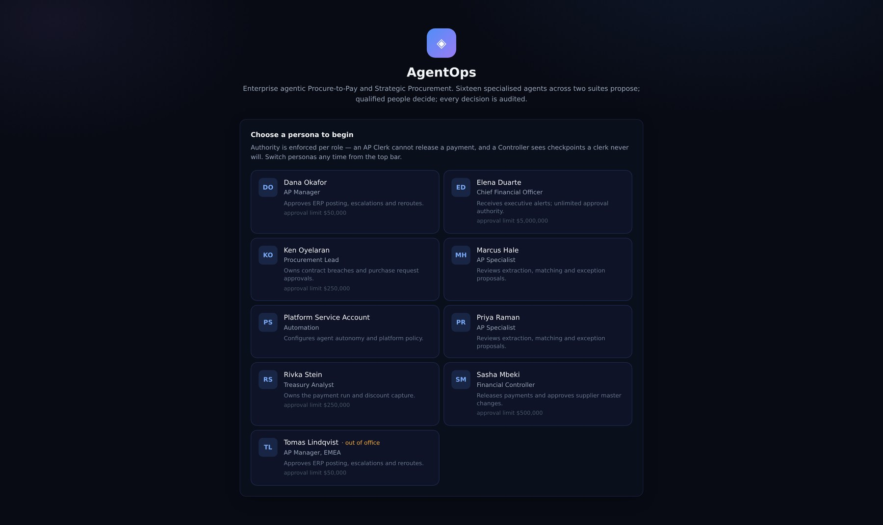
PART 02 · GETTING STARTED
Sign in — personas, not passwords
Nine seeded personas across the authority ladder. Identity is selected; authority is enforced.
WHAT TO LOOK AT
The persona is the auth token
The client sends the chosen id in X-User-Id; get_current_user resolves it. Production puts SSO here and changes nothing else.
Role drives everything downstream
What each persona can decide is enforced server-side in hitl.decide(), not hidden in the UI.
Start as Priya (AP Clerk)
The lowest rung makes the authority limits visible within two clicks.
Part 02 · Getting started
6
Notes:
Sign in — personas, not passwords. Nine seeded personas across the authority ladder. Identity is selected; authority is enforced. The persona *is* the auth token: The client sends the chosen id in X-User-Id; get_current_user resolves it. Production puts SSO here and changes nothing else. Role drives everything downstream: What each persona can decide is enforced server-side in hitl.decide(), not hidden in the UI. Start as Priya (AP Clerk): The lowest rung makes the authority limits visible within two clicks.

Slide 8
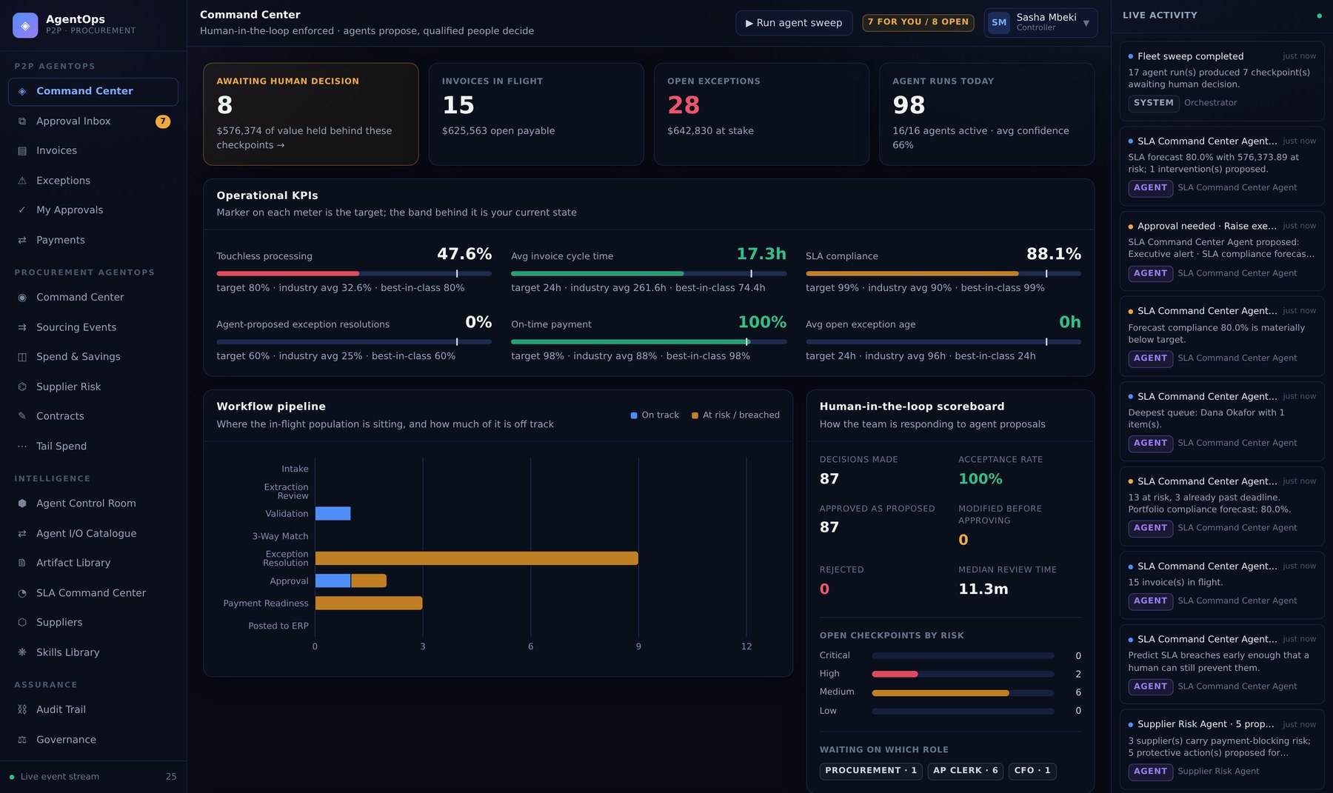
PART 02 · P2P AGENTOPS
Command Center — the portfolio at a glance
KPIs against industry benchmarks, the invoice pipeline, aging, and the human-in-the-loop scoreboard.
WHAT TO LOOK AT
Touchless rate is real
Computed from invoices.human_touches, not a constant. Approving proposals moves it.
The HITL scoreboard
Open checkpoints, value held, and how many are irreversible — the number that matters in a governance conversation.
Live activity rail
Server-Sent Events from GET /api/events/stream, fed by workflow_events.
Part 02 · P2P AgentOps
7
Notes:
Command Center — the portfolio at a glance. KPIs against industry benchmarks, the invoice pipeline, aging, and the human-in-the-loop scoreboard. Touchless rate is real: Computed from invoices.human_touches, not a constant. Approving proposals moves it. The HITL scoreboard: Open checkpoints, value held, and how many are irreversible — the number that matters in a governance conversation. Live activity rail: Server-Sent Events from GET /api/events/stream, fed by workflow_events.

Slide 9
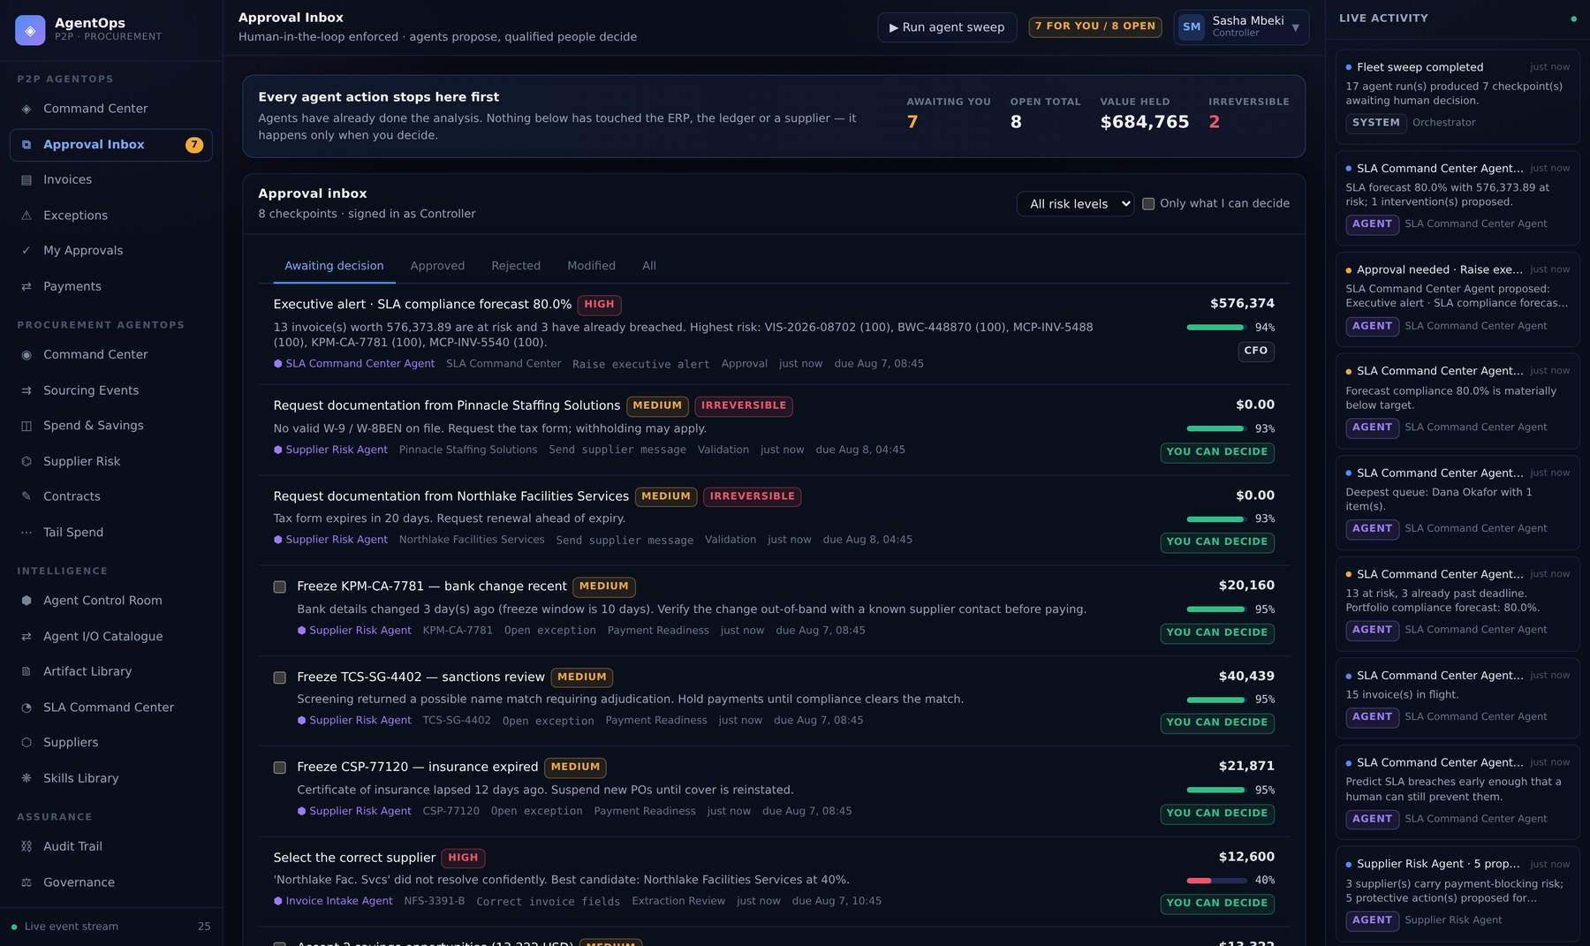
PART 02 · P2P AGENTOPS
Approval Inbox — where every agent action stops
Nothing below has touched the ERP, the ledger or a supplier. That happens only when a human decides.
WHAT TO LOOK AT
One row per human_tasks record
The inbox is a straight read of the checkpoint table, filtered by what your role may decide.
Risk and irreversibility are badges
Both come from the policy verdict stored on the task at creation time.
"Only what I can decide"
Toggles the role filter. Higher roles see more checkpoints, not fewer.
Part 02 · P2P AgentOps
8
Notes:
Approval Inbox — where every agent action stops. Nothing below has touched the ERP, the ledger or a supplier. That happens only when a human decides. One row per `human_tasks` record: The inbox is a straight read of the checkpoint table, filtered by what your role may decide. Risk and irreversibility are badges: Both come from the policy verdict stored on the task at creation time. "Only what I can decide": Toggles the role filter. Higher roles see more checkpoints, not fewer.

Slide 10
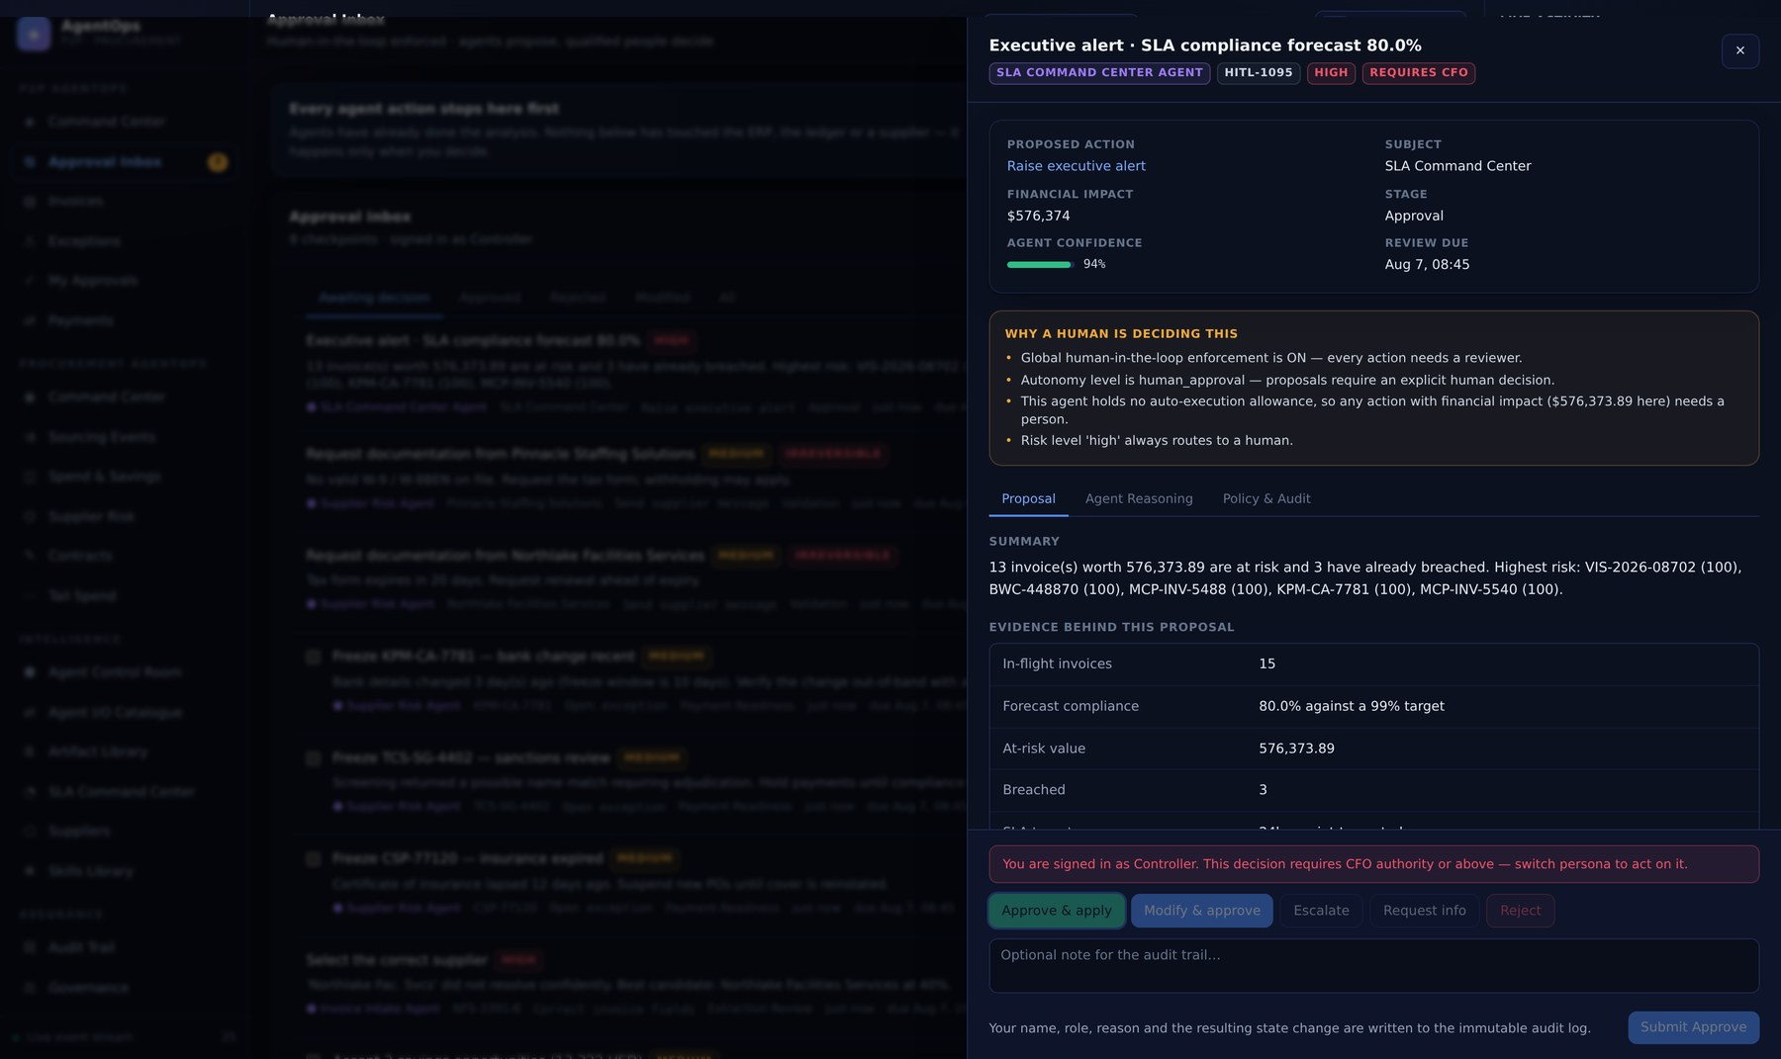
PART 02 · THE CHECKPOINT
Proposal — what would change, and why it stopped
The amber panel answers the auditor's question directly: why is a human deciding this?
WHAT TO LOOK AT
"Why a human is deciding this"
Each line is a policy gate that blocked, rendered from the stored PolicyDecision. Not marketing copy — the actual verdict.
Authority is enforced here
Signed in as Controller, this CFO-level decision is refused. The buttons are present; the server rejects it.
Evidence, not assertion
Every row cites the observation it came from, so the decision is reconstructable months later.
Part 02 · The checkpoint
9
Notes:
Proposal — what would change, and why it stopped. The amber panel answers the auditor's question directly: why is a human deciding this? "Why a human is deciding this": Each line is a policy gate that blocked, rendered from the stored PolicyDecision. Not marketing copy — the actual verdict. Authority is enforced here: Signed in as Controller, this CFO-level decision is refused. The buttons are present; the server rejects it. Evidence, not assertion: Every row cites the observation it came from, so the decision is reconstructable months later.

Slide 11
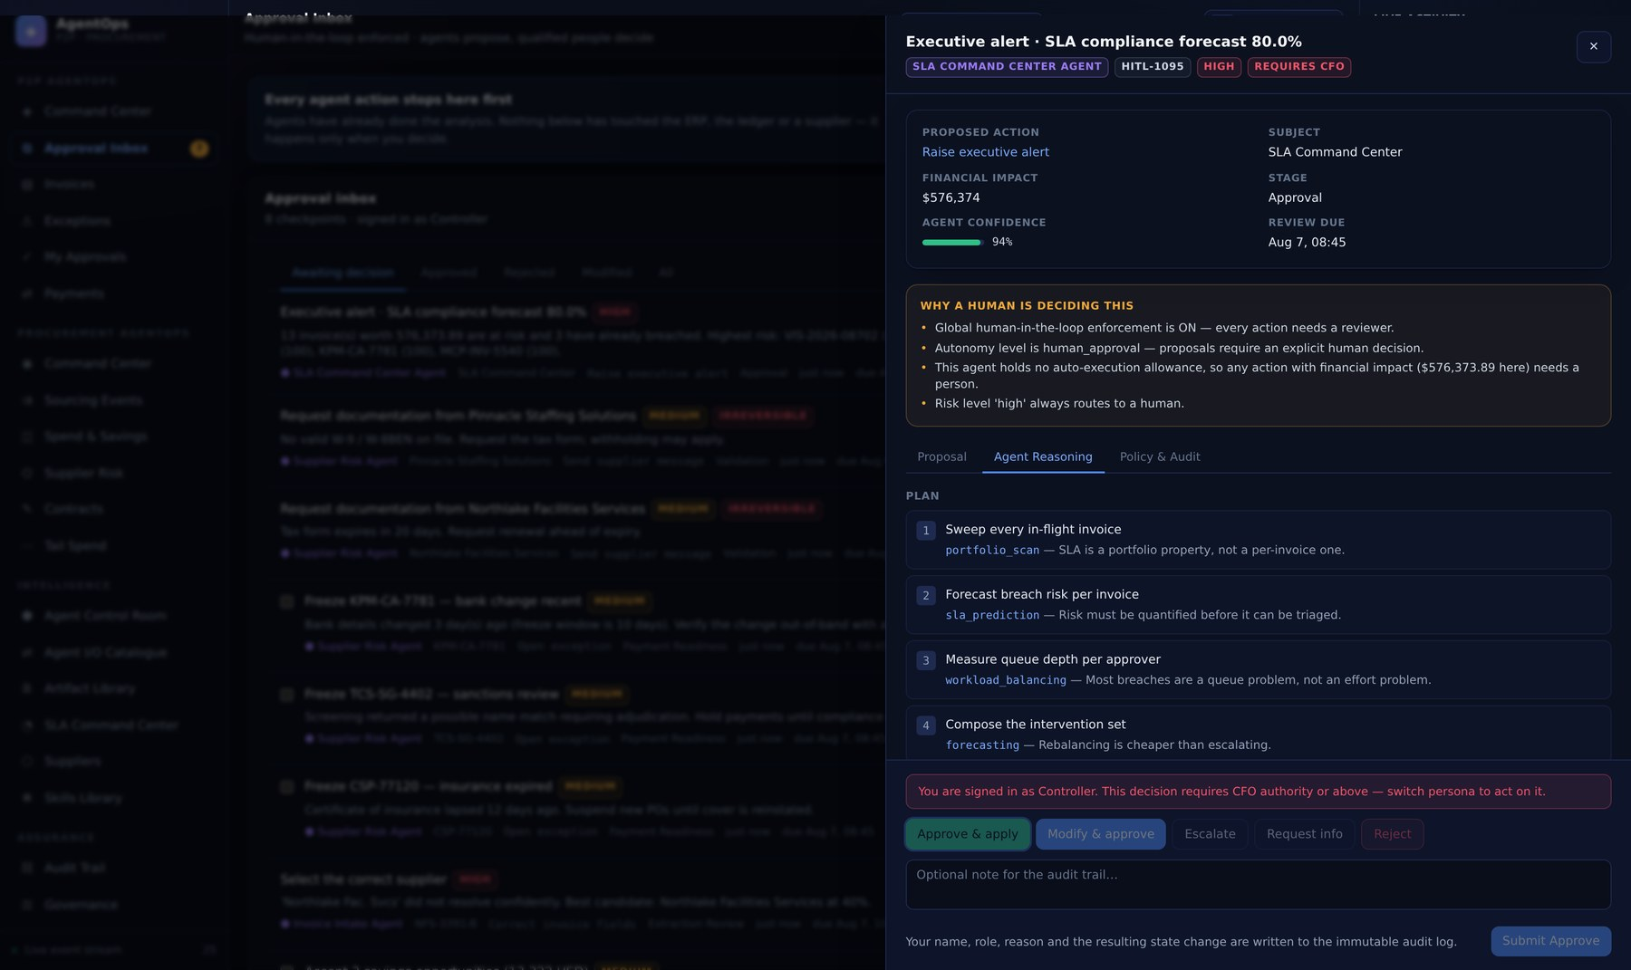
PART 02 · THE CHECKPOINT
Agent reasoning — the plan, the tools, the confidence
The full run: what it planned, each tool call and what came back, and the decision rules it applied.
WHAT TO LOOK AT
Persisted, not regenerated
Read from agent_executions.plan / .observations / .evidence. Re-opening this in a year shows the same thing.
Decision rules are quantitative
e.g. "Amount variance +8.00% against a 3% tolerance" — a rule you can argue with.
The narrator cannot change the outcome
The policy engine decided before the LLM was asked to explain it.
Part 02 · The checkpoint
10
Notes:
Agent reasoning — the plan, the tools, the confidence. The full run: what it planned, each tool call and what came back, and the decision rules it applied. Persisted, not regenerated: Read from agent_executions.plan / .observations / .evidence. Re-opening this in a year shows the same thing. Decision rules are quantitative: e.g. "Amount variance +8.00% against a 3% tolerance" — a rule you can argue with. The narrator cannot change the outcome: The policy engine decided before the LLM was asked to explain it.

Slide 12
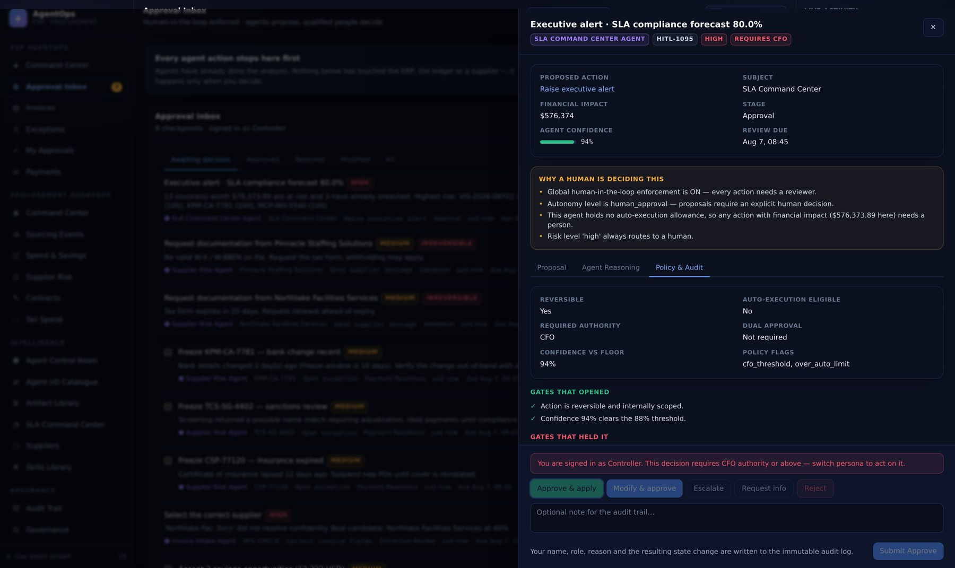
PART 02 · THE CHECKPOINT
Policy & audit — every gate, opened or blocked
All seven gates with their verdicts, the required role, and the audit entries this decision will write.
WHAT TO LOOK AT
Default deny
allow_auto_execute needs every gate to open. Any single block sends it here.
Value-based escalation is visible
The flags — controller_threshold, cfo_threshold, dual_approval — are the ones the engine actually set.
The decision writes the chain
Approving appends a hash-chained audit_logs row covering the previous row's hash.
Part 02 · The checkpoint
11
Notes:
Policy & audit — every gate, opened or blocked. All seven gates with their verdicts, the required role, and the audit entries this decision will write. Default deny: allow_auto_execute needs every gate to open. Any single block sends it here. Value-based escalation is visible: The flags — controller_threshold, cfo_threshold, dual_approval — are the ones the engine actually set. The decision writes the chain: Approving appends a hash-chained audit_logs row covering the previous row's hash.

Slide 13
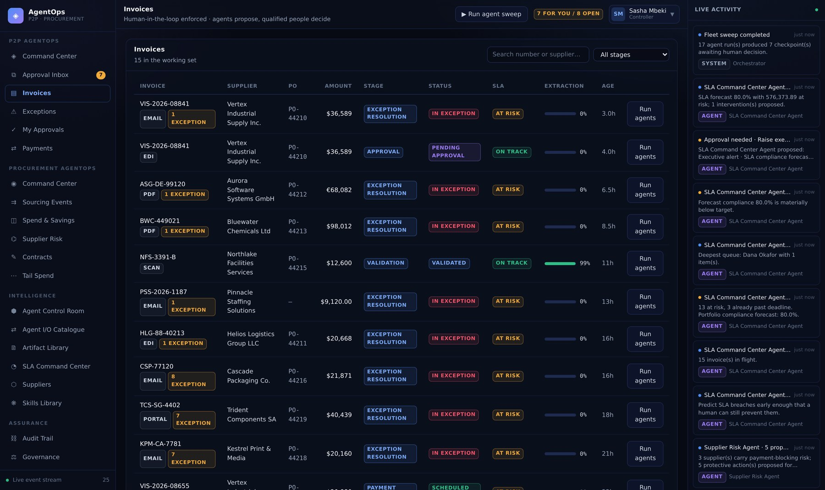
PART 02 · P2P AGENTOPS
Invoices — the working set
Every in-flight invoice with its stage, match result, owner and agent activity.
WHAT TO LOOK AT
stage decides which agent owns it
The orchestrator maps stage → agent. matching belongs to Three-Way Match, and nothing else touches it.
Match result is stored, not derived
The full line-level analysis is kept on invoices.match_details for audit.
Filter by stage to follow one agent
The fastest way to see a single agent's working set.
Part 02 · P2P AgentOps
12
Notes:
Invoices — the working set. Every in-flight invoice with its stage, match result, owner and agent activity. `stage` decides which agent owns it: The orchestrator maps stage → agent. matching belongs to Three-Way Match, and nothing else touches it. Match result is stored, not derived: The full line-level analysis is kept on invoices.match_details for audit. Filter by stage to follow one agent: The fastest way to see a single agent's working set.

Slide 14
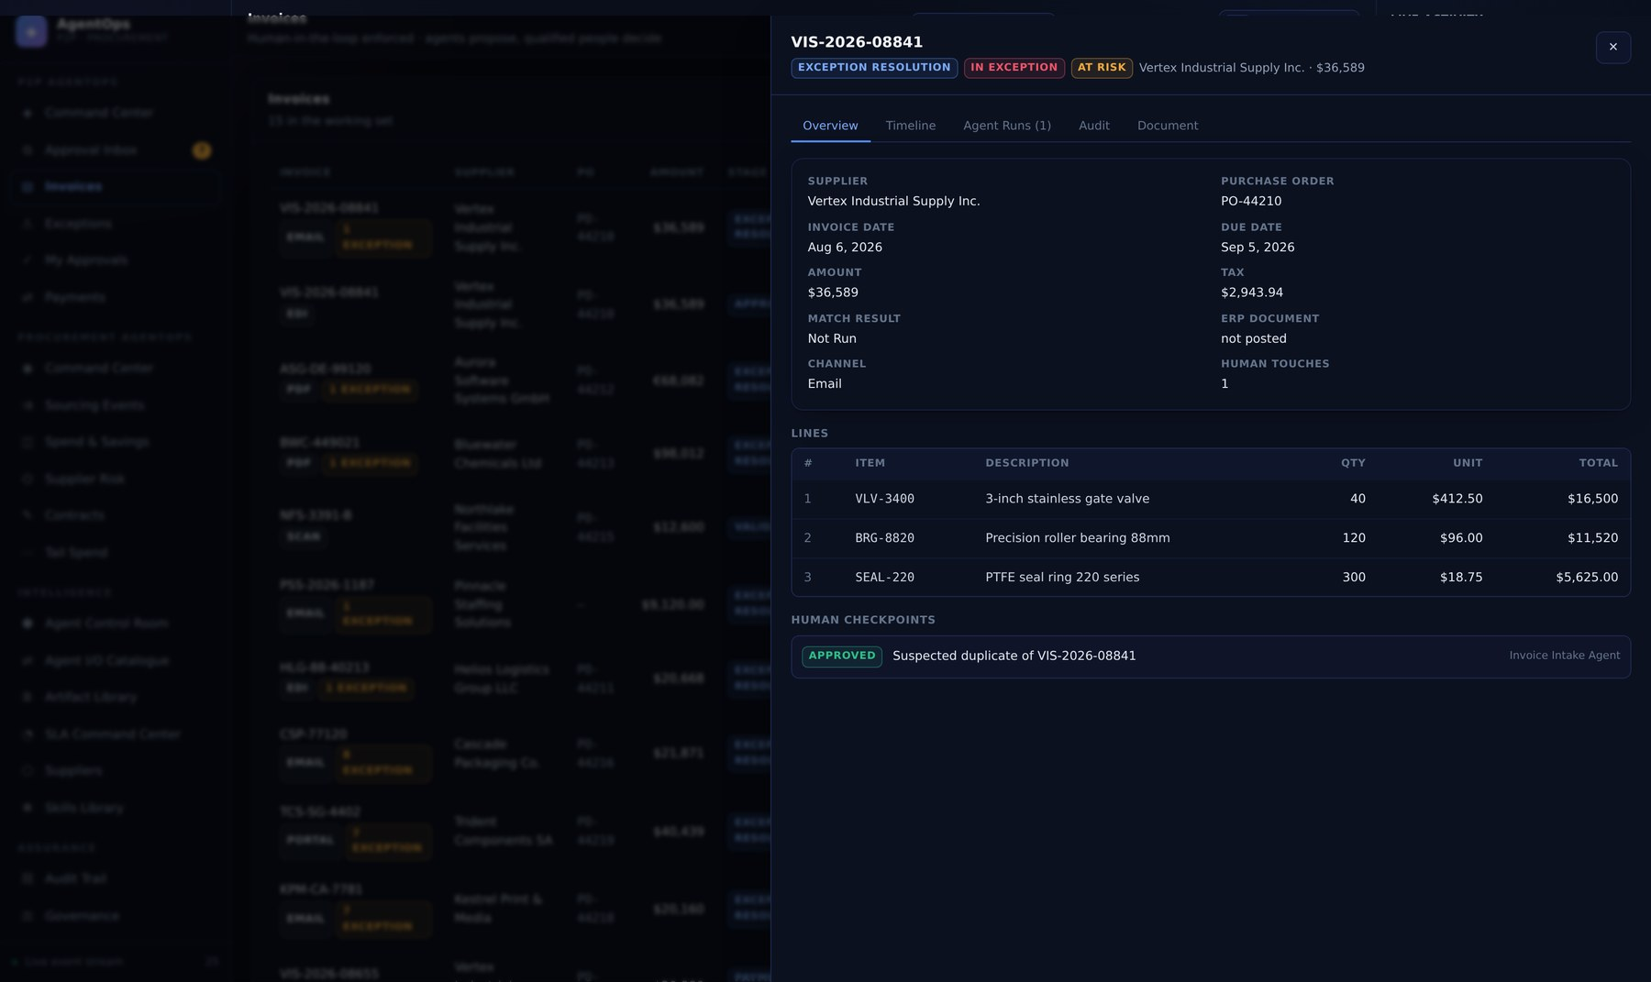
PART 02 · P2P AGENTOPS
Invoice detail — timeline, runs and source document
Every event, every agent run and every human decision against one invoice, in order.
WHAT TO LOOK AT
The timeline is workflow_events
Append-only and derived. Nothing in it can be edited from the UI.
Agent runs link to their checkpoints
Run → proposal → decision → applied payload, all navigable.
The source document is retained
Extraction is auditable against the text it actually read.
Part 02 · P2P AgentOps
13
Notes:
Invoice detail — timeline, runs and source document. Every event, every agent run and every human decision against one invoice, in order. The timeline is `workflow_events`: Append-only and derived. Nothing in it can be edited from the UI. Agent runs link to their checkpoints: Run → proposal → decision → applied payload, all navigable. The source document is retained: Extraction is auditable against the text it actually read.

Slide 15
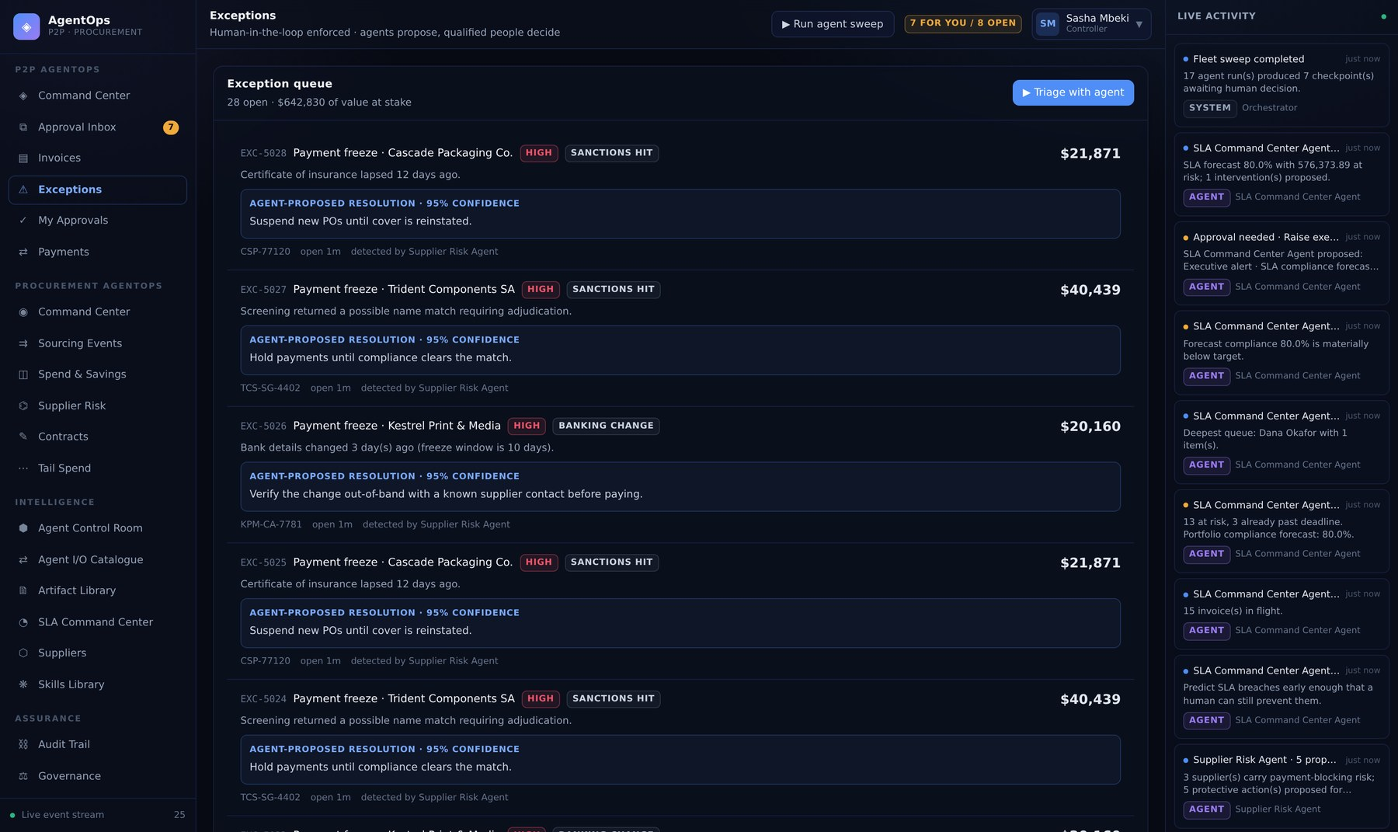
PART 02 · P2P AGENTOPS
Exceptions — the agent's diagnosis, priced
Open cases with the proposed resolution and the alternatives costed out.
WHAT TO LOOK AT
Alternatives carry payloads
Picking one substitutes its payload into the checkpoint — the reviewer never retypes anything.
Below 70% confidence it proposes nothing
Exception Resolution asks for a human owner instead. A confident wrong answer is worse than none.
Severity is computed from impact
Not a label the agent picked; a function of the money at stake.
Part 02 · P2P AgentOps
14
Notes:
Exceptions — the agent's diagnosis, priced. Open cases with the proposed resolution and the alternatives costed out. Alternatives carry payloads: Picking one substitutes its payload into the checkpoint — the reviewer never retypes anything. Below 70% confidence it proposes nothing: Exception Resolution asks for a human owner instead. A confident wrong answer is worse than none. Severity is computed from impact: Not a label the agent picked; a function of the money at stake.

Slide 16
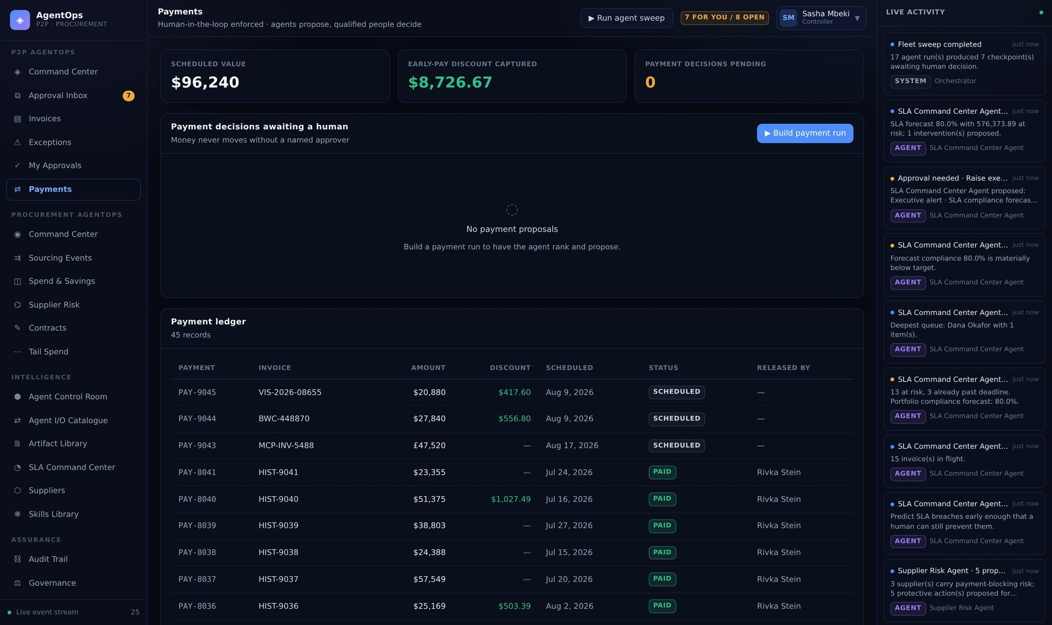
PART 02 · P2P AGENTOPS
Payments — scheduling, discounts and release
Payment-run proposals ranked by priority score, with the early-pay discount at stake quoted.
WHAT TO LOOK AT
due_risk + supplier_tier + discount_value + sla_risk
The breakdown is shown, not just the total — a total on its own is not reviewable.
Blocked suppliers never appear
Payment Readiness skips them entirely rather than proposing a release that would be rejected.
Release is irreversible
Always a Controller, always a human, at any autonomy level.
Part 02 · P2P AgentOps
15
Notes:
Payments — scheduling, discounts and release. Payment-run proposals ranked by priority score, with the early-pay discount at stake quoted. `due_risk + supplier_tier + discount_value + sla_risk`: The breakdown is shown, not just the total — a total on its own is not reviewable. Blocked suppliers never appear: Payment Readiness skips them entirely rather than proposing a release that would be rejected. Release is irreversible: Always a Controller, always a human, at any autonomy level.

Slide 17
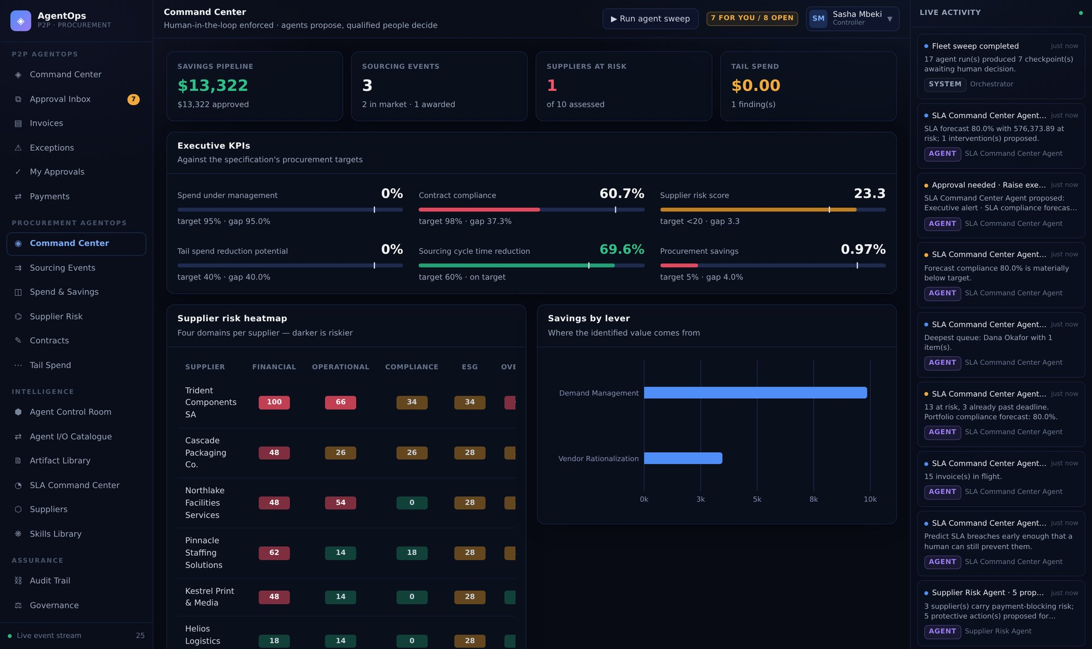
PART 02 · PROCUREMENT AGENTOPS
Procurement Command Center — six executive KPIs
Spend under management, contract compliance, supplier risk, tail spend, cycle time and savings.
WHAT TO LOOK AT
Most start off target on purpose
Approving the agents' proposals is what closes the gaps — that is the story worth showing.
Publishing the brief is CFO-level
It reaches an audience that will act on it and cannot be unsent.
Heatmap data is an artifact
Produced as a downloadable .json, born a draft like every other deliverable.
Part 02 · Procurement AgentOps
16
Notes:
Procurement Command Center — six executive KPIs. Spend under management, contract compliance, supplier risk, tail spend, cycle time and savings. Most start off target on purpose: Approving the agents' proposals is what closes the gaps — that is the story worth showing. Publishing the brief is CFO-level: It reaches an audience that will act on it and cannot be unsent. Heatmap data is an artifact: Produced as a downloadable .json, born a draft like every other deliverable.

Slide 18
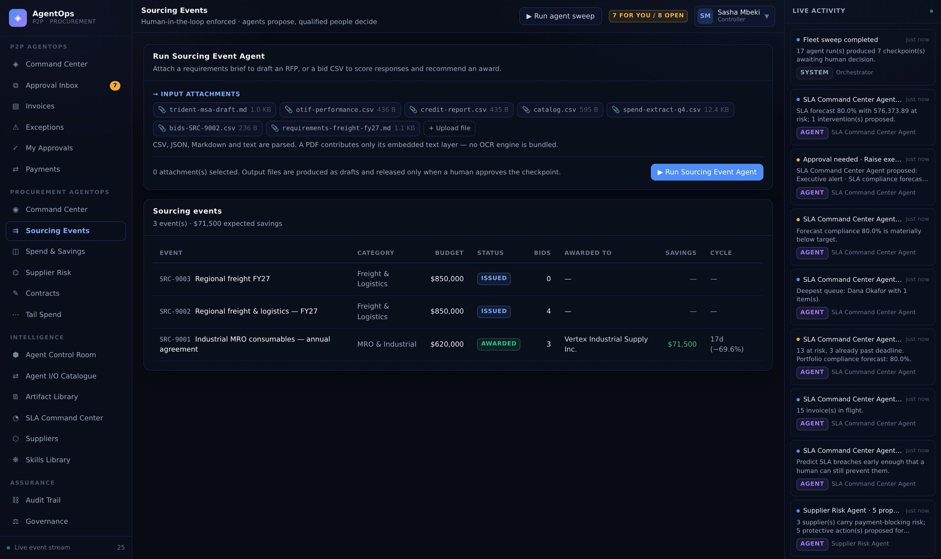
PART 02 · PROCUREMENT AGENTOPS
Sourcing Events — RFP to award
The RFP pipeline, bid scorecards and the award decision, with weights published up front.
WHAT TO LOOK AT
Compliance is a gate, not a weight
A supplier failing a mandatory rule is excluded, not scored down. A weight can be outvoted by price; a gate cannot.
Issuing an RFP has zero financial impact
It invites bids and commits nothing. The award is where the money moves — and where CFO escalation applies.
Above $100k the award needs two approvers
Compared by user.id, so one person signing twice is one approval.
Part 02 · Procurement AgentOps
17
Notes:
Sourcing Events — RFP to award. The RFP pipeline, bid scorecards and the award decision, with weights published up front. Compliance is a gate, not a weight: A supplier failing a mandatory rule is excluded, not scored down. A weight can be outvoted by price; a gate cannot. Issuing an RFP has zero financial impact: It invites bids and commits nothing. The award is where the money moves — and where CFO escalation applies. Above $100k the award needs two approvers: Compared by user.id, so one person signing twice is one approval.

Slide 19
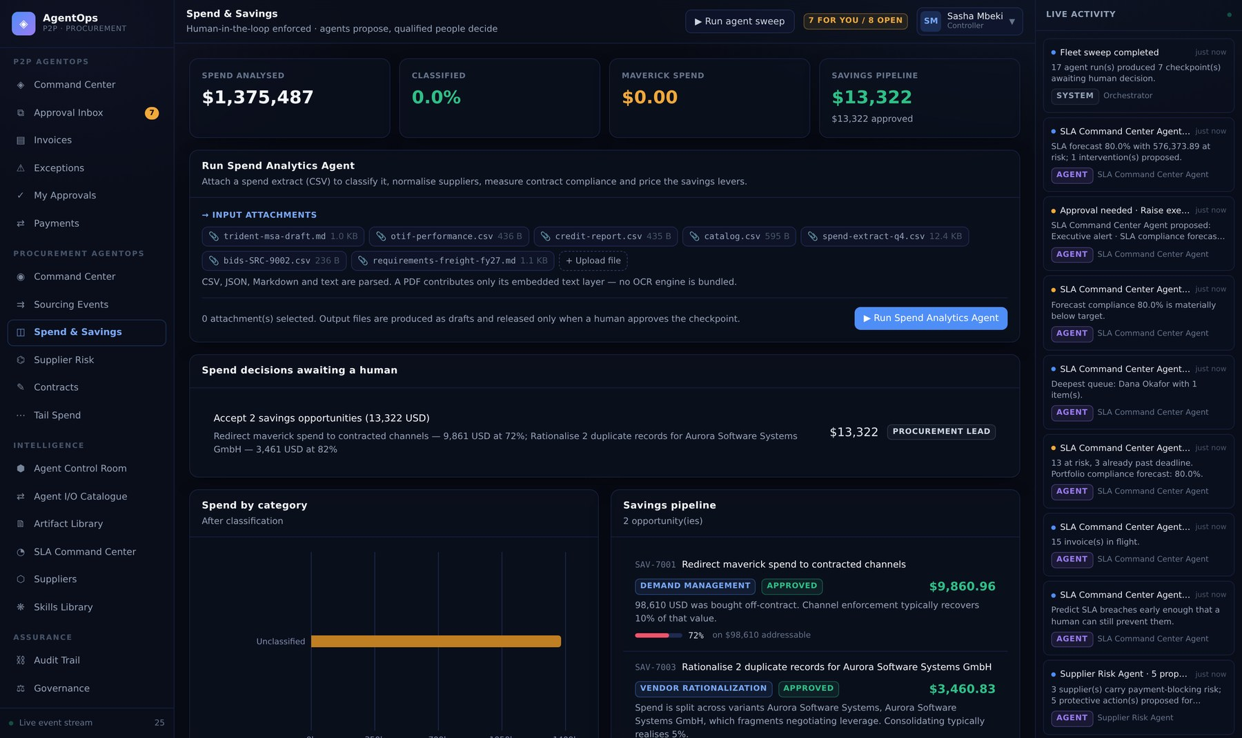
PART 02 · PROCUREMENT AGENTOPS
Spend & Savings — classification and the savings pipeline
Classified spend by category, coverage, and savings priced per lever.
WHAT TO LOOK AT
The unclassified residual ships as a file
A coverage percentage you cannot see inside cannot be acted on.
Savings are modelled, not estimated
Published rates per lever, so two runs over the same data agree and the method is auditable.
Below 85% coverage it escalates
The savings numbers would rest on too little classified spend.
Part 02 · Procurement AgentOps
18
Notes:
Spend & Savings — classification and the savings pipeline. Classified spend by category, coverage, and savings priced per lever. The unclassified residual ships as a file: A coverage percentage you cannot see inside cannot be acted on. Savings are modelled, not estimated: Published rates per lever, so two runs over the same data agree and the method is auditable. Below 85% coverage it escalates: The savings numbers would rest on too little classified spend.

Slide 20
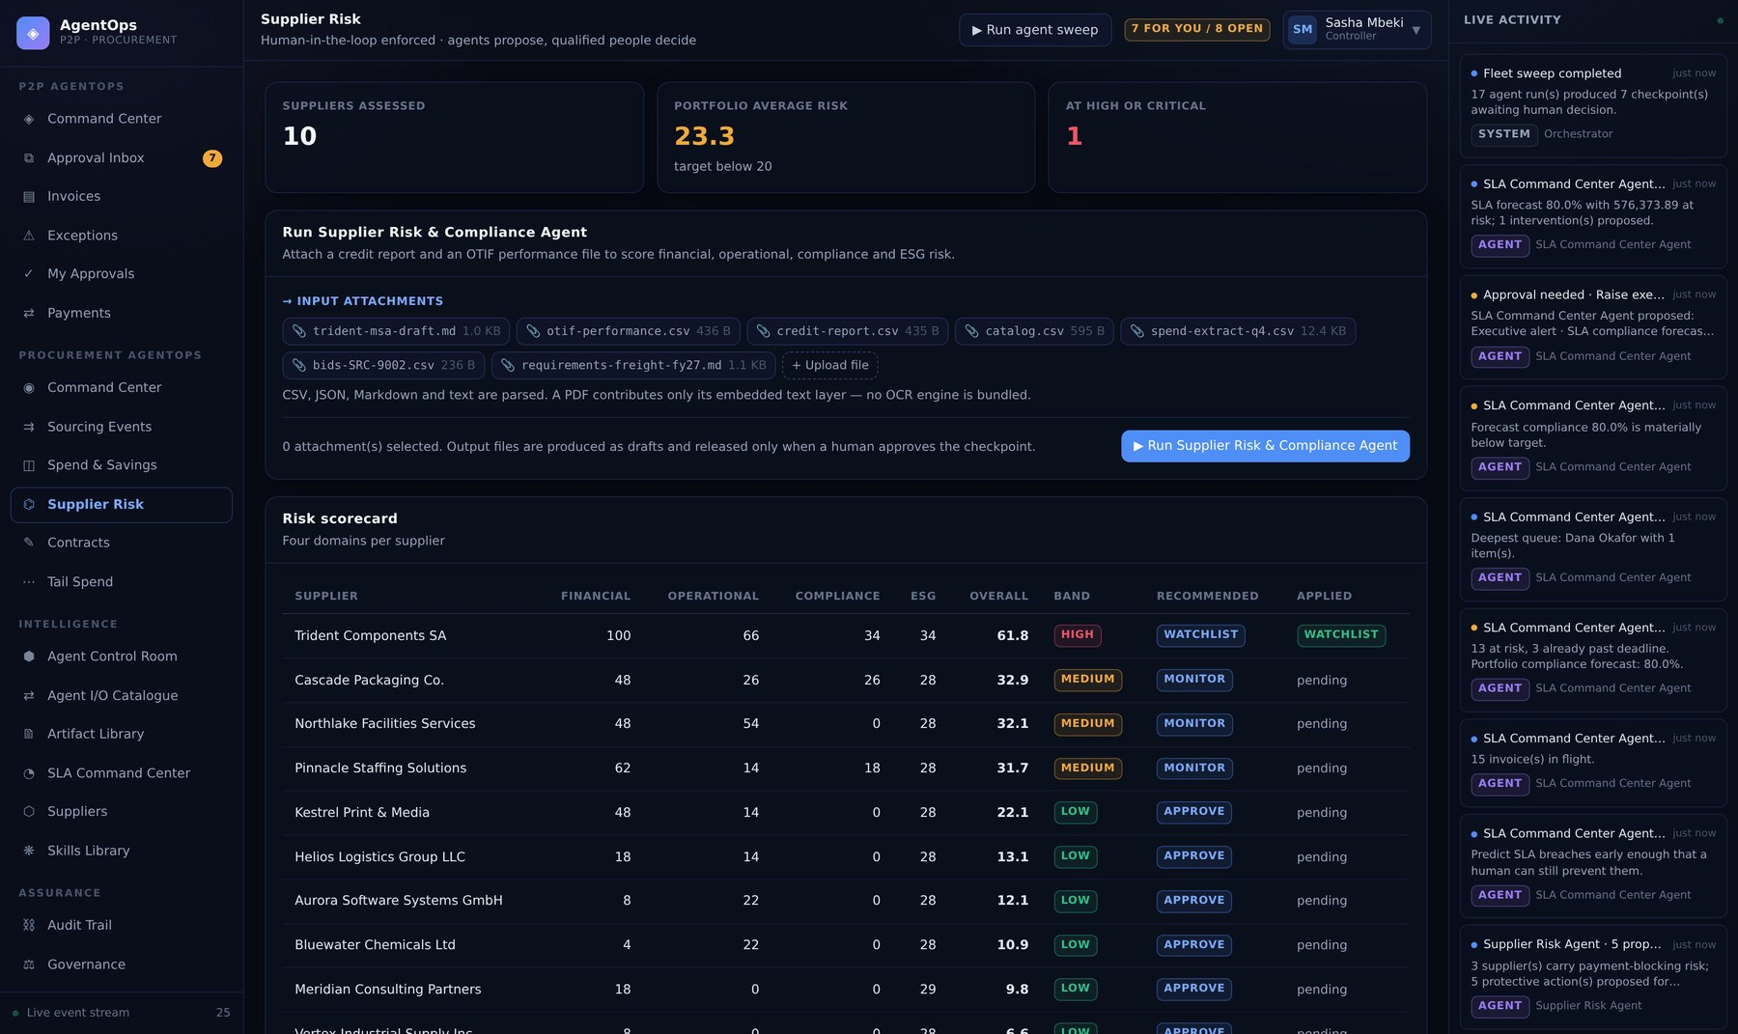
PART 02 · PROCUREMENT AGENTOPS
Supplier Risk — four domains, one disposition
Financial, operational, compliance and ESG risk scored separately, then blended.
WHAT TO LOOK AT
0.30 / 0.25 / 0.30 / 0.15
A weighted blend, so one bad domain does not by itself condemn a supplier — but each domain is carried through.
applied_disposition stays null
The assessment records the recommendation. The vendor master changes only on approval.
Thin evidence lowers confidence
Two or more "no data" findings drop it to 0.72 rather than scoring confidently on nothing.
Part 02 · Procurement AgentOps
19
Notes:
Supplier Risk — four domains, one disposition. Financial, operational, compliance and ESG risk scored separately, then blended. 0.30 / 0.25 / 0.30 / 0.15: A weighted blend, so one bad domain does not by itself condemn a supplier — but each domain is carried through. `applied_disposition` stays null: The assessment records the recommendation. The vendor master changes only on approval. Thin evidence lowers confidence: Two or more "no data" findings drop it to 0.72 rather than scoring confidently on nothing.

Slide 21
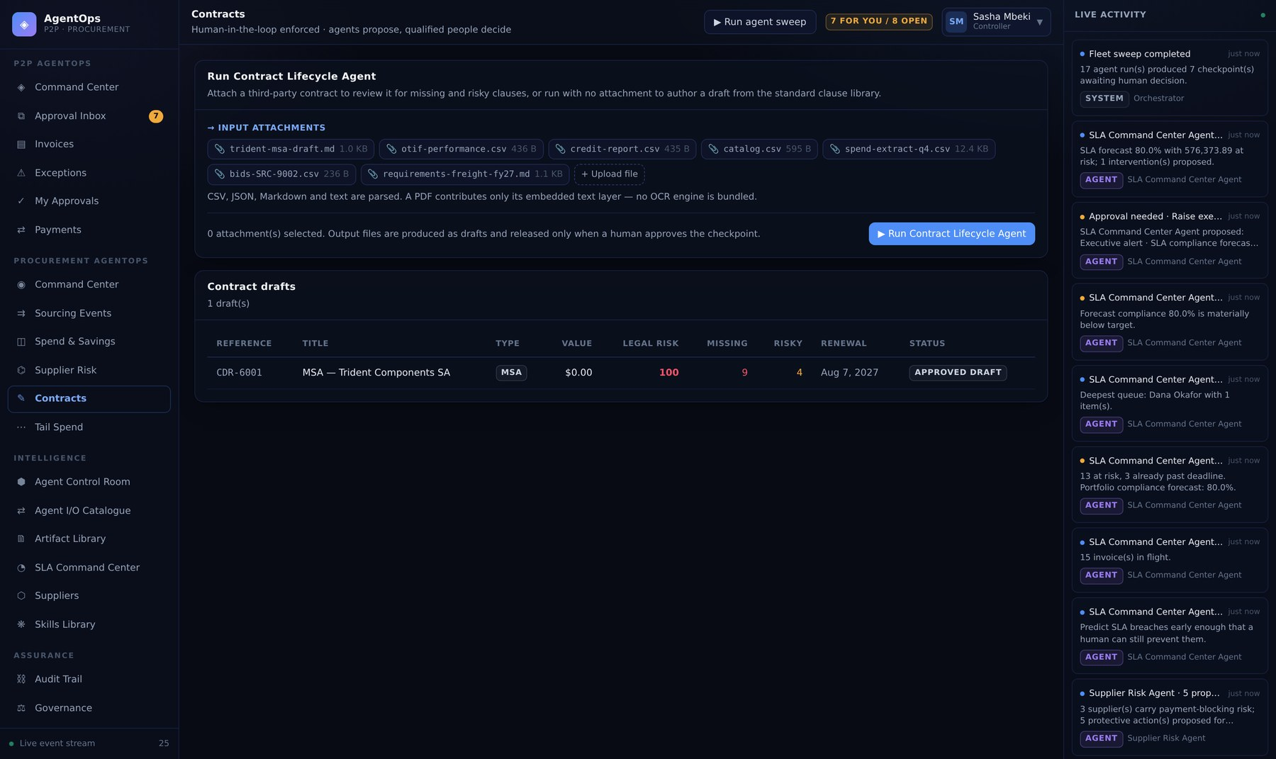
PART 02 · PROCUREMENT AGENTOPS
Contracts — clause review that withholds signature
Drafts, clause findings, obligations and renewals, with the legal risk score built additively.
WHAT TO LOOK AT
Signature is not offered on bad paper
While mandatory clauses are missing or risky ones present, the proposal is never made — so it cannot be approved.
A missing clause carries weight too
An omission is a risk, not a neutral absence.
Silent auto-renewal is flagged with its notice period
The risk is the date passing unnoticed, not the clause existing.
Part 02 · Procurement AgentOps
20
Notes:
Contracts — clause review that withholds signature. Drafts, clause findings, obligations and renewals, with the legal risk score built additively. Signature is not offered on bad paper: While mandatory clauses are missing or risky ones present, the proposal is never made — so it cannot be approved. A missing clause carries weight too: An omission is a risk, not a neutral absence. Silent auto-renewal is flagged with its notice period: The risk is the date passing unnoticed, not the clause existing.

Slide 22
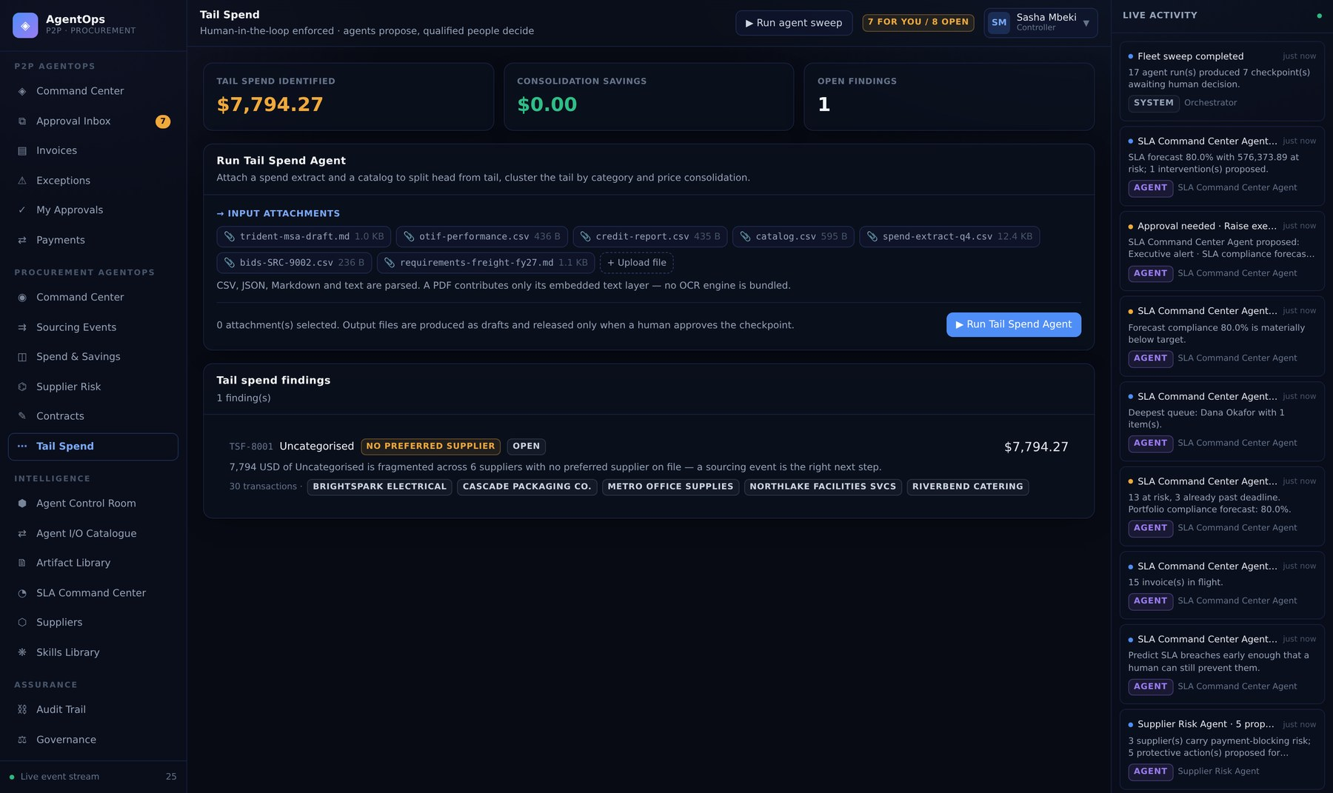
PART 02 · PROCUREMENT AGENTOPS
Tail Spend — the long tail, governed
Head/tail split on a Pareto cut, consolidation clusters and off-catalogue enforcement.
WHAT TO LOOK AT
$4,000 materiality floor
Without it, clustering surfaces dozens of clusters that cost more to action than they save.
No preferred supplier → zero savings claimed
The finding is recorded honestly rather than claiming savings nobody can realise.
Enforcement needs a substitute
Where no catalogue item exists, the buyer had no compliant option — so nothing is proposed.
Part 02 · Procurement AgentOps
21
Notes:
Tail Spend — the long tail, governed. Head/tail split on a Pareto cut, consolidation clusters and off-catalogue enforcement. $4,000 materiality floor: Without it, clustering surfaces dozens of clusters that cost more to action than they save. No preferred supplier → zero savings claimed: The finding is recorded honestly rather than claiming savings nobody can realise. Enforcement needs a substitute: Where no catalogue item exists, the buyer had no compliant option — so nothing is proposed.

Slide 23
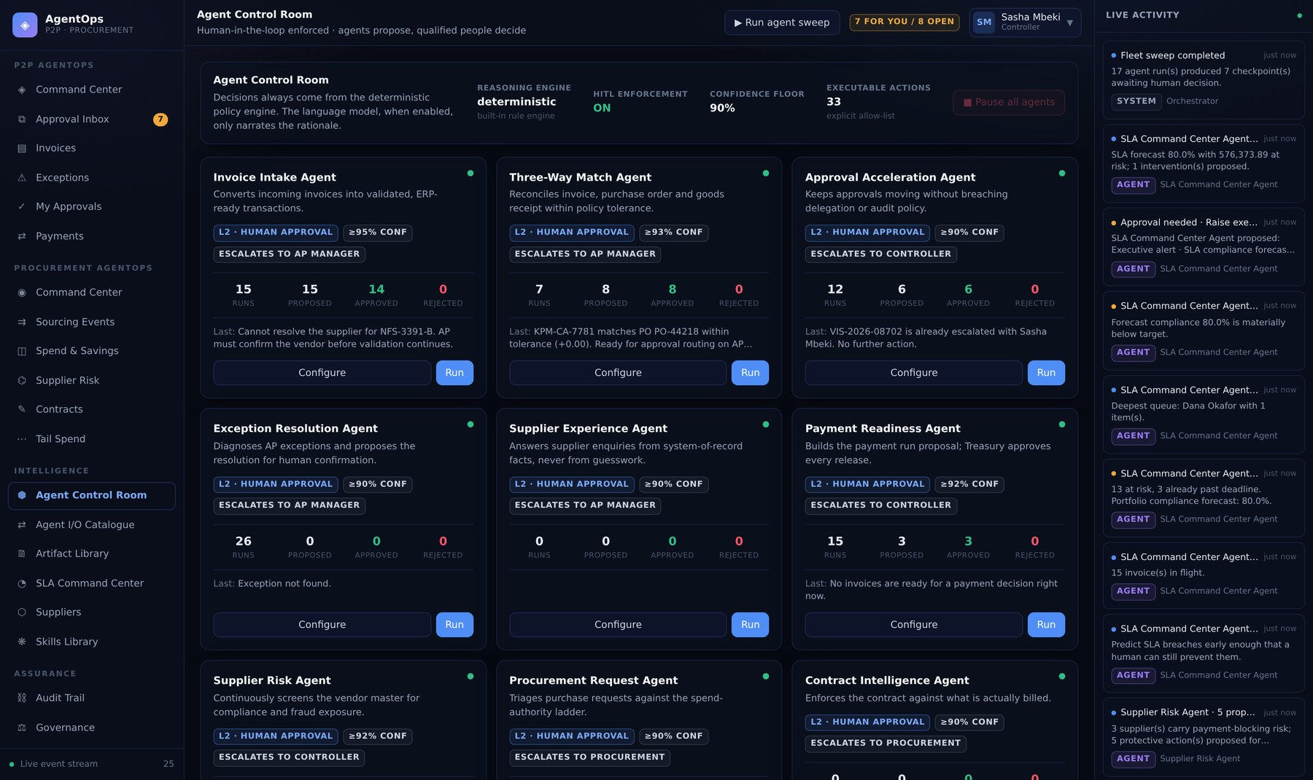
PART 02 · INTELLIGENCE
Agent Control Room — governance per agent
Autonomy level, confidence threshold, financial ceiling, permitted actions and run history.
WHAT TO LOOK AT
All 16 ship at L2 · Human Approval
Every proposal waits. L4 is disabled entirely while global enforcement is on.
The fleet kill switch
P2P_AGENTS_PAUSED or the button — a disabled agent returns blocked_by_policy without running.
Run one agent on demand
The fastest development loop: change decide(), click run, read the checkpoint.
Part 02 · Intelligence
22
Notes:
Agent Control Room — governance per agent. Autonomy level, confidence threshold, financial ceiling, permitted actions and run history. All 16 ship at L2 · Human Approval: Every proposal waits. L4 is disabled entirely while global enforcement is on. The fleet kill switch: P2P_AGENTS_PAUSED or the button — a disabled agent returns blocked_by_policy without running. Run one agent on demand: The fastest development loop: change decide(), click run, read the checkpoint.

Slide 24
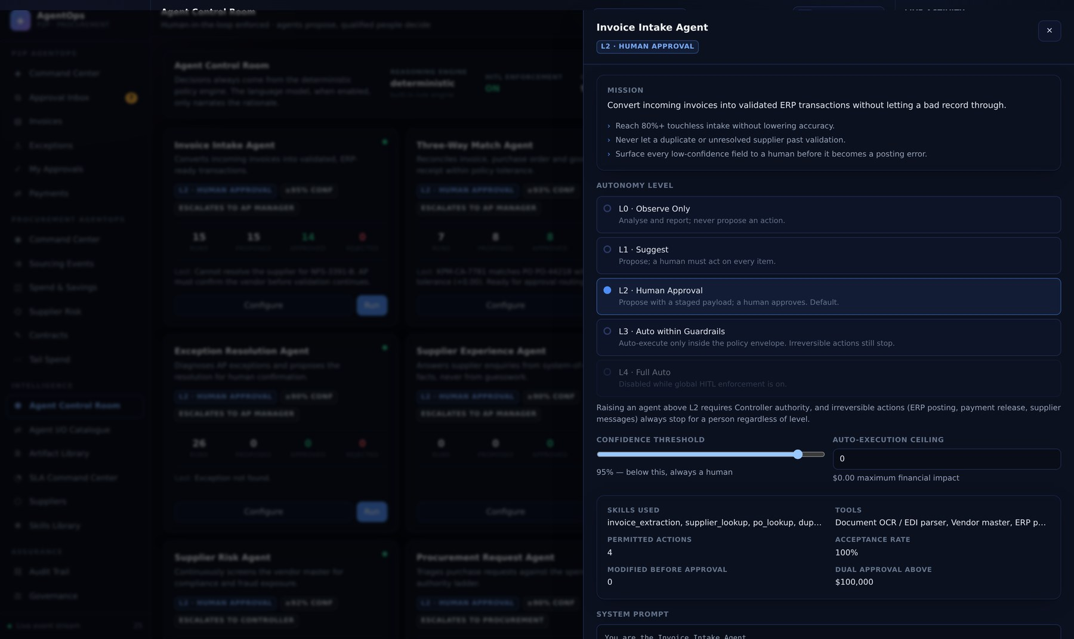
PART 02 · INTELLIGENCE
Agent configuration — the envelope you can move
Everything the policy engine reads about this agent, editable and audited.
WHAT TO LOOK AT
These are agent_configs rows
Seeded from the class defaults, then owned by the database. Governance is data.
Raising autonomy does not bypass HITL
Gate 1 is the global switch; gates 2–7 still apply either way.
The prompt is shown, not hidden
Generated by BaseAgent.prompt_template() from the declared identity.
Part 02 · Intelligence
23
Notes:
Agent configuration — the envelope you can move. Everything the policy engine reads about this agent, editable and audited. These are `agent_configs` rows: Seeded from the class defaults, then owned by the database. Governance is data. Raising autonomy does not bypass HITL: Gate 1 is the global switch; gates 2–7 still apply either way. The prompt is shown, not hidden: Generated by BaseAgent.prompt_template() from the declared identity.

Slide 25
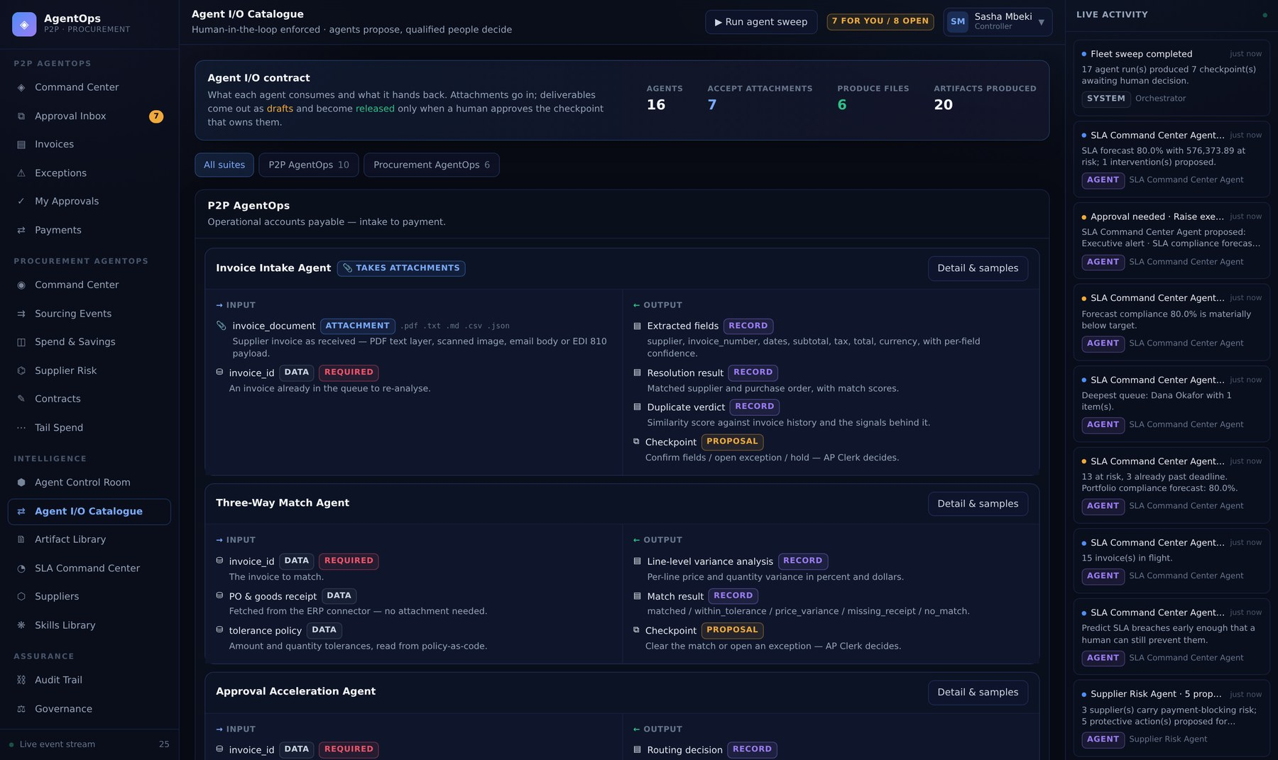
PART 02 · INTELLIGENCE
Agent I/O Catalogue — the contract, all 16 agents
What each agent consumes and what it hands back, with formats and the files it has produced.
WHAT TO LOOK AT
Rendered from IOSpec declarations
Not a written document — the same objects the agent declares in code.
Five kinds
attachment, data, artifact, record, proposal — the last one is always a checkpoint.
Produced files are downloadable
Straight from artifacts, with their draft/released state visible.
Part 02 · Intelligence
24
Notes:
Agent I/O Catalogue — the contract, all 16 agents. What each agent consumes and what it hands back, with formats and the files it has produced. Rendered from `IOSpec` declarations: Not a written document — the same objects the agent declares in code. Five kinds: attachment, data, artifact, record, proposal — the last one is always a checkpoint. Produced files are downloadable: Straight from artifacts, with their draft/released state visible.

Slide 26
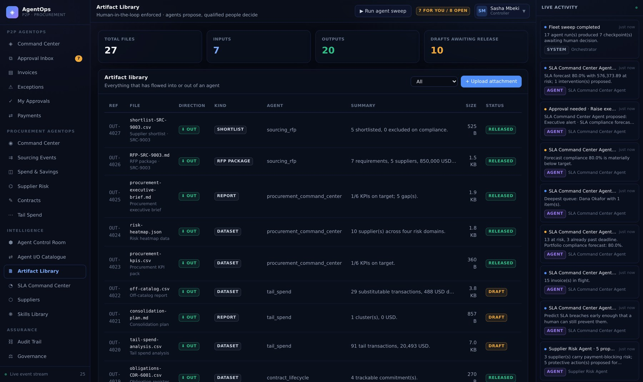
PART 02 · INTELLIGENCE
Artifact Library — documents in and out
One table, two directions. Uploaded attachments and agent deliverables side by side.
WHAT TO LOOK AT
Outputs are born draft
They become released only when the checkpoint that owns them is approved.
Rejection leaves them as drafts
Evidence of what was considered, with nothing issued.
Seven samples ship seeded
So a demo can run an agent against real input with no preparation.
Part 02 · Intelligence
25
Notes:
Artifact Library — documents in and out. One table, two directions. Uploaded attachments and agent deliverables side by side. Outputs are born `draft`: They become released only when the checkpoint that owns them is approved. Rejection leaves them as drafts: Evidence of what was considered, with nothing issued. Seven samples ship seeded: So a demo can run an agent against real input with no preparation.

Slide 27
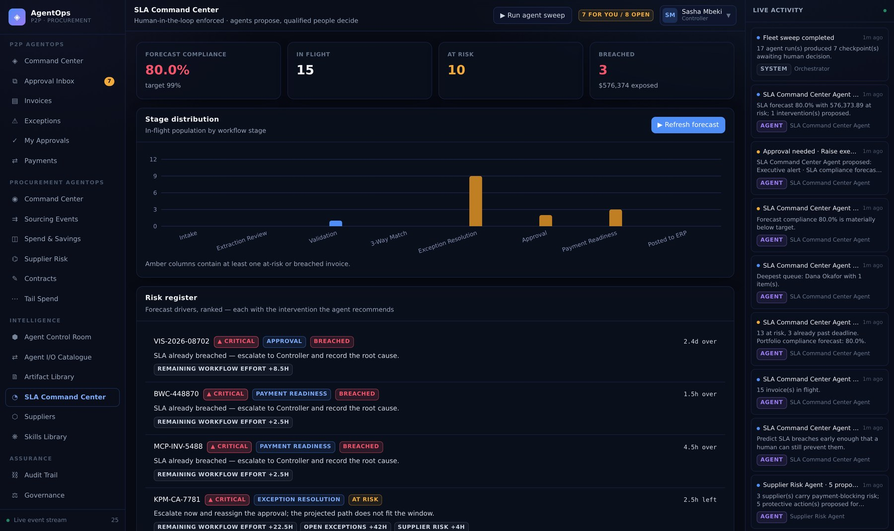
PART 02 · INTELLIGENCE
SLA Command Center — forecast, not report
Breach forecast per invoice with its drivers, and the interventions that would protect it.
WHAT TO LOOK AT
Costs remaining stages only
Charging every invoice for exception handling forecasts the whole portfolio at risk — wrong and useless.
Rebalancing respects approval limits
A move that creates an unapprovable assignment has relocated the problem, not solved it.
Below 95% forecast compliance it escalates
That is an executive condition, not a queue item.
Part 02 · Intelligence
26
Notes:
SLA Command Center — forecast, not report. Breach forecast per invoice with its drivers, and the interventions that would protect it. Costs remaining stages only: Charging every invoice for exception handling forecasts the whole portfolio at risk — wrong and useless. Rebalancing respects approval limits: A move that creates an unapprovable assignment has relocated the problem, not solved it. Below 95% forecast compliance it escalates: That is an executive condition, not a queue item.

Slide 28
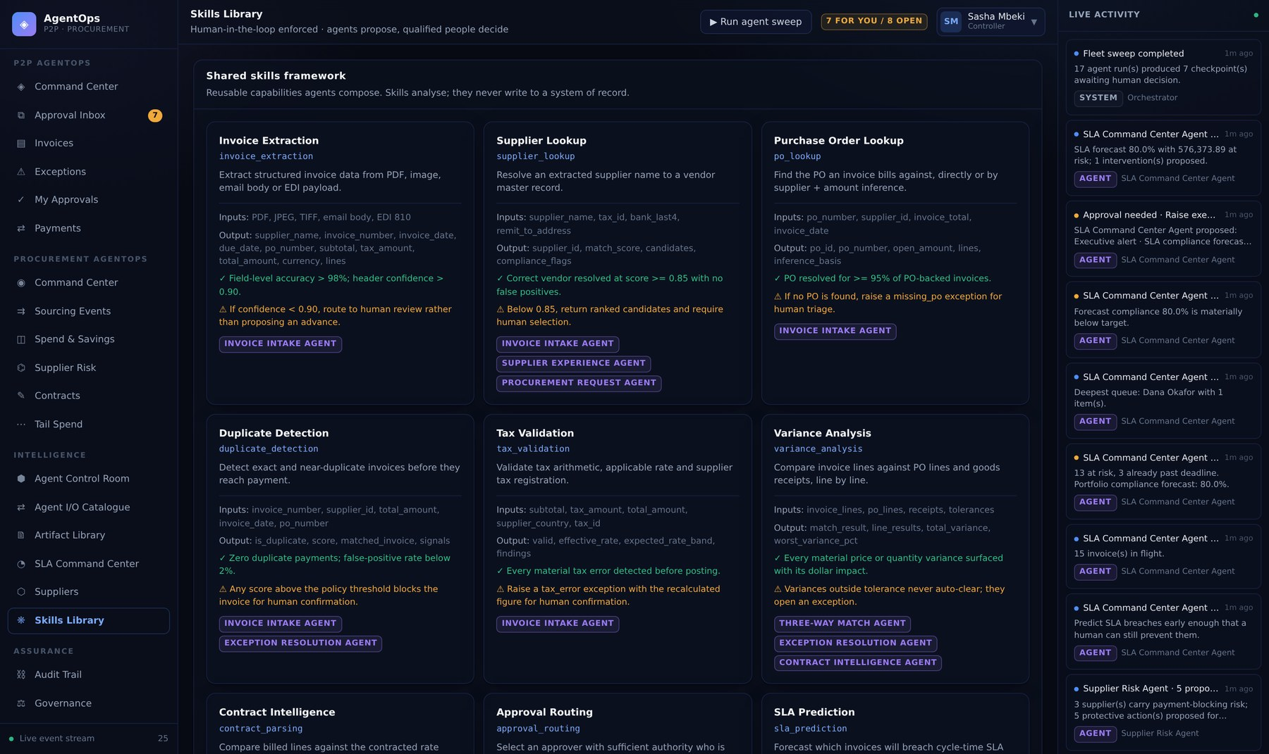
PART 02 · INTELLIGENCE
Skills Library — 28 shared capabilities
The analysis layer the agents compose. A skill returns evidence; it never writes.
WHAT TO LOOK AT
Contracts are generated
skills/<name>/SKILL.md from the live descriptors, so documentation cannot drift.
Skills are pure functions of their inputs
No session, no writes — which is why they are trivially testable.
Reused across agents
variance_analysis serves Three-Way Match, Exception Resolution and Contract Intelligence.
Part 02 · Intelligence
27
Notes:
Skills Library — 28 shared capabilities. The analysis layer the agents compose. A skill returns evidence; it never writes. Contracts are generated: skills/<name>/SKILL.md from the live descriptors, so documentation cannot drift. Skills are pure functions of their inputs: No session, no writes — which is why they are trivially testable. Reused across agents: variance_analysis serves Three-Way Match, Exception Resolution and Contract Intelligence.

Slide 29
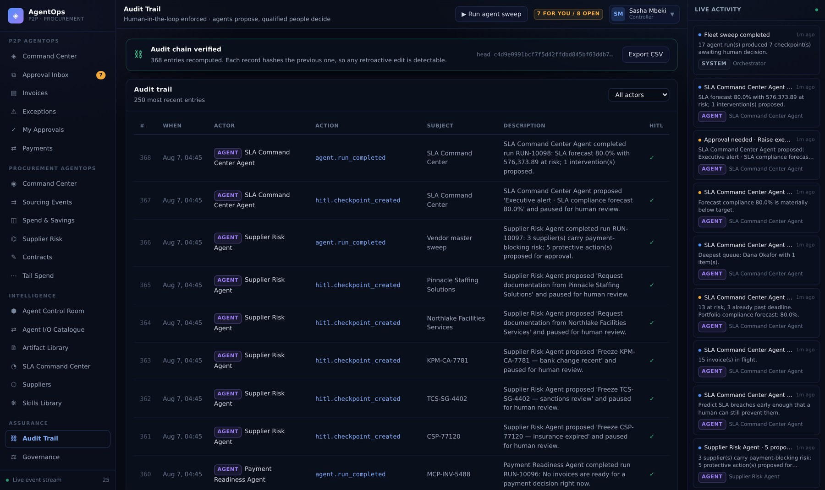
PART 02 · ASSURANCE
Audit Trail — hash-chained and verifiable
Every decision, who made it, on what evidence, and whether enforcement was on at the time.
WHAT TO LOOK AT
sha256(previous_hash ‖ payload)
Each row covers the one before it. Editing history breaks verification at that row.
GET /api/audit/verify replays from genesis
And reports the first divergence, if any.
Agent and human entries are distinguished
actor_type separates what the agent concluded from what a person decided.
Part 02 · Assurance
28
Notes:
Audit Trail — hash-chained and verifiable. Every decision, who made it, on what evidence, and whether enforcement was on at the time. `sha256(previous_hash ‖ payload)`: Each row covers the one before it. Editing history breaks verification at that row. `GET /api/audit/verify` replays from genesis: And reports the first divergence, if any. Agent and human entries are distinguished: actor_type separates what the agent concluded from what a person decided.

Slide 30
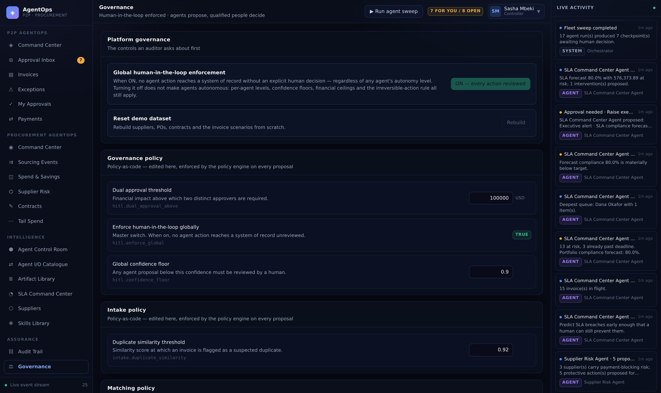
PART 02 · ASSURANCE
Governance — policy as data
Fifteen rules, the master HITL switch, and the thresholds every agent reads on every run.
WHAT TO LOOK AT
Changing governance is a data change
Tolerances and thresholds are rows in policy_rules, not constants in code.
The master switch opens gate 1 only
An L2 agent still stops; an irreversible action still stops; a low-confidence proposal still stops.
Every edit is audited
Who loosened the tolerance, when, and from what to what.
Part 02 · Assurance
29
Notes:
Governance — policy as data. Fifteen rules, the master HITL switch, and the thresholds every agent reads on every run. Changing governance is a data change: Tolerances and thresholds are rows in policy_rules, not constants in code. The master switch opens gate 1 only: An L2 agent still stops; an irreversible action still stops; a low-confidence proposal still stops. Every edit is audited: Who loosened the tolerance, when, and from what to what.

Slide 31
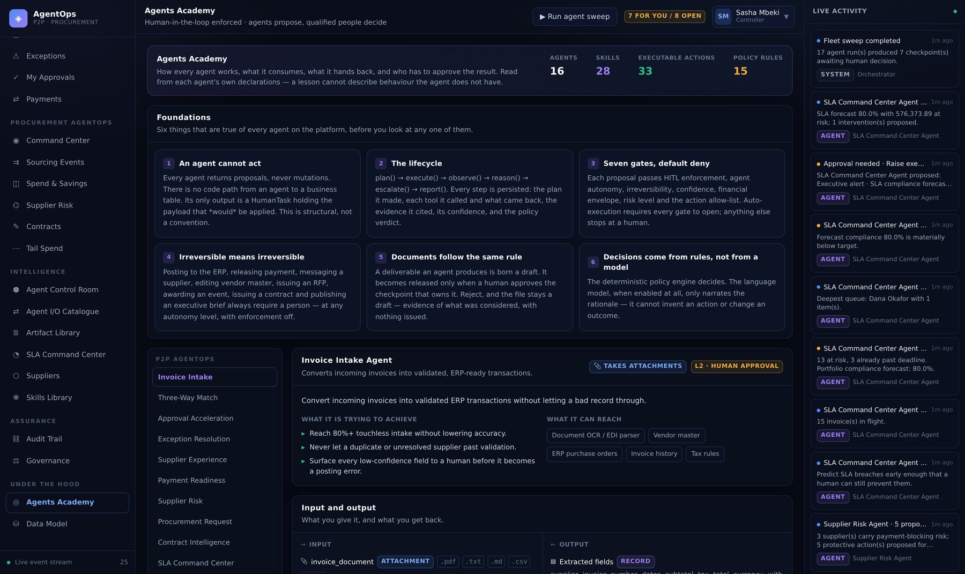
PART 02 · UNDER THE HOOD
Agents Academy — six foundations, then each agent
What is true of every agent before you look at any one of them.
WHAT TO LOOK AT
Read from the agents' own declarations
A lesson cannot describe behaviour the agent does not have.
The foundations are the mental model
An agent cannot act · the lifecycle · seven gates · irreversible means irreversible · documents follow the same rule · rules decide, not a model.
This is the onboarding path
New developer, no context: read the six, then pick the agent you are changing.
Part 02 · Under the Hood
30
Notes:
Agents Academy — six foundations, then each agent. What is true of every agent before you look at any one of them. Read from the agents' own declarations: A lesson cannot describe behaviour the agent does not have. The foundations are the mental model: An agent cannot act · the lifecycle · seven gates · irreversible means irreversible · documents follow the same rule · rules decide, not a model. This is the onboarding path: New developer, no context: read the six, then pick the agent you are changing.

Slide 32
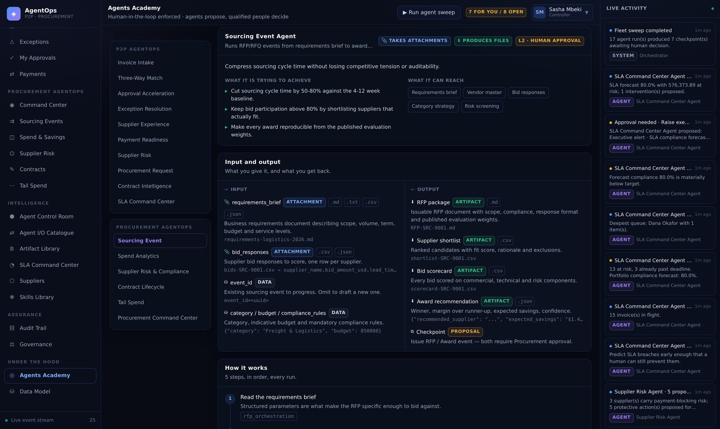
PART 02 · UNDER THE HOOD
Academy — input and output, per agent
The question the screen exists to answer: what do I give it, and what do I get back?
WHAT TO LOOK AT
Kind, format and example per field
Enough to construct a call without reading the source.
Attachments arrive parsed
CSV as typed rows, JSON as records, PDF as its text layer — the agent never touches storage.
Outputs name the checkpoint they need
So the approval path is visible before you run anything.
Part 02 · Under the Hood
31
Notes:
Academy — input and output, per agent. The question the screen exists to answer: what do I give it, and what do I get back? Kind, format and example per field: Enough to construct a call without reading the source. Attachments arrive parsed: CSV as typed rows, JSON as records, PDF as its text layer — the agent never touches storage. Outputs name the checkpoint they need: So the approval path is visible before you run anything.

Slide 33
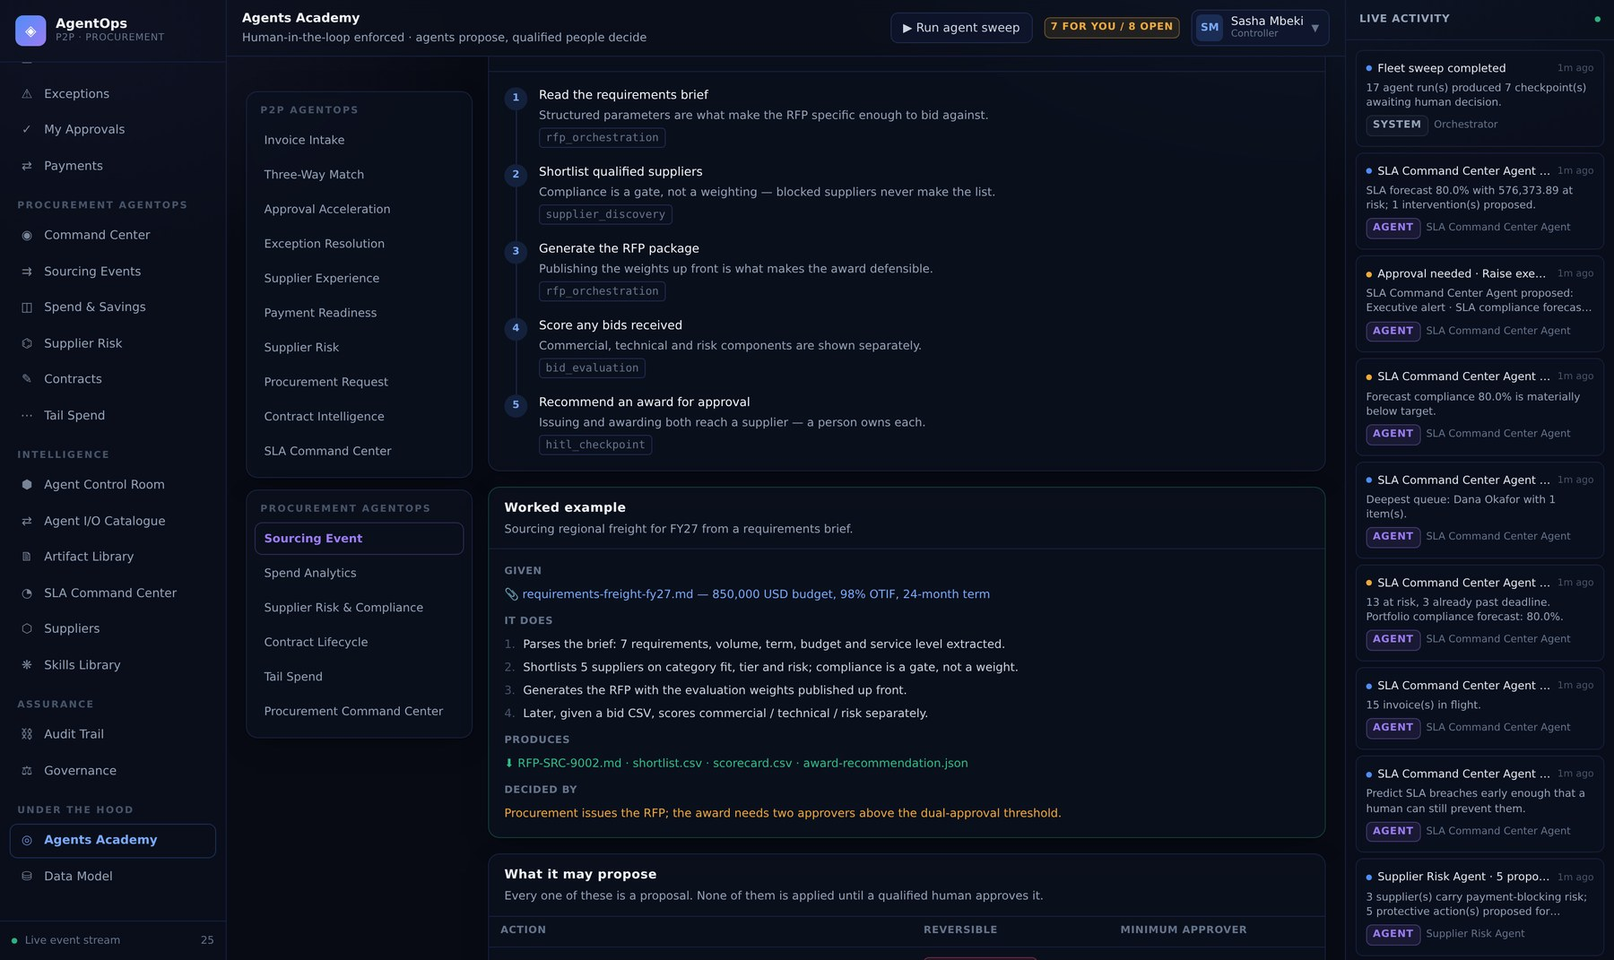
PART 02 · UNDER THE HOOD
Academy — a worked example against seeded data
Given → it does → produces → decided by. Runnable in the demo as written.
WHAT TO LOOK AT
The lifecycle is the declared plan()
With the tool and the rationale for each step.
The example uses shipped fixtures
You can reproduce it in the running demo in under a minute.
"Decided by" names the authority
Including when two approvers are required.
Part 02 · Under the Hood
32
Notes:
Academy — a worked example against seeded data. Given → it does → produces → decided by. Runnable in the demo as written. The lifecycle is the declared `plan()`: With the tool and the rationale for each step. The example uses shipped fixtures: You can reproduce it in the running demo in under a minute. "Decided by" names the authority: Including when two approvers are required.

Slide 34
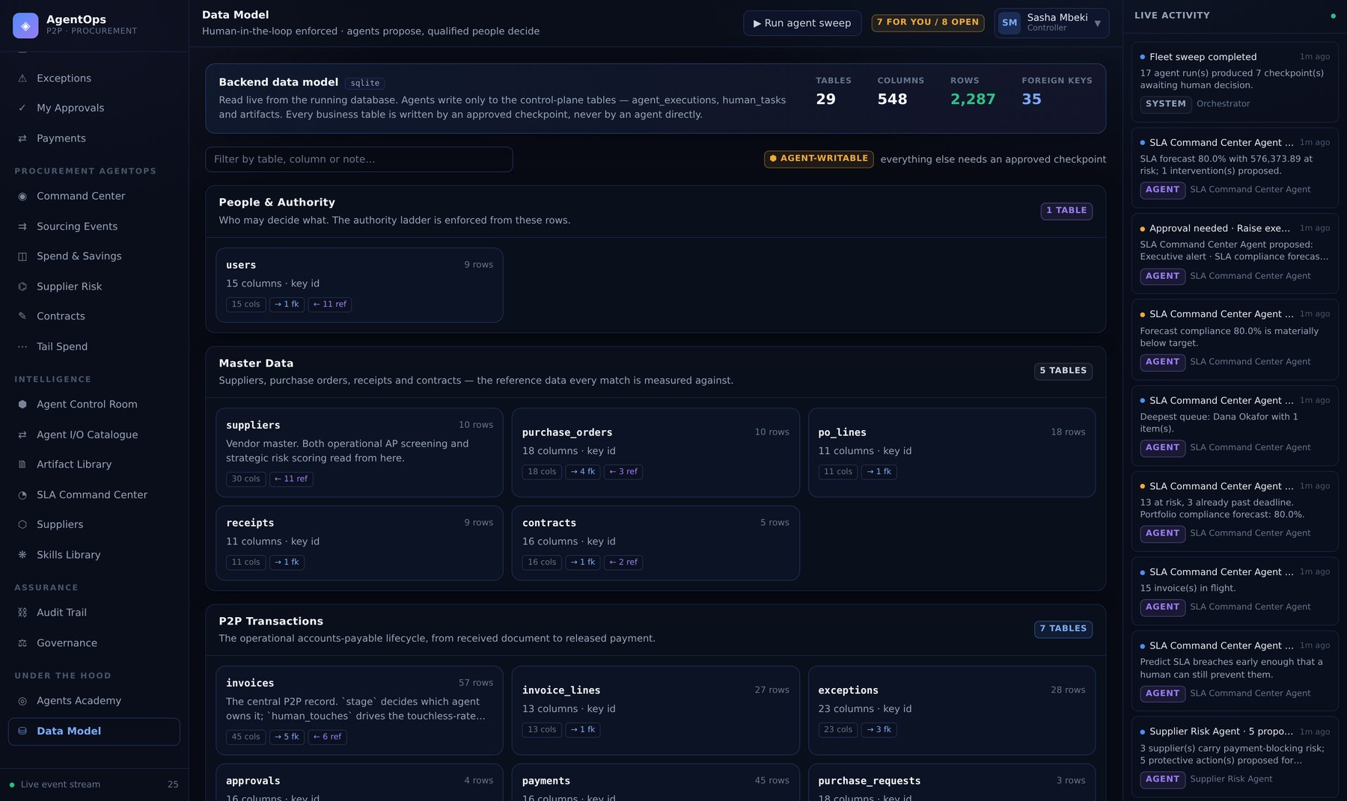
PART 02 · UNDER THE HOOD
Data Model — the live schema, seven domains
29 tables introspected from SQLAlchemy metadata, with row counts read at request time.
WHAT TO LOOK AT
Agent-writable tables are marked
Only agent_executions, human_tasks and artifacts. Everything else needs an approved checkpoint.
Nothing here is hand-maintained
A new table appears the moment it exists — and a test fails if it has no domain.
Row counts are live
COUNT(*) per table per request. Cheap at demo scale; cache it at volume.
Part 02 · Under the Hood
33
Notes:
Data Model — the live schema, seven domains. 29 tables introspected from SQLAlchemy metadata, with row counts read at request time. Agent-writable tables are marked: Only agent_executions, human_tasks and artifacts. Everything else needs an approved checkpoint. Nothing here is hand-maintained: A new table appears the moment it exists — and a test fails if it has no domain. Row counts are live: COUNT() per table per request. Cheap at demo scale; cache it at volume.

Slide 35
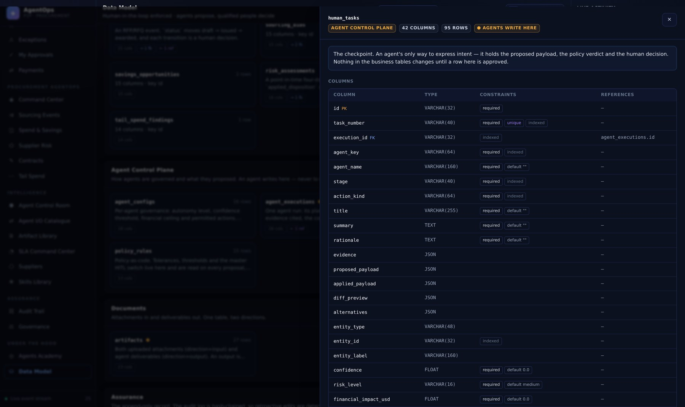
PART 02 · UNDER THE HOOD
Data Model — one table, both directions
Columns with types, keys, indexes and defaults, and foreign keys resolved both ways.
WHAT TO LOOK AT
human_tasks is the checkpoint
Proposed payload, policy verdict, human decision, applied payload — the whole story in one row.
Both ends of every foreign key
Points-at and pointed-at-by, each clickable to jump.
Watch the primary keys
workflow_events and audit_logs use an integer PK because SQLite only autoincrements a primary key.
Part 02 · Under the Hood
34
Notes:
Data Model — one table, both directions. Columns with types, keys, indexes and defaults, and foreign keys resolved both ways. `human_tasks` is the checkpoint: Proposed payload, policy verdict, human decision, applied payload — the whole story in one row. Both ends of every foreign key: Points-at and pointed-at-by, each clickable to jump. Watch the primary keys: workflow_events and audit_logs use an integer PK because SQLite only autoincrements a primary key.

Slide 36
PART 03
The code
The run loop, the anatomy of an agent, the policy engine,
the executor registry — and how to add your own.
35

Slide 37
PART 03 · THE CODE
The run loop — identical for all sixteen agents
Everything except plan(), gather() and decide() is the base class. That is why the guarantees hold uniformly.
Resolve attachments
Check the config
1
context["attachment_ids"] → parsed records in context["attachments"]
2
A disabled agent returns blocked_by_policy without running
Plan
Execute / observe
3
plan() → PlanSteps, persisted to agent_executions.plan
4
gather() → Observations, each persisted and streamed live
Reason
Escalate
5
decide() → AgentDecision; llm.reason() narrates what was already decided
6
Records an event. It annotates — it does not change what a human decides
Propose
Report
7
Each proposal → policy.evaluate() → a HumanTask carrying the verdict
8
An audit entry and a completion event
Step 7 is where the guarantee lives: policy.evaluate() runs on every proposal, and the result is a HumanTask — never a write.
Part 03 · The code
36

Slide 38
PART 03 · THE CODE
Why an agent cannot write
The whole guarantee reduces to what this dataclass does not contain.
@dataclass
class ProposedAction:
action_kind: str # one of 33 ActionKinds
title: str
summary: str
payload: dict # what the executor will apply
diff_preview: list[dict] # before/after for the reviewer
alternatives: list[dict] # priced options, each with its own payload
confidence: float
financial_impact_usd: float
artifact_ids: list[str] # drafts this action releases on approval
# No session. No ORM object. No executor reference.
# It cannot write anything, because there is nothing here to write with.
THE CONSEQUENCE
1
An agent that wanted to write to a business table would have to be rewritten to do so — it is not a matter of discipline.
2
A code reviewer does not need to check for stray writes. There is nothing to write with.
3
Testing this is trivial: run the agent, count the rows, assert nothing moved.
Part 03 · The code
37

Slide 39
PART 03 · THE CODE
Anatomy of an agent — plan()
Three-Way Match, the clearest of the sixteen. plan() declares the steps; it does not run them.
def plan(self, db: Session, context: dict) -> list[PlanStep]:
return [
PlanStep(1, "Fetch the purchase order and its lines", "po_fetch",
"The PO is the contractual basis for what may be billed."),
PlanStep(2, "Fetch goods receipts posted against the PO", "gr_fetch",
"Receipt confirms the goods or services actually arrived."),
PlanStep(3, "Run line-level variance analysis", "variance_analysis",
"Header totals hide offsetting line errors."),
PlanStep(4, "Apply tolerance policy", "policy_compliance",
"Tolerance is a governance decision, not an agent preference."),
PlanStep(5, "Propose clearance or an exception", "hitl_checkpoint",
"Either outcome is reviewed by AP before it takes effect."),
]
EVERY STEP ANSWERS THREE THINGS
1
What it does
Written for a reviewer, not a log line.
2
Which tool
The name shown in the Academy and in the run timeline.
3
Why
plan() is called with an empty context by the Academy screen and by the build-spec generator. If it queried the database, both would break — and it would no longer be a plan, it would be a trace.
The rationale a reader needs to judge whether the step belongs. "Header totals hide offsetting line errors" is a reason; "fetch data" is not.
Part 03 · The code
38

Slide 40
PART 03 · THE CODE
Anatomy of an agent — gather()
Collects evidence and returns one Observation per tool. Still writes nothing.
def gather(self, db: Session, context: dict) -> list[Observation]:
store = PolicyStore(db) # governance is data, read every run
context["tolerances"] = {
"amount_pct": store.number("match.amount_variance_pct", 3.0),
"quantity_pct": store.number("match.quantity_variance_pct", 2.0),
"amount_abs": store.number("match.amount_variance_abs", 50.0),
}
analysis = variance_analysis.analyze(
invoice_lines=..., po_lines=..., received_qty_by_line=...,
**context["tolerances"])
context["analysis"] = analysis # state on context, never on self
return [Observation("variance_analysis",
f"Match '{analysis['match_result']}'",
analysis, ok=analysis["clean"])]
WHY IT IS SHAPED THIS WAY
1
One Observation per tool
Each is persisted and streamed to the activity rail as it happens, so a reviewer sees what was asked and what came back.
2
Policy is read per run
Tolerances come from policy_rules every time, so loosening one takes effect without a deploy.
3
Failure is an observation too
ok=False with a summary. An agent that cannot read its input says so rather than raising.
State goes on context, never on self. Agents are singletons in the registry — anything stored on the instance leaks into the next run.
Part 03 · The code
39

Slide 41
PART 03 · THE CODE
Anatomy of an agent — decide()
Returns an AgentDecision. Every field is something a reviewer will read.
def decide(self, db, context, observations) -> AgentDecision:
analysis = context["analysis"]
if not analysis["clean"]:
... # exception path
return AgentDecision(
conclusion=f"{invoice.invoice_number} matches within tolerance.",
confidence=0.97 if result == MatchResult.MATCHED else 0.94,
decision_rules=[
f"Amount variance {analysis['total_variance_pct']:+.2f}% "
f"against a {tolerances['amount_pct']}% tolerance.",
],
evidence=[evidence_item("Total variance", ..., "variance_analysis")],
proposals=[ProposedAction(
action_kind=ActionKind.ADVANCE_STAGE,
payload={"invoice_id": invoice.id,
"stage": WorkflowStage.APPROVAL,
"match_result": result, "match_details": analysis},
confidence=0.97, financial_impact_usd=amount)],
handoff_to="approval_acceleration",
)
THE FOUR RULES
Confidence is real
A number the agent stands behind. The policy engine gates on it, so a constant 0.95 defeats the control.
Evidence cites its source
Every item names the observation it came from.
Impact is what is at risk
It drives role escalation. Inflated blocks work; deflated under-reviews it.
Rules are quantitative
"+8.00% against a 3% tolerance" is arguable. "Looks wrong" is not.
Part 03 · The code
40

Slide 42
PART 03 · THE CODE
The policy engine — seven gates, default deny
allow_auto_execute requires every gate to open. Anything else becomes a checkpoint.
OPENS WHEN
1
Global HITL enforcement
hitl.enforce_global is off
# services/policy.py — every gate must open. Default deny.
if store.flag("hitl.enforce_global", settings.enforce_human_in_the_loop):
blocked.append("Global human-in-the-loop enforcement is ON.")
if action_kind in IRREVERSIBLE_ACTIONS:
blocked.append(f"'{action_kind}' is irreversible — always a human.")
if confidence < threshold:
blocked.append(f"Confidence {confidence:.0%} below {threshold:.0%}.")
# Authority escalates with value, on top of the per-action minimum.
if financial_impact_usd >= 250_000:
required_role, flag = Role.CFO, "cfo_threshold"
elif financial_impact_usd >= 50_000:
required_role, flag = Role.CONTROLLER, "controller_threshold"
dual_approval = (financial_impact_usd >= dual_threshold
and action_kind in IRREVERSIBLE_ACTIONS)
return PolicyDecision(allow_auto_execute=not blocked, reasons=..., ...)
2
Agent autonomy
The agent is at L3 or above
3
Irreversibility
The action is not in IRREVERSIBLE_ACTIONS
4
Confidence
Proposal confidence ≥ the agent threshold
5
Financial envelope
Impact ≤ the agent's max_auto_amount_usd
6
Risk level
Computed risk is not high or critical
7
Action allow-list
The action is in the agent's permitted set
Turning global enforcement off opens gate 1 only. An L2 agent still stops, an irreversible action still stops, a low-confidence proposal still stops.
Part 03 · The code
41

Slide 43
PART 03 · THE CODE
The executor registry — the only writer
Thirty-three executors, one per action kind. If you are writing business data, you are writing one of these.
# services/hitl.py — the ONLY place business data is written.
_HANDLERS: dict[str, Handler] = {}
def action(kind: str): # registration decorator
def wrapper(fn): _HANDLERS[str(kind)] = fn; return fn
return wrapper
@action(ActionKind.ADVANCE_STAGE)
def _advance_stage(db, task, payload, actor) -> dict:
invoice = _invoice(db, task, payload)
before = snapshot(invoice, INVOICE_AUDIT_FIELDS)
_advance(db, invoice, payload["stage"], payload.get("status"), actor.full_name)
write_audit(db, action="invoice.stage_advanced", actor=actor.full_name,
actor_type="human", before_state=before,
after_state=snapshot(invoice, INVOICE_AUDIT_FIELDS), ...)
return {"stage": invoice.stage, "status": invoice.status}
# An action with no registered handler simply cannot happen.
12 ARE IRREVERSIBLE
post_to_erp · schedule_payment
release_payment · block_supplier
update_supplier_master
send_supplier_message
approve_purchase_request
issue_rfp · award_sourcing_event
issue_contract_for_signature
consolidate_suppliers
publish_executive_brief
EACH ONE REACHES OUTSIDE
A ledger, a bank, a supplier, a signature, a boardroom. None can be taken back by editing a row — so none may execute without a person, at any autonomy level, with enforcement off.
Part 03 · The code
42

Slide 44
PART 03 · THE CODE
Adding your own agent
Six steps. The tests tell you what you forgot.
# 1. backend/app/agents/my_agent.py
class MyAgent(BaseAgent):
key = "my_agent"
name = "My Agent"
suite = AgentSuite.P2P
default_autonomy = AutonomyLevel.HUMAN_APPROVAL
default_confidence_threshold = 0.90
allowed_actions = [ActionKind.CREATE_EXCEPTION]
inputs = [IOSpec("invoice_id", "The invoice to inspect.", required=True)]
outputs = [IOSpec("Checkpoint", "Open an exception — AP Clerk decides.",
kind="proposal")]
def plan(self, db, context): ... # static declaration
def gather(self, db, context): ... # one Observation per tool
def decide(self, db, ctx, obs): ... # returns proposals, never writes
# 2. registry.py → add MyAgent to P2P_AGENT_CLASSES
# 3. explain.py → add a WORKED_EXAMPLES["my_agent"] entry
# 4. agent_build_notes.py → add BUILD_NOTES["my_agent"]
# 5. python scripts/generate_agent_specs.py
# 6. pytest — three drift guards will tell you what you missed
THE GUARDS THAT CATCH YOU
✕
No executor for an action
An agent may not advertise an action nothing can apply.
✕
No Academy lesson
A new agent must not ship undocumented.
✕
No build notes
A spec without the reasoning is not one anyone can rebuild from.
✕
A stale AGENT.md
Specs are regenerated in-memory and compared to what you committed.
Part 03 · The code
43

Slide 45
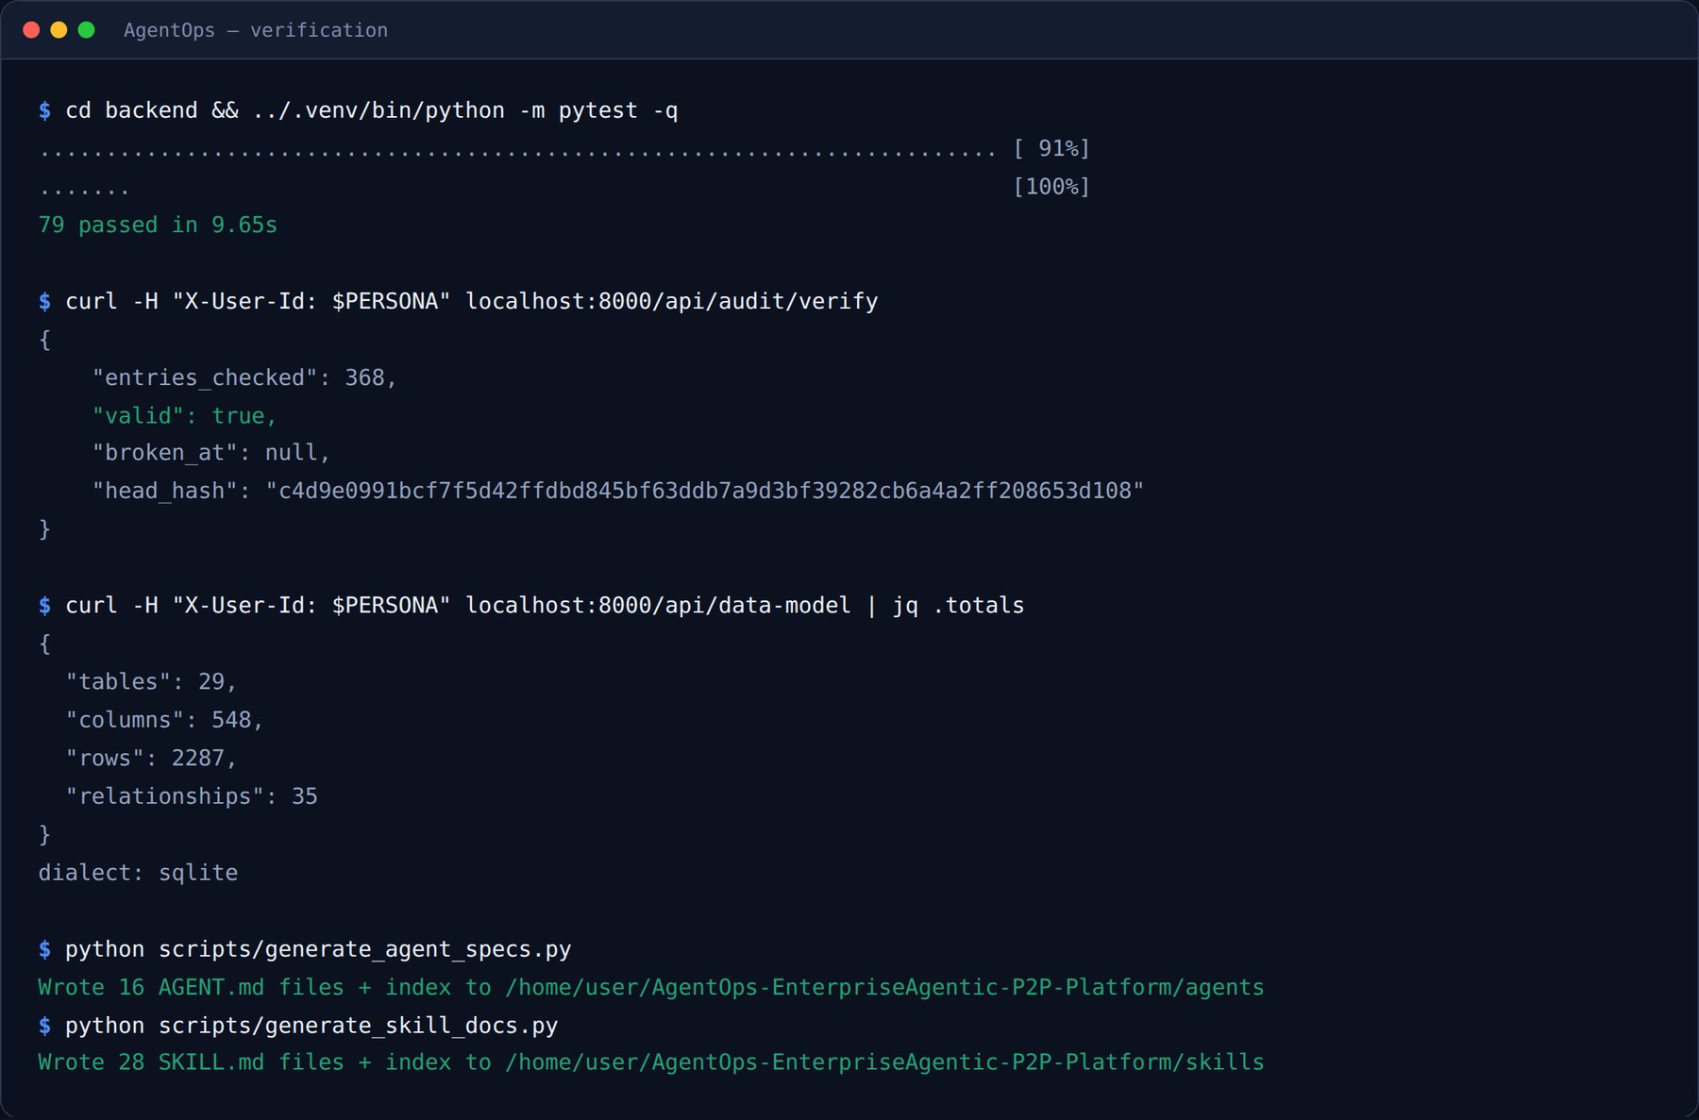
PART 03 · THE CODE
Testing — 79 tests, and the ones that fail the build
Verified live: the full suite, the audit chain replayed from genesis, and both documentation generators.
def test_agent_cannot_mutate_state(seeded):
before = db.execute(select(SavingsOpportunity)).all()
get_agent("spend_analytics").run(db, {...})
after = db.execute(select(SavingsOpportunity)).all()
assert len(after) == len(before)
def test_spec_matches_the_code(agent_key):
"""Change an agent, forget to regenerate
its spec, and this fails."""
expected = gen.render(agent, BUILD_NOTES[key])
committed = (ROOT / "agents" / key /
"AGENT.md").read_text()
assert committed == expected
THREE DRIFT GUARDS
A new table outside a domain · a new agent without a lesson · a committed spec that no longer matches its code. Each fails the build rather than the demo.
Part 03 · The code
44

Slide 46
REFERENCE
Where to look when something is wrong
An agent proposes nothing
A proposal will not execute
Its decide() returned no proposals, or the agent is disabled in agent_configs. Check the run in the Control Room — a blocked run says so.
Read the checkpoint's Policy & audit tab. It names the gate that held it and the role required.
A decision is refused
The audit chain is broken
Authority. ACTION_MIN_ROLE, plus value-based escalation, plus dual approval above $100k on irreversible actions.
GET /api/audit/verify names the first divergent row. Something wrote history out of band.
A deliverable stays a draft
A doc test fails
Its checkpoint was rejected, or the proposal never carried artifact_ids.
Not a bug — a missed step. Run the two generators in scripts/ and commit the result.
AgentOps · Developer Walkthrough
45

Slide 47
WHERE TO GO NEXT
Read in this order
1
docs/SPECIFICATION.md
The platform: guarantees, enums, data model, governance, API — and a rebuild order.
2
agents/<key>/AGENT.md
One complete build specification per agent. Enough to rebuild it without the source.
3
skills/<name>/SKILL.md
The 28 shared capabilities and their contracts.
4
The Agents Academy screen
The same material, live, against seeded data you can run.
Check any rebuild against the invariant, not the feature list. An agent that can write to a business table has the same screens and none of the guarantees.
46

