Slide 1
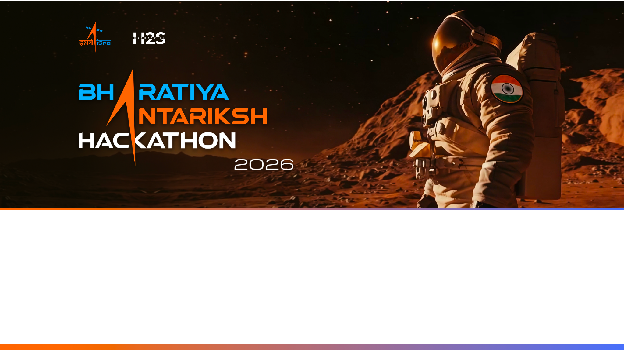
Team Name : The Spark
Team Leader Name : Snehi Patel
Problem Statement : AI-Powered Digital Twin of India's Climate using India's National Data (PS-05)

Slide 2

Team Members & Roles
Team Leader: Name: Snehi Patel Role: AI/ML Lead & System Architect (Data Pipeline & Temperature Models) Team Member-1: Name: Juhi Vanjara Role: Machine Learning Engineer (Climate Prediction & Simulation)
Team Member-2: Name: Yashvi Sanghvi Role: Full-Stack Developer (Dashboard, UI/UX & Model Deployment)

Slide 3
Opportunity & Key Differentiators:
• How different is it from existing ideas?
• How will it solve the problem?
• USP of the proposed solution:
Existing | Our Digital Twin
Slow NWP simulations | Instant AI predictions
Large regional forecasts | Grid-level forecasts
Modern data only | Modern AI + Bhadali Knowledge
IMD + INSAT (75 years)
AI Models
(LightGBM + XGBoost)
Digital Twin
Temperature
Rainfall
Alerts
Ancient + AI
Bhadali + ML
ISRO Verified data INSAT + IMD
High Accuracy R² 98%+ Temp
AI Climate Advisor
Reduce Future Climate Impact

Slide 4
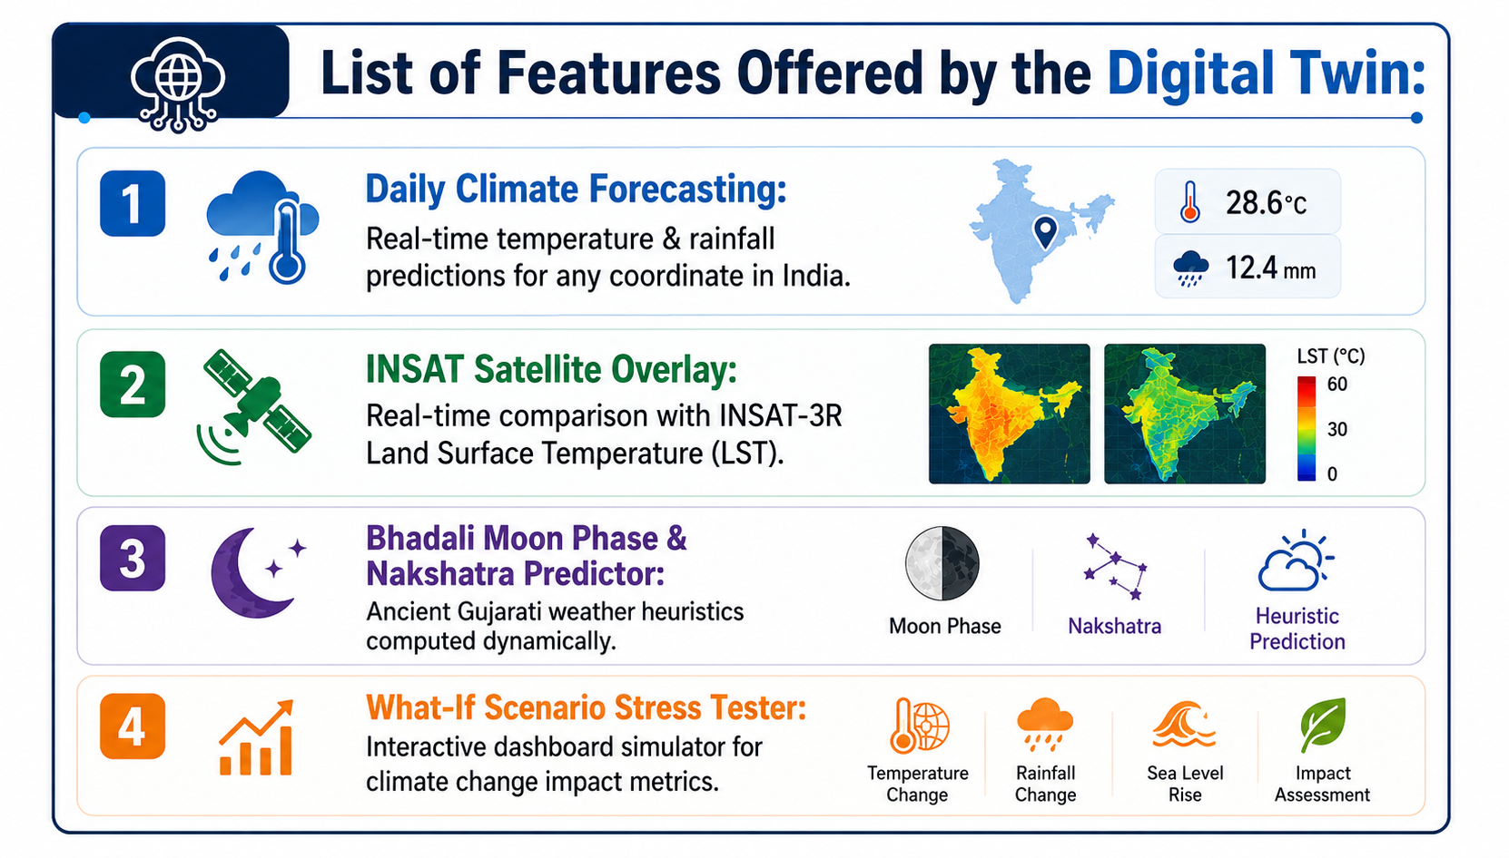
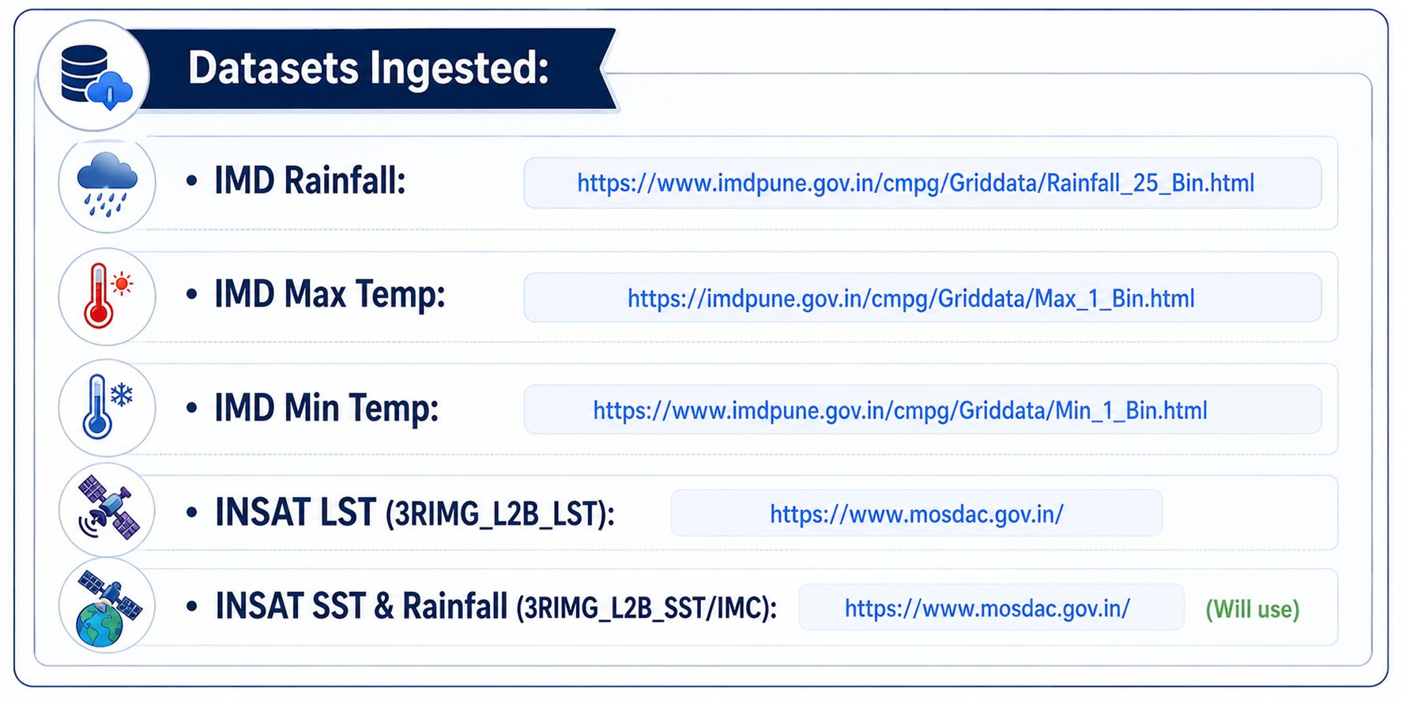
List of Features Offered by the Digital Twin:
1. Daily Climate Forecasting
2. INSAT Satellite Overlay
3. Bhadali Moon Phase & Nakshatra Predictor
4. What-If Scenario Stress Tester
Datasets Ingested:
• IMD Rainfall: https://www.imdpune.gov.in/cmpg/Griddata/Rainfall_25_Bin.html
• IMD Max Temp: https://imdpune.gov.in/cmpg/Griddata/Max_1_Bin.html
• IMD Min Temp: https://www.imdpune.gov.in/cmpg/Griddata/Min_1_Bin.html
• INSAT LST (3RIMG_L2B_LST): https://www.mosdac.gov.in/
• INSAT SST & Rainfall (3RIMG_L2B_SST/IMC): https://www.mosdac.gov.in/ (Will use)

Slide 5
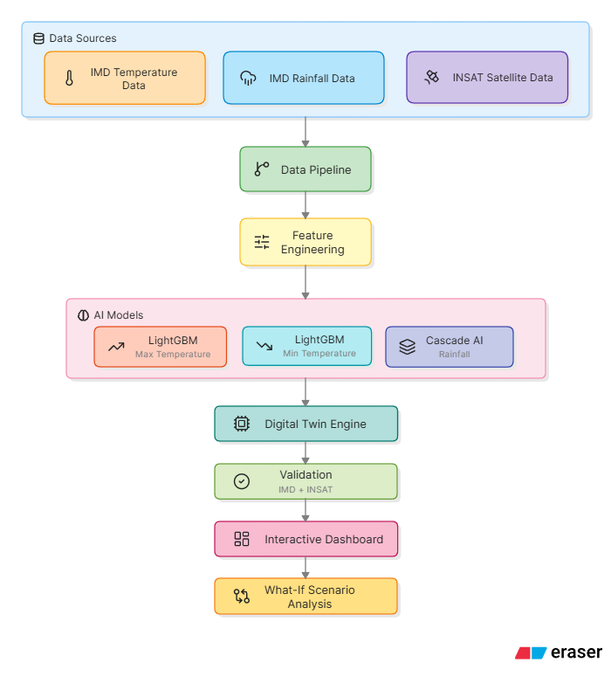
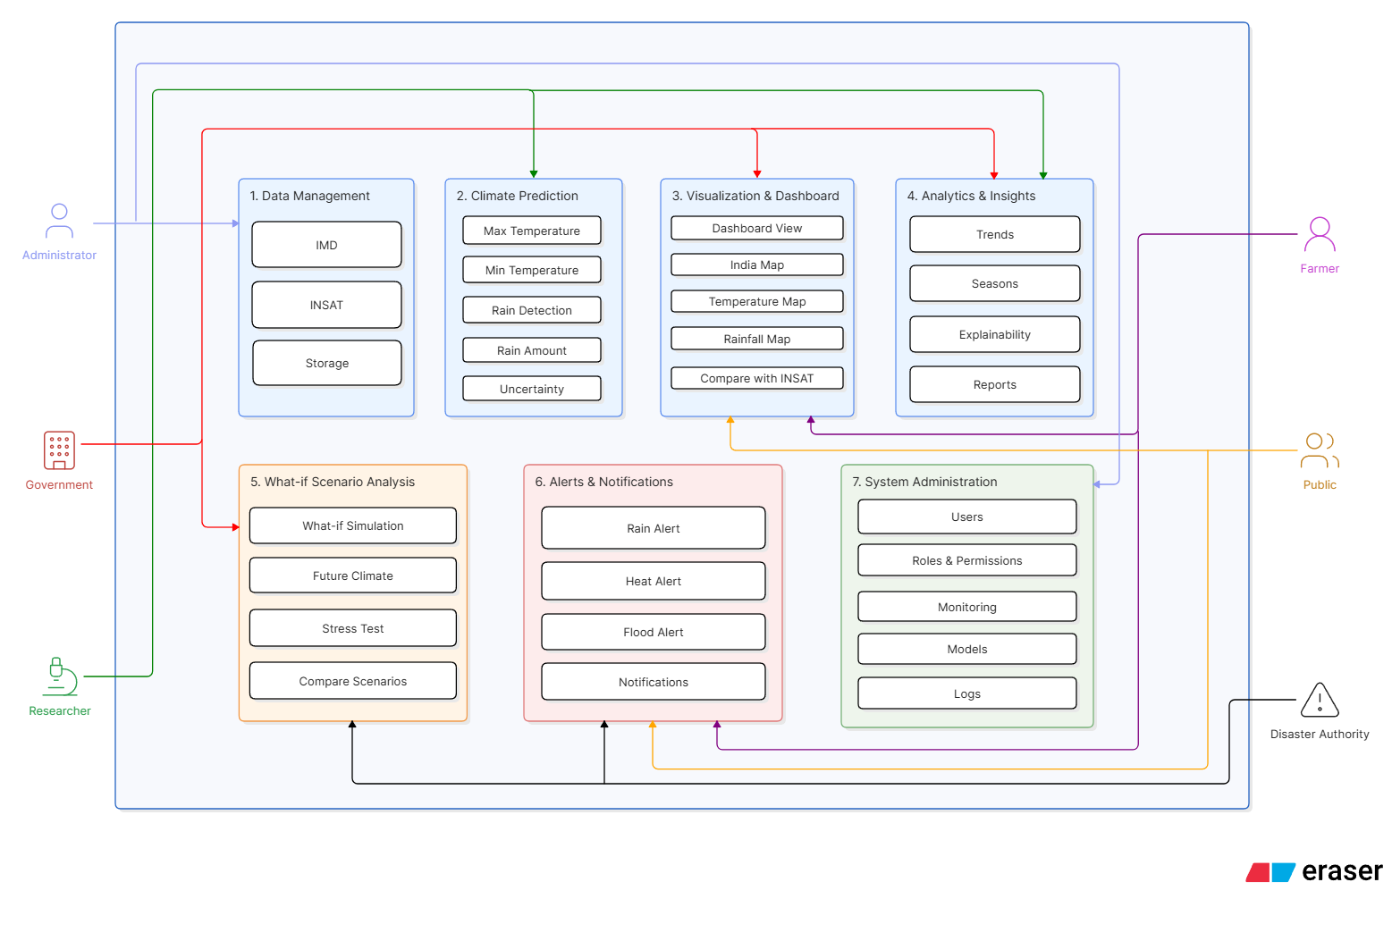
System Flow Diagram
Use Case Diagram

Slide 6
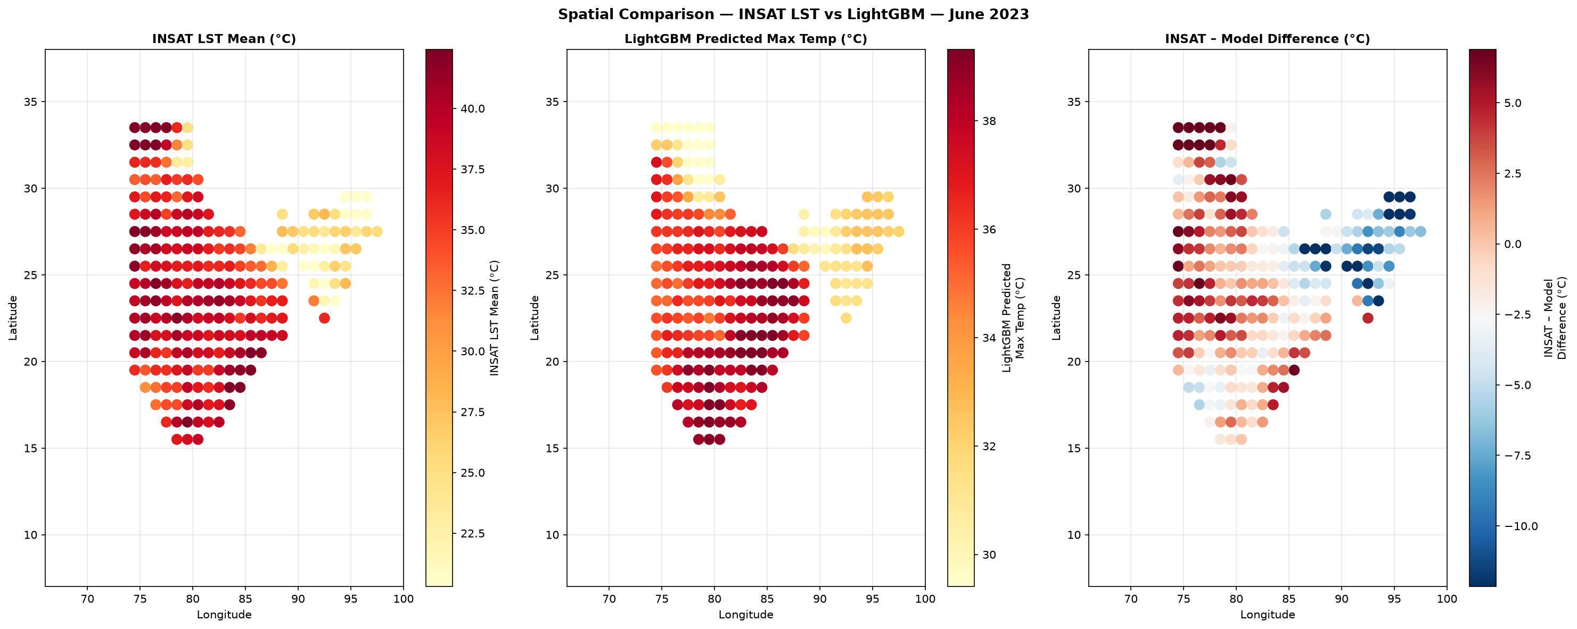
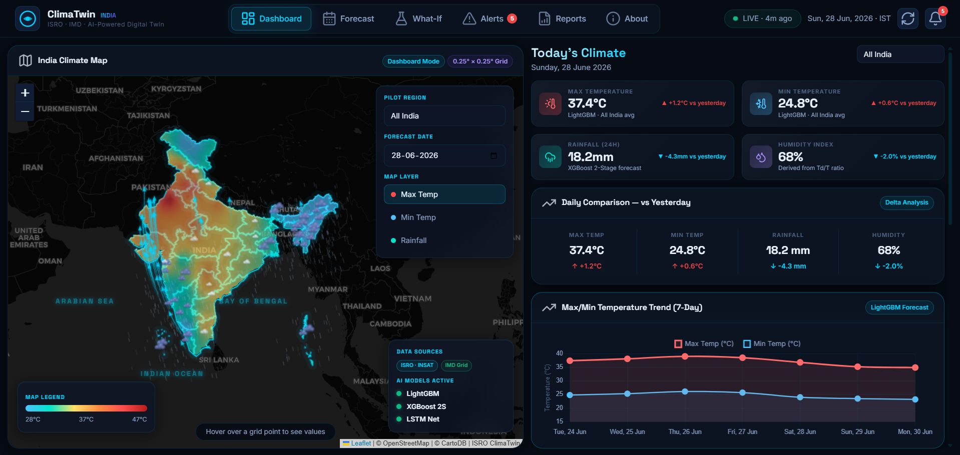
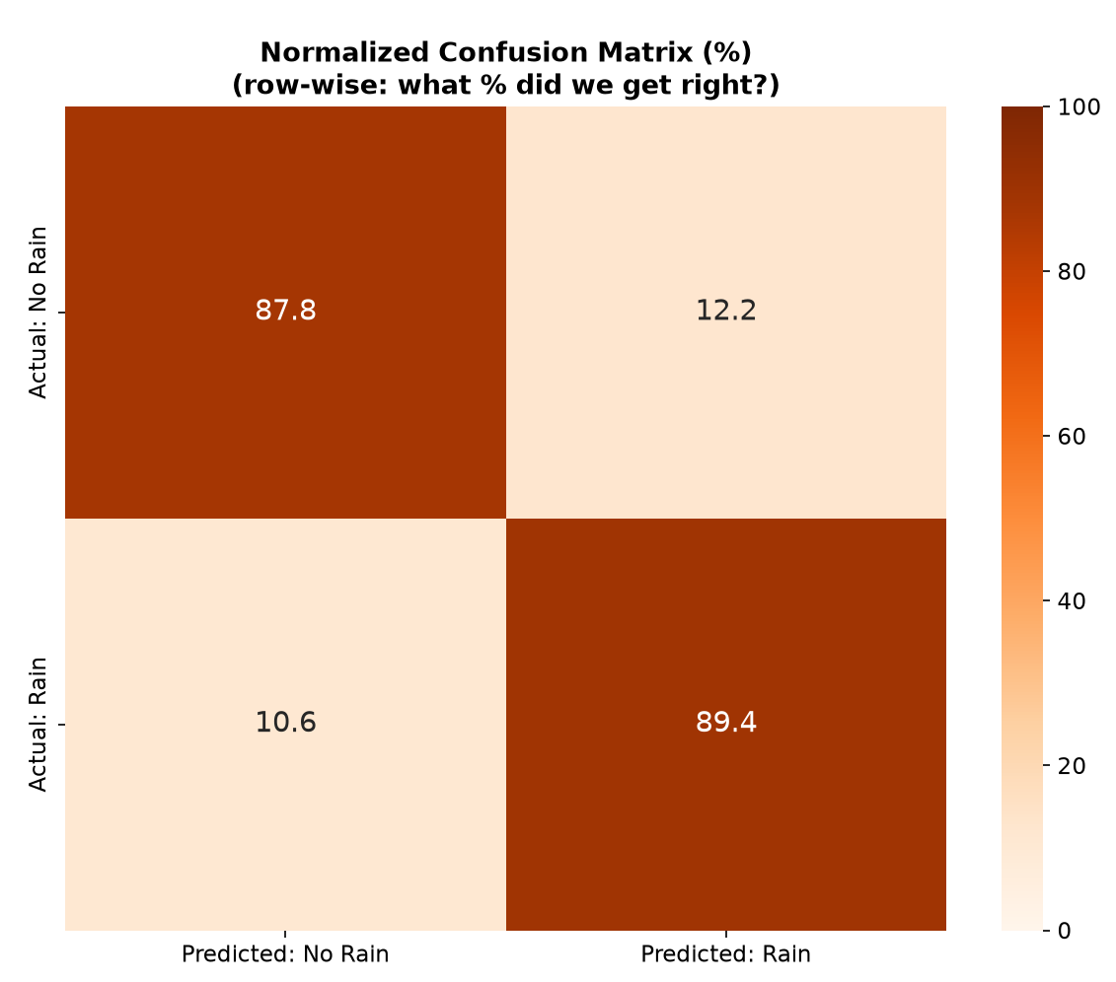
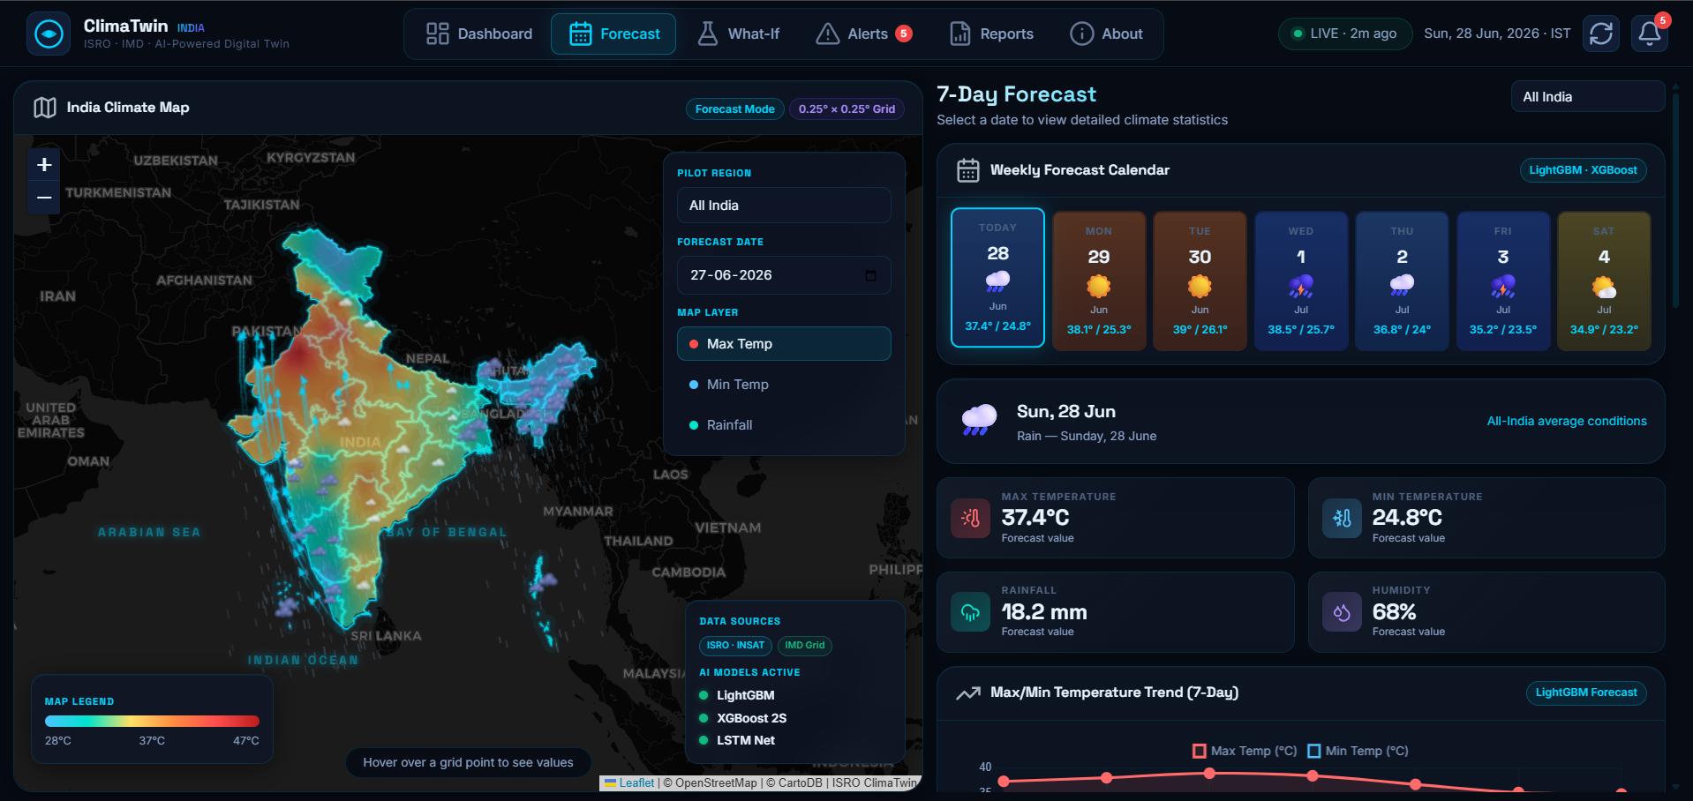
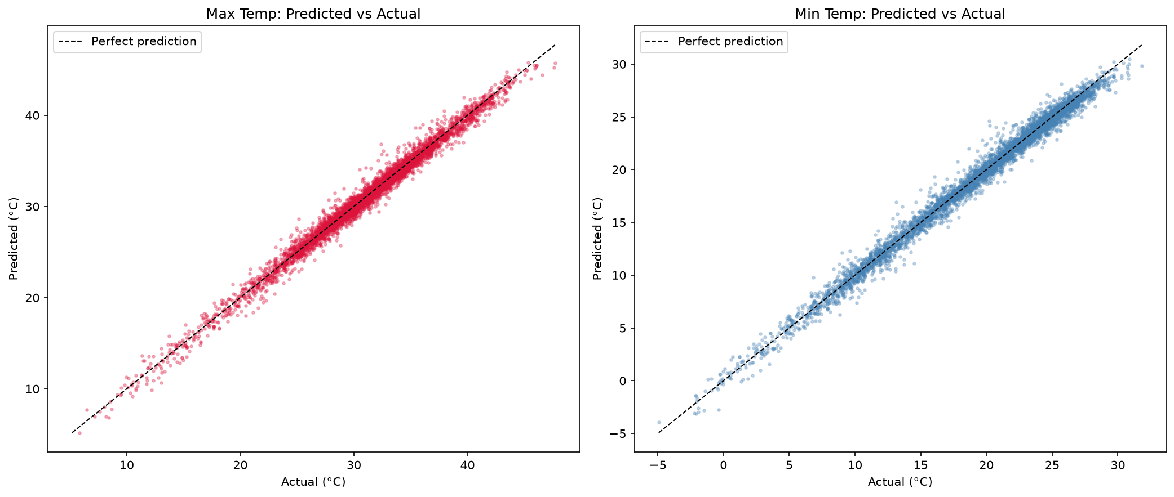
Wireframes/Mock diagrams of the proposed solution
Satellite Validation (INSAT vs AI Prediction)
Interactive Digital Twin Dashboard
Max Temp:
R² = 0.995
MAE = 0.42°C
Min Temp
R² = 0.994
MAE = 0.39°C
Rainfall Model Validation
with ~89.4% accuracy

Slide 7
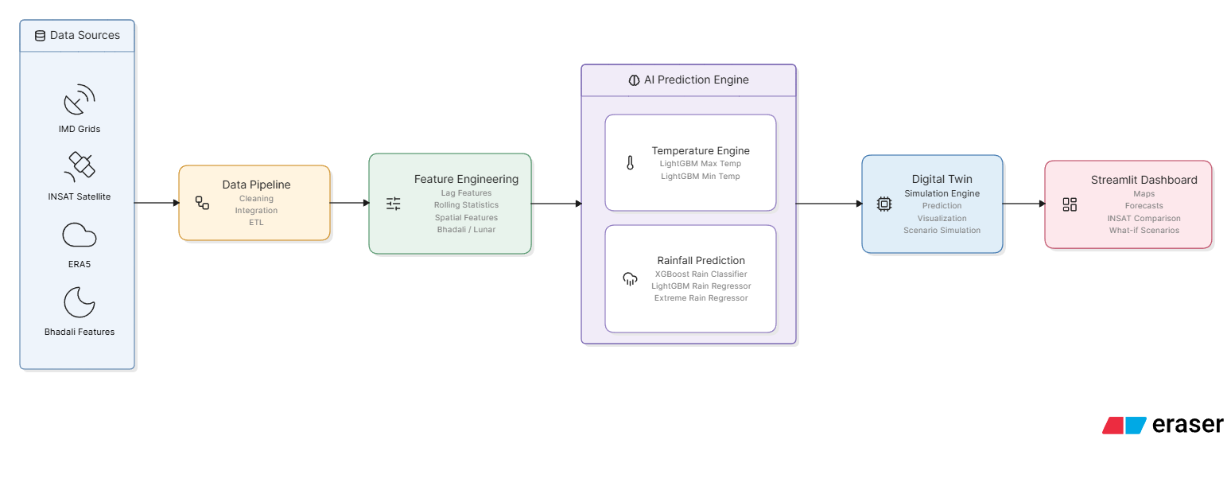
AI Architecture & Model Accuracies:
Max Temperature (LightGBM): R² 98.65% | MAE 0.49°C
Min Temperature (LightGBM): R² 98.92% | MAE 0.49°C
Rainfall Detection (XGBoost): 89.4% Accuracy | F1 0.8765
Includes Uncertainty Estimation (90% Prediction Intervals)
Validated Against: IMD Ground Stations + INSAT Satellite Observations
AI Architecture

Slide 8
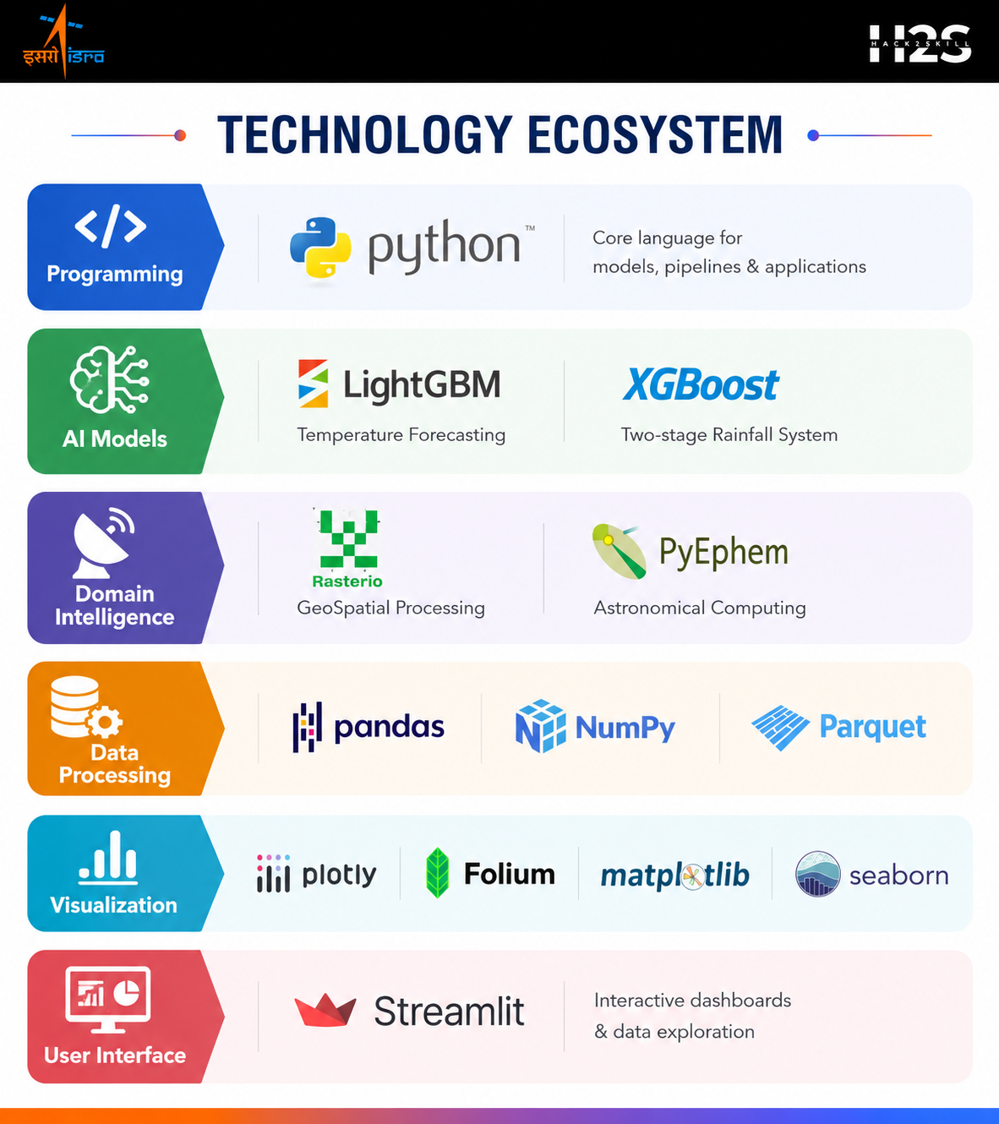
Technologies Used in the Proposed Solution:

Slide 9
Estimated Implementation Cost:
Component | Estimated Cost
Software Stack | ₹0
IMD & MOSDAC Data | ₹0
Cloud Compute | ₹3,300–₹4,700/month
Storage | ₹400–₹500/month
Total Operational Cost | ₹3,700–₹5,200/month
Deployment Ready: Docker • AWS • Azure • Google Cloud • On-Premise

Slide 10
