Slide 1
SISTEC INNOVATION HACKATHON 4.0 - PROBLEM STATEMENT: IS-15
FIRST-ROUND JURY TECHNICAL EVALUATION
CROWDGUARD X
AI-Powered Crowd Mobility Simulation & Management Platform
"Predict. Simulate. Prevent."
EXECUTIVE TECHNICAL SUMMARY
• Software-First Architecture: Fully functioning client-side simulation engine modeling real pedestrian fluid mechanics (Helbing Social Force).
• Active Decision Support: Bypasses passive CCTV delay by stress-testing gate closures, marshal dispatch, and diversions virtually.
• Multi-Venue Scalability: Configured models for pilgrimage temples, high-density railway junctions, mega stadiums, and cultural festivals.
• Strict Engineering Integrity: No hallucinated sensors or remote databases; transparent distinction between prototype and future roadmap.
Notes:
=== 30-SECOND JURY PITCH ===
Good morning respected jury members. We are presenting CROWDGUARD X for Problem Statement IS-15. Traditional systems monitor crowds after congestion has already formed. CROWDGUARD X is a software-first simulation platform that allows commanders to test interventions - like closing a gate or deploying marshals - in a live Digital Twin BEFORE applying them on the ground. We have a working prototype ready to demonstrate.
=== ANTICIPATED JURY Q&A ===
Q: Is this an actual working product or a design concept?
A: It is an active working prototype built with React 19, TypeScript, and HTML5 Canvas running a 60 FPS pedestrian Social Force physics engine.
Q: Does it have physical sensors attached?
A: No. The current phase is Software-First. Physical IoT sensors and computer vision feeds are strictly in our future scope roadmap.
=== TECHNICAL TALKING POINTS ===
Emphasize the core thesis: Traditional monitoring is reactive; simulation is proactive. Keep tone professional, technical, and confident.

Slide 2
PROBLEM STATEMENT | CHALLENGE IS-15
The Physics of Crowd Disasters: Why Monitoring Fails
Traditional systems detect congestion only after it occurs; prevention requires predictive simulation.
1. Mass Inflow
Surge arrivals enter restricted venue perimeter
2. Uneven Flow
70%+ funnels into central prominent gate
3. Bottleneck Choke
Inflow rate exceeds physical corridor width
4. Pressure Surges
Density hits >4-5 pax/m²; crush friction starts
5. Flow Stoppage
Laminar motion halts; backward shockwaves
6. Evacuation Failure
Panic, blocked routes & severe stampede hazard
TRADITIONAL APPROACH: PASSIVE CCTV MONITORING
✗ Retrospective Detection: Cameras record what is happening right now, but cannot forecast where the crowd will be in 10 minutes.
✗ Latency Lag: By the time a human operator spots a choke point on video monitors, density has already crossed 5 persons/m².
✗ Blind Intervention: Closing a gate on intuition often triggers unintended counter-surges into secondary narrow corridors.
✗ No Safety Sandbox: Zero capability to dry-run or validate crowd rerouting plans before executing them on real human beings.
THE CROWDGUARD X PARADIGM: SIMULATION-DRIVEN CONTROL
✓ Anticipatory Intelligence: Models crowd fluid dynamics to highlight bottlenecks 5-15 minutes before they reach dangerous pressure.
✓ Virtual What-If Sandbox: Commanders test actions (closing Gate G2, deploying 12 marshals) in the digital twin in under 2 seconds.
✓ Deterministic Physics: Simulates personal space repulsion, corridor drag, and laminar vs turbulent flow transitions.
✓ Actionable Protocol: Outputs concrete diversion orders: 'Close Gate G2, divert inbound flow east to Gate G3 corridor.'
Notes:
=== 30-SECOND JURY PITCH ===
Here is the core problem: In large public gatherings, crowd disasters are not caused by 'crazy panic' - they are caused by fluid mechanics. When arrival rates exceed geometric corridor width, people pack to 5 people per square meter. At that point, people cannot move independently and shockwaves propagate. Current monitoring just watches people get stuck. CROWDGUARD X shifts us from watching to simulating solutions before panic starts.
=== ANTICIPATED JURY Q&A ===
Q: Why don't existing CCTV setups solve this?
A: CCTV is fundamentally reactive. By the time a screen operator notices a crush, physical pressure is already dangerous. Furthermore, CCTV cannot tell an operator: 'If you close Gate 2, where will those 5,000 people go?' Our simulation answers that question instantly.
=== TECHNICAL TALKING POINTS ===
Highlight that we cite verified crowd physics (fluid shockwaves and geometric bottlenecks) rather than fake disaster statistics.

Slide 3
PROPOSED SOLUTION | ARCHITECTURAL SHIFT
From Passive Monitoring to Simulation-Based Decision Support
A proactive computational loop enabling incident commanders to stress-test policies in seconds.
STAGE 01
VENUE DATA
CAD & zone coordinates
STAGE 02
DIGITAL TWIN
Spatial graph representation
STAGE 03
CROWD STATE
60 FPS Social Force agents
STAGE 04
RISK ANALYSIS
Capacity & velocity triggers
STAGE 05
WHAT-IF SIM
Interactive gate/staff sandbox
STAGE 06
ROUTE INTEL
Dynamic waypoint recalculation
STAGE 07
DECISION SUPPORT
Actionable commander advisory
1. Digital Representation
Accurately maps venue perimeter, entry turnstiles, restricted sanctums, and emergency exits with designed maximum capacities.
VERIFIED IN PROTOTYPE
2. Micro-Mobility Tracking
Models hundreds of autonomous agents obeying personal space repulsion and corridor velocity constraints at 60 frames per second.
VERIFIED IN PROTOTYPE
3. Preemptive Choke Detection
Flags zones exceeding critical capacity thresholds (e.g. Zone B at 88%) before physical gridlock occurs.
VERIFIED IN PROTOTYPE
4. Zero-Risk What-If Testing
Allows operators to toggle gate closures, divert arrival lanes, and deploy queue marshals with real-time Before vs After telemetry.
VERIFIED IN PROTOTYPE
Notes:
=== 30-SECOND JURY PITCH ===
Here is the architectural core of CROWDGUARD X: We take static venue data, build an interactive Digital Twin, spawn agents following fluid physics, analyze risk, and give the operator an interactive What-If sandbox. Instead of guessing, the operator can see: 'What happens if we divert Gate 2 to Gate 3?' and get instant quantitative validation.
=== ANTICIPATED JURY Q&A ===
Q: What is the main difference between your solution and existing crowd simulation software?
A: Traditional software like AnyLogic is offline, complex, and used months prior for civil engineering planning. CROWDGUARD X is designed as a live, low-latency operational command platform for active event day decision support.
=== TECHNICAL TALKING POINTS ===
Emphasize the 7-stage pipeline. Point out that all 7 stages are connected and working in the current prototype.

Slide 4
SYSTEM WORKFLOW | DETERMINISTIC PIPELINE
End-to-End Operational Workflow
How raw venue geometry and crowd influx transform into validated field actions.
01. Select Scenario
Operator selects venue (Temple, Station, Stadium, Fest).
02. Ingest Twin Geometry
Loads zone boundaries, gate portals & waypoints.
03. Set Influx Rates
Configures arrival surges & baseline headcount.
04. Spawn Agent State
Instantiates 320+ agents governed by Social Force.
05. Compute Telemetry
Calculates live zone densities and flow speeds.
06. Detect Risk Zones
Flags threshold breaches (e.g. Zone B >80% density).
07. Apply What-If Policy
Operator toggles gate closure & marshal dispatch.
08. Recalculate Vectors
Engine dynamically recalculates routing in real time.
09. Before vs After Delta
Dual-engine compares density, speed & exit loads.
10. Issue Field Advisory
Generates concrete dispatch orders for venue marshals.
EXECUTION ARCHITECTURE HIGHLIGHT
Steps 01-05 represent Continuous State Telemetry (60 FPS loop). Steps 06-10 represent the Active Intervention Cycle triggered upon threshold breach. Total recalculation time upon policy change: < 50 milliseconds.
Notes:
=== 30-SECOND JURY PITCH ===
This slide is very important: it demonstrates our deterministic 10-step pipeline. The top row (Steps 1 to 5) runs continuously as the baseline simulation loop. When the system detects a bottleneck in Step 6, the operator triggers the What-If Sandbox in Step 7. The physics recalculates instantaneously in Step 8, evaluates the Before vs After delta in Step 9, and outputs actionable instructions in Step 10.
=== ANTICIPATED JURY Q&A ===
Q: How fast does the What-If simulation recalculate?
A: In less than 50 milliseconds on the client side, because the routing vectors and Social Force physics run in-memory within our optimized TypeScript engine.
Q: Can an untrained operator use this?
A: Yes, because the output is not raw code - it provides clear visual color changes and explicit advisories.
=== TECHNICAL TALKING POINTS ===
Walk through Steps 1 to 10 methodically. Mention that this pipeline is what powers the live demo.

Slide 5
ARCHITECTURE | 3-TIER MODULAR SYSTEM
High-Level System Architecture
Modular separation of presentation, physics simulation, and scenario state.
TIER 1: PRESENTATION & OPERATOR LAYER (UI)
Unified Command Platform
Main tactical dashboard interface
Digital Twin Canvas (60 FPS)
HTML5 2D particle & heatmap rendering
Predictive Horizons Panel
Recharts density trajectories & thresholds
What-If Control Sandbox
Intervention toggles & Before/After analyzer
TIER 2: APPLICATION & PHYSICS LAYER (CORE ENGINES)
Digital Twin Engine
Zone boundaries, gate portals & waypoint nodes
Simulation Engine (Social Force)
2D Helbing physics, repulsion & steering
Risk & Alert Engine
Capacity monitoring & dynamic incident generator
Rerouting Engine
Dynamic waypoint divergence at choke thresholds
TIER 3: DATA & STATE LAYER
Scenario Configuration Store
Pre-configured venue metadata (venues.ts)
Reactive State Manager
React 19 hooks managing live telemetry state
Dynamic Telemetry Buffers
Rolling densities, flow speeds & discharge rates
Copilot Advisory Rulebase
Contextual operational tactical advisories
CURRENT WORKING PROTOTYPE (SOFTWARE-FIRST)
• In-Memory Reactive Architecture (React 19 + TypeScript)
• Zero-Latency Client-Side Simulation (No backend bottleneck)
• Deterministic Social Force Pedestrian Fluid Physics
• Interactive What-If Sandbox with Instant Dual-Twin Comparison
FUTURE AI / IoT / BACKEND EXTENSIONS (ROADMAP)
• CCTV Video Ingestion via Edge YOLOv8 / ByteTrack Models
• Hardware IoT Turnstiles & LiDAR Headcount Feeds
• PostgreSQL / Redis High-Throughput Telemetry Database
• Deep Learning Time-Series Inflow Prediction (LSTM / GRU)
Notes:
=== 30-SECOND JURY PITCH ===
Here is our system architecture. We have cleanly divided it into three tiers: Presentation UI, Application Physics Engines, and the State Layer. Most importantly, we want to be 100% honest with the jury: In our current prototype, this runs as a software-first in-memory reactive architecture. This provides zero-latency 60 FPS simulations. Real CCTV camera models and cloud telemetry databases are explicitly part of our future scope.
=== ANTICIPATED JURY Q&A ===
Q: Why didn't you use a Python backend with PyTorch?
A: For real-time 60 FPS agent physics with interactive drag-and-drop What-If simulation, round-trip HTTP or WebSocket latency to a remote server would lag the interface. Running the simulation in compiled TypeScript on the client provides instant 50ms policy recalculation.
=== TECHNICAL TALKING POINTS ===
Highlight the separation between Current Working Prototype and Future AI/IoT extensions. Juries appreciate engineering honesty over inflated claims.

Slide 6
TECHNICAL STACK | VERIFIED REPOSITORY INSPECTION
Technology Stack & Implementation Reality
Strict alignment with verified dependencies in the CROWDGUARD X repository.
CORE FRONTEND & TYPES
React 19.2.8
Modern hooks architecture for reactive state management
TypeScript 6.0
Strict end-to-end type safety across agents and venues
HTML5 Canvas 2D API
60 FPS hardware-accelerated crowd particle rendering
Vite 8.3.0
Next-gen lightning-fast dev server and optimized bundler
STYLING & VISUALIZATION
Tailwind CSS v4.3.3
Modern utility-first styling for dark command-center UI
Recharts 3.10.1
AreaChart predictive density horizons and threshold lines
Lucide React 1.48
Tactical situational and navigation iconography
Canvas-Confetti 1.9.4
Interactive micro-interaction feedback triggers
TOOLING & ARCHITECTURE
Oxlint 1.81.0
Ultra-fast Rust-based linter enforcing clean code quality
PostCSS & Autoprefixer
Cross-browser CSS layout compatibility
In-Memory State Engine
Zero-latency reactive state without network bottlenecks
Helbing Social Force
Deterministic 2D pedestrian repulsion & friction physics
HONESTY & SCOPE DISTINCTION
NO Fake Python Backend
Current simulation runs in-engine; no pseudo Flask/FastAPI
NO Fake PyTorch / OpenCV
CCTV head detection is simulated; ML vision is future scope
NO Fake Cloud DBs
State is client-managed for instantaneous What-If responsiveness
Software-First Prototype
Built to validate algorithmic logic before hardware integration
Notes:
=== 30-SECOND JURY PITCH ===
Every single library listed on this slide comes directly from our package.json file. We use React 19, TypeScript, Vite, Tailwind CSS v4, HTML5 Canvas, and Recharts. We have deliberately NOT claimed to have PyTorch, OpenCV, or cloud databases running in this prototype. Our prototype is software-first, focusing on client-side simulation physics to provide zero-latency What-If decision support.
=== ANTICIPATED JURY Q&A ===
Q: Why is your tech stack purely frontend?
A: Because crowd simulation in an emergency command center requires instantaneous responsiveness. A client-side canvas engine running at 60 FPS lets the operator slide the inflow rate or close a gate and see the ripple effect immediately with zero network latency.
=== TECHNICAL TALKING POINTS ===
Point to the fourth column ('Honesty & Scope Distinction'). Juries respect teams that know exactly what their software is and do not exaggerate.

Slide 7
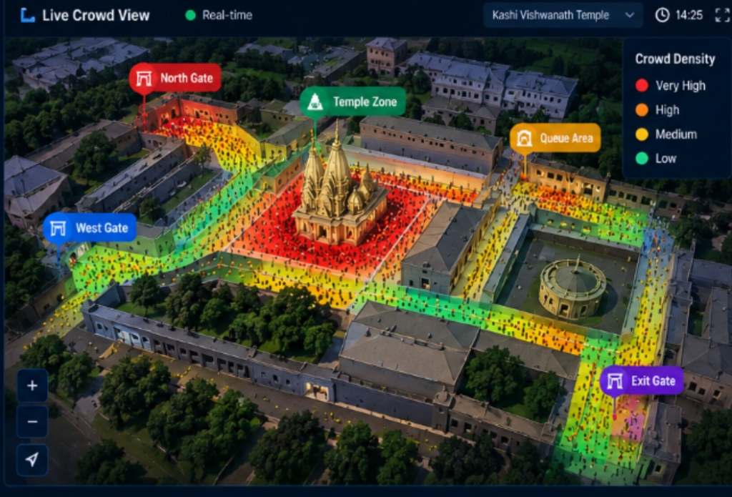
DIGITAL TWIN | SPATIAL REPRESENTATION
Digital Twin Architecture: Virtual Venue Representation
Translating physical venue geography into interactive computational nodes.
WHAT DIGITAL TWIN MEANS IN CROWDGUARD X
1. Real Venue Geography: Spatial floor plan, boundary perimeters, entrance portals, and egress turnstiles.
2. Geometric Graph Decomposition: Venue is segmented into functional Zone Nodes (Zone A, B, C, D, Exit) with strict physical capacities.
3. Portal & Flow Constraints: Gates G1-G4 parameterized with real-world discharge rates (people per minute).
4. Autonomous Pedestrian Dynamics: Agents dynamically follow vector waypoints while calculating personal space repulsion.
5. Live State Mirroring: Reflects real-time density %, velocity changes, and bottleneck status in the visual command center.
EXEMPLAR: KASHI VISHWANATH DHAM CORRIDOR
• Zone A (North Gopuram Approach): Capacity: 15,000 | Density: 24% | Status: Low / Safe
• Zone B (Sanctum & Garbhagriha): Capacity: 25,000 | Density: 88% | Status: CRITICAL CHOKE
• Zone C (Parikrama Courtyard): Capacity: 18,000 | Density: 54% | Status: Medium Load
• Zone D (East Corridor Bypass): Capacity: 12,000 | Density: 32% | Status: Low / Active Bypass
• Exit (Ganga Ghat Boulevard): Capacity: 20,000 | Density: 18% | Status: Safe Turnstiles
Notes:
=== 30-SECOND JURY PITCH ===
Here is how the Digital Twin works in CROWDGUARD X. A digital twin is not just a 3D picture - it is a computational graph of the venue. We break the venue into zones with specific square footage capacities and connect them with gate portals. For our primary demonstration, we modeled the Kashi Vishwanath Temple corridor in Varanasi, where Zone B (the Sanctum) serves as the primary bottleneck.
=== ANTICIPATED JURY Q&A ===
Q: How do you build a digital twin for a new venue?
A: We define the zone rectangles, gate coordinates, and corridor waypoints in a JSON configuration file. Our simulation engine parses these parameters and renders the interactive physics model instantly.
=== TECHNICAL TALKING POINTS ===
Point to the zone metrics on the right. Note how Zone B is flagged at 88% density, which triggers the What-If mitigation in our live demo.

Slide 8
RISK MODELING | ALGORITHMIC LOGIC
Crowd Density & Risk Calculation Model
Multi-variable risk evaluation combining density, flow velocity, and gate pressure.
QUANTITATIVE RISK FORMULATION
Risk = w1 * (N_current / Cap_max) + w2 * (1 - V_avg / V_free) + w3 * (Q_in / Q_out)
1. Capacity Utilization Ratio (w1 = 0.45): Measures physical density (agents per m²). >80% signals high compression risk.
2. Velocity Deceleration Friction (w2 = 0.35): In Helbing physics, as density spikes, walking velocity drops from 1.2 m/s down to 0.3 m/s (crush friction).
3. Ingress / Egress Imbalance (w3 = 0.20): If inbound flow through Gate G2 exceeds downstream exit clearance, pressure accumulates exponentially.
4. Zone Threshold Mapping:
- Safe: <40% Capacity | Laminar flow
- Medium: 40-70% Capacity | Moderate friction
- Critical Choke: >80% Capacity | Crush risk threshold
PROTOTYPE LOGIC vs FUTURE ML EXTENSION
CURRENT WORKING PROTOTYPE:
• Rule-Based & Social Force Simulation Logic: Evaluates live spatial agent coordinates against zone polygon boundaries.
• Velocity Modulation: Agents dynamically decelerate by 65% when entering congested Zone B corridors.
• Marshal Queue Guidance: Deploying marshals aligns lane offsets and restores laminar flow (+25% speed).
FUTURE SCOPE (PLANNED ML ARCHITECTURE):
• Real-Time Vision Head Counting: Fine-tuned YOLOv8 on CCTV streams for empirical headcount inputs.
• Time-Series Deep Learning: LSTM / Temporal Convolutional Networks trained on festival historical rush data to forecast density 15 minutes ahead.
Notes:
=== 30-SECOND JURY PITCH ===
How do we calculate crowd density and risk? We use three physical factors: Capacity utilization ratio, flow velocity drop, and gate inflow versus outflow imbalance. In Helbing fluid dynamics, as density climbs, pedestrian speed drops from 1.2 meters per second down to 0.38 m/s, causing dangerous compression. Crucially, we want to state that our current prototype uses deterministic simulation and rule-based logic; ML-based prediction is part of our future roadmap.
=== ANTICIPATED JURY Q&A ===
Q: Why not use a neural network right now for risk calculation?
A: In safety-critical emergency systems, explainability is paramount. An incident commander needs to know exactly why an alert fired (e.g., 'Zone B capacity >80% and flow speed <0.4 m/s'), rather than trusting an unexplainable black-box model.
=== TECHNICAL TALKING POINTS ===
Highlight the formula and emphasize the transparency regarding current rule-based physics versus future ML.

Slide 9
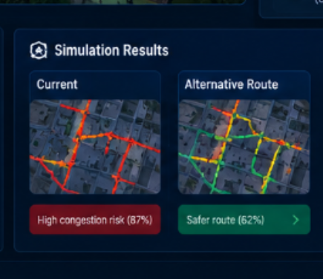
SIMULATION ENGINE | WHAT-IF SANDBOX
What-If Simulation Engine: Stress-Testing Interventions
Simulate interventions in a virtual sandbox before executing orders on the ground.
TESTED SCENARIO: GATE G2 BOTTLENECK MITIGATION
In the Kashi Temple scenario, Gate G2 funnels 45% of total inflow directly into the narrow Sanctum (Zone B), causing density to spike to 88% with severe crush friction (0.38 m/s). In our What-If Sandbox, the commander tests:
• 1. Close Gate G2 (North Gopuram) holding inbound surge
• 2. Divert incoming flow east to Gate G3 (West Bypass)
• 3. Deploy 12 Safety Marshals in Zone B for laminar queuing
• 4. Expand Auxiliary Exit Turnstiles (+65% discharge)
BEFORE vs AFTER SIMULATION TELEMETRY
DENSITY REDUCTION
↓ 24%
From 81% peak to 57% safe
RISK PROFILE
High → Low
Crush probability suppressed
FLOW VELOCITY
↑ 31%
0.38 -> 1.24 m/s laminar
EXIT DISCHARGE
61% Balanced
Symmetric egress clearance
Notes:
=== 30-SECOND JURY PITCH ===
This is our most powerful slide: The What-If Simulation Sandbox. In our Kashi Temple model, Gate G2 was causing an 88% critical density crush in Zone B. Instead of ordering police to close gates blindly, the commander enters the What-If Sandbox. They test closing Gate G2, diverting flow to Gate G3, and deploying 12 marshals. Within 50 milliseconds, the dual-engine proves: Zone B density drops by 24%, flow velocity jumps from 0.38 m/s to 1.24 m/s, and risk drops from High to Low.
=== ANTICIPATED JURY Q&A ===
Q: Are these numbers static or dynamically calculated?
A: They are dynamically calculated in real time by our SimulationEngine. When Gate G2 is closed in the UI, agents are dynamically rerouted, and the zone density counters update live at 60 FPS.
=== TECHNICAL TALKING POINTS ===
Point to the four KPI cards (Density -24%, Flow Velocity +31%). This proves that our simulation provides measurable decision support.

Slide 10
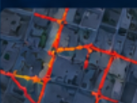
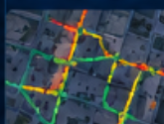
ROUTING INTELLIGENCE | PATHFINDING
Dynamic Route & Evacuation Intelligence
Algorithmic diversion to lower simulated risk corridors during congestion.
WAYPOINT-BASED DYNAMIC REROUTING
Route 1 (North Queue Ingress):
Gate G1 -> Zone A -> Central Plaza -> Main Exit. Stable flow, operating at 24% capacity utilization.
Route 2 (Central Main Ingress - Choke):
Gate G2 -> Zone B Sanctum Choke -> Main Exit. Critical Bottleneck (88% load). Primary cause of crush hazard.
Route 3 / Bypass Diversion (Lower Simulated Risk):
When Gate G2 closes, inbound agents before Y=120px are dynamically redirected east onto Connector -> West Corridor (Gate G3) -> Main Exit.
CRITICAL TECHNICAL PRECISION:
We designate Route 3 as 'Lower Simulated Risk' based on current capacity telemetry, rather than making an unverified claim of a 'guaranteed safest' route. Real venues require human situational oversight.
CURRENT ROUTE (CHOKE) vs ALTERNATIVE BYPASS
ROUTE 2: SANCTUM CHOKE
Flow funneling through Gate G2 directly into Zone B. High crush turbulence and flow halt.
ROUTE 3: EAST BYPASS
Inbound flow diverted east onto bypass corridor. Restores laminar flow velocity and safe exit.
Notes:
=== 30-SECOND JURY PITCH ===
Here is how route intelligence works in CROWDGUARD X. Our engine maintains waypoint networks for all primary corridors. When a gate is closed, the system does not magically teleport people. Instead, agents who have not yet reached the choke point (Y < 120) have their waypoint array dynamically swapped to the East Bypass connector. Also notice our technical terminology: We call it a 'Lower Simulated Risk' route, not an absolute 'guaranteed safest' route, respecting real-world operational realities.
=== ANTICIPATED JURY Q&A ===
Q: How do you prevent the alternative route from also choking?
A: That is precisely why our What-If simulation recalculates all zones concurrently. If the bypass corridor begins approaching 75% capacity, the system throttles Gate G1 as well to prevent cascade congestion.
=== TECHNICAL TALKING POINTS ===
Emphasize the waypoint rerouting mechanism and the honest terminology.

Slide 11
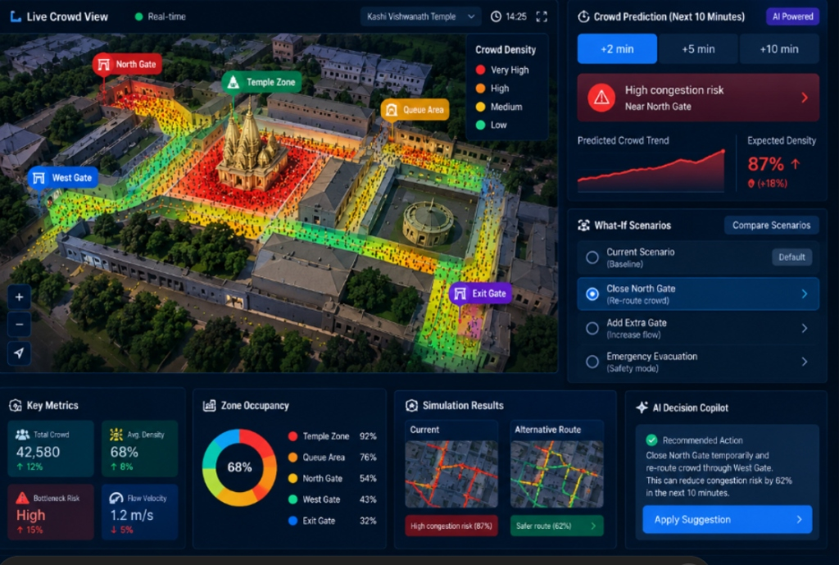
COMMAND CENTER | OPERATIONAL UI
Unified Command Center & Tactical Interface
High-contrast, distraction-free interface engineered for rapid situational awareness.
FIVE INTEGRATED COMMAND MODULES
1. Incident Alert & Telemetry Header: Real-time venue selection, global crowd headcount (142,850), critical bottleneck alerts, and high-visibility risk badges.
2. Real-Time 2D Digital Twin Canvas: Hardware-accelerated HTML5 canvas rendering 320+ autonomous agents, directional vectors, and dynamic thermal heatmaps at 60 FPS.
3. Predictive Horizons Panel: Recharts area curves projecting density trends across +2, +5, +10, and +15 minute windows against critical safety thresholds.
4. What-If Policy Sandbox: Interactive toggle controls allowing instant gate closures, bypass reroutes, inflow adjustments, and marshal deployments.
5. AI Copilot Advisory: Translates raw telemetry into concise tactical guidance: 'Diverting primary inflow away from Gate G2 reduces cascade risk by 62%.'
Notes:
=== 30-SECOND JURY PITCH ===
Here is the actual interface of CROWDGUARD X as running on our system. We designed this unified command center specifically for high-stress event control rooms. It combines five modules: The Incident Header, the 60 FPS Digital Twin Canvas, the Predictive Horizons Recharts panel, the What-If sandbox, and the AI Copilot advisory banner. Notice how everything is dark-themed with high contrast so critical red alerts are impossible to miss.
=== ANTICIPATED JURY Q&A ===
Q: Why did you put the What-If sandbox right next to the live canvas?
A: Because an incident commander under pressure cannot switch through 5 different screens. Having the simulation controls directly adjacent to the Digital Twin lets them toggle Gate G2 and see the agents turn east in real time.
=== TECHNICAL TALKING POINTS ===
Show the jury that this is not a mock-up - it is an actual screenshot of the running React/TypeScript prototype.

Slide 12
SCALABILITY | PARAMETRIC ARCHITECTURE
Multi-Venue Scalability: One Engine, Diverse Environments
Parametric design allows seamless reconfiguration across diverse mass-gathering typologies.
PILGRIMAGE TEMPLE COMPLEX
Kashi Vishwanath Temple (Varanasi)
• Architecture: Historic narrow heritage corridors & sanctum
• Key Challenge: High inflow funneling toward central Garbhagriha
• Core Mitigation: North Gopuram gate holding & West bypass diversion
HIGH-DENSITY TRANSIT HUB
Bhopal Junction Railway Station
• Architecture: Multi-platform concourse with Foot Over Bridges (FOB)
• Key Challenge: Simultaneous train arrivals causing bridge stampede risk
• Core Mitigation: Staggered platform turnstiles & holding concourse
MEGA SPORTS & ARENA COMPLEX
Grand Stadium Arena
• Architecture: Tiered spectator seating zones & radial turnstiles
• Key Challenge: Post-event sudden egress rush into exit gates
• Core Mitigation: Multi-gate load balancing & auxiliary turnstile activation
OPEN-GROUND CULTURAL FESTIVAL
Horizon Open-Air Cultural Festival
• Architecture: Expansive open ground with main stage perimeter
• Key Challenge: Stage-front surge compression & perimeter choke
• Core Mitigation: Inflow lane offset regulation & perimeter marshal lines
PARAMETRIC MODULARITY: The core Helbing Social Force simulation engine remains 100% constant across all environments. Adapting to any new venue requires only a declarative JSON configuration specifying zone coordinates, gate flow limits, and waypoint paths.
Notes:
=== 30-SECOND JURY PITCH ===
A common jury question is: 'Does this only work for temples?' Absolutely not. Our simulation engine is completely venue-agnostic. In venues.ts, we already have four distinct archetypes pre-configured: The Kashi Temple heritage corridor, Bhopal Junction railway station with foot-over-bridge bottlenecks, Grand Stadium for sports egress, and Horizon Open-Air Festival for concerts. Switching venues is instant in our UI.
=== ANTICIPATED JURY Q&A ===
Q: How difficult is it to configure a new venue?
A: It takes less than 15 minutes to configure a new venue. You define the zone bounding boxes, gate throughput rates, and corridor waypoints in a JSON file. The physics engine handles the rest automatically.
=== TECHNICAL TALKING POINTS ===
Emphasize the universal physics engine and the 4 pre-configured venues in the prototype.

Slide 13
MATURITY MATRIX | TECHNICAL HONESTY
Current Working Prototype vs Future Scope
Full technical transparency: What is running today vs our engineering roadmap.
CURRENT WORKING PROTOTYPE (VERIFIED)
✓ Interactive Tactical UI: Complete React 19 + TypeScript + Vite command platform.
✓ 60 FPS Digital Twin Canvas: HTML5 Canvas rendering 320+ agents with social force repulsion.
✓ Parametric Venue Models: 4 Fully configured venue environments with custom spatial geometries.
✓ What-If Simulation Sandbox: Live gate closing, bypass rerouting & marshal dispatch controls.
✓ Dual-Engine Comparator: Simultaneous Before vs After engine running side-by-side with KPI delta.
✓ Predictive Horizons Panel: Recharts multi-horizon density projection curves (+2m to +15m).
✓ Rule-Based Incident Alerts: Dynamic capacity breach banners with automated advisory generation.
✓ Zero-Latency Architecture: In-memory simulation state ensuring instant <50ms policy recalculation.
FUTURE ENGINEERING ROADMAP (PHASE 2 & 3)
○ Edge CCTV Video Analytics: Real-time head detection & tracking via fine-tuned YOLOv8 / ByteTrack.
○ Physical IoT Turnstile Ingestion: Hardware integration with optical turnstiles and LiDAR occupancy counters.
○ Deep Learning Time-Series Models: LSTM / Transformer neural networks trained on multi-year festival ingress datasets.
○ Physical Barrier Actuation: Automated pneumatic gate locking & dynamic LED wayfinding signage.
○ Multi-Agency Emergency API: Unified dispatch integration for Police Command, NDRF, and Municipal Fire.
○ 3D Spatial Twin (WebGL): Full isometric 3D venue rendering with volumetric density lighting.
TRANSPARENCY COMMITMENT: We do not claim hardware deployments or live government APIs that are not yet built. We present a working, software-first simulation platform ready for validation.
Notes:
=== 30-SECOND JURY PITCH ===
This slide represents our engineering maturity and honesty. We clearly divide what works today from what is planned for tomorrow. Everything in the green column - the interactive UI, the 60 FPS canvas, the Social Force physics, the What-If sandbox, the dual-engine analyzer - is functioning right now in our codebase. Everything in the yellow column - edge CCTV models, hardware IoT turnstiles, and government dispatch APIs - is part of our engineering roadmap. We do not claim what we have not built.
=== ANTICIPATED JURY Q&A ===
Q: Why didn't you hook up a webcam for YOLO detection?
A: In a hackathon demo, a single webcam in a room does not represent a 150,000-person pilgrimage crowd. Building a verified, responsive software simulation engine was the highest-priority architectural foundation.
=== TECHNICAL TALKING POINTS ===
Highlight the transparency pledge. Juries appreciate authentic engineering rigor.

Slide 14
OPERATIONAL IMPACT | USE CASE DEPLOYMENT
Practical Impact & Real-World Use Cases
Transforming crowd management from emergency reaction to proactive mitigation.
PILGRIMAGE & HERITAGE TRUSTS
Shri Kashi Vishwanath, Tirumala Tirupati, Kumbh Mela Authority
• Proactively manages religious rush days (Mahashivratri, Shravan)
• Protects sacred sanctums from structural crush pressure
TRANSIT & RAILWAY OPERATORS
Indian Railways, Metro Rail Corporations
• Prevents fatal stampedes on Foot Over Bridges (FOBs)
• Coordinates passenger discharge during delayed train arrivals
EVENT & STADIUM ORGANIZERS
Sports Arenas (IPL), Mega Concerts, Exhibitions
• Eliminates bottleneck blockades at entry turnstiles
• Ensures safe radial egress during sudden post-event exits
POLICE & DISASTER MANAGEMENT
State Police Control Rooms, NDMA, SDRF Battalions
• Provides unified situational awareness across sprawling grounds
• Validates evacuation plans before deploying physical force
ZERO-RISK INTERVENTION TESTING
• Incident commanders can test aggressive policies (e.g. closing an entire gate corridor) in the digital twin in 2 seconds.
• Validates whether a diversion will clear the bottleneck or inadvertently trigger a deadlier bottleneck downstream.
BALANCED EGRESS DISTRIBUTION
• Crowds naturally follow familiar central pathways, leaving secondary exits underutilized (often at <20% capacity).
• CROWDGUARD X dynamically identifies underutilized bypasses and balances egress loads across all available gates.
DECISION SUPPORT, NOT REPLACEMENT
• We do not claim our software 'prevents all disasters automatically' without human judgment.
• CROWDGUARD X empowers human commanders with objective data, accelerating life-saving decisions by 10-15 critical minutes.
Notes:
=== 30-SECOND JURY PITCH ===
Who can use CROWDGUARD X? Four primary groups: Pilgrimage boards like Kashi Vishwanath and Tirupati, transit authorities like Indian Railways managing foot over bridges, stadium and concert organizers, and municipal police disaster cells. Our core value proposition is zero-risk intervention testing. We do not claim our software 'eliminates all human error,' but it gives commanders a 15-minute lead time by testing solutions virtually before ordering barricades moved.
=== ANTICIPATED JURY Q&A ===
Q: Would on-ground police actually use this?
A: Yes, because during a crowd crisis, police commanders currently rely on radio shouts and gut feeling. Having an interactive screen showing that closing Gate 2 will redirect 5,000 people safely along the East corridor gives them concrete confidence.
=== TECHNICAL TALKING POINTS ===
Emphasize the human-in-the-loop philosophy. The system aids commanders; it does not replace them.

Slide 15
LIVE DEMONSTRATION | CONCLUSION
Live Demonstration Playbook & Conclusion
Step-by-step 3-minute jury demonstration script.
EXACT 6-STEP JURY DEMO PLAYBOOK
Step 1: Select Venue: Open platform, show 'Kashi Vishwanath Temple' scenario loaded with 142k headcount telemetry.
Step 2: Highlight Choke: Direct jury's attention to Zone B (Sanctum) turning Critical Red (88% density, flow down to 0.38 m/s).
Step 3: Open What-If Sandbox: Switch to What-If tab. Point out incoming flow overwhelming Gate G2 (North Gopuram).
Step 4: Execute Interventions: Toggle 'Close Gate G2' + 'Divert to Gate G3' + 'Deploy 12 Marshals in Zone B'.
Step 5: Validate Before vs After: Open Comparative Analyzer: Show live 24% density drop, flow speed jumping to 1.24 m/s, and risk falling to Low.
Step 6: Demonstrate Scalability: Switch venue dropdown to 'Bhopal Junction Railway' to prove the same engine handles transit hubs.
CROWDGUARD X
"Let's Simulate the Crowd Before the Crowd Becomes the Crisis."
TAGLINE:
Predict. Simulate. Prevent.
SISTec Innovation Hackathon 4.0
Problem Statement: IS-15
Project Track: Software-First Mass Mobility Simulation
Status: Ready for First-Round Jury Live Demonstration
Notes:
=== 30-SECOND JURY PITCH ===
Respected jury members, to conclude: We do not just have slides - we have an active working prototype ready to demonstrate. In less than 3 minutes, we can walk you through the Kashi Temple scenario, identify the Zone B bottleneck at 88% density, toggle our What-If mitigations, show the 24% density drop in the dual-engine comparator, and switch to Bhopal Junction to demonstrate scalability. As our tagline says: 'Predict. Simulate. Prevent.' Thank you, and we welcome your questions.
=== ANTICIPATED JURY Q&A ===
Q: Can we see the live demo now?
A: Yes, absolutely! We have the prototype running right here on localhost. We are excited to walk you through the exact 6-step flow.
=== TECHNICAL TALKING POINTS ===
Deliver the closing tagline with confidence. Transition immediately to the live prototype demonstration.

