Slide 1

Recognizing Coronary Artery Disease using PPG-Signals through Deep Learning
1. K. Venkata Rohith 22KQ1A6147
2. G. Samuel 22KQ1A6142
3. A. V. Tejaswani 22KQ1A6101
4. E. Akhila 22KQ1A6106
5. Sk. Yasmeen 22KQ1A6125
Team Members:
Names RollNos
Under the Guidance :
A.Y : 2025-26
Department of AIML
Dr. Raghunath Reddy (AI & ML Department)

Slide 2
Outline
Abstract
Introduction
Literature Review
Problem Statement
Objectives
Proposed methodology
Hardware & Software Requirements
References

Slide 3
Abstract
Coronary Artery Disease (CAD) is a leading cause of cardiovascular mortality, making early detection critically important. Traditional diagnostic methods are invasive, expensive, and unsuitable for continuous monitoring. Photoplethysmography (PPG) provides a non-invasive and wearable-friendly alternative for cardiovascular assessment. In this work, a hybrid deep learning framework combining Convolutional Neural Networks (CNN) and Bidirectional Long Short-Term Memory (BiLSTM) networks is proposed to analyze segmented PPG signals. An attention mechanism is employed to highlight diagnostically relevant signal segments. Experimental results demonstrate that the proposed approach achieves high sensitivity and strong ROC-AUC, indicating its potential for effective non-invasive CAD screening.

Slide 4
Introduction
Problem Domain: Healthcare Artificial Intelligence
CAD affects blood flow to the heart.
Delayed diagnosis increases risk of heart attacks.
AI helps in early disease detection.
Wearable sensors generate large PPG data.
Why this domain is important
CAD is a leading cause of death worldwide.
Many patients do not show early symptoms.
PPG sensors are available in smartwatches.
Deep Learning improves disease prediction accuracy

Slide 5
Literature Review
S.No. | Author & Year | Title | Objectives | Methodology | Findings | Limitations
1 | Ye Li et al., 2025 | Prediction of Cardiovascular Disease Events From the PPG Waveform | To evaluate whether PPG waveform features can predict cardiovascular disease events | PPG signals from the UK Biobank were analyzed using handcrafted feature extraction and statistical survival models. | PPG systolic features showed strong association with cardiovascular events and improved risk prediction. | Uses handcrafted features and statistical models; no deep learning–based end-to-end classification.
2 | Zhaoying Li et al., 2025 | CAD Detection Using PPG via GAF Transformation and Deep Learning | To develop a non-invasive deep learning method for CAD detection using PPG signals. | PPG signals were filtered, segmented, transformed into GASF and GADF images, and classified using an SE-ResNet deep learning model. | The proposed model achieved high accuracy (92.43%) and AUC (0.98), outperforming existing PPG-based methods. | Limited dataset, binary classification only, and high computational cost due to image transformation..
3 | Wu et al., 2024 | Res-BiANet: Hybrid Deep Learning for Arrhythmia Detection Using PPG | To detect and classify multiple cardiac arrhythmias using PPG signals. | PPG signals were segmented and analyzed using a hybrid ResNet–BiLSTM model with multi-head attention for spatial and temporal feature learning. | The model achieved 92.38% accuracy and an F1-score of 86.88%, outperforming conventional CNN and RNN models. | Focused on arrhythmia detection, not CAD, and requires high computational resources with limited data.

Slide 6
Literature Review
S.No. | Author & Year | Title | Objectives | Methodology | Findings | Limitations
4 | Sadaf Iqbal et al., 2023 | Deep Learning–Based CAD Detection Using Bilateral Finger PPG | To detect coronary artery disease using non-invasive bilateral PPG signals and deep learning. | Bilateral finger PPG signals were transformed into scalogram images and classified using a CNN (GoogLeNet) with transfer learning, and compared with K-NN. | The CNN model achieved 83.8% accuracy and showed better performance than traditional machine learning methods, with good agreement to angiography results. | Small dataset, requires high-quality PPG signals, and lacks large-scale validation.
5 | Johnson et al., 2016 | MIMIC-III: A Freely Accessible Critical Care Database | To provide a large, open-access clinical database for medical and machine learning research. | ICU patient data including vital signs, waveform signals (ECG, PPG), and clinical records were collected, de-identified, and organized into relational tables. | MIMIC-III contains data from over 50,000 ICU admissions and is widely used for cardiovascular and deep learning research. | Contains noisy and incomplete signals, requiring extensive preprocessing before analysis.

Slide 7
Problem Statement
Coronary Artery Disease (CAD) is one of the leading causes of death worldwide.
Existing CAD diagnosis methods such as ECG, angiography, and stress tests are costly and
invasive.
Photoplethysmography (PPG) signals are non-invasive and easily available through wearable
devices.
However, PPG signals are noisy and sensitive to motion artifacts.
There is a need for an accurate Deep Learning–based system to detect CAD using PPG signals.

Slide 8
Objectives
Primary Objective
To detect Coronary Artery Disease using PPG signals and Deep Learning techniques.
Secondary Objectives
To preprocess and clean noisy PPG signals.
To design a Deep Learning model for CAD detection.
To analyze temporal patterns in PPG signals.
To evaluate the model using standard performance metrics.

Slide 9
Proposed Methodology
Collect PPG signals and clinical data from a standard medical dataset.
Preprocess the PPG signals by cleaning, normalizing, and removing flat or noisy segments.
Segment the PPG signals into fixed-length windows to ensure uniform input for the model.
Train a hybrid CNN–Bidirectional LSTM model with an attention mechanism to learn both waveform and temporal features.
Aggregate segment-level predictions using patient-level top-K soft voting with optimized threshold selection.
Evaluate the system using patient-wise test data to accurately predict the presence or absence of CAD.

Slide 10
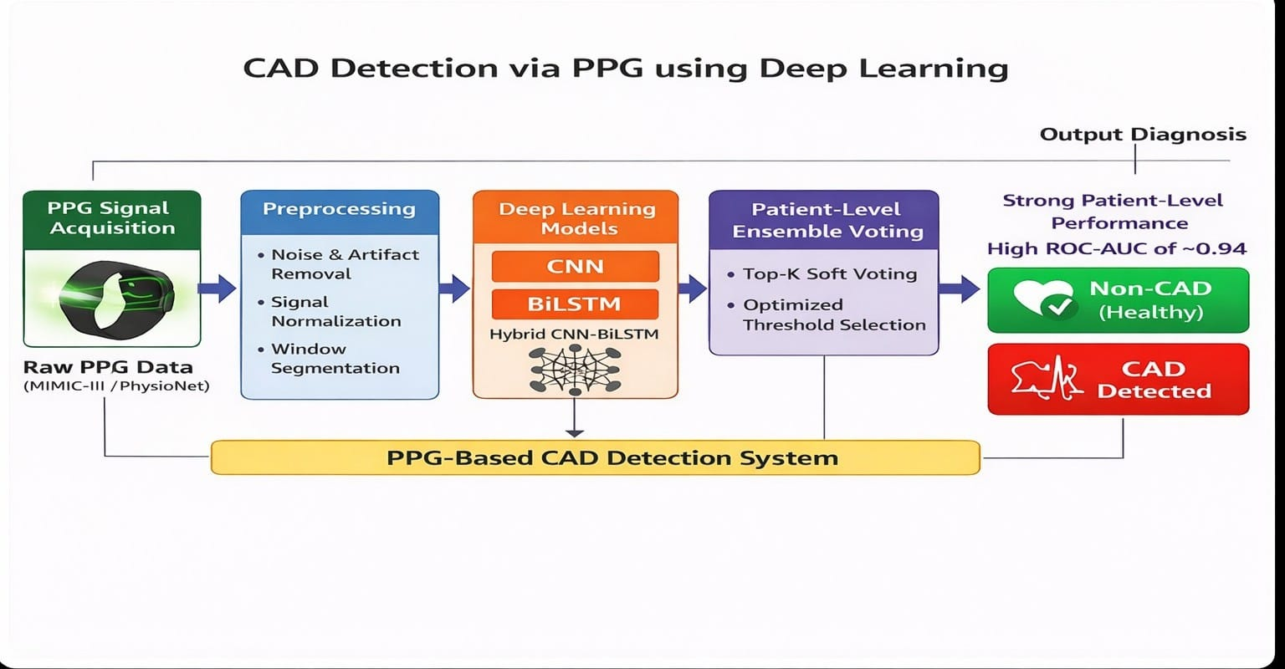
Block Diagram

Slide 11
Dataset
Dataset Source
PhysioNet – MIMIC-III Clinical Database
Publicly available medical dataset
Collected from ICU patients
Contains physiological signals including PPG
Type of Data
Photoplethysmography (PPG) signals
Time-series pulse waveform data
Non-invasive signal collected using sensors
Purpose of Dataset
Used to analyze cardiovascular conditions
Helps in detecting Coronary Artery Disease (CAD)

Slide 12
Dataset
Dataset Statistics
Number of Samples: Thousands of PPG signal segments
Features: Raw PPG waveform values (time-series)
Classes:
  CAD
  Non-CAD
Data Challenges
Presence of motion noise and artifacts
Signal variability across patients
Class imbalance between CAD and Non-CAD cases
Missing or corrupted signal segments
Dataset Samples
Raw PPG waveform plots
Cleaned PPG signals after preprocessing

Slide 13
Algorithms
Deep Learning Models Used
Convolutional Neural Network (CNN)
Extracts local morphological features from PPG waveforms and identifies important patterns such as peaks and variations
Bidirectional Long Short-Term Memory (BiLSTM)
Captures temporal dependencies in PPG signals from both past and future directions which improves understanding of heartbeat dynamics
CNN + BiLSTM with Attention (Hybrid Model)
Combines spatial feature extraction and temporal learning
Reason for Selection
Automatically learns features
Handles raw PPG signals
Provides better accuracy than traditional ML methods

Slide 14
Hardware & Software Requirements
Software Requirements
Python
TensorFlow / PyTorch
NumPy, Pandas
Matplotlib
Scikit-learn
Platform
Google Colab
Jupyter Notebook
Hardware Requirements
Minimum 8 GB RAM
GPU (recommended for Deep Learning training)

Slide 15
Proposed Approach
Step-by-Step Approach
1. Data Collection
PPG signals and associated clinical information are collected from a standard medical dataset.
2. Preprocessing
Raw PPG signals are converted into numerical form.
Flat, noisy, and invalid signal segments are removed to improve data quality.
3. Signal Segmentation
PPG signals are divided into fixed-length segments.
This ensures uniform input size for deep learning models.
4. Model Training
A hybrid CNN–Bidirectional LSTM with Attention model is trained on segmented PPG data.
CNN extracts waveform features, BiLSTM captures temporal patterns, and attention highlights important segments.
5. Patient-Level Voting Strategy
Segment-level predictions are aggregated at the patient level using top-K soft voting.
An optimized decision threshold is selected to balance sensitivity and specificity.
6. Performance Evaluation
The proposed system is evaluated using patient-wise test data.
Performance is measured using accuracy, sensitivity, specificity, F1-score, and ROC-AUC.

Slide 16
Experimentation
Experimental Setup
Dataset: MIMIC-III PPG signals
Task: Binary classification (CAD / Non-CAD)
Input: Pre-processed and segmented PPG signal windows
Experiments Performed
Experiment 1 – CNN Model
  Extracts spatial and morphological features from PPG signals.
  Provided strong baseline performance.
Experiment 2 – LSTM Model
  Captures temporal dependencies in PPG time-series data.
  Improved learning of long-term signal patterns.

Slide 17
Experimentation
Experiment 3 – Ensemble Model (CNN + LSTM)
  Combined CNN and LSTM predictions using top-K soft voting.
  Reduced individual model errors and improved robustness.
Evaluation & Outcome
Metrics used: Accuracy, Sensitivity, Specificity, F1-score, ROC-AUC
Best Model: Ensemble (CNN + LSTM)
Final Performance:
  Accuracy: 85.16%
  ROC-AUC: 92.25%

Slide 18
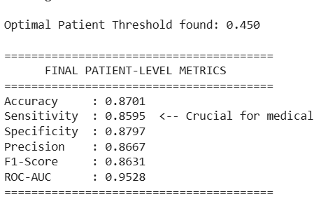
Model Performance & Results
Final Model Results
The ensemble deep learning model produced the
following results:
Accuracy: 87.01%
Sensitivity (Recall): 85.95%
Specificity: 87.97%
Precision: 86.67%
F1-Score: 86.31%
ROC-AUC: 95.28%

Slide 19
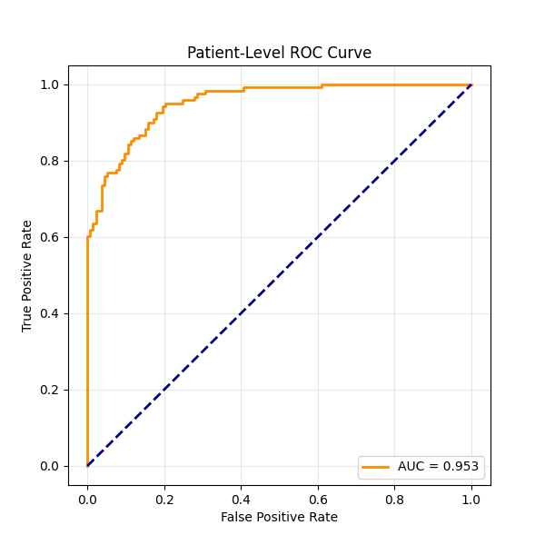
Result Interpretation
Result Analysis
High ROC-AUC (95.28%) indicates strong class separation.
High Sensitivity shows effective detection of CAD patients.
Balanced Specificity reduces false CAD predictions.
F1-Score confirms good balance between precision and
recall.

Slide 20
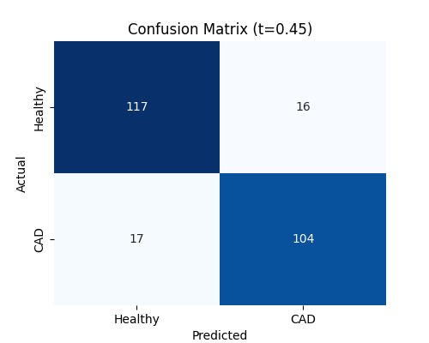
Confusion Matrix Analysis
Confusion Matrix
[[117 16]
[ 17 104]]
Explanation:
True Positives (104): Correctly detected CAD cases.
True Negatives (117): Correctly detected non-CAD cases.
False Positives (16): Healthy cases predicted as CAD.
False Negatives (17): CAD cases missed by the model.

Slide 21
Comparison with Existing Work
Paper Considered - Sadaf Iqbal et al., 2023
Deep Learning Identification of Coronary Artery Disease from Bilateral Finger PPG
Aspect | Existing Paper (Iqbal et al., 2023) | Proposed Project (Your Work)
Disease Focus | Coronary Artery Disease (CAD) | Coronary Artery Disease (CAD)
Signal Type | Bilateral finger PPG | Single-channel PPG signals
Data Source | Controlled experimental data | Clinical dataset (MIMIC-III)
Preprocessing | CWT scalogram image conversion | Direct time-series preprocessing
Model Used | CNN (GoogLeNet with transfer learning) | CNN, LSTM, and Ensemble (CNN+LSTM)
Feature Learning | Image-based feature learning | Spatial + temporal feature learning
Classification | Single deep learning model | top-K soft voting strategy
Performance | Accuracy ≈ 83.8% | Accuracy ≈ 87.01%, ROC-AUC 95.28%
Practical Use | Proof-of-concept study | More scalable and robust approach

Slide 22
Key Improvements in Our Project
Utilizes clinically realistic PPG data with associated patient information, reflecting real-world conditions.
Eliminates the need for complex signal-to-image transformations, reducing computational complexity.
Processes PPG signals directly in the time domain, resulting in a simpler and faster pipeline.
Employs a hybrid CNN–Bidirectional LSTM with Attention model to effectively capture both waveform and temporal features.
Applies patient-level top-K soft voting with optimized threshold selection to improve robustness and prediction stability.
Achieves strong patient-level performance with high sensitivity and ROC-AUC, demonstrating reliable CAD detection.
Provides a scalable and practical framework suitable for continuous monitoring and wearable health systems.

Slide 23
Limitations
The model performance depends on the quality of PPG signals.
PPG signals are affected by noise and motion artifacts.
The dataset is limited to clinical ICU data, which may affect generalization.
Deep learning models require high computational resources for training.
The system currently supports binary classification (CAD / Non-CAD) only.

Slide 24
Future Scope
Improve performance using larger and more diverse datasets.
Integrate real-time PPG data from wearable devices.
Extend the system to detect multiple cardiovascular diseases.
Apply model optimization to reduce computational complexity.
Add explainable AI techniques for better clinical interpretation.
Deploy the model as a mobile or web-based healthcare application.

Slide 25
Conclusion
This project presents a deep learning–based framework for the detection of Coronary Artery Disease using non-invasive PPG signals. Raw PPG data is preprocessed, segmented into fixed-length samples, and analyzed using a hybrid CNN–Bidirectional LSTM model with an attention mechanism. Patient-level aggregation using top-K soft voting and optimized threshold selection is employed to enhance prediction reliability. The proposed system achieves strong patient-level performance with high sensitivity and a ROC-AUC of approximately 0.95, demonstrating effective classification capability. These results indicate that PPG signals combined with deep learning provide a practical and scalable solution for early, non-invasive CAD screening.

Slide 26
References
Zhaoying Li et al., Coronary Artery Disease Detection Based on Photoplethysmography via Gramian Angular Field Transformation and Deep Learning, 2025.
Ye Li et al., Prediction of Cardiovascular Disease Events From the Photoplethysmograph Waveform, 2025.
Wu, Y., Tang, Q., Zhan, W., Li, S., & Chen, Z., Res-BiANet: A Hybrid Deep Learning Model for Arrhythmia Detection Based on PPG Signal, Electronics, 2024.
Sadaf Iqbal et al., Deep Learning Identification of Coronary Artery Disease from Bilateral Finger Photoplethysmography Sensing, 2023.
Johnson, A. E. W. et al., MIMIC-III: A Freely Accessible Critical Care Database, Scientific Data, Nature, 2016.
Dataset Link:
MIMIC-III Dataset: https://physionet.org/content/mimiciii/

