Slide 1
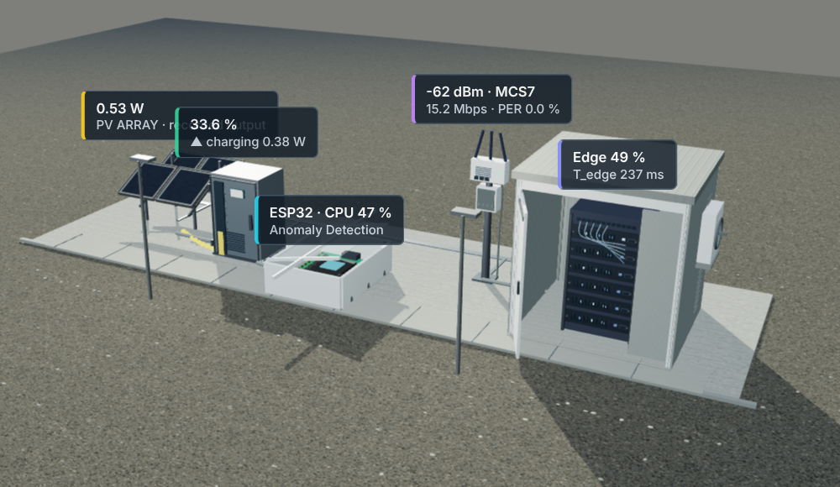
Explainable ANN-ANFIS Hybrid for Renewable-Aware Task Offloading
19CSE362 · Fundamentals of Soft Computing
in solar-powered IoT nodes, studied with a digital twin
Sanjith M P · CB.EN.U4ELC24035
Rohith S · CB.EN.U4CCE24042
Darshan R · CB.EN.U4CCE24144
Vishaanth R · CB.EN.U4ELC24163
The project's own 3D digital twin (twin3d/scene.js)
Notes:
[0:00] Good morning, respected faculty. Our project is an explainable ANN–ANFIS hybrid for renewable-aware task offloading in solar-powered IoT nodes, using a digital twin. I am Rohith, and with me are Sanjith, Darshan and Vishaanth.

Slide 2
Where should each IoT task run?
Rohith S
Run locally on the ESP32
Costs CPU time and battery energy. No network needed.
Every minute
an IoT monitoring task arrives at the solar-powered ESP32
Run it where?
Offload to the edge server over WiFi
Costs radio energy, network delay and server delay, but the server is far faster.
The best choice keeps changing with
Sunlight
Battery level
WiFi signal
Server load
Goal: choose well using only what the node knows, and explain why.
Notes:
[0:15] Picture a solar-powered ESP32 sensor node. Every minute a monitoring task arrives. It can run the task locally, spending CPU time and battery, or offload it over WiFi to an edge server, spending radio energy and waiting for the network and the server. The right choice keeps changing with the sun, the battery, the signal and the server load. Our goal is to choose well using only what the node knows, and to explain why.
Handover: Sanjith built a digital twin to study this at scale. Over to Sanjith.

Slide 3
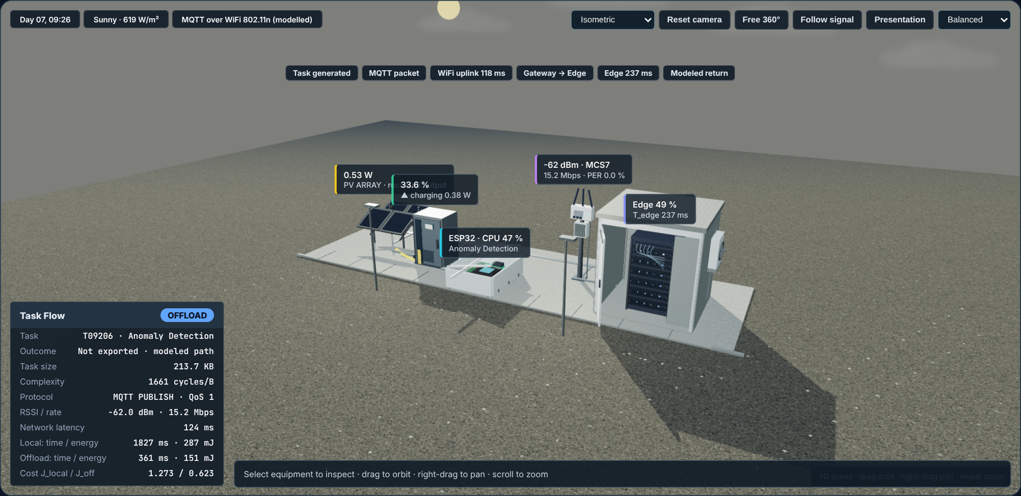
A physics-based digital twin of the node
Sanjith M P
Solar panel (1 W)
Power = 1 W × sunlight ÷ 1000 × 0.85; clouds drift with the day's weather
Battery (12 Wh)
Charge goes up with solar power and down with power used, at 95 % efficiency
Tasks (5 types)
From sensor aggregation (light) to image preprocessing (heavy), one per minute
The project's 3D twin replaying task T09206 (day 7, 09:26, sunny), which is offloaded
ESP32 (240 MHz)
Work = data size × work per byte; time = work ÷ free CPU speed; energy = power × time
Closed loop
The energy of the chosen option is taken from the battery, so every decision changes the next one.
Notes:
[0:50] Thank you, Rohith. Hardware tests at this scale are impractical, so I built a physics-based digital twin that advances one minute per step. For solar, irradiance follows a half-sine from 6 am to 6 pm, times a smoothly drifting cloud factor, with Markov-chain weather. The battery is a 12 watt-hour lithium-ion pack with 95 % efficiency and a CC/CV taper above 90 %. There are five task types, from sensor aggregation at 60 cycles per byte up to image preprocessing at 3000, and task sizes follow a smooth AR(1) process that grows during working hours. On the ESP32, a task needs C equals D times c CPU cycles, that is, data size times cycles per byte. At 240 megahertz that gives the local time, and the local energy is idle power plus alpha times CPU load, multiplied by that time. Most importantly, the energy of whichever option is chosen is drawn from the battery, so every decision affects the next one. It is a closed loop.

Slide 4
From the twin to a labelled dataset
Sanjith M P
Run the twin for 7 days, one task per minute
Work out both options for every task
Give each option a cost
The cheaper option is the correct label (the oracle)
How the cost is worked out
Cost = energy × battery price + time as a share of the 5-second deadline + a penalty if it would be late.
Offloading also adds small risk terms for a weak WiFi link and a busy server.
Battery price is 1 when the battery is full and rises steeply to 5 when it is empty.
10,080
tasks (7 days)
38
features per task
54 / 46 %
local / offload
20 / 20
engineering checks pass
Time & weather · 4
Solar & battery · 8
Task & ESP32 · 9
Network · 10
Edge server · 3
Cost & decision · 4
Example T09206 (214 KB anomaly detection): local 1.8 s and 287 mJ, offload 0.36 s and 151 mJ, so the oracle offloads it
Notes:
[2:00] The twin computes the true cost of both options. J equals a battery price lambda times energy, plus time over the 5-second deadline, plus a deadline penalty, and for offloading, link and server risk terms. Lambda equals 1 plus 4 times (1 minus SOC) to the power 1.5, so the same joule costs up to five times more on an empty battery. The cheaper option is the oracle decision. Running seven days gives our dataset: 10,080 tasks with 38 features in six groups: time and weather, solar and battery, task and ESP32, network, edge server, and cost and decision. Every row stores both options in full, which is exactly what supervised learning needs. About 54 % run locally and 46 % are offloaded, a split that emerges from the physics. Take task T09206, a 214-kilobyte anomaly-detection task: locally it would take 1.8 seconds and 287 millijoules, offloaded 361 milliseconds and 151 millijoules, so the oracle offloads it. We will follow this task through the whole talk.
[3:10] To trust the twin, validate_twin.py runs 20 engineering checks. For example, distance up means RSSI down, server load up means edge time up, the decision always equals the minimum cost, and the battery energy balance closes to within 10⁻⁵ %. All 20 pass.
Handover: The offload side of the twin, the WiFi link and the edge server, was modelled by Darshan, who will explain it now.

Slide 5
Modelling the offload path
Darshan R
WiFi link (the node sits on moving equipment)
Distance
3 to 40 m, changes slowly
Signal strength
weaker with distance and obstacles
WiFi speed
65 down to 6.5 Mbit/s
Packet errors
weak signal means more retries
Send time and energy
time = data ÷ speed; energy = 0.6 W × time
Edge server (3 GHz)
Edge time = work ÷ (3 GHz × spare capacity)
Offload time = network time + edge time
Offload energy = radio sending + listening while it waits
A busy server is slow: at 90 % load it is 10 times slower.
Notes:
[3:50] Thank you, Sanjith. I modelled the offload path. The node moves, so its distance to the access point wanders between 3 and 40 metres. RSSI follows log-distance path loss, minus 40 minus 26 log d, plus correlated shadowing. From the RSSI, 802.11n rate adaptation picks a speed from 65 down to 6.5 megabits per second. The packet error rate is 10 % at the sensitivity limit and falls with margin, which gives retransmissions. Transmission time is the bytes, with MQTT and TCP/IP headers, over the effective rate; radio energy is 0.6 watts times that time. At the edge, time equals cycles over 3 gigahertz times one minus the load, so it explodes as the server saturates.

Slide 6
What the node knows, and two baselines
Darshan R
The oracle knows
current signal strength
current server load
the true offload time and energy
The ESP32 knows
its battery level
the task size and type
its own local time and energy
the last measured signal
the last reported server load
Baseline 1 · Fuzzy only (Mamdani)
4 inputs, each described with 3 words: battery, task load, WiFi link, server load
12 hand-written rules, for example: IF the task is heavy AND the link is good, THEN offload
Easy to explain, but the thresholds are guesses
Baseline 2 · ANN only (classifier)
9 inputs → 24 → 16 → 1 neurons, trained on the oracle's choices
Accurate, but a black box: it cannot say why
So we need controllers that decide under uncertainty
Every controller is tested in a closed loop: it drives the battery through weeks it has never seen.
Notes:
[4:40] Here is the key problem. The oracle needs the current signal and server load. A real ESP32 knows only the last measured RSSI and the last reported load. So I built two baselines that decide under this uncertainty. The first is a Mamdani fuzzy controller with four linguistic inputs: battery, task load, WiFi link and server load. It uses trapezoid and triangle membership functions and 12 expert rules, like 'IF the task is heavy AND the link is good, THEN offload', with min for AND, max aggregation and centroid defuzzification. The second is an ANN classifier: 9 inputs, two hidden layers, and a sigmoid output trained on the oracle labels.
[5:25] Every controller is tested in a closed loop, driving the battery through weeks it has never seen.
Handover: To decide well, the node must first know what offloading will cost. Rohith is back to show how we predict it.

Slide 7
ANN: predicting what offloading will cost
Rohith S
6 inputs (known before sending)
2 outputs
Task size
Hidden layer 1
24 neurons (tanh)
Hidden layer 2
16 neurons (tanh)
Work per byte
Offload time
Last signal strength
Last server load
Offload energy
Hour of day (sine)
Hour of day (cosine)
Written from scratch in NumPy
Adam optimiser · rate 0.01 · 60 epochs
Train: first 5.6 days · test: last 1.4 days
602 learned weights
Notes:
[5:40] Thank you, Darshan. My part is the ANN predictor, the predict step. It estimates, before sending, the offload time and energy. The inputs are six things the node knows: the log of task size, the log of complexity, the last RSSI, the last server load, and the hour encoded as sine and cosine. The outputs are the log of offload time and the log of offload energy. We use logs because these values span 10 milliseconds to 4 seconds, so the network learns relative error.
[6:15] The architecture is 6–24–16–2, with tanh hidden layers and linear outputs: 602 parameters, written from scratch in NumPy with back-propagation and the Adam optimiser, learning rate 0.01, batch 128, 60 epochs. The split is chronological: the first 5.6 days train, and the last 1.4 days are validation it has never seen.

Slide 8
ANN results and ablation study
Rohith S
0.989
accuracy, time (R²)
0.987
accuracy, energy (R²)
≈ 5 %
median error
Example: task T09206
Last signal −68.8 dBm, actual signal −62 dBm
Predicted 353 ms and 149 mJ; real 361 ms and 151 mJ (within 2 %)
Without the ANN
If ANFIS gets the raw signal instead of the predicted cost:
agreement 96.6 % → 93.6 %, deadline misses 9 → 14
Notes:
[6:40] The results: R² of 0.989 for time and 0.987 for energy, with a median error of about 5 %. Take Sanjith's task T09206, an anomaly-detection task of 214 kilobytes. The last RSSI was −68.8 while the actual signal was −62. Even so, the ANN predicts 353 milliseconds and 149 millijoules, against a truth of 361 and 151. That is within 2 %.
[7:05] I ran an ablation study, removing one input at a time and retraining. Removing task size hurts most: time R² falls to 0.924. Complexity, last RSSI and server load follow, while the hour barely matters, at 0.988. Then at system level: if ANFIS is given the raw RSSI instead of my ANN's predicted cost, agreement with the oracle on an unseen week drops from 96.6 to 93.6 %, and deadline misses rise from 9 to 14. The ANN is what turns uncertain network conditions into usable numbers.
Handover: But an ANN alone is a black box: it cannot tell us why. Vishaanth will show how ANFIS makes the decision explainable.

Slide 9
ANFIS: fuzzy rules that can learn
Vishaanth R
Battery level
Low · Medium · High
1 · Fuzzify
How much is each input Low, Medium or High? Bell-shaped curves, learned
2 · Rule strength
Multiply the matching degrees (AND)
3 · Normalise
Each rule's share of the total
4 · Rule output
A simple straight-line formula of the inputs, learned
5 · Add up
Weighted sum = offload score; above 0.5 means offload
Energy ratio (from ANN)
Offload cheaper · Similar · Local cheaper
Time gain (from ANN)
Small · Large
Server load
Light · Busy
3 × 3 × 2 × 2 = 36 rules (one for every combination) · 200 learned numbers: 20 for curve shapes, 180 for rule outputs
Notes:
[7:50] Thank you, Rohith. My part is the reason step: ANFIS, the Adaptive Neuro-Fuzzy Inference System. ANFIS is a fuzzy rule base built as a five-layer network, so it can be trained. It has four inputs, and two of them come from Rohith's ANN. They are battery SOC, with the words Low, Medium and High; the energy ratio, the log of predicted offload energy over local energy, with Offload cheaper, Similar and Local cheaper; the time gain, Small or Large; and server load, Light or Busy. Three times three times two times two gives 36 rules, one for every combination.
[8:30] Layer one uses Gaussian membership functions. Layer two multiplies them to get each rule's strength. Layer three normalises. In layer four each rule outputs a linear function, p·x plus q. That makes it first-order Takagi–Sugeno. Layer five takes the weighted sum, which is the offload score; above 0.5 means offload. In total there are 200 trainable parameters.

Slide 10
How ANFIS is trained, and one real decision
Vishaanth R
Hybrid learning (repeated 30 times)
Worked example · task T09206
Step 1 · Least squares
Solve the 180 rule-output numbers exactly
ANN predicts
353 ms and 149 mJ to offload
ANFIS inputs
battery 33.5 % · offload needs about half the energy · time gain 29 % · server 49 %
Step 2 · Gradient descent
Nudge the 20 curve centres and widths
Strongest rule
Battery Medium AND Offload cheaper AND Small gain AND Busy server: 19 % of the decision
Teacher: a soft target
How strongly one option is cheaper: 0 = clearly local, 0.5 = a tie, 1 = clearly offload
Trained on the ANN's predictions, so it learns to live with the ANN's errors
Offload score 0.9965 → OFFLOAD
The teacher's value was 0.9945
Notes:
[8:55] Training uses Jang's hybrid learning. Each epoch, least squares solves the 180 rule-output parameters exactly, then gradient descent tunes the membership centres and widths, for 30 epochs. The target is a soft oracle preference, a tanh of the cost difference, so ANFIS learns how strongly one option is better. And because it is trained on the ANN's predictions, it learns to live with the ANN's errors. For task T09206, the energy ratio says offloading needs about half the energy. Its memberships are SOC Medium 0.73, Offload cheaper 0.51, Small gain 0.61 and Busy server 0.70; multiplied together, that rule's strength is 0.16. The strongest rule, SOC Medium AND Offload cheaper AND Small gain AND Busy server, carries 19 % of the weight, and the final score is 0.9965, so offload. The teacher's value was 0.9945.

Slide 11
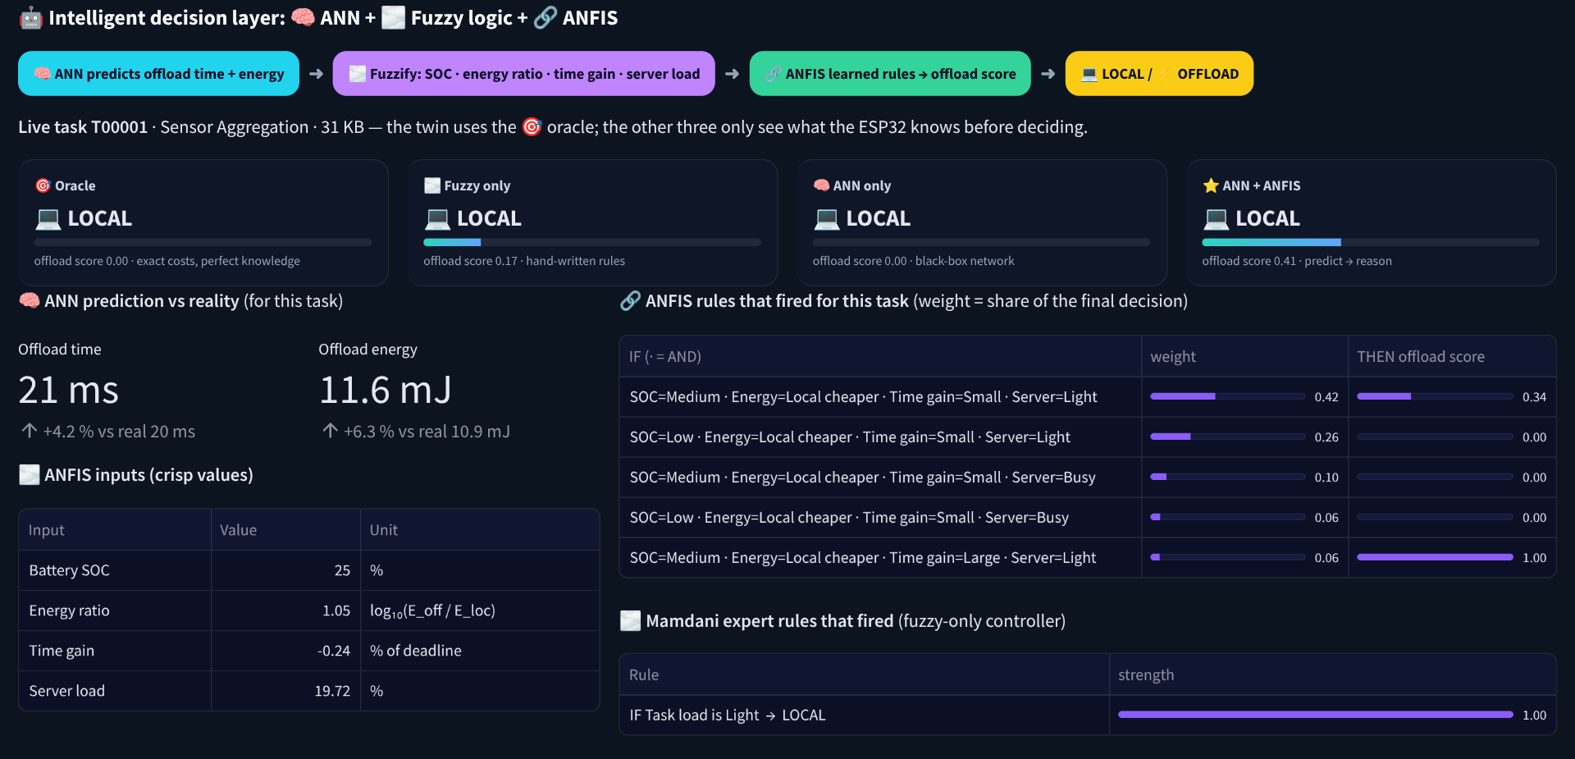
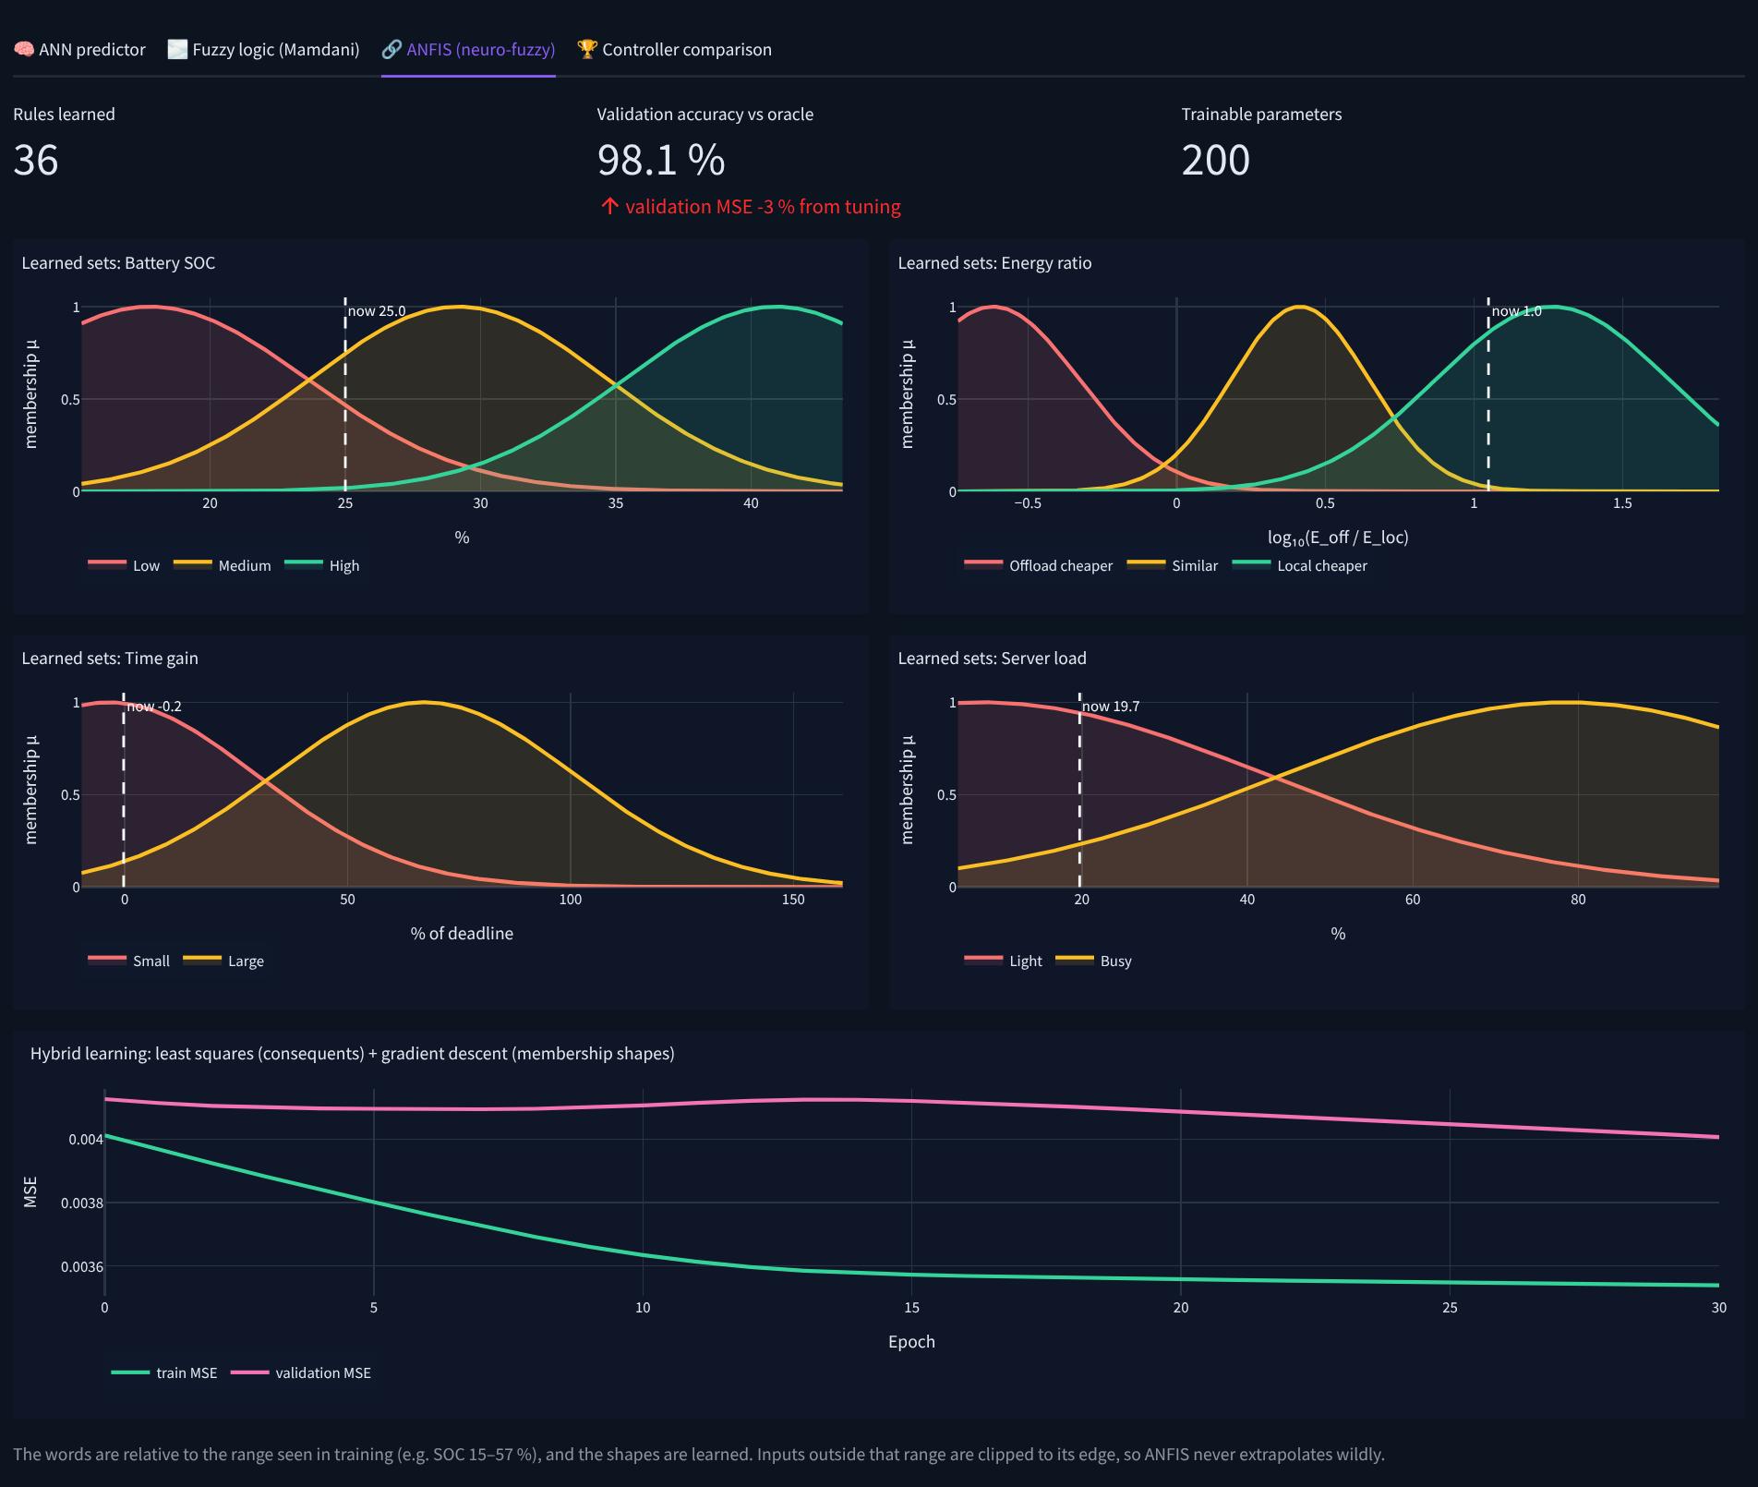
Every decision is explained on the dashboard
Vishaanth R
Live view: each controller's decision and the ANFIS rules that fired
Design check (unseen week) | Agreement
Full hybrid | 96.6 %
Hard 0/1 target instead of soft | 92.5 %
No curve tuning | 97.0 %
No ANN | 93.6 %
ANFIS tab: the learned curves and the training curve
Notes:
[9:55] We also checked my design choices. Training on hard 0-or-1 labels instead of the soft target drops agreement on an unseen week from 96.6 to 92.5 %. Tuning the membership functions changes little: it is slightly better on validation and slightly worse on this test week. The least-squares rule outputs do most of the work, and we report that honestly.
[10:20] Finally, I built the Streamlit dashboard. It shows live cards for all four controllers, the ANN's prediction against reality, the ANFIS rules that fired with their weights, the learned membership functions, and the comparison charts. Every decision is explained.
Handover: Darshan will now present how all the controllers performed.

Slide 12
Results on 11 unseen weeks
Darshan R
vs Fuzzy only
Better in all 11 weeks on accuracy, energy and extra cost (p ≈ 0.001)
vs ANN only
Same accuracy (p = 0.83), but less energy in all 11 weeks (p ≈ 0.001)
And it explains itself
Every decision shows the rules that fired
Charts start at 90 % and 950 J so the differences are visible. Significance: Wilcoxon signed-rank test, paired by week.
Notes:
[10:50] To evaluate fairly, every controller runs in a closed loop on 11 unseen weeks, each with a new random seed, and we compare the paired results with the Wilcoxon signed-rank test. Mean agreement with the oracle is 92.5 % for fuzzy, 96.7 for the ANN alone and 96.8 for our hybrid. Against fuzzy, the hybrid is better in all 11 weeks on agreement, energy and regret, with p about 0.001. Against the ANN alone, the accuracy difference is not significant. But the hybrid used less task energy in all 11 weeks, about 17 joules per week, and had lower regret, again with p about 0.001.

Slide 13
Conclusion
As accurate as the best black-box ANN
Makes cheaper decisions: less energy, lower extra cost
Explains every decision with readable rules
Limitations
Simulated, not yet calibrated on real hardware; no cloud tier
Next steps
Hardware calibration, a cloud tier, and running ANFIS on the ESP32 itself
Thank you. Questions?
Notes:
[11:35] So our hybrid is as accurate as the best black box, makes cheaper mistakes, and explains every decision. The limitations: the twin is simulated, not yet calibrated on real hardware, and there is no cloud tier. Next we plan hardware calibration, a cloud tier, and running ANFIS on the ESP32 itself. Thank you; we are happy to take your questions.

