Slide 1
Customer Analytics Dashboard
Total Customers : 4
Average Age : 24
Youngest Customer : 22
Oldest Customer : 26

Slide 2
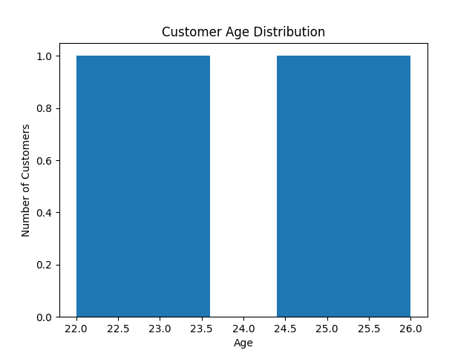

Slide 3
