Slide 1

SENTIMENTAL ANALYSIS FOR REPORT MANAGEMENT SYSTEM USING MACHINE LEARNING ALGORITHMS
CMR COLLEGE OF ENGINEERING & TECHNOLOGY
Kandlakoya, Medchal, Hyderabad - 501401
Department of Computer Science and Engineering
BATCH NO: 43
ANDE HEMANTH (16H51A0566)
MEDIDHI HENIN (18H51A05A3)
MUTHYALA VENKATA SIVA ROHITH (18H51A05D2)
Under esteemed guidance of
MR. G. RAVI KUMAR

Slide 2
Table of Contents
Abstract
Introduction
Literature Survey
Problems in Existed System
Research Objectives
Problem Definition
Research Work
- Proposed System Architecture
- Methods Used
- Comparision of Proposed System with an existed System
Stepwise Implementation
Results
Conclusion And Future Work
References

Slide 3
ABSTRACT Academic industries used to accumulate comments from the scholars at the precept factors of direction which include arrangements, contents, punctual, skills, appreciation, and gaining knowledge of enjoying. The remarks are gathered in terms of every qualitative and quantitative core.Recent techniques for opinion mining use manual strategies and it is aware totally of the quantitative comments. So the assessment can't be made via deeper analysis. In this,we boom a student remarks mining tool which applies text analytics and sentiment evaluation technique to provide teachers a quantified and deeper analysis of the qualitative remarks from college students for the purpose to improve the students for knowing their learning experience.We have accumulated feedback from the students and then textual content processing is accomplished to smooth the statistics. These subjects are extracted from the pre-processed file. Feedback approximately every challenge rely on are accumulated and made as a cluster. Classify the remarks by the usage of sentimental classifier and observe the visualization techniques to symbolize the views of college students.

Slide 4
INTRODUCTION Sentiment analysis is an interdisciplinary field that crosses natural language processing, artificial intelligence, and text mining. Since most opinions are available in the text format and its processing is easier than other formats, sentiment analysis has emerged as a subfield of text mining. It generally recognizes opinions of people expressed in text. The opinions could be judgments, evaluations, affective (or emotional) states, beliefs, or wishes. Classifying the polarity of a given text as positive or negative is the basic task of sentiment analysis. Due to its many aspects it is often referred to with different names such as opinion mining, sentiment classification, sentiment analysis, and sentiment extraction. It is widely believed that Sentiment analysis is needed and useful. It is also widely accepted that extracting sentiment from text is a hard semantic problem even for human beings. Additionally, sentiment analysis is domain specific, therefore the polarity of some terms depends on the context in which they are used.

Slide 5
LITERATURE SURVEY 1. Analyzing Recommendation of colleges for students using Data Mining techniques Recommendation Systems are the type of information filtering systems designed to help users to find their way through todays large information spaces. Till date Recommendation Systems are the best examples of personalization system. Recommendation Systems uses a number of different technologies. The design of such Recommendation engines depends on the domain and the particular characteristics of the data available. Recommendation systems differ in the way they analyze these data sources to develop notions of affinity between users and items which can be used to identify well-matched pairs. Collaborative Filtering systems analyze historical interactions alone, while Content-based Filtering systems are based on profile attributes; and Hybrid techniques attempt to combine both of these designs.

Slide 6
LITERATURE SURVEY 2. Faculty Rating System Based on Students Feedback Using Sentimental Analysis the four major attributes for evaluating a faculty which were mentioned earlier, to store the data entered by the student. All the details entered by the student are then mapped onto the respective attributes in the database. The user interacts with the front end of the application. The feedback of the faculty is collected from the student using the feedback form. Now, once this is done we need to find that one word which best describes the behavior of the teacher by taking into consideration all the emotions that we captured from the input. For this we have built two table of the emotions that most users use frequently and their respective values.

Slide 7
LITERATURE SURVEY 3. Performance Analysis on Students Feedback Using Machine Learning Algorithms The paper proposes ways to research the feedback information victimization data processing techniques for a higher understanding of the college, course, and student. The format of feedback varies from establishment to establishment, thus there cannot be a general technique which will appropriate all. On victimization Opinion Mining method for classifying the student's comments acquired during module evaluation survey. The mined and preprocessed datasets have been based to numerous supervised evaluations taking out rule like aid Vector Naïve Bayes (NB), Nearest Neighbor (KNN) and Neural Networks (NN). The feedback information is used for analyzing all the parameters thought of for feedback which might facilitate management in creating policy choices in teaching-learning method. This Paper surveys all data processing technique that is applied for analyzing feedback information.

Slide 8
PROBLEMS IN EXISTED SYSTEM

Slide 9
Analyzing recommendation of colleges for Students using Data Mining Techniques : Merits: 1. We proposed a system to provide a recommendation system which will generate the user interested colleges list. Information seeker will give ratings to the questions according to his interest rate. 2.The list of college will be stored in the dataset for calculating the accuracy and precision of the system. Also the students will be giving feedback to the system for their performance. Demerits: 1)In rural area people are unaware of the colleges and their facilities. 2) There are some systems which are having colleges information including their facilities also there is no such system which will provide recommendations of Engineering Colleges at one place based on the information seekers/ students interest. .

Slide 10
2. Faculty Rating System Based On Student Feedbacks Using Sentimental Analysis : Merits: 1)The proposed model is about sentimental analysis and machine learning for capturing emotions from the student feedback system. 2)this model gives an accurate and efficiency to rate the faculty belongings to a particular educational institute. Demerits: 1)To keep track of performance of each faculty in each department is critical. 2)This system is using reviews from various web sources and using machine learning algorithms to predict sentiment of users.

Slide 11
3. Performance Analysis on Student Feedback using Machine Learning Algorithms : Merits: 1) It investigates opinion mining by means of supervised learning techniques to search out the emotion of the each student. 2)clarification of the technique of accomplishment of opinion mining on after scholar remarks using the open source tool. 3) Python, the work additionally offers a comparative overall performance take a look remarks supported, extracted alternatives like examination, teaching and so on. Demerits: 1)The total of information that whichever organization within the humankind managing is huge. 2)It is usually a lot of concerning of these three dimensions coming back along than considering any of them on an individual basis.

Slide 12
RESEARCH OBJECTIVES

Slide 13
RESEARCH OBJECTIVES 1)Detection of spam and fake reviews: The web contains both authentic and spam contents. For effective Sentiment classification, this spam content should be eliminated before processing. 2)Limitation of classification filtering: There is a limitation in classification filtering while determining most popular thought or concept. For better sentiment classification result this limitation should be reduced. 3)Domain-independence: The biggest challenge faced by opinion mining and sentiment analysis is the domain dependent nature of sentiment words. 4)Incorporation of opinion with implicit and behavior data: For successful analysis of sentiment, the opinion words should integrate with implicit data. The implicit data determine the actual behavior of sentiment words. 5)Natural language processing overheads: The natural language overhead like ambiguity, co-reference, Implicitness, inference etc. created hindrance in sentiment analysis too.

Slide 14
Problem Definition Recent approaches for feedback mining use manual methods and it focus mostly on the quantitative comments. So the evaluation cannot be made through deeper analysis. In this project, we will develop a student feedback mining system which applies text analytics and sentiment analysis approach to provide instructors a quantified and deeper analysis of the qualitative feedback from students that will improve the students learning experience.

Slide 15
RESEARCH WORK

Slide 16
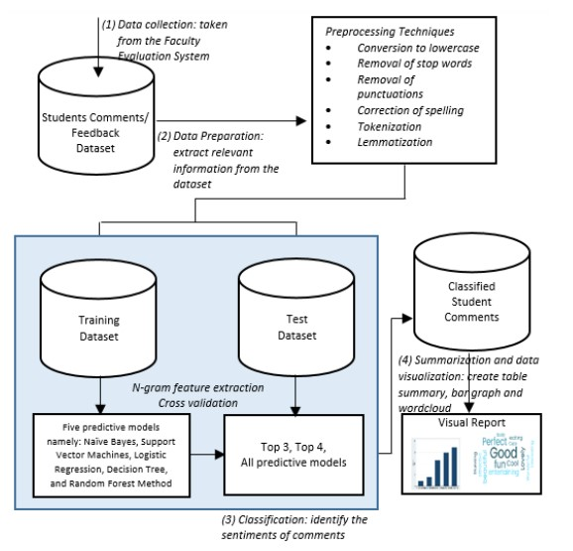
PROPOSED SYSTEM ARCHITECTURE

Slide 17
METHODS USED

Slide 18
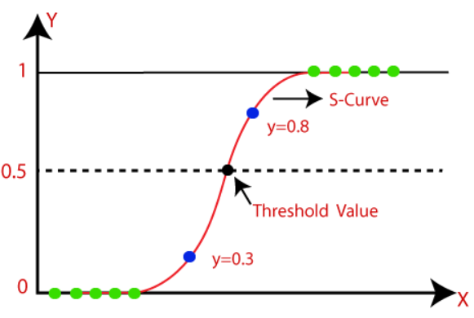
LOGISTIC REGRESSION
Logistic regression is, which comes under the Supervised Learning technique. It is used for predicting the categorical dependent variable using a given set of independent variables.
Logistic regression predicts the output of a categorical dependent variable. Therefore the outcome must be a categorical or discrete value. It can be either Yes or No, 0 or 1, true or False, etc. but instead of giving the exact value as 0 and 1, it gives the probabilistic values which lie between 0 and 1.
n Logistic regression, instead of fitting a regression line, we fit an "S" shaped logistic function, which predicts two maximum values (0 or 1).
Logistic Regression is a significant machine learning algorithm because it has the ability to provide probabilities and classify new data using continuous and discrete datasets.

Slide 19
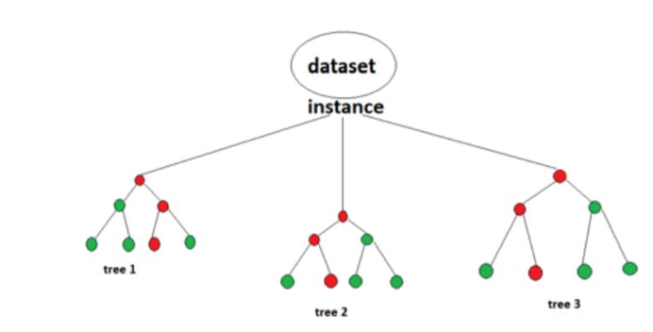
RANDOM FOREST ALGORITHM
Random Forest algorithm is a supervised classification algorithm. We can see it from its name, which is to create a forest by some way and make it random. There is a direct relationship between the number of trees in the forest and the results it can get: the larger the number of trees, the more accurate the result. But one thing to note is that creating the forest is not the same as constructing the decision with information gain or gain index approach. It uses a tree-like graph to show the possible consequences. If you input a training dataset with targets and features into the decision tree, it will formulate some set of rules. When we have our dataset categorized into 3 category so now Random forest helps to make classes from the dataset. Random forest is clusters of decision trees all together, if you input a training dataset with features and labels into a tree, it willformulate some set of rules, which will be used to make the predictions.

Slide 20
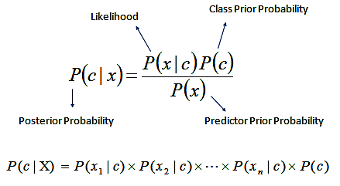
NAÏVE BAYES CLASSIFIER
The Bayes Rule provides the formula for the probability of Y given X. But, in real-world problems, you typically have multiple X variables. When the features are independent, we can extend the Bayes Rule to what is called Naive Bayes. It is called ‘Naive’ because of the naive assumption that the X’s are independent of each other. Regardless of its name, it’s a powerful formula.
Naive Bayes is a classification technique with a notion which defines all features are independent and unrelated to each other. It defines that status of a specific feature in a class does not affect the status of another feature.

Slide 21
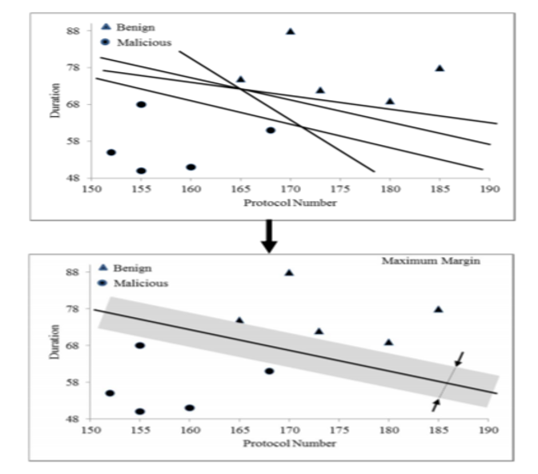
SUPPORT VECTOR MACHINES
“Support Vector Machine” (SVM) is a supervised machine learning algorithm which can be used for both classification or regression challenges.. In this algorithm, we plot each data item as a point in n-dimensional space Then, we perform classification by finding the hyper-plane that differentiate the two classes very well The SVM algorithm is implemented in practice using a kernel. The learning of the hyperplane in linear SVM is done by transforming the problem using some linear algebra, which is out of the scope . A powerful insight is that the linear SVM can be rephrased using the
f(x) = B0 + sum(ai * (x,xi))
This is an equation that involves calculating the inner products of a new input vector (x).

Slide 22
COMPARED TO EXISTING SYSTEM
Using SVM would be a safe bet because it is not prone to catastrophic failures along with that the algorithm is able to correlate with other elements within the corpus that help to understand the dense features in NLP resulting in sentimental analysis or machine translation, but in case of Naive Bayes, the results are not consistent enough.
Though it is more of a generalized algorithm that works effectively and cheaply when we want to classify a small corpus of data having a relatively small amount of input features, you don’t expect the inputs to be meaningfully correlated. If an algorithm is not able to capture the correlation between different words and its intensity then how can you expect it to learn “Word Order” Also, removing stop words and performing TD-IDF adds on to the misery of NB as it takes away a good chunk of raw text. There are other forms of Naïve Bayes that require hyperparameter tuning those results in much better results.

Slide 23
STEPWISE IMPLEMENTATION
For Building Machine Learning Models :
1. Numpy :
A python library that provides scientific libraries, works efficiently with large multi dimensional arrays,
2. Sci-Kit Learn:
ML library in python that provides tools for classification, clustering, etc. It contains various algorithms such as SVM, Random forest, KNN, Naïve Bayes etc.
3. Pandas:
Built on top of Numpy, it provides functions & methods to speed up the data analysis process, also provides functions for data preprocessing
Joblib :
Joblib library saves trained model and reuses it. It uses API’s.
(Training a model may take seconds to several days. Hence, it is not practical to train model again & again. )

Slide 24
STEPWISE IMPLEMENTATION
Step 01 : Data Set Collection
For the proposed project the dataset is taken from Github (a website that provides various datasets) for student and Teacher Review.
1. Student Feedback Dataset:
1. Number of samples: 676
2. Number of attributes : 2
3. Number of students: 420
4. Source: https://github.com/rohith-33/resume/blob/master/current_data%20(2).csv

Slide 25
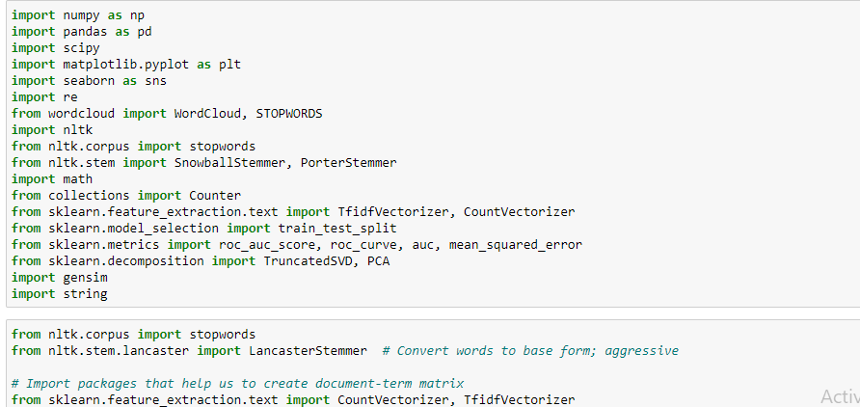
STEPWISE IMPLEMENTATION
Step 02 : Importing Libraries and Dataset
To import libraries such as Pandas, Numpy, Sklearn and Joblib. To import the dataset as.csv files.

Slide 26
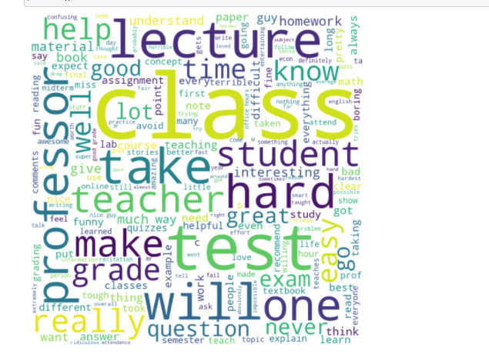
STEPWISE IMPLEMENTATION
Step 03 : Exploration of Data
A Machine Learning project is as good as the foundation of data on which it is built. In order to perform well, machine learning data exploration models must ingest large quantities of data, and model accuracy will suffer if that data is not thoroughly explored first. Data exploration steps to follow before building a machine learning model include:

Slide 27
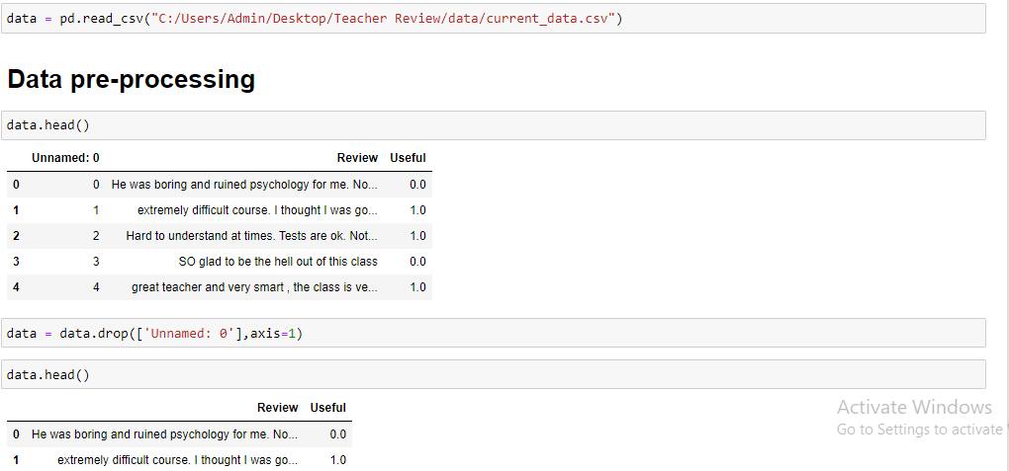
STEPWISE IMPLEMENTATION
Step 04 : Preprocessing Of The Data
Removing Missing Values: To remove the missing values by replacing them with the mean of that in data.
particular attribute. The other way is by dropping the rows or columns that contain null values.
Extraction of Dependent and Independent Values: For every Machine Learning model, it is necessary to separate the independent variables (matrix of features) and dependent variables in a dataset.

Slide 28
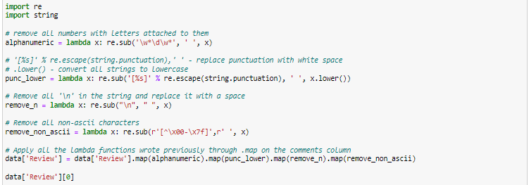
STEPWISE IMPLEMENTATION
Step 05 : Text Preprocessing
The data consists of sentiments expressed by users on the various movies. Here each comment is a record, which is either classified as positive or negative.
This dataset described in the previous paragraph contains review comments on several movies. Comments in the dataset are already labelled as either positive or negative. The dataset contains the following two fields separated by a tab character.
1. text:- Actual review comment
2. sentiment:- Positive sentiments are labelled as 1 and negative sentiments are labelled as 0.

Slide 29
STEPWISE IMPLEMENTATION
Step 06: Feature Of Extraction
A Text feature extraction is the process of taking out a list of words from the text data and then transforming them into a
feature set which is usable by a classifier. This work emphasizes on the review of available feature extraction methods.
6.1. Bag of words
The bag of words is the most common and the simplest among all the other feature extraction methods; it forms a word
presence feature set from all the words of an instance. The features can be used in modelling with machine learning algorithms. This method is very flexible and simple.
6.2. TF-IDF
This way of scoring is known as Term Frequency – Inverse Document Frequency.
• Term Frequency (TF) is the frequency of the word in the current document.
• Inverse Document Frequency (IDF) is the score of the words among all the documents.
These scores can highlight the words that are unique that is the words that represent needful information in a specified document.
6.3. Word2Vec
Word2Vec is used to construct word embeddings. The models created by using word2vec are shallow meaning two-layer
neural networks It then creates a vector space which is usually of hundreds of dimensions. Each distinctive word in the corpus is alloted with corresponding vector in the space.

Slide 30
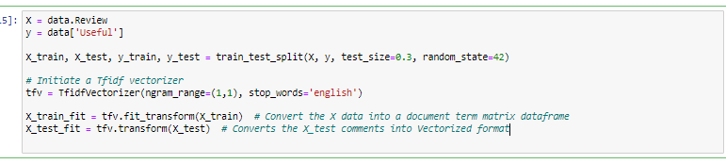
STEPWISE IMPLEMENTATION
Step 07 : Model Generation
Machine learning is about predicting and recognizing patterns and generate suitable results after understanding them.
ML algorithms study patterns in data and learn from them. An ML model will learn and improve on each attempt.
To gauge the effectiveness of a model, it’s vital to split the data into training and test sets first. So before training our models, we split the data into Training set which was 70% of the whole dataset and Test set which was the remaining 30%.
it is important to implement a selection of performance metrics to the predictions made by our model.

Slide 31
STEPWISE IMPLEMENTATION
Step 08 : Building Machine learning Algorithms Model:
Using All the machine Learning models to train the dataset and get the performance results of all the algorithms.
Step 09 : Predicting Test Set Results
Since the model is fitted to the training set, so now we can predict the test result. Accuracy is also calculated for the predicted values.

Slide 32
STEPWISE IMPLEMENTATION
Step 10 : Saving the trained model using joblib
Training a machine learning model may take from few seconds to several days even months. Hence it’s not practical to train a machine learning model again and again. Hence it’s required to save trained model and reuse it.
Joblib intended to replace Pickle as alternative to save and load machine learning models.
Once the model is built and trained it is exported to a file using joblib
The model can be simply loaded to predict when required.

Slide 33
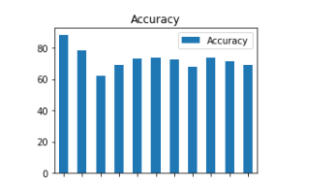
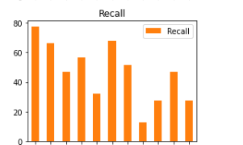
RESULTS
ACCURACY
RECALL

Slide 34
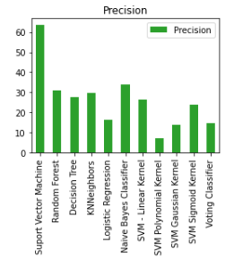
RESULTS
PRECISION

Slide 35
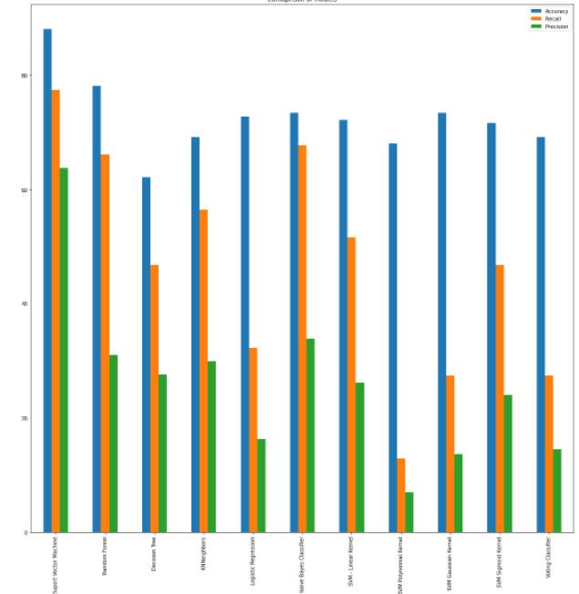
PERFORMANCE RESULTS

Slide 36
Conclusion And Future Work A Student feedback system is build to analyze topics and their sentiments from student generated feedback. This uses preprocessing ,topic extraction,clustering in ways to represent the students views in a graphical way. It will be useful for the students learning and instructor’s method of delivery.

Slide 37
REFERENCES
[1] J. Sang, H. Naeem (2015) . A Generic Feedback System for Better Evaluation of Teacher Perforamance.
[2] J. Zahorik (1990). Stability and Flexibility in Teaching.
[3] H. W. Marsh (1987). Students’ evaluation of university teaching: Research findings, methodological issues, and directions for future research. International Journal of Educational Research,1987. 11(3): p. 253-388.
[4] S. Noor (2012). Students' Perception on Good Lecturer Based on Lecturer Performance Assessment
[5] H. W. Marsh (1987). Students’ evaluation of university teaching: Research findings, methodological issues, and directions for future research. International Journal of Educational Research, 1987. 11(3): p. 253-388.
[6] J.T.E.Richardson (2005).Instruments for obtaining student feedback: a review of the literature. Assessment & Evaluation in Higher Education, 2005. 30(4): p. 387-415.
[7] B. Pang, and L. Lee (2008).Opinion mining and sentiment analysis. Foundations and Trends in Information Retrieval, 2008. 2(1-2): p. 1-135
[8] P.-Y. S. Chen, S.-Y.Wu, and J. Yoon (2004).“The impact of online recommendations and consumer feedback on sales,” in International Conference on Information Systems (ICIS), pp. 711–724, 2004.

Slide 38


