Slide 1
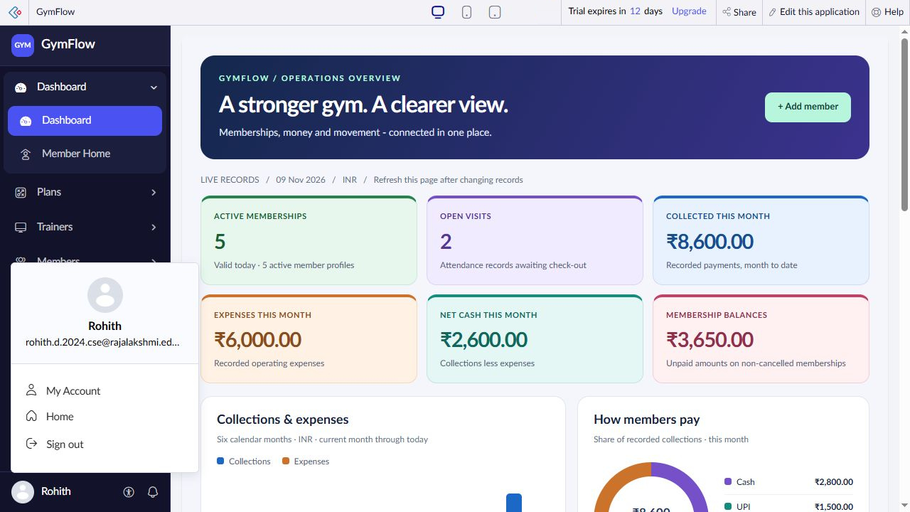
RAJALAKSHMI ENGINEERING COLLEGE
GymFlow
Gym Management System
Low-code application
built with Zoho Creator
My application and Creator account
STUDENT
REGISTER NUMBER
COURSE FACULTY
Rohith D
2116240701435
Dr.Jinu Sophia
Department of Computer Science and Engineering
CB23F35 Low-Code Application Development using Zoho Creator
Notes:
Good morning. I am Rohith D, register number 2116240701435, from the Department of Computer Science and Engineering. My project is GymFlow, developed for CB23F35 under Dr.Jinu Sophia. It connects gym administration in Zoho Creator. The picture shows my actual application and signed-in account. The project was developed with AI assistance. I will explain the data model, dashboard, rules and verified email feature.
Evidence: C:\Users\SANTHOSH A\Desktop\JEDSD\output\gymflow\build-status.json
C:\Users\SANTHOSH A\Desktop\JEDSD\tmp\gymflow-report\screenshots\account-profile.jpg
Project baseline verified 9 November 2026. Demonstration data; values and date-sensitive counts can change.
PRESENTATION CUE
Opening, about 30 seconds: Introduce yourself, the course and faculty. Explain that GymFlow is a Zoho Creator application for connected gym administration.

Slide 2
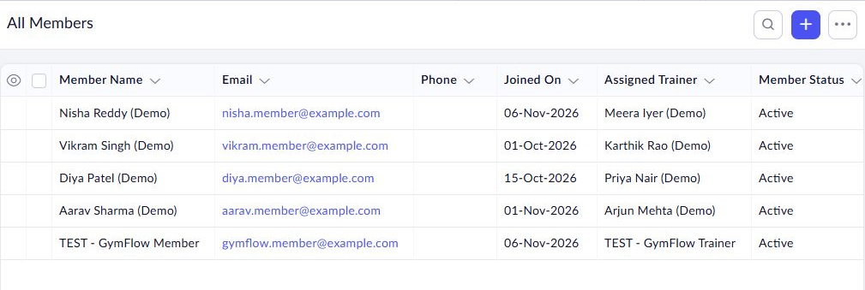
Gym operations in one application
The problem
Separate registers make renewals and unpaid balances difficult to track.
The solution
Linked records, validation rules and a dashboard for gym staff.
One member profile connects subscriptions,
attendance and class bookings.
9
48
8
45
Forms
Data fields
Lookup relationships
Demo records
2 / 7
Notes:
Gyms often use notebooks or separate spreadsheets. This makes it hard to see which memberships are valid, which members have unpaid balances and who has checked in. GymFlow stores related records in one application. The nine forms contain 48 data fields and eight lookup relationships. Nine list reports display the records. The demonstration contains five records in each form, 45 in total. The actual member directory shown here provides the shared identity used by memberships, attendance and bookings.
Evidence: C:\Users\SANTHOSH A\Desktop\JEDSD\output\gymflow\build-status.json
C:\Users\SANTHOSH A\Desktop\JEDSD\tmp\gymflow-report\field-inventory.json
C:\Users\SANTHOSH A\Desktop\JEDSD\tmp\gymflow-report\screenshots\members-report.jpg
Project baseline verified 9 November 2026. Demonstration data; values and date-sensitive counts can change.
PRESENTATION CUE
About 45 seconds: Point to the actual member records. Explain that one identity links several activities and avoids repeated personal details. The dataset has five demonstration records per form.

Slide 3
How the gym workflow connects
01
02
03
04
Set up
Enroll
Operate
Review
Plans
Trainers
Members
Memberships
Payments
Attendance
Classes and Bookings
Expenses
Dashboard
Owner email
Built with Zoho Creator
Zoho Creator
Deluge
HTML and CSS
Forms, records and hosting
Calculations and validation
Dashboard layout and charts
3 / 7
Notes:
First, staff create reusable plans and trainer profiles. Next, they register a member and create a membership linked to that person and a plan. Daily operations record receipts, attendance and class bookings. Expenses record gym spending. The dashboard queries these saved records. Lookups connect existing records without repeating all personal details. A person has one member profile but can renew for multiple membership periods. A membership can have several payments because instalments are supported. There are nine list reports and two pages: Dashboard and Member Home. Zoho manages storage and hosting. Deluge supplies the business rules, while HTML and CSS implement the custom dashboard.
Evidence: C:\Users\SANTHOSH A\Desktop\JEDSD\output\gymflow\build-status.json
C:\Users\SANTHOSH A\Desktop\JEDSD\tmp\gymflow-report\field-inventory.json
Project baseline verified 9 November 2026. Demonstration data; values and date-sensitive counts can change.
PRESENTATION CUE
About 60 seconds: Walk left to right. A profile can have multiple membership periods. Each membership can have multiple receipts. Explain the platform, logic and interface layers. Nine reports display records and two pages provide Dashboard and Member Home.

Slide 4
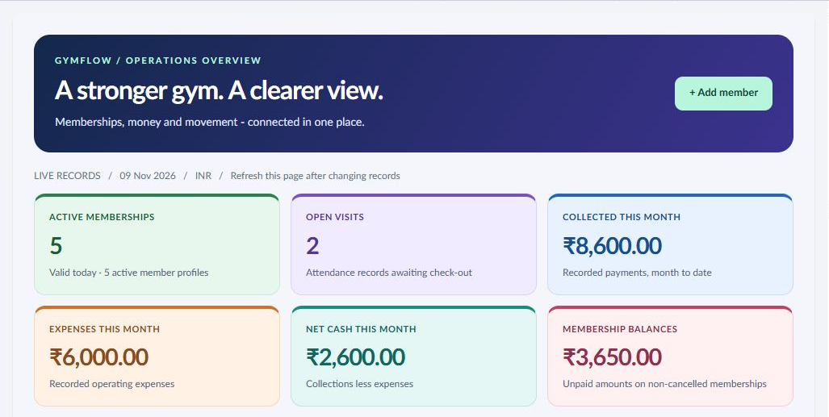
Dashboard: daily activity and money
Activity
Memberships valid today
Visits awaiting check-out
Month to date
Payments received
Expenses recorded
Balances
Unpaid membership amounts
₹8,600 − ₹6,000 = ₹2,600 net cash
Refresh after changes. Demo baseline: 9 Nov 2026. Net cash is collections less expenses.
4 / 7
Notes:
The dashboard is the landing page. Active memberships require Valid status and dates covering today. Open visits are attendance rows without a check-out, including any old visit left unclosed. Collections and expenses cover the current month through today. Net cash is collections minus expenses, not full accounting profit. Outstanding balance sums membership totals minus linked receipts for memberships marked Valid, and is not restricted to this month. The baseline is 5 active memberships, 2 open visits, collections of INR 8,600, expenses of INR 6,000, net cash of INR 2,600 and balances of INR 3,650. The page recalculates on load or refresh, not by continuous streaming. Shortcuts open membership, payment, attendance, booking and member reports. Coming-up counts highlight valid memberships ending through today plus seven days and scheduled classes whose start time is still in the future.
Evidence: C:\Users\SANTHOSH A\Desktop\JEDSD\output\gymflow\dashboard-snippet.html
C:\Users\SANTHOSH A\Desktop\JEDSD\output\gymflow\build-status.json
C:\Users\SANTHOSH A\Desktop\JEDSD\tmp\gymflow-report\screenshots\dashboard-home.jpg
Project baseline verified 9 November 2026. Demonstration data; values and date-sensitive counts can change.
PRESENTATION CUE
About 60 seconds: Read the six cards once, then explain their source records. Collections and expenses are month to date. Outstanding balances use linked receipts and can span months. Refresh recalculates the page. Net cash is not a complete accounting profit measure.

Slide 5
Four views of gym performance
Collections and expenses
Payment method mix
Jun–Nov 2026, INR
₹8,600 recorded collections
Active memberships by plan
Expenses by category
Demo data as of 9 Nov 2026. Monthly expenses: ₹6,000. Current month is partial.
5 / 7
Notes:
There are four dashboard charts. The first compares collections and expenses over six calendar months, with the current month partial. The second shows payment methods. The editable chart on this slide uses the same demonstration totals: Cash INR 2,800, UPI INR 1,500, Card INR 800 and Bank transfer INR 3,500, totalling INR 8,600. The third counts current active memberships by plan. Monthly Essential has 2, Personal Training Plus 1, Quarterly Strength 1, TEST 30 Day Plan 1 and Annual All Access 0. The fourth groups current-month expenses: Rent 2,000, Utilities 850, Equipment 1,200, Maintenance 450, Salary 1,500 and Other 0. The screenshot shows the actual latter two charts. The application implements its charts using Deluge aggregates and HTML/CSS. Card and UPI are recorded payment methods, not connected payment gateways.
Evidence: C:\Users\SANTHOSH A\Desktop\JEDSD\output\gymflow\dashboard-snippet.html
C:\Users\SANTHOSH A\Desktop\JEDSD\output\gymflow\demo-data-audit.json
C:\Users\SANTHOSH A\Desktop\JEDSD\tmp\gymflow-report\screenshots\dashboard-plans.jpg
Project baseline verified 9 November 2026. Demonstration data; values and date-sensitive counts can change.
PRESENTATION CUE
About 75 seconds: Start with six-month totals, then explain how members paid. Use the lower charts to identify the popular active plan and largest expense. These editable presentation charts reproduce the verified app data. The application itself uses HTML/CSS charts. Cash flow has no earlier demo transactions in June through October. Payment methods are labels, not live gateways.

Slide 6
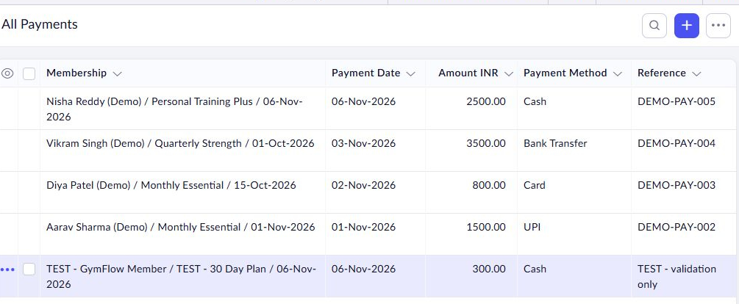
A member journey with built-in checks
TEST membership
₹1,000
− ₹100
− ₹300
= ₹600
Plan fee
Discount
Payment received
Balance
Payment control
Receipts cannot exceed
the remaining balance.
Attendance control
One open visit per member.
Booking control
Check eligibility and capacity.
6 / 7
Notes:
Use the existing TEST membership to trace the data. Its plan costs INR 1,000. A discount of INR 100 produces a total of INR 900. A recorded Cash payment of INR 300 leaves INR 600. The 30-day membership starts 6 November and ends 5 December, using start date plus duration minus one day. Payments can be partial. The validation prevents a new payment exceeding the remaining balance. If the balance is still INR 600, entering INR 601 is a simple rejected-submission demonstration. Attendance validates membership dates and prevents another open visit. Booking rules check member eligibility, duplicates and capacity. Executed tests include expiry and discount calculation, partial payment, overpayment rejection, check-in and check-out, duplicate open attendance rejection and duplicate booking rejection. Not every concurrency or deletion scenario has been tested.
Evidence: C:\Users\SANTHOSH A\Desktop\JEDSD\output\gymflow\build-status.json
C:\Users\SANTHOSH A\Desktop\JEDSD\output\gymflow\workflows\Memberships.deluge
C:\Users\SANTHOSH A\Desktop\JEDSD\tmp\gymflow-report\screenshots\payments-report.jpg
Project baseline verified 9 November 2026. Demonstration data; values and date-sensitive counts can change.
PRESENTATION CUE
About 60 seconds: Explain the calculation from left to right. The membership total is INR 900 after the discount. A partial payment leaves INR 600. In the live app, check that this balance is still current before showing a rejected overpayment. The rules reject duplicate open visits and duplicate bookings and check capacity and eligibility.

Slide 7
GYMFLOW PROJECT
Thank you
Questions and discussion
GymFlow connects member records, attendance and renewals in one staff dashboard.
Open GymFlow for the live demonstration
Rohith D
Rajalakshmi Engineering College
7 / 7
Notes:
Thank the faculty and invite questions. Use the live demo link with the appropriate signed-in Zoho Creator account. Show how the staff dashboard connects member records, attendance and renewals. Mention that delivery of the owner summary email to the college inbox was verified. Member permissions and end-to-end external signup verification remain pending.

