Slide 1

KMIT BRANCH PREDICTOR
B. ROHITH
G. SAI PRANEETH
K. RAHUL

Slide 2
Abstract
After the announcement of the TS EAMCET results, every student has these doubts in their mind:
“ In which college will I secure a seat ?”
“ Whether I will get a seat in this particular college or not. If yes, then which department ?”
The code allows users to login with their information and check the seat eligibility in KMIT.

Slide 3
Software used and FEATURES
This slide provides an overview of the code structure, highlighting the main functions and Json files.
Python is the main software used for this project and developed using tkinter module.
JSON FILES:
One for storing user’s data.
Another one is for storing previous year seat allotment information.
Purpose of each function:
login: Handles the user login process.
Prediction: to check eligibility.
Sendmail: to send the output of the program to our device through e-mail.

Slide 4
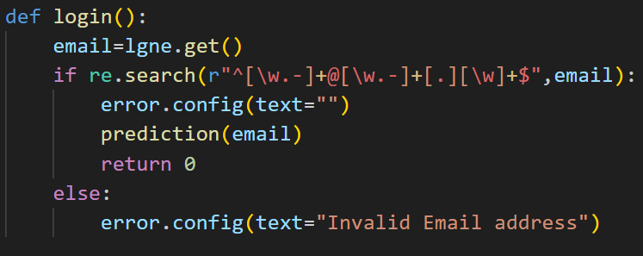
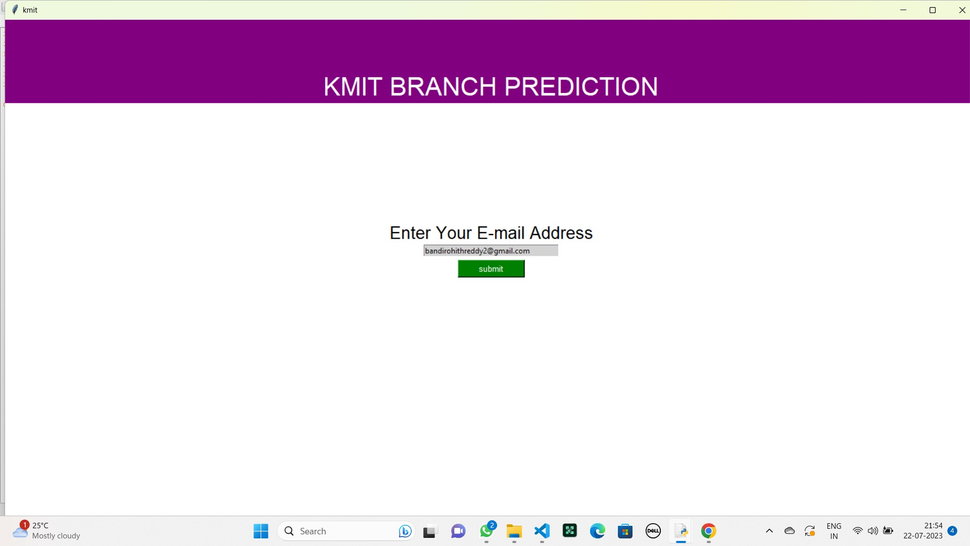
LOGIN FUNCTION
This slide covers the user login process, specifically within the login function.
The input required from the user: their e-mail address.
The steps involved in the login function, such as handling JSON file operations.
The login function retrieves the user's information from the JSON file, allowing them access to the desired functionalities.

Slide 5
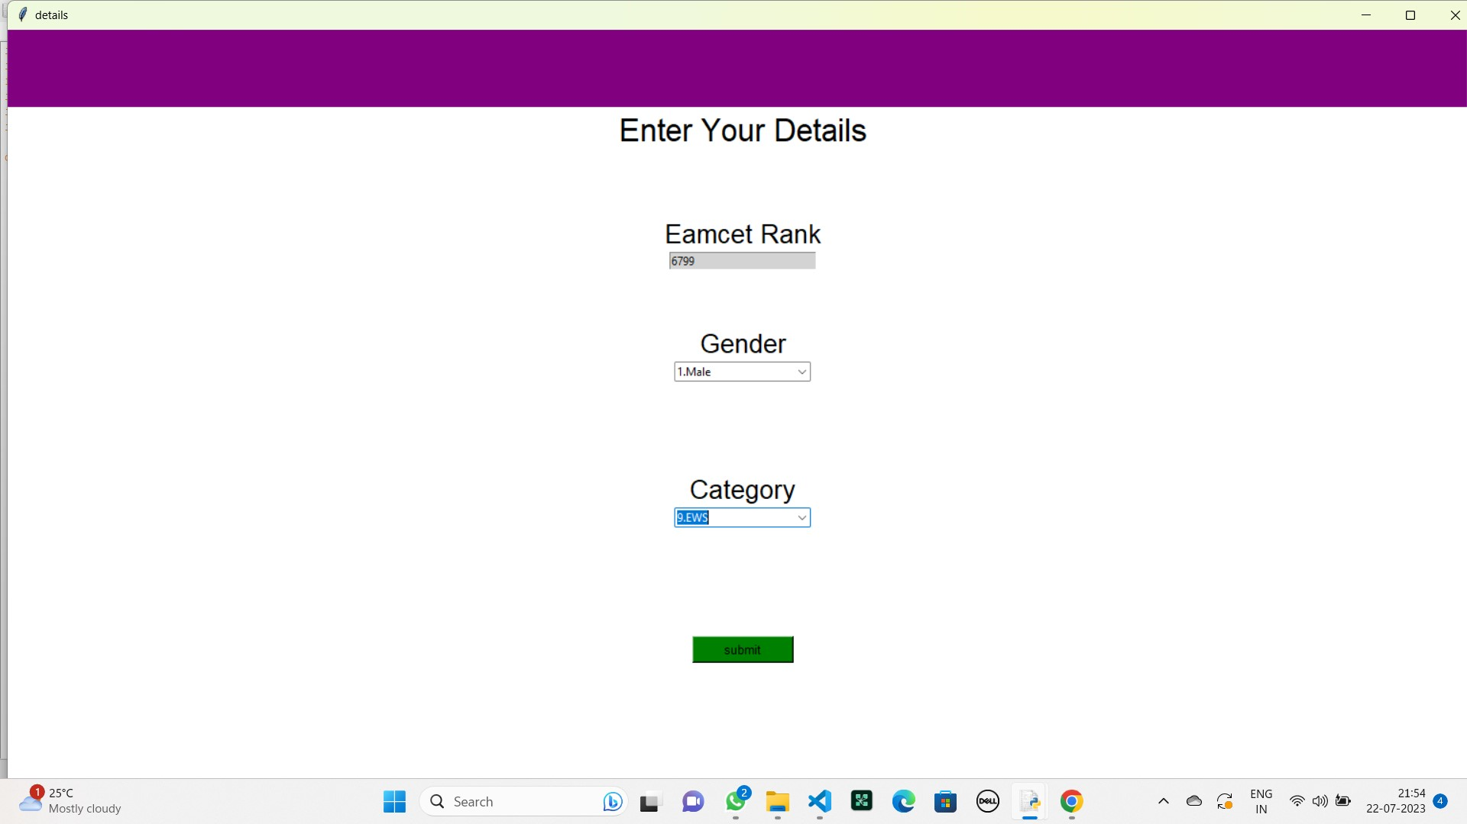
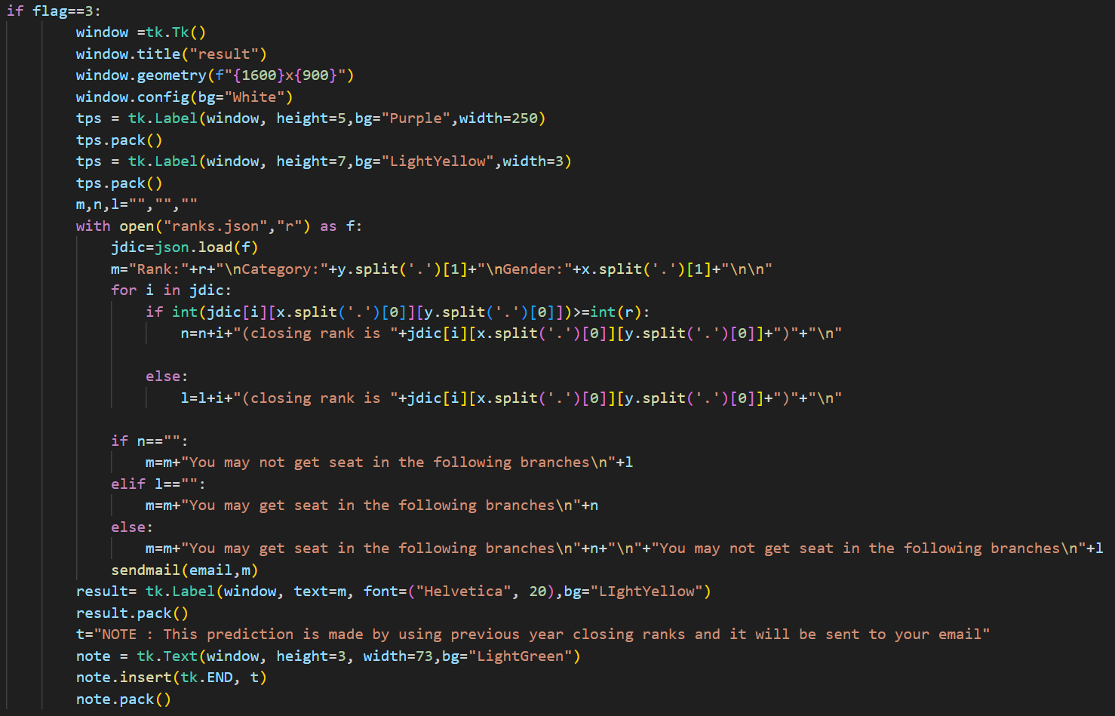
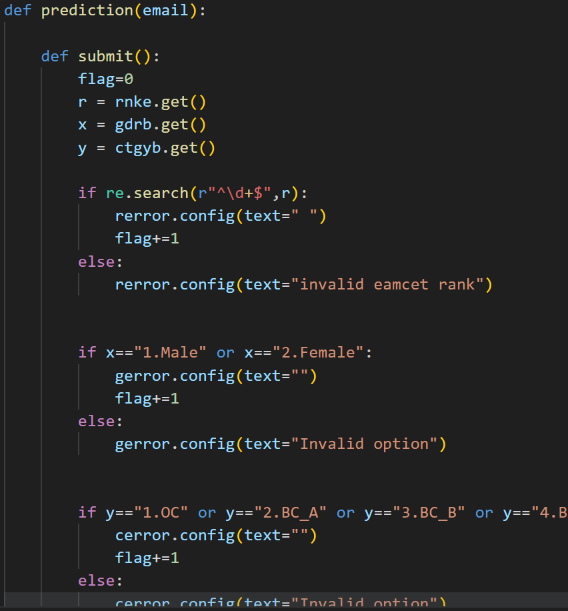
Prediction Function
Its main objective is to check the seat information based on user input (eamcet rank, gender, category).
This function compares the user information with the information (previous year seat allotment) present in the ranks json file.

Slide 6
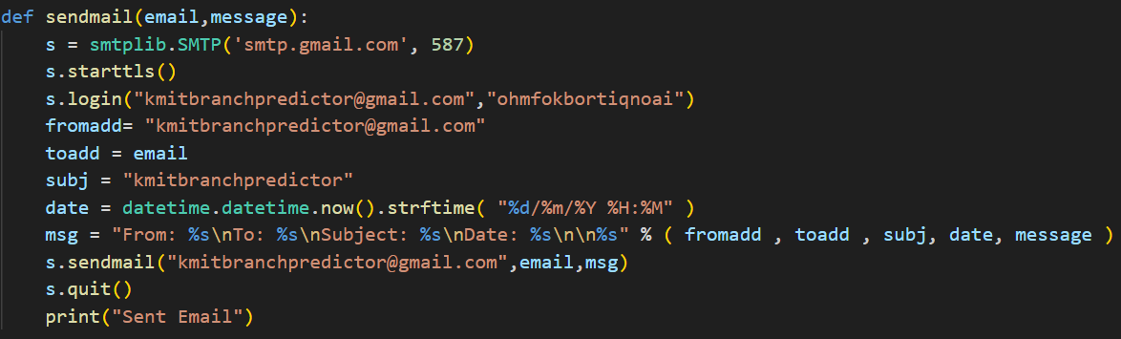
Sendmail function
This function sends the final output of the program to our device through e-mail.

Slide 7
JSON FILES and raw data
Json file for registering user data.
Json file of previous year seat allotments in KMIT.

Slide 8
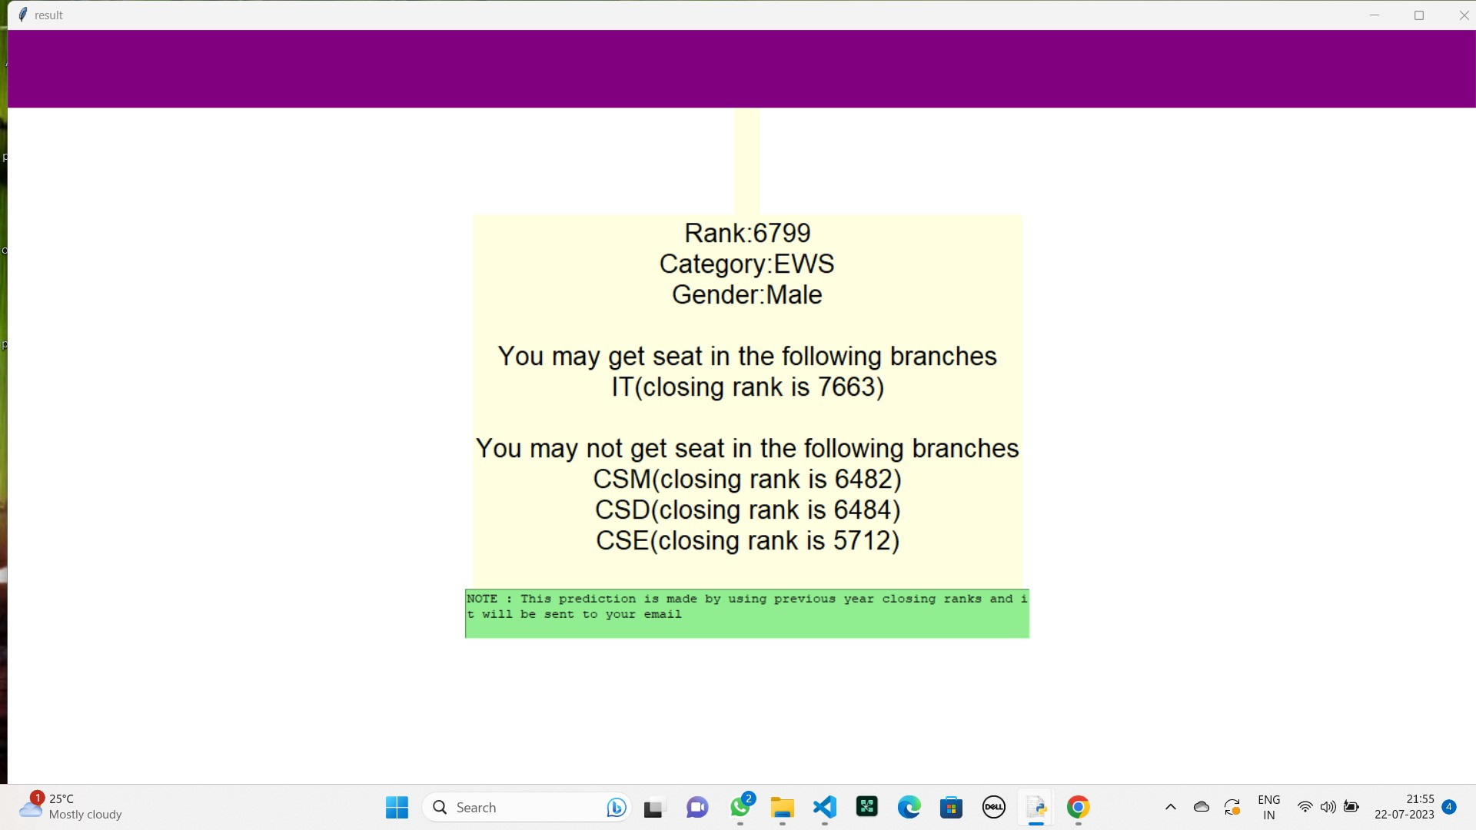
output:

Slide 9
THANK YOU

