Slide 1
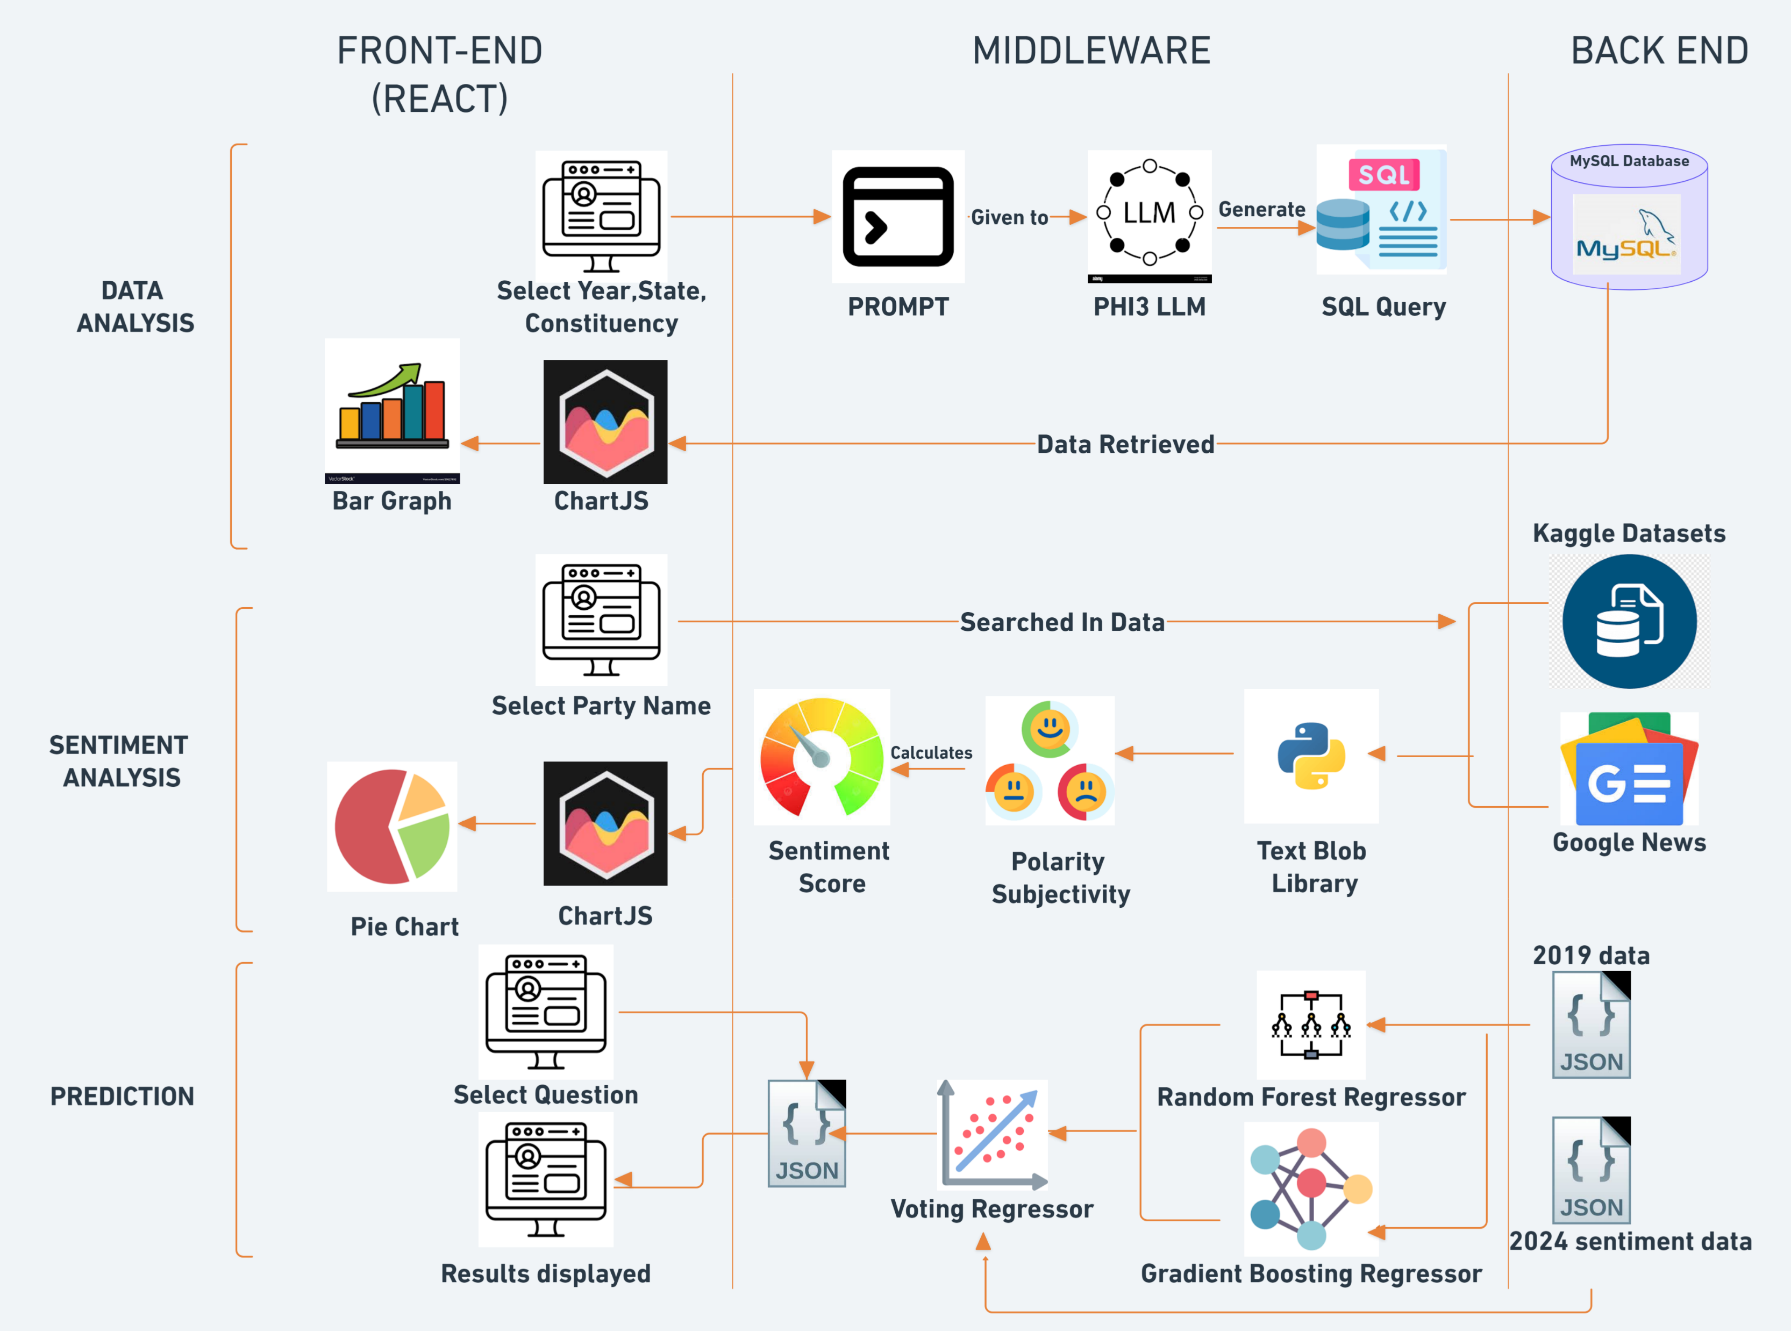
Architecture Diagram

Slide 2
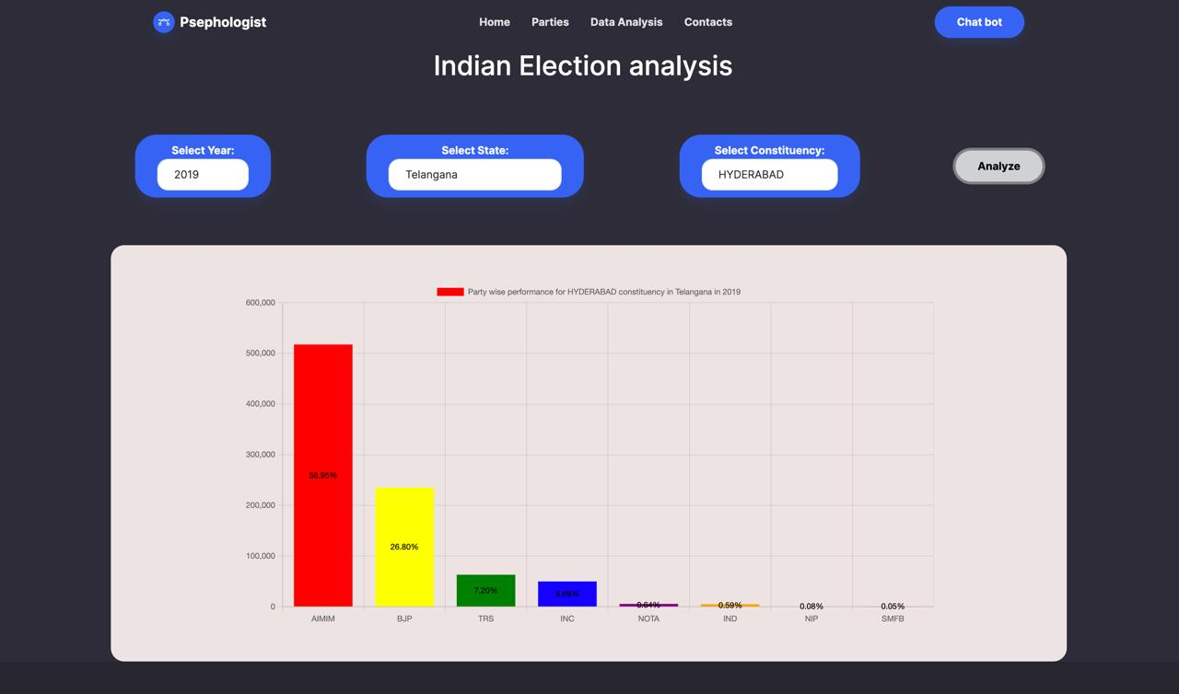
Data Analysis
LLM model :- Phi3 Model Concise and precise answers
Database-MySQL
Method-Text to SQL
OLAMA– It is a platform for downloading LLM’s in local server.
User selects the required year, state and constituency->LLM generates query->database generates answer-> given back to user

Slide 3
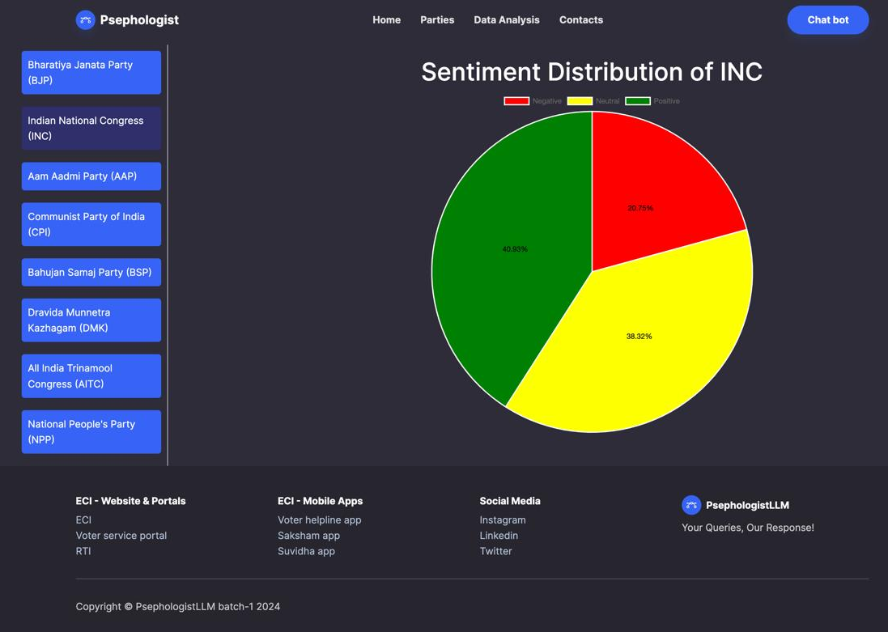
Sentimental Analysis
Text-Blob : It is a python library used for calculating sentiment score combining the subjectivity and polarity scores.
Polarity: It is the amount of sentiment of neutral positive or negative in the tweet.
Subjectivity: This is the amount of personal opinion present in the tweet.
User selects party name->sent to check dataset->returns a pie chart of sentiments

Slide 4
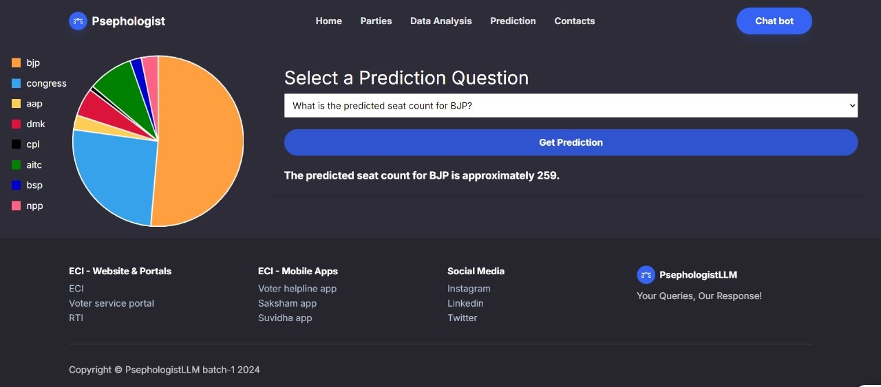
Predictive Analysis
We train Voting regressor model with 2019 json data.
Voting regressor = Random forest Regressor + Gradient boost Regressor
Then predict the number of seats using the sentiment data of 2024.
X – factors for sentiment analysis
Y – number of seats

