Slide 1
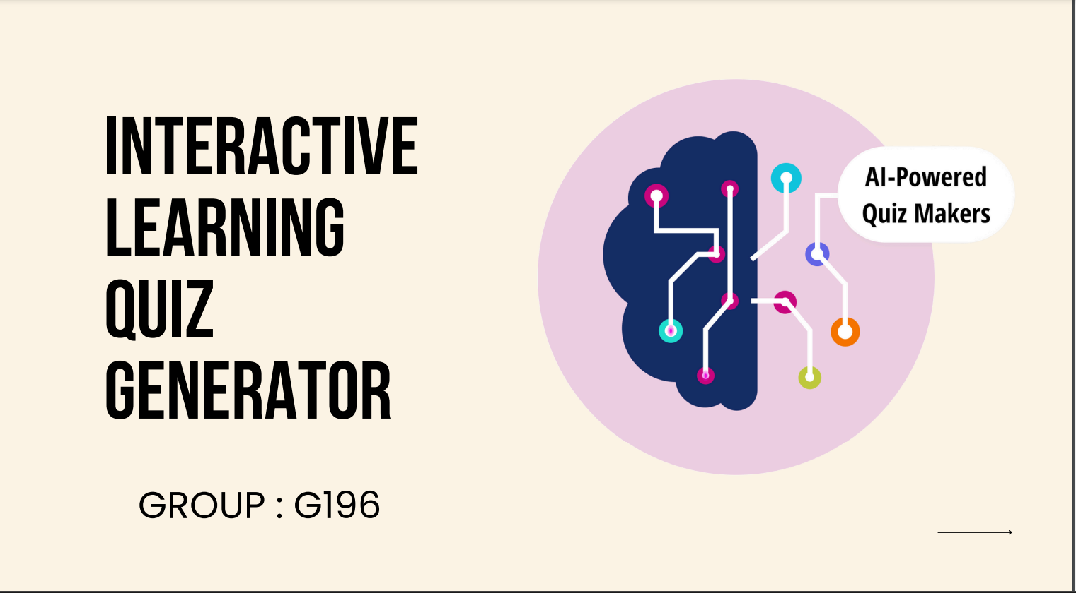

Slide 2
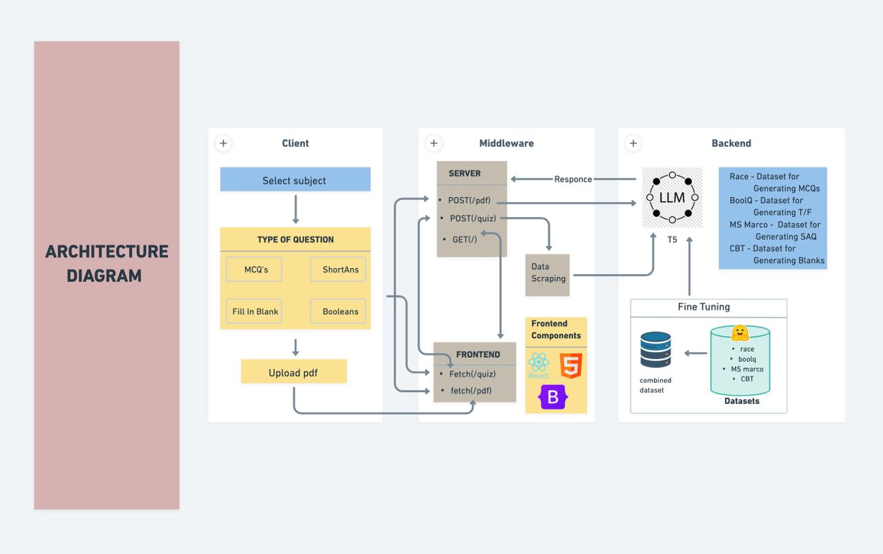

Slide 3
Workflow
The client begins by selecting their preferred subject and topic.
They then specify the type and number of questions they want to generate, with an additional option to upload a PDF for generating questions.
Once the options are selected from the dropdown menu, the request is sent to the server for processing.
The system scrapes relevant data based on the chosen topic or subtopic from the web and provides it to the LLM for question generation.
The LLM generates the requested types of questions as per the client’s input.
Finally, these generated questions are sent to the frontend, where the client can view and utilize them.

Slide 4
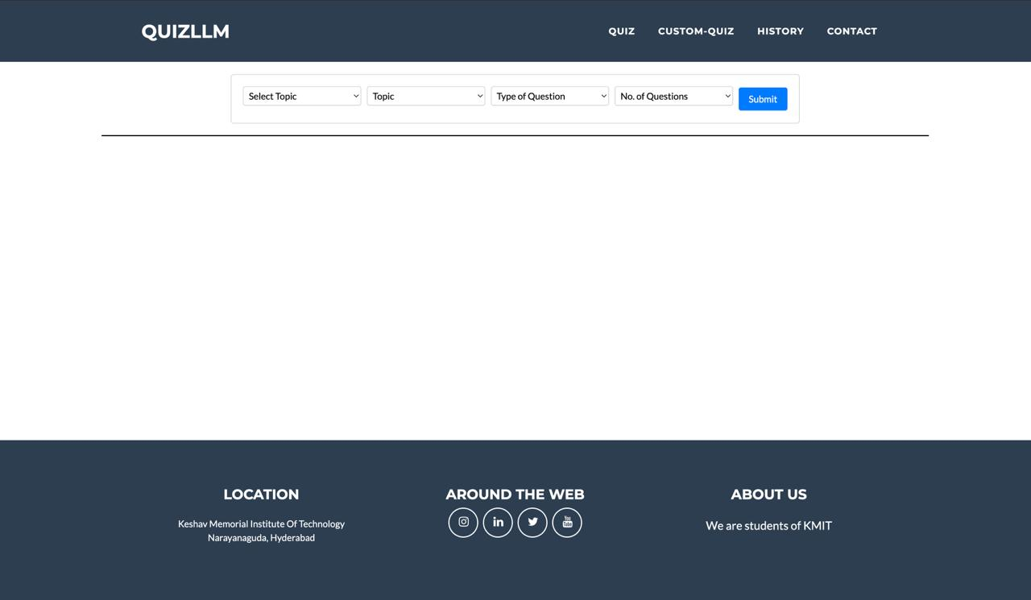
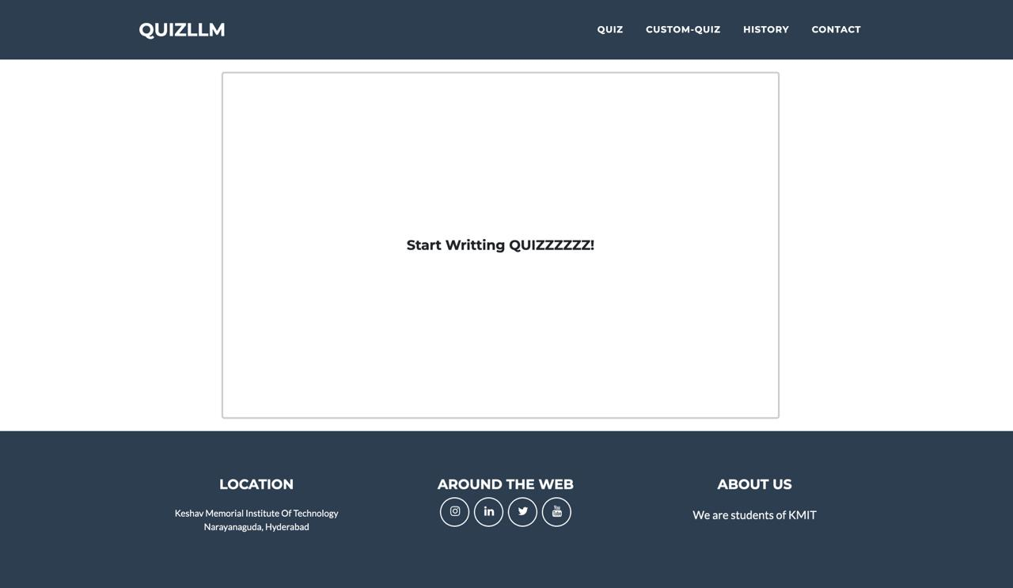
User Interface

Slide 5
T5 LLM
The T5 LLM is fine tuned on how to generate different type of questions.
The LLM is fine tuned by combining boolq, ms-marco, cbt and race datasets for generating different type of questions.
BOOLQ- This dataset helps t5 to learn how to generate true and false questions.
MS-MARCO- This dataset is used to generate short answers questions
CBT-This dataset is used to generate fill in the blanks
Race- This dataset is used to generate mcqs.

